Slide 1

EXTERNSHIP PROJECT ON NATURAL GAS PRICE PREDICTION
SUBMITTED BY:
BITLA.VAMSHI KRISHNA
REKULA.VENKAT REDDY
VARANGANTI.KAVYA
PULI.KAVYA

Slide 2
INTRODUCTION:
Natural gas is the one of the most abundant energy resources on the planet.
Natural gas was first developed commercially in 1825 in the United States, but took off as a major source of energy around the world in the 1970s.
Today, natural gas is used by power plants to generate electricity, as well as for domestic cooking and heating.
yet more than one-third of global natural gas reserves remain stranded and undeveloped.
70% of the gas traded internationally is exported by pipeline.30% by liquefied natural gas(LNG).
The use of natural gas is growing quickly and is expected to overtake coal in the second spot by 2030.
The world’s largest producers of natural gas are currently the United States, Russia, Iran, Qatar, Canada, China and Norway.
These countries have excess natural gas that can be exported to other countries around the world, which is either transported through pipelines or as liquefied natural gas (LNG).

Slide 3
Abstract:
Natural gas has become a solution to increase the security of energy supply and reduce environmental pollution around the world. Being able to forecast natural gas price benefits various stakeholders and has become a very valuable tool for all market participants in competitive natural gas markets. Machine learning algorithms have gradually become popular tools for natural gas price forecasting.We investigate data-driven predictive models for natural gas price forecasting based on common machine learning tools, i.e., artificial neural networks (ANN), support vector machines (SVM), gradient boosting machines (GBM), and Gaussian process regression (GPR).By these four machine learning algorithms have different performance in predicting natural gas prices.

Slide 4
THREE MAJOR FACTORS:
SUPPLY
DEMAND
STORAGE

Slide 5

SUPPLY: Increases in natural gas supply generally result in lower natural gas prices, and decreases in supply tend to lead to higher prices. DEMAND: Increases in demand generally lead to higher prices, and decreases in demand tend to lead to lower prices. STORAGE: Natural gas is a commodity that can be stored for an indefinite period of time in natural gas storage facilities for later consumption

Slide 6
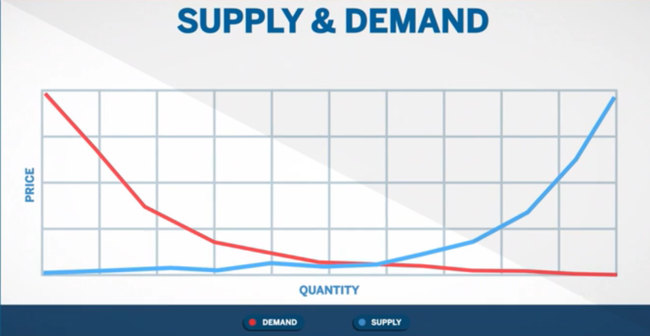

Slide 7
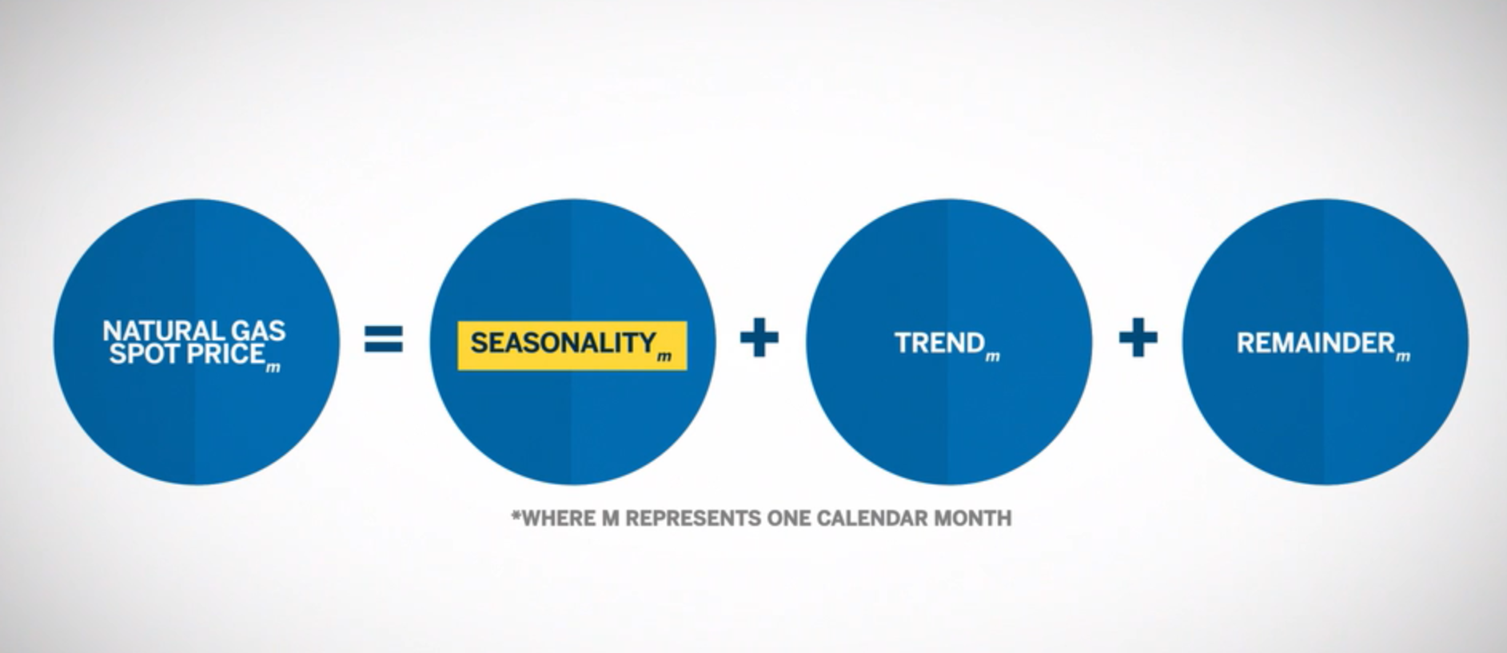
Natural Gas Seasonality
Seasonality plays an important role when analyzing natural gas supply and demand.

Slide 8
Consumption Driving Patterns
When you look at consumption, heating and cooling demand are the main drivers for the cyclical pattern. In winter, the increase of space heating for both residential and commercial use leads to the surge of demand of natural gas.
During the summer, use of natural gas is much lower due to summer cooling through air-conditioning. Other factors may influence the demand of natural gas, including climate change and the price of competing generation fuels sources such as coal and fuel oil.
Having a general understanding of seasonality in natural gas markets and the potential impact on gas prices is important to anyone planning a natural gas trading strategy.

Slide 9
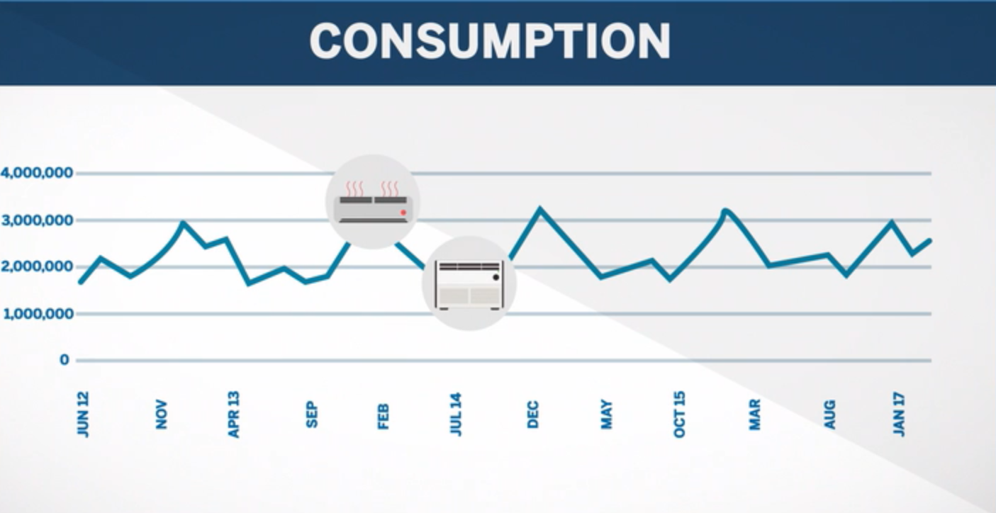

Slide 10
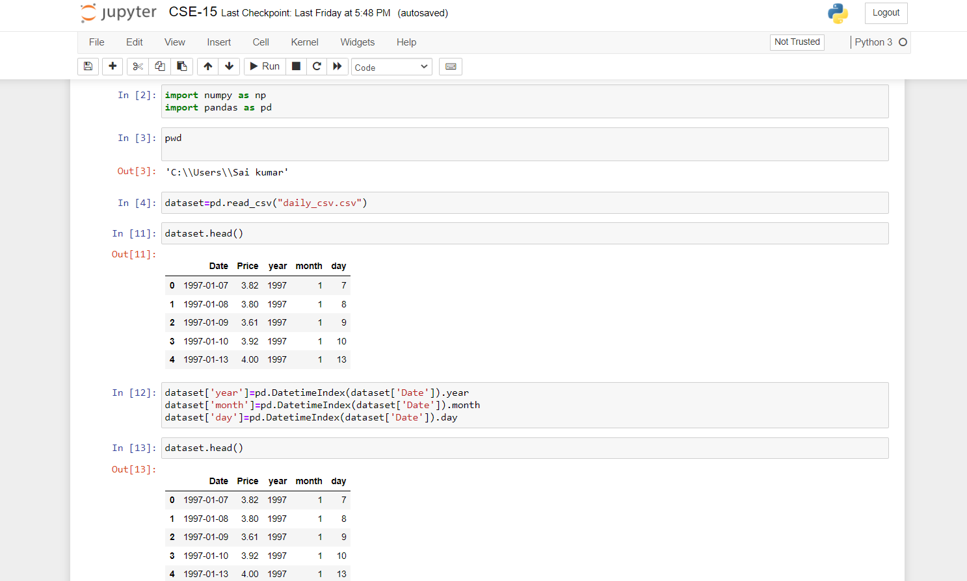
PROJECT SCREENSHOTS:

Slide 11
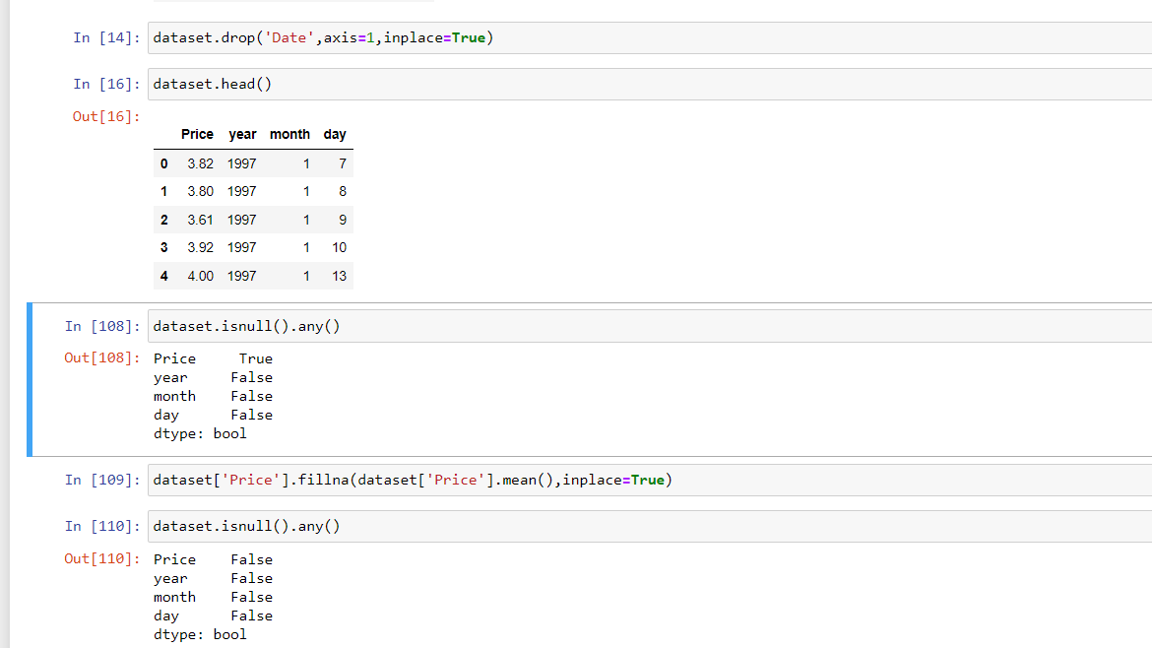

Slide 12
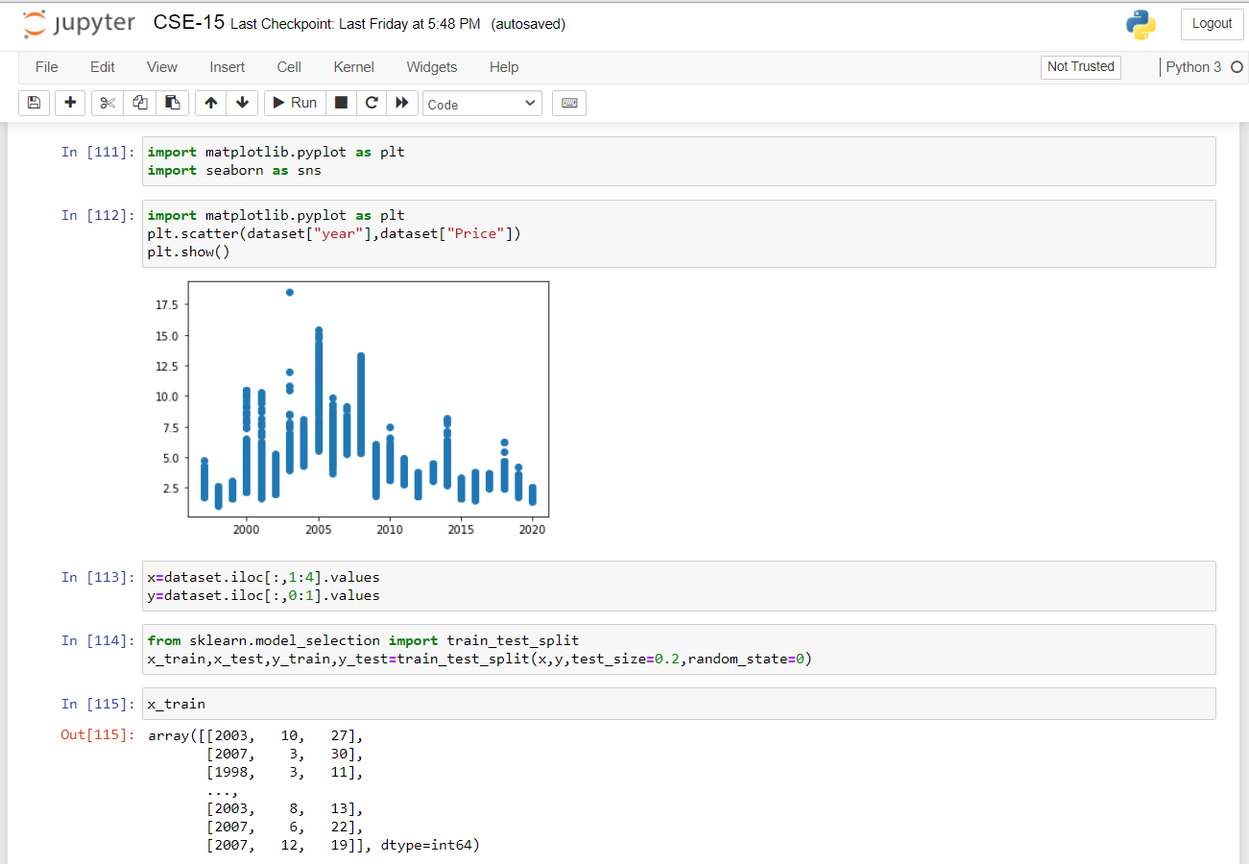

Slide 13
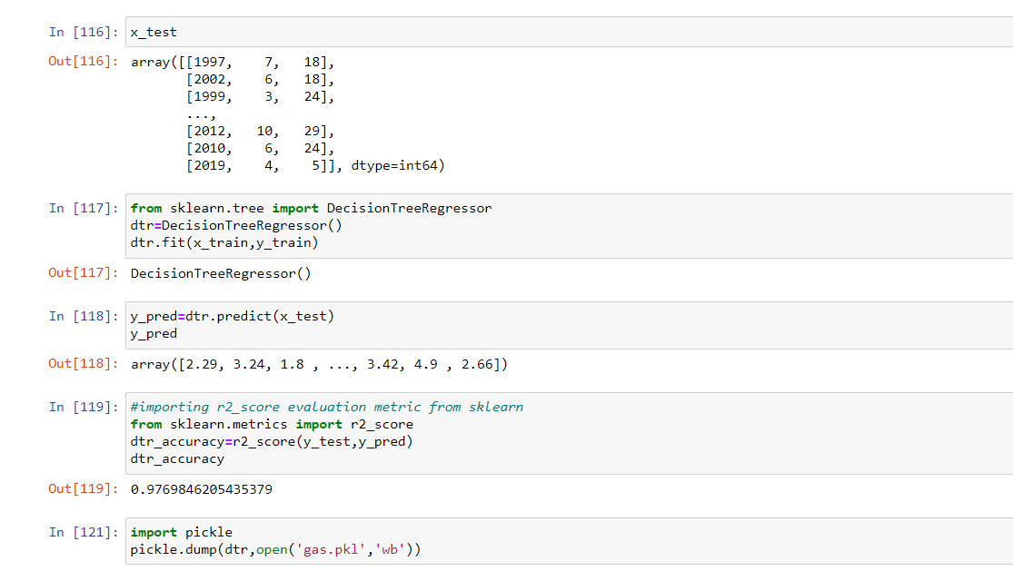

Slide 14
TOOLS IMPORTED IN PROJECT:
#Imported Libraries
import numpy as np
import pandas as pd
import matplotlib.pyplot as plt
import seaborn as sns
from sklearn.model_selection import train_test_split
from sklearn.tree import DecisionTreeRegressor
from sklearn.metrics import r2_score
import pickle

Slide 15
SUMMARY:
It has always been a difficult task to predict the exact daily price of the stock market index. Many factors such as political events, general economic conditions, and traders’ expectations may have an influence on the spot price index.
Here, we have applied several input variables to predict the price direction of next 12 months. However, the prediction performance may be improved further by selecting effective input indicators.
In addition, we can include a few other technical indicators that may affect the prediction performance. The models in the experiment have solved the problem as a regression.
Regression model can be combined with Classification model predicting rise and fall to improve the directional accuracy for precise predictions. Moreover, the same model need to be tested with large amount of data for prediction accuracy because non-parametric modeling approach requires a lot more training data to estimate the mapping function.

Slide 16
THANK YOU

