Slide 1
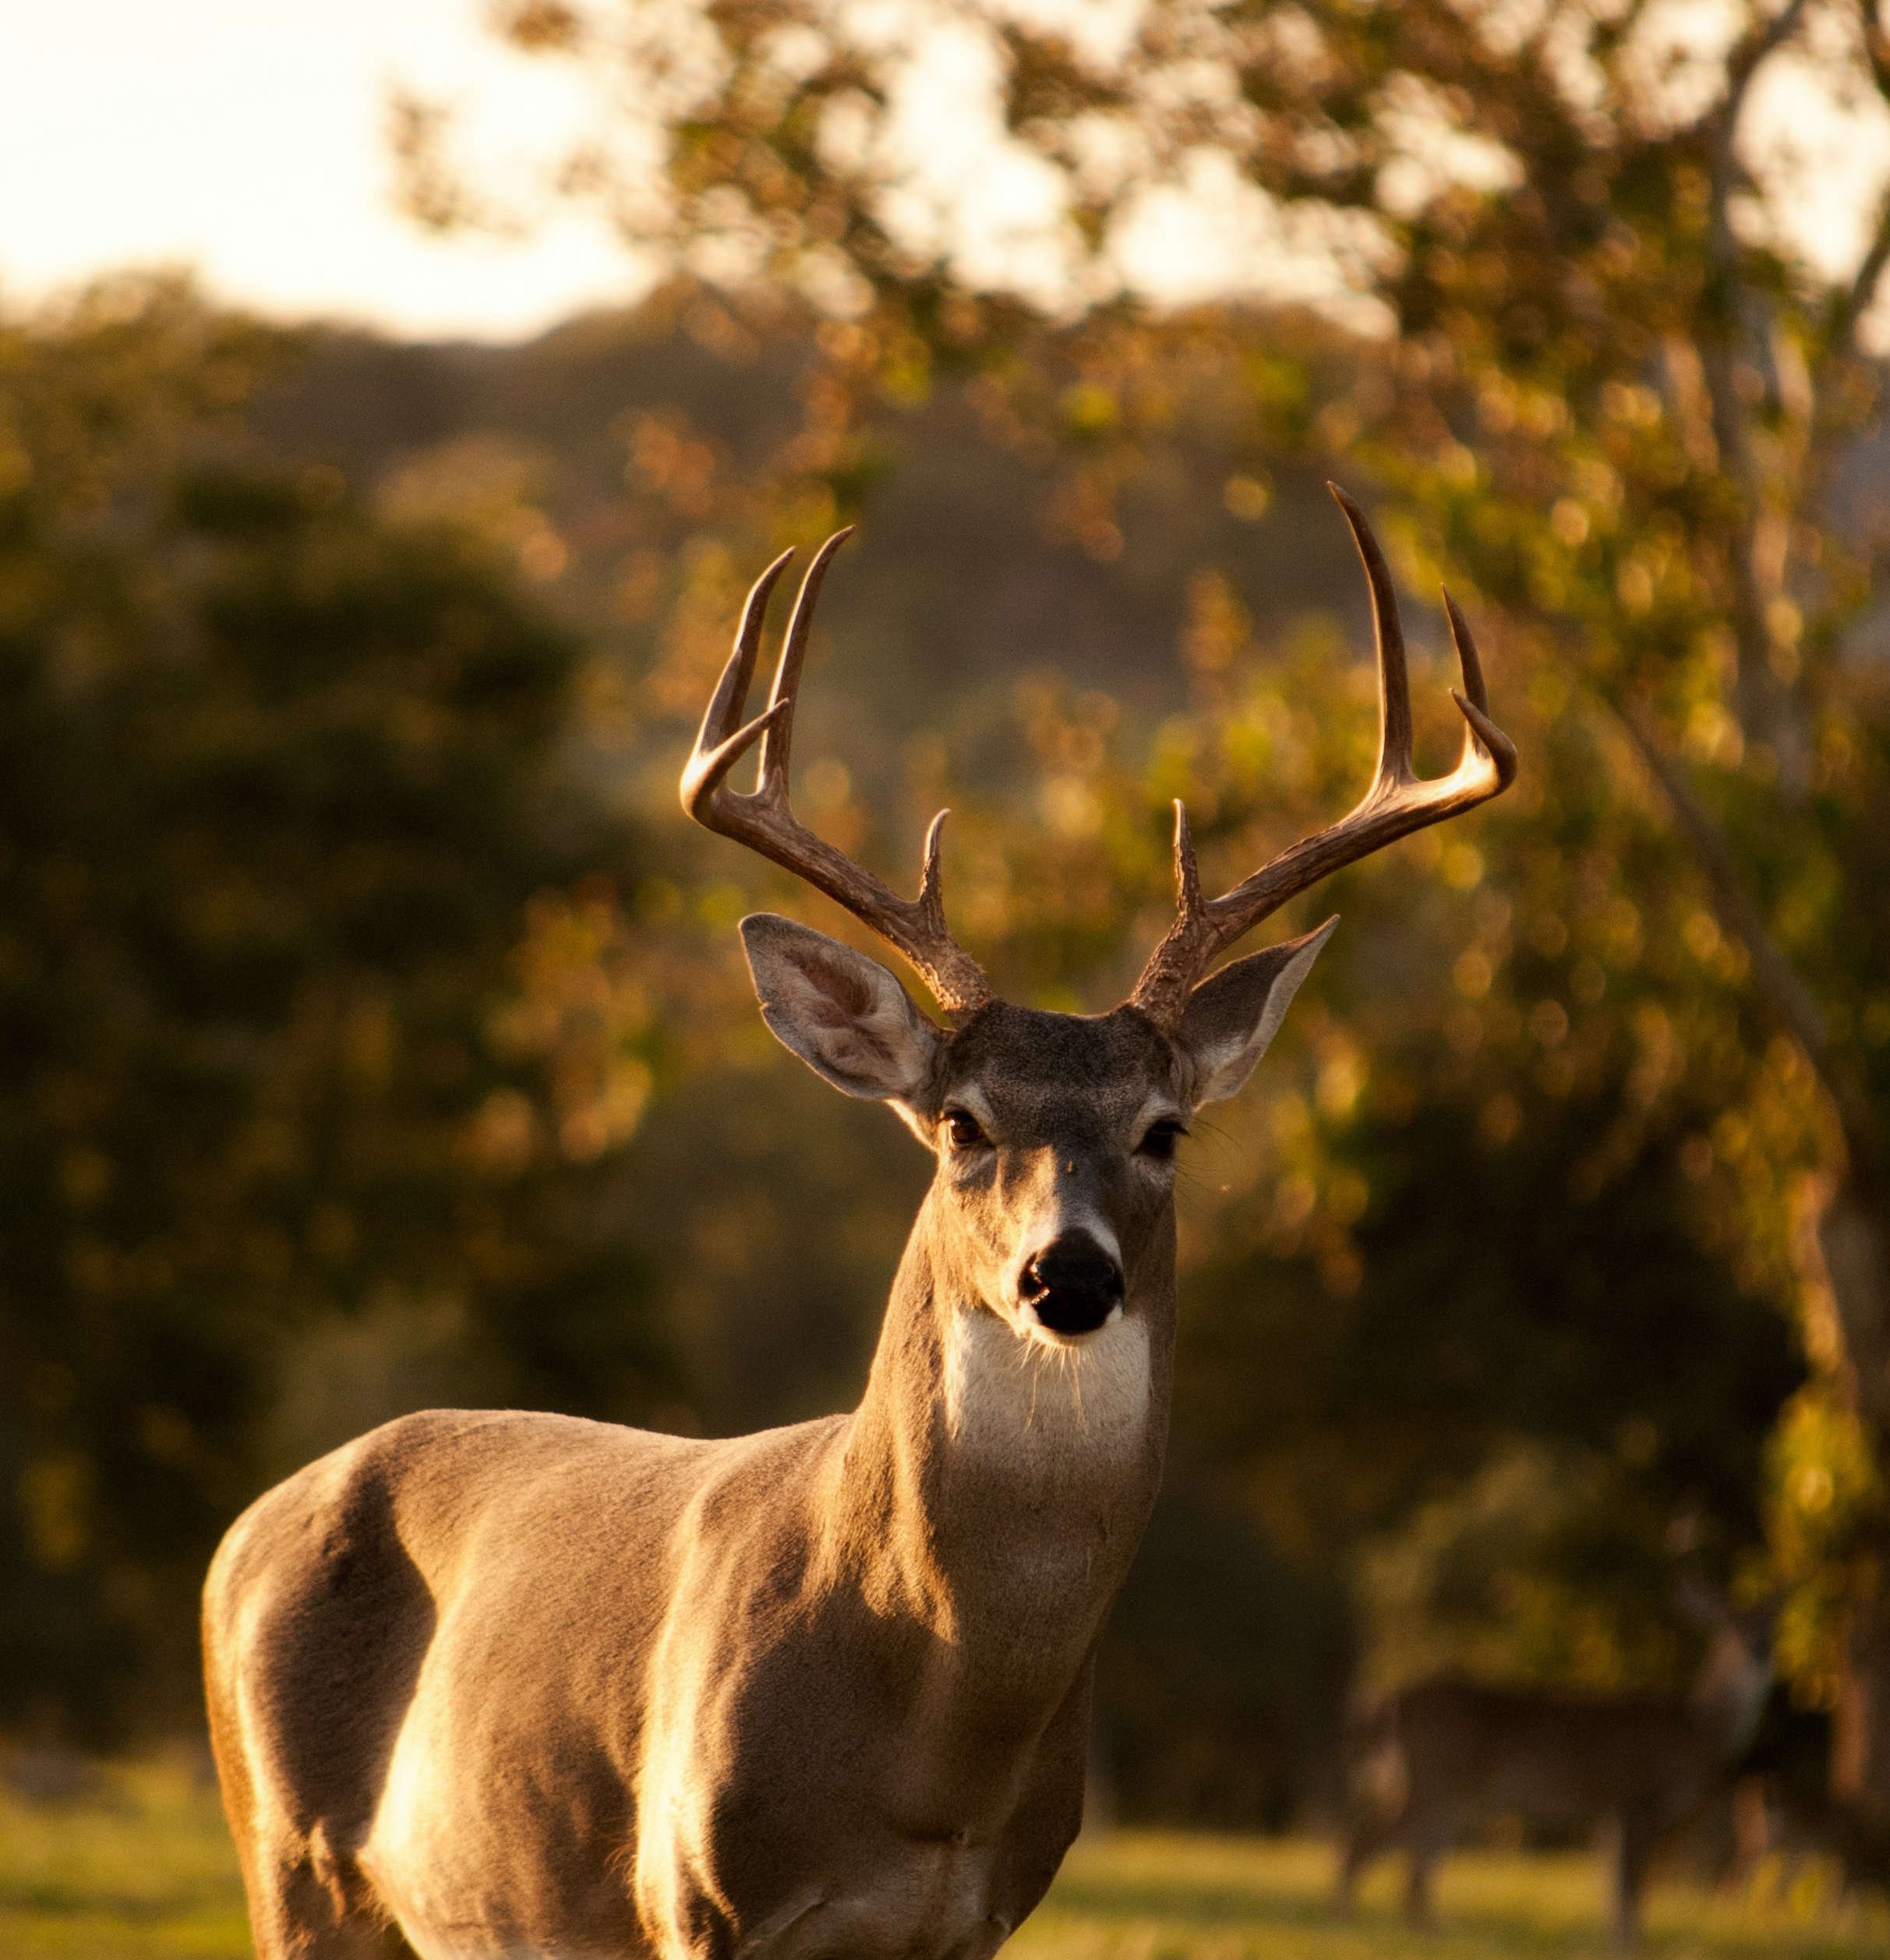

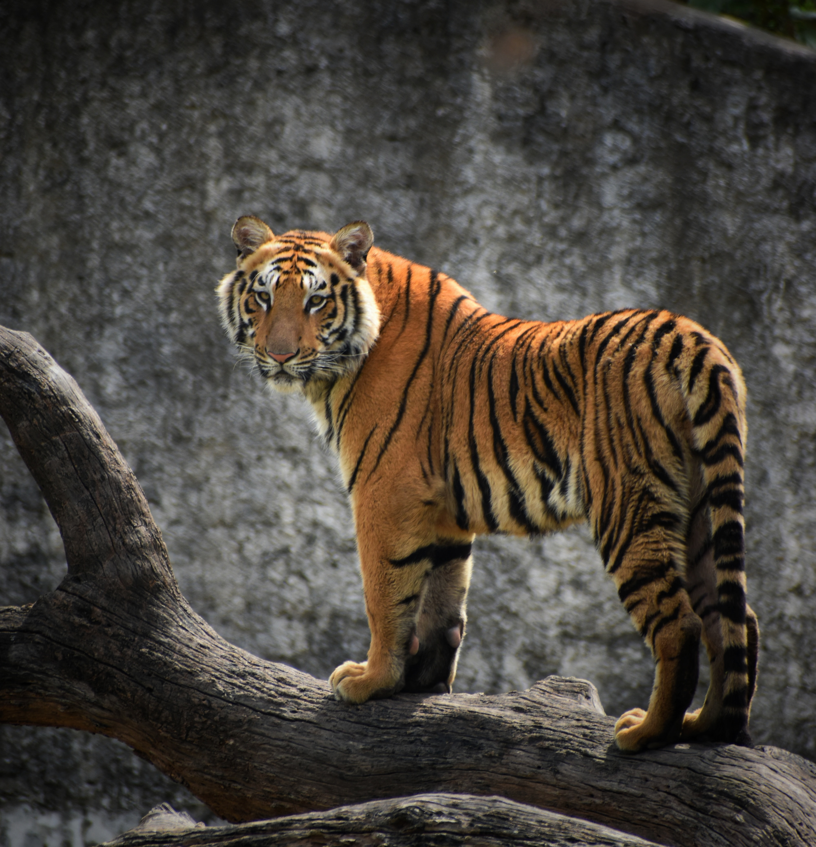
Wild Animal Detection And Alerting System For Forest Departments

Slide 2
Introduction
The Internet of things describes the network of physical objects that are embedded with sensors, software, and other technologies that is used for the purpose of connecting and exchanging data with other devices and systems over the Internet.
The object of our project is to detect wild animals and send alerts to the authorities and nearby people in the form of voice alerts. Our system would be able to capture images and the detected images can be visualized in web UI.

Slide 3
Problem Statement
Deforestation, lack of natural prey and habitat loss has forced wild animals to live closely with human settlement prey on domestic livestock. So, animals are started attacking humans for their food.
The safety of animal and human is identically important. To overcome this problem an intelligent monitoring system is required to monitor automatically and recognize the image of animal entry and gives an alert message to human.

Slide 4
Methodology
Using python to take a live video streaming and capture the image , use Clarifai service to detect if any wild animals in the images.
01
The images sent to IBM COS and the Image URL to Cloudant DB.
02
Integrated voice alerts in the code by using IBM text to speech service.
03
Visualizing the image in the UI using NodeRed.
04

Slide 5
Benefits
The system will capture live images.
Recently captured images can be visualized in web UI.
Voice alerts will be sent to authorities and nearby people.

Slide 6
Thankyou Group Chitrankshi Rathour 19BCE10419 Divyam Khare 19BCG10013 Ishita Jain 19BEC1422 Jaishree Sharma 19BCE10307

