Slide 1

WALL FOLLOWING ROBOT
CHAITANYA KRISHNA

Slide 2
INTRODUCTION
Obstacles/wall following robots are widely used in industrial applications.
A wall following robot is also an obstacle avoidance robot which follows the wall. If any obstacle comes in between, the robot will turn right or left depending upon the position of obstacle.
An obstacle robot is an intelligent device which can automatically sense and overcome obstacles on its path.
It is part of a robotic discipline with the objective of moving vehicles with the help of information from external devices such as sensors, lasers etc.

Slide 3
PROBLEM STATEMENT
Obstacle detection can be considered as the central issue in designing mobile robots.
Without the help of sensor or lasers it is impossible for a robot to traverse in unfamiliar environments without damaging itself.

Slide 4
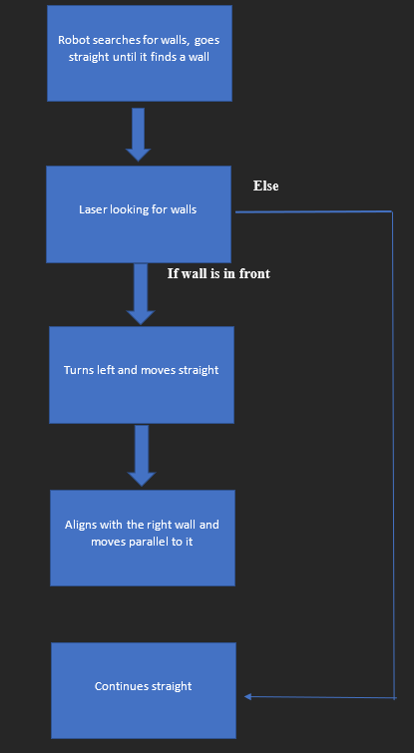
BLOCK DIAGRAM

Slide 5
SOFTWARES USED
Robot Operating System
Gazebo simulator
Python
Rviz
rqt

Slide 6
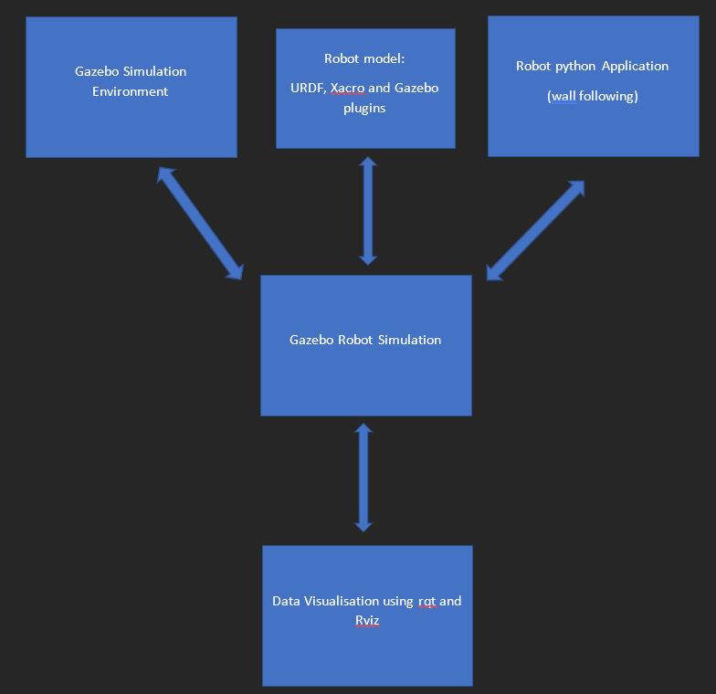
PROCEDURE AND FLOWCHART

Slide 7
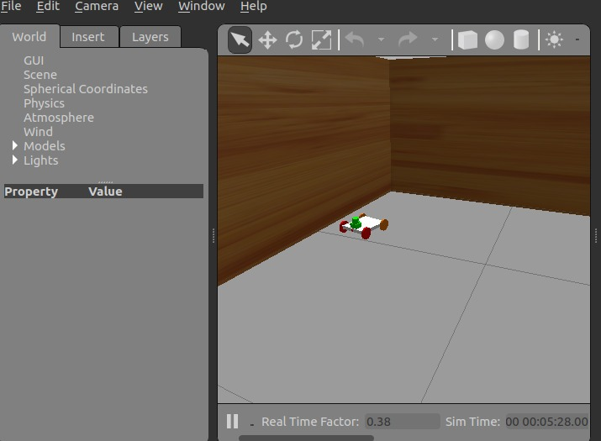
RESULTS

Slide 8
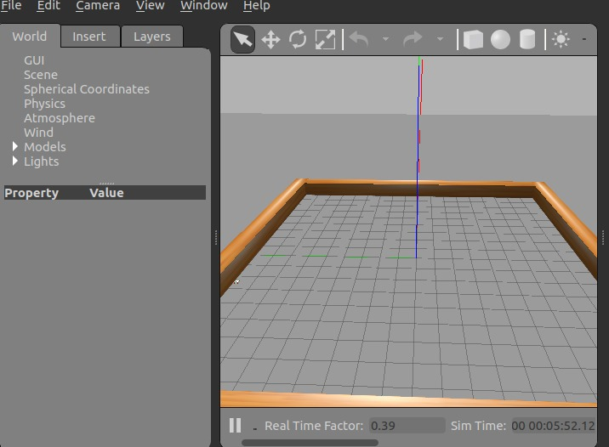

Slide 9
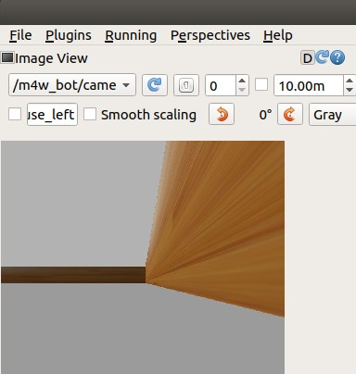
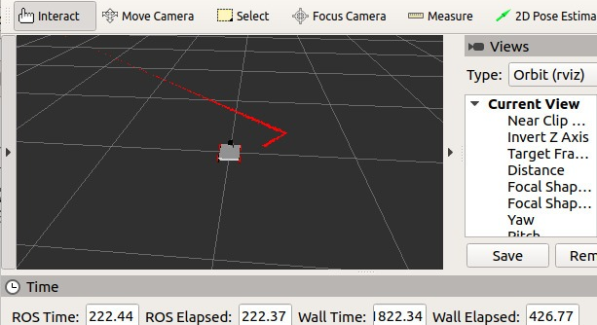
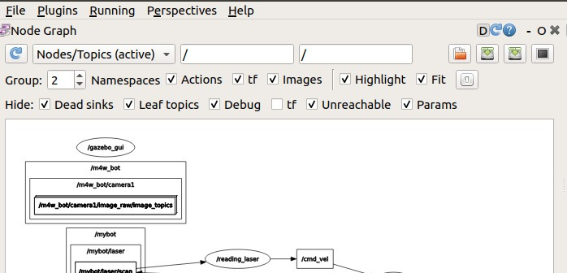

Slide 10
ADVANTAGES AND DISADVANTAGES
Advantages:
It can be used a surveillance system
It doesn’t require man power
Can be used for critical applications such as disasters, floods, fire attack etc.
Easy to operate and perform
Disadvantages:
Requires good amount of technical knowledge in order to build such kind of sophisticated robot.
Slow paced robot. Not good for immediate responses.

Slide 11

APPLICATIONS
Can be used in military applications where the robot needs to spy along border areas.
Can be used in abandoned mines to map the mine structure.
Can be used as a cleaning robot which cleans the surroundings along walls.
Can be used for emergency responses during disaster or accidents and get information about the accident site.
Can be used as a surveillance system

Slide 12
THANK YOU

