Slide 1
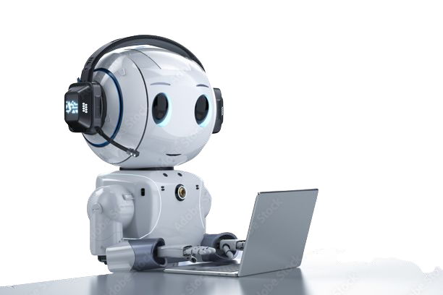
CHAT BOT USING DEEP LEARNING
Katta Roopsai - 20BCI7065
Byna Varun - 20BCD7137
Katikala Chaitanya Reddy - 20BCI7046
Padamata Sai Satyanarayana - 20BCE7135

Slide 2
Table Of Contents
Abstract
Literature Review
Design

Slide 3
Literature Review
[1] presents a chatbot which was created for a college website. On a college's website, it's common to be doubtful of where to look for information. It becomes difficult to obtain information for someone who is not a student or employee at the university. These problems can be solved by implementing a college inquiry chatbot, a quick and informative tool added to college websites to enhance the user experience and provide users with accurate information.
The paper [2], provides an overview of the technologies behind chatbots, including Information Extraction and Deep Learning. They discussed that, “conversational chatbots” are trained based on free-form chat logs while “transactional chatbots” are defined in a manual manner to accomplish a particular goal, such as booking a flight online. In addition, they offered an overview of commercial tools and platforms for developing and deploying chatbots. An interactive chatbot for medical purposes acts as a virtual doctor, according to a paper published in

Slide 4
Literature Review
[3]. Using pattern matching algorithms and NLP, this chatbot was built in Python. The chatbot answered 80 percent of the correct questions in a survey assessing its performance, while 20 percent were ambiguous or incorrect. These results point to the potential use of the chatbot as both a virtual doctor for care and awareness, as well as for teaching medical students.

Slide 5
Objective
A chatbot is a piece of Artiﬁcial Intelligence (AI) software that simulates a natural language conversation between a user and an interface, such as a website, a mobile app, or a telephone. In the context of human-machine interaction, chatbots are often referred to as one of the most advanced and promising methods. Nevertheless, from a technological standpoint, a chatbot is simply an
NLP-enabled question and-answer system. Currently, there are two basic models used in the development of a chatbot i.e., models that are generative and retrieval in nature. As deep learning and AI have advanced in recent years, methods based on handwritten instructions or patterns and statistical methods have quickly become obsolete.

Slide 6
Needed Libraries
You should have this following libraries in your system which will be required while creating ChatBot :
Tensorﬂow (pip install tensorﬂow)
Keras (pip install keras)
Numpy (pip install numpy)
Natural Language processing (Nltk) (pip install nltk)
Pickle (pip install pickle)
Corpus (pip install corpus)

Slide 7
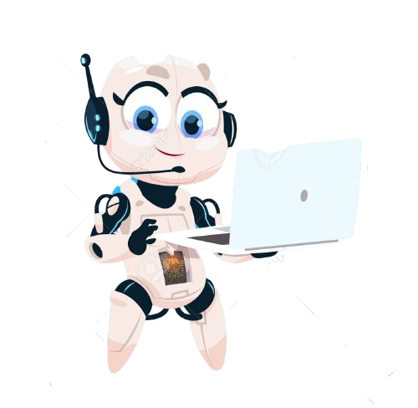
TABLE OF CONTENTS:
Introduction to chatbot
Types of chatbot
Top applications of chatbot
Architecture of chatbots

Slide 8
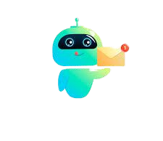
Introduction to Chatbots
What are chatbots?
Chatbots are illustrations which can understand human language , process and it and interact back with humans while performing speciﬁc tasks
The ﬁrst chatbot was created by Joseph Wiesenbaum in 1996

Slide 9
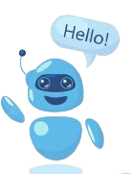
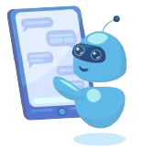
Types of chatbots
Important Types:
Voice-based chatbots
Text-based chatbots

Slide 10
Types of chatbots
Chatbots are designed using two approaches:
Rule-based chatbots - Bot answers the questions based on some rules on which it is trained in . The rules deﬁned can be very simple to very complex
Self-Learning chatbots - Bot that communicates using the result of machine learning model to learn and asses current situation.

Slide 11
Top applications of chatbot
Hundreds of applications today:
❏ Helpdesk assistant
❏ Home assistant
❏ Email distributor
❏ Operation assistant
❏ Phone assistant
❏ Entertainment assistant

Slide 12
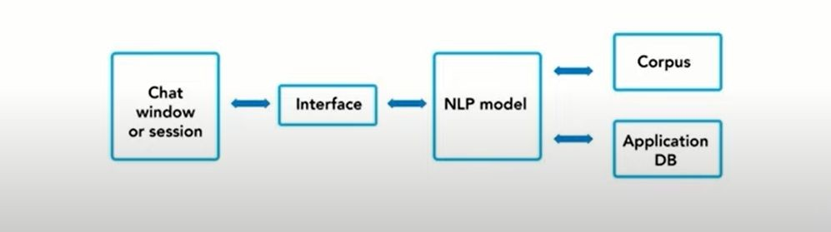
Chatbot Architecture
What is Chatbot Architecture?
❏ Chatbot architecture is the spine of the chatbot. The type of architecture for your chatbot
depends on various factors like use-case, domain, chatbot type, etc. However, the basic conversation ﬂow remains the same. Critical components of chatbot architecture.

Slide 13
Chatbot Architecture
Following are the key components of a conversational chatbot architecture:
Environment
Question and Answer System
Plugins/Components
Node Server / Trafﬁc Server
Front-end Systems

Slide 14
Chatbot Architecture
1. Environment
This is where the core interpretation happens.
Natural Learning Process (NLP) engine and context
NLP Engine
NLP Engine is the core component that interprets what users say at any given time and converts the language to structured inputs that system can further process. Since the chatbot is domain speciﬁc, it must support so many features. NLP engine contains advanced machine learning algorithms to identify the user’s intent and further matches them to the list of available intents the bot supports.

Slide 15
Chatbot Architecture
Feedback Mechanism: Here the agent takes the feedback from user time to time to learn if the bot is doing ﬁne with the conversation and the user is satisﬁed with the bot’s response. This reinforces the bot to learn from mistakes and corrects itself in future conversations.
Policy Learning: Policy learning is a higher-level framework that teaches the bot to take more of happy paths during the conversation to improve overall end-user satisfaction.
Broadly it creates the network of happy paths and routes the conversation to end-user satisfaction.
The bot then tries to learn from the interactions and follows the interaction ﬂow about the conversation it had with similar users in the past.

Slide 16
Chatbot Architecture
Question and Answer System
This is the key component in answering users’ frequently asked questions. Q&A system interprets the question and responds with relevant answers from the knowledge base. It has the following components
Manual Training: Manual training involves the domain expert creating the list of frequently asked users queries and map its answers. This helps the bot quickly identify the answers to the most important questions.
Automated Training: Automated training involves submitting the company’s documents like policy documents and other Q&A type of documents to the bot and ask it to train itself. The engine comes up with a list of question and answers from these documents. The bot then can answer with conﬁdence.

Slide 17
Chatbot Architecture
Plugins/Components
Plugins offer chatbots solution APIs and other intelligent automation components for chatbots used for internal company use like HR management and field-worker chatbots.
Node Server / Trafﬁc Server
The server that handles the trafﬁc requests from users and routes them to appropriate components. The trafﬁc server also routes the response from internal components back to the front-end systems.

Slide 18
Chatbot Architecture
Front-End Systems
Front-end systems can be any client-facing platforms. They can be the actual chatbot interfaces that reside in various platforms like:
Facebook
Slack
Google Hangouts
Skype for Business
Microsoft Teams

Slide 19
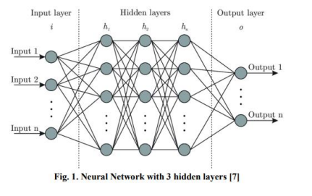
Methodology
Deep learning is one of the components of Machine Learning. The goal of deep learning is to learn from the structures of the brain. Algorithms that employ deep learning analyze data continuously based on a predetermined logical structure to draw similar conclusions as humans. Neural network, a multi-layered structure of algorithms, allows it to achieve this. Just as the human brain recognizes patterns and categorizes various types of information, neural networks can be taught to do the same.

Slide 20
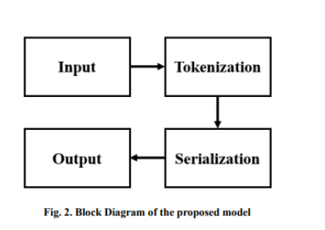
Methodology
The bot gives the best answer according to user’s input from the list of training data from which the bot has learned. The dataset consists of a JSON file containing a dictionary. It mainly contains “Tags”, “Patterns” and “Responses”.

Slide 21
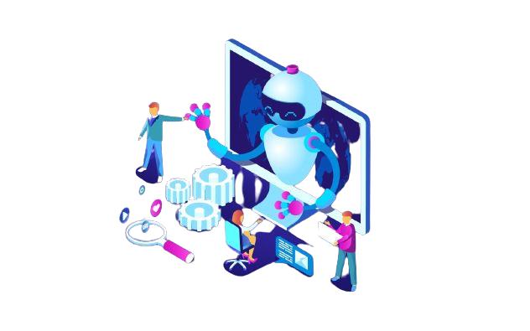
Practical Working
Google Colab

