Slide 1


Analysis Of Amazon Cell Phone Reviews Using IBM Watson Services
NAME: PUVANAAH MANOKARAN
STUDENT ID: 1106191007

Slide 2
INTRODUCTION
Mobile phones have revolutionized the way that we purchase products online, making all the information available at our fingertips. Reviews and ratings submitted by consumers became an integral part of the customer’s buying decision process. The review and rating platform provided by eCommerce players creates a transparent system for consumers to take decisions and feel confident about it.

Slide 3
Problem statement
The problem statement of this project is that it is difficult to read all the feedback for a particular item especially for the popular items with many comments.

Slide 4
Project OBJECTIVES
The objectives that will be achieved by the end of this project are:
Knowing fundamental concepts and techniques of natural language processing (NLP).
Gaining a broad understanding of text data.
Knowing how to pre-process/clean the data using different data pre-processing techniques.
Knowing how to build a web application using Flask framework.

Slide 5
Project flow
This project contains the following activities such as:
Data Collection.
Feature Selection
Text Pre-Processing
Model Building
Application Building
Deploying Application on IBM

Slide 6
solution
In this project, the factors that contribute to classifying reviews as positive or negative will be attempted to understood with the help of Natural language processing to analyse the sentiment (positive or a negative) of the given review. Besides, a sample web application is integrated to the model built.

Slide 7
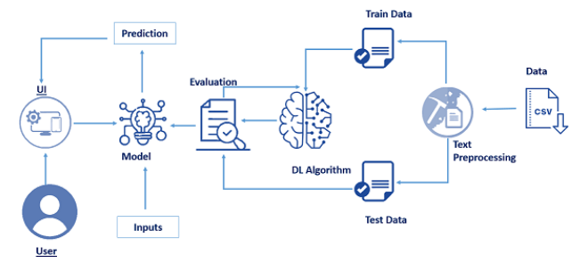
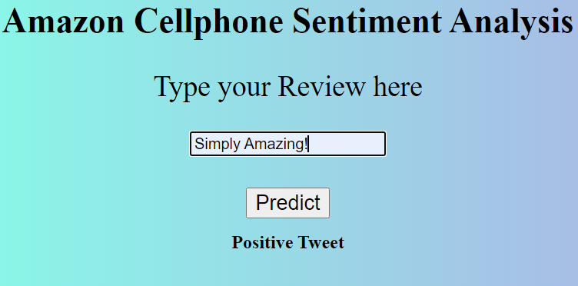
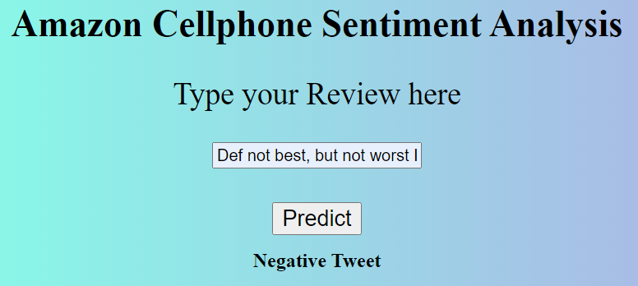
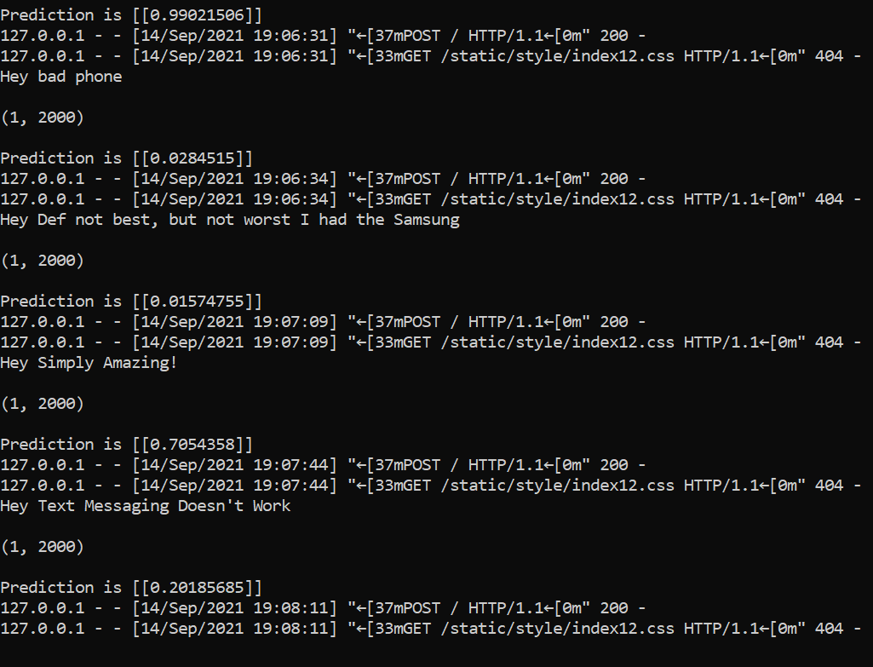

Slide 8
Future improvements
Evolving from human-computer interaction to human-computer conversation.
Biometrics
Humanoid Robotics

Slide 9
conclusion
In conclusion, this project was a great exposure to Natural Language Processing. NLP will undoubtedly gain in popularity as the amount of available data continues to rise, and algorithms get more complex and accurate. Human-machine interaction is changing as a result of it. Unstructured information makes up as much as 80% of what we encounter. As a result, NLP is one of the most important disciplines of data science. Organizing this data is a significant problem that numerous academics face on a daily basis. NLP is advancing at a rapid pace, and we may anticipate it to impact more and more parts of our life in the future.

