Slide 1
Unveiling The Virtual Classroom: An In-Depth Analysis Of The Online Education System
By
J Gowri Thangam

Slide 2
Define Problem
Specify the business problem
Business Requirements
Literature Survey
Social or Business Impact

Slide 3
Specify the business problem
In the wake of the COVID-19 pandemic and the rapid advancement of technology, the education industry has witnessed a profound shift towards online learning.
This transformation has introduced both opportunities and challenges.
The primary business problem to address in this analysis is:
Effectiveness and Sustainability of Online Education
Equity and Accessibility
Technology Integration

Slide 4
Business Model Viability
Regulatory and Accreditation Challenges
Mental Health and Well-being
Continuous Improvement
Market Research
Infrastructure and Technology
Post-Pandemic Transition

Slide 5
Literature Survey
A literature survey on the topic of online education, specifically focusing on the business problems and challenges mentioned earlier, would involve reviewing a range of academic and industry publications. Below are some key areas of focus and notable sources that can provide valuable insights:

Slide 6
Literature Survey
A Meta-Analysis of the Effects of Online Learning on Student Performance" by U.S. Department of Education: This meta-analysis provides insights into the effectiveness of online learning compared to traditional classroom learning.
"Online Learning: Does It Help Low-Income and Underprepared Students?" by Caroline Hoxby and Jeffrey Smith: This study investigates the impact of online education on underserved student populations.
"Online Education: A Catalyst for Higher Education Reforms" by Educause Review: This article discusses the potential for online education to drive reforms in higher education.

Slide 7
Data Collection
Data contains all the meta information regarding the Online Education System Review described in the CSV files

Slide 8
Data Preparation
Data preparation is the process of preparing raw data so that it is suitable for further processing and analysis

Slide 9
Data Visualization
Preparing the data for visualization involves cleaning the data to remove irrelevant or missing data, transforming the data into a format that can be easily visualized, exploring the data to identify patterns and trends, filtering the data to focus on specific subsets of data, preparing the data for visualization software, and ensuring the data is accurate and complete.
This process helps to make the data easily understandable and ready for creating visualizations to gain insights into the performance and efficiency.

Slide 10
Dashboard
The responsiveness and design of a dashboard for online education review data is crucial to ensure that the information is easily understandable and actionable. Key considerations for designing a responsive and effective dashboard include user-centered design, clear and concise information, interactivity, data-driven approach, accessibility, customization, and security.
The goal is to create a dashboard that is user-friendly, interactive, and data-driven,

Slide 11
Story
A data story is a way of presenting data and analysis in a narrative format, with the goal of making the information more engaging and easier to understand.
A data story typically includes a clear introduction that sets the stage and explains the context for the data, a body that presents the data and analysis in a logical and systematic way, and a conclusion that summarizes the key findings and highlights their implications.
Data stories can be told using a variety of mediums, such as reports, presentations, interactive visualizations, and videos.

Slide 12
Story
The number of scenes in a storyboard for a data visualization analysis of the performance and efficiency of online education will depend on the complexity of the analysis and the specific insights that are trying to be conveyed.
A storyboard is a visual representation of the data analysis process and it breaks down the analysis into a series of steps or scenes.

Slide 13
Report
A report is a document that presents information in a specific format and layout, usually based on data from a database or other data source.
A report in IBM Cognos can contain various elements, such as tables, charts, graphs, and images, as well as text and data elements, and it is designed to be used by business users to help them better understand their data and make informed decisions.
There are several different types of reports available in IBM Cognos, including list reports, crosstab reports, chart reports, and report studio reports, among others.
The type of report that you choose will depend on the specific needs and requirements of your organization, as well as the data that you need to present.

Slide 14
Performance testing
Performance testing is a non-functional software testing technique that determines how the stability, speed, scalability, and responsiveness of an application holds up under a given workload.

Slide 15
Web Integration
Publishing helps us to track and monitor key performance metrics, to communicate results and progress. help a publisher stay informed, make better decisions, and communicate their performance to others.

Slide 16
Conclusions
In conclusion, online education continues to evolve and grow, offering diverse learning opportunities and addressing the evolving needs of learners in the digital age.
Success in online education hinges on effective teaching strategies, inclusive practices, technological innovation, and responsive policies that promote accessibility and quality.

Slide 17
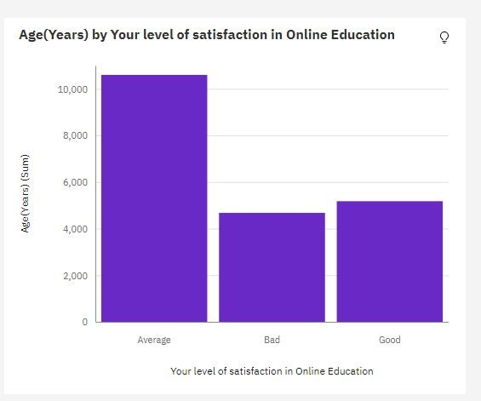

Slide 18
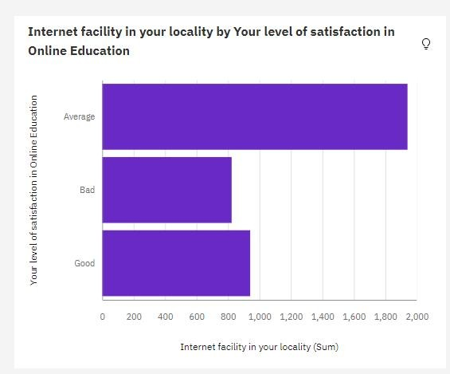

Slide 19
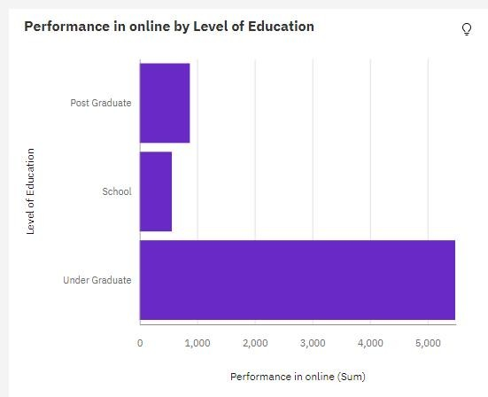

Slide 20
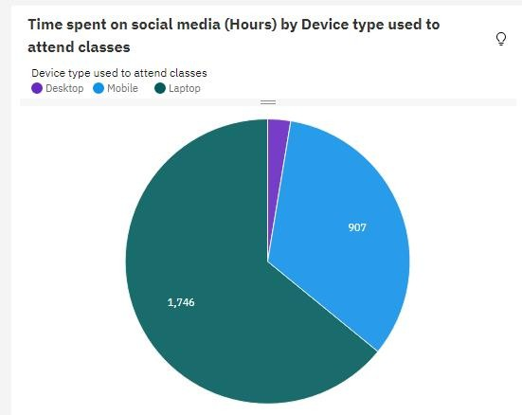

Slide 21
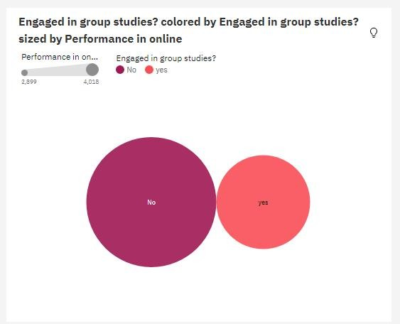

Slide 22
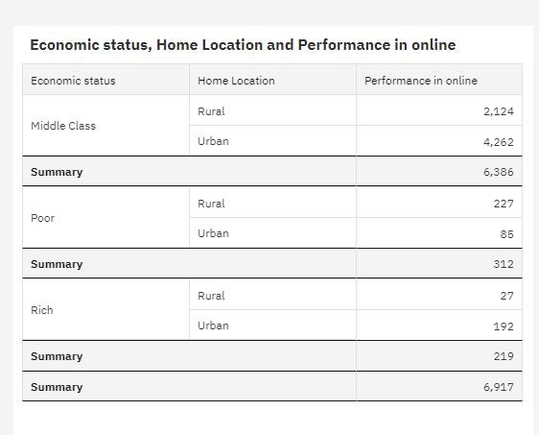

Slide 23
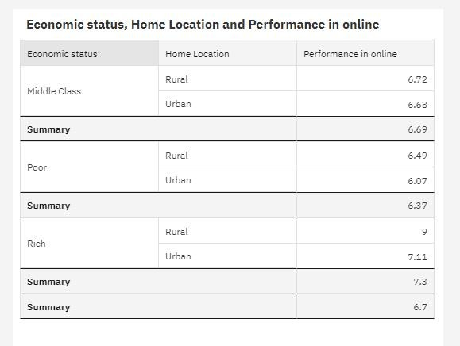

Slide 24
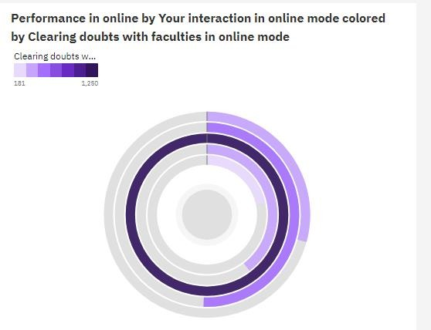

Slide 25
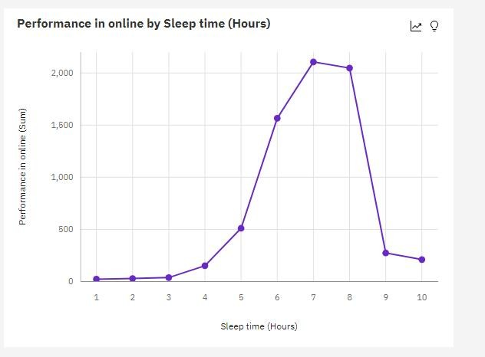

Slide 26
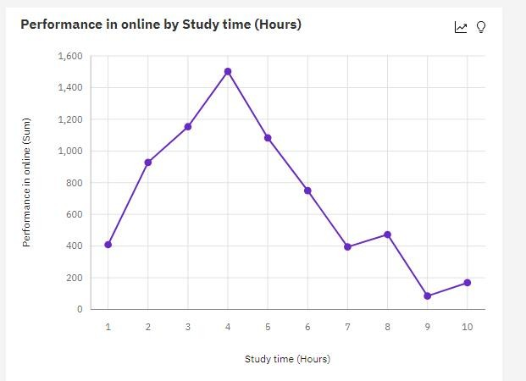

Slide 27
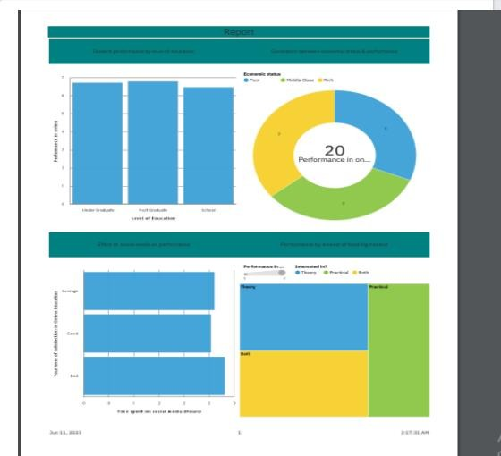

Slide 28
8/31/23, 11:47 AM Project_Story
ONLINE EDUCATION SYSTEM - STORY
https://us3.ca.analytics.ibm.com/bi/?perspective=story&id=iDA696D24E32C420A90DE6A1FB86BBC74&objRef=iDA696D24E32C420A90DE6A1… 1/5

Slide 29
Level of Satisfaction by Age
8/31/23, 11:47 AM Project_Story
Your level of satisfaction in Online Education Average has the highest total Age(Years) due to Home Location Urban. Age(Years) is unusually high when Your level of satisfaction in Online Education is Average.
Age(Years) by Your level of satisfaction in Online Education
12,000
10,599
10,000
8,000
6,000
Age(Years) (Sum)
4,000
2,000
0
4,676
5,177
Average
Bad
Good
Your level of satisfaction in Online Education
https://us3.ca.analytics.ibm.com/bi/?perspective=story&id=iDA696D24E32C420A90DE6A1FB86BBC74&objRef=iDA696D24E32C420A90DE6A1… 2/5

Slide 30
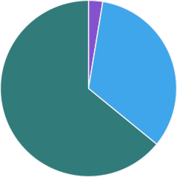
8/31/23, 11:47 AM Project_Story
Time spent on social media (Hours) by different devices
Across all device type used to attend classes, the sum of time spent on social media is over 2500.
Time spent on social media is unusually high when device type used to attend classes in Laptop.
Time spent on social media (Hours) by Device type used to attend classes
Device type used to attend classes
Desktop Mobile Laptop
33.3%
64.1%
https://us3.ca.analytics.ibm.com/bi/?perspective=story&id=iDA696D24E32C420A90DE6A1FB86BBC74&objRef=iDA696D24E32C420A90DE6A1… 3/5

Slide 31
8/31/23, 11:47 AM Project_Story
Correlation between economic status, home location and performance in online
Economic status, Home Location and Performance in online
The performance of online having economic status in middle class and residing in rural location is higher than urban
Economic status | Home Location | Performance in online
Middle Class | Rural | 6.72
 | Urban | 6.68
Summary |  | 6.69
Poor | Rural | 6.49
 | Urban | 6.07
Summary |  | 6.37
Rich | Rural | 9
 | Urban | 7.11
Summary |  | 7.3
Summary |  | 6.7
https://us3.ca.analytics.ibm.com/bi/?perspective=story&id=iDA696D24E32C420A90DE6A1FB86BBC74&objRef=iDA696D24E32C420A90DE6A1… 4/5

Slide 32
8/31/23, 11:47 AM
Project_Story
https://us3.ca.analytics.ibm.com/bi/?perspective=story&id=iDA696D24E32C420A90DE6A1FB86BBC74&objRef=iDA696D24E32C420A90DE6A1… 5/5

Slide 33

8/31/23, 11:49 AM
Online_Project_Dashboard
Tab 1
Internet facility in your locality by Your level of satisfaction in Online Education
Age(Years) by Your level of satisfaction in Online Education
12,000
10,599
10,000
8,000
6,000
Your level of satisfaction in Online Ed…
Average
1,941
Age(Years) (Sum)
Bad
823
4,000
2,000
0
4,676
5,177
Good
941
Average
Bad
Good
0 200 400 600 800 1,000 1,200 1,400 1,600 1,800 2,000 2,200
Internet facility in your locality (Sum)
Your level of satisfaction in Online Education
Average marks scored before pandemic in traditional classroom colored by Average marks scored before pandemic in traditional classroom
Average marks scored before pandemic in traditional classroom
0-10 11-20 21-30 31-40 41-50 51-60 61-70 71-80
Time spent on social media (Hours) by Device type used to attend classes
Device type used to attend classes
Desktop Mobile Laptop
51-60
71-80
21-30
91-100
81-90
11-20
31-40
61-70
41-50
0-10
https://us3.ca.analytics.ibm.com/bi/?perspective=dashboard&id=i195791EEFD1441CE8792FA1B8ED137FD&objRef=i195791EEFD1441CE8792… 1/4

Slide 34
8/31/23, 11:49 AM
Online_Project_Dashboard
Tab 2
Economic status, Home Location and Performance in online
Performance in online by Level of Education
Economic status | Home Location | Performance in online
Middle Class | Rural | 6.72
 | Urban | 6.68
Summary |  | 6.69
Poor | Rural | 6.49
 | Urban | 6.07
Summary |  | 6.37
Rich | Rural | 9
 | Urban | 7.11
Summary |  | 7.3
Post Graduate
875
Level of Education
School
562
Under Graduate
5,480
0 500 1,000 1,500 2,000 2,500 3,000 3,500 4,000 4,500 5,000 5,500 6,000
Performance in online (Sum)
Engaged in group studies? colored by Engaged in group studies? sized by Performance in online
Performance in on… Engaged in group studies?
No yes
2,899 4,018
No
yes
https://us3.ca.analytics.ibm.com/bi/?perspective=dashboard&id=i195791EEFD1441CE8792FA1B8ED137FD&objRef=i195791EEFD1441CE8792… 2/4

Slide 35
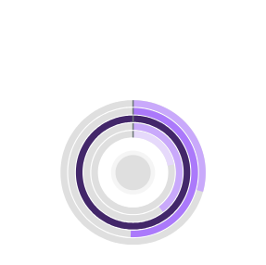
8/31/23, 11:49 AM
Online_Project_Dashboard
Tab 3
Performance in online by Study time (Hours)
Performance in online by Sleep time (Hours)
2,000
1,500
1,000
500
0
1 2 3 4 5 6 7 8 9 10
Sleep time (Hours)
1,600
1,400
Performance in online (Sum)
1,200
Performance in online (Sum)
1,000
800
600
400
200
Performance in online by Your interaction in online mode colored by Clearing doubts with faculties in online mode
Clearing doubts w…
0
1 2 3 4 5 6 7 8 9 10
Study time (Hours)
181
1,250
https://us3.ca.analytics.ibm.com/bi/?perspective=dashboard&id=i195791EEFD1441CE8792FA1B8ED137FD&objRef=i195791EEFD1441CE8792… 3/4

Slide 36
8/31/23, 11:49 AM
Online_Project_Dashboard
https://us3.ca.analytics.ibm.com/bi/?perspective=dashboard&id=i195791EEFD1441CE8792FA1B8ED137FD&objRef=i195791EEFD1441CE8792… 4/4

Slide 37
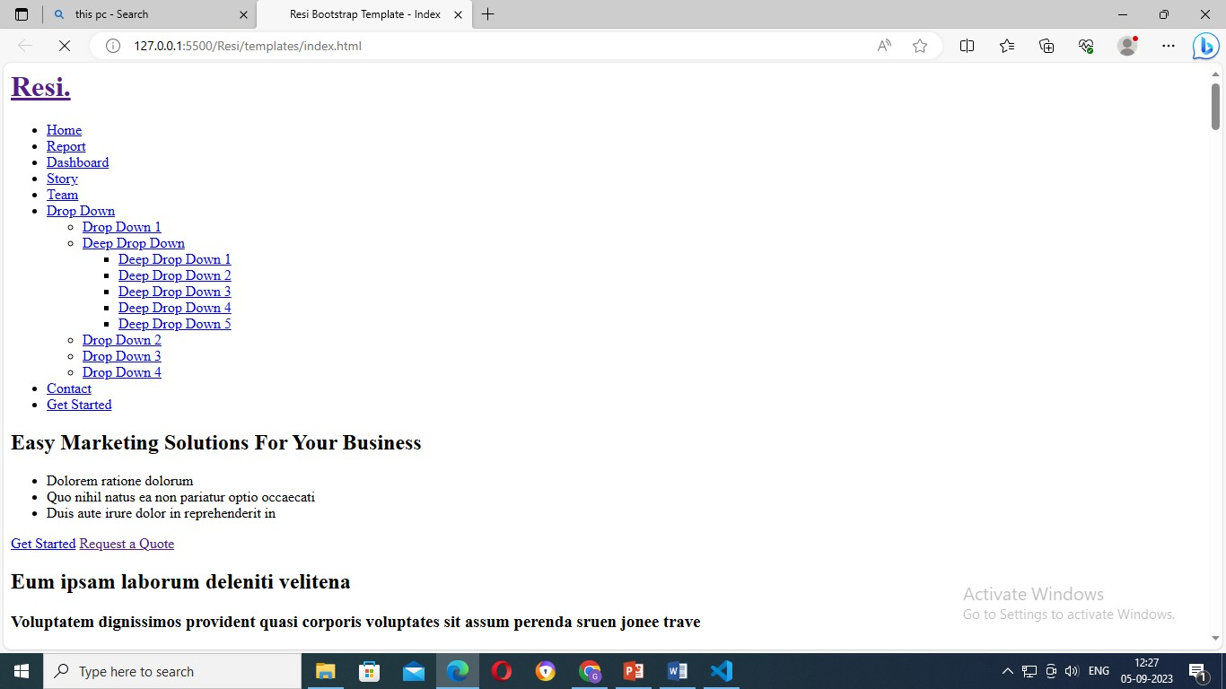
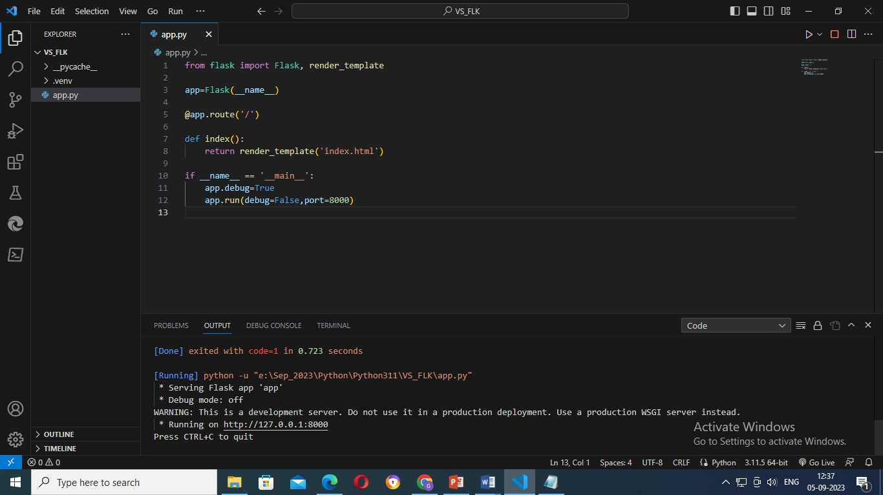
Dashboard And Story Embed With UI With Flask

