Slide 1


Automated Essay Grading System
Group members:
Andrina Martin
Ashna Rafeek
Pallavi Nair
Sania Ejaz

Slide 2

contents
Problem statement
Our Solution : AES
Block Diagram
Dataset
Data Preprocessing
Defining Input and Output
Model Training and Testing : NLP and RNN
Flask Integration
Accuracy
Conclusion

Slide 3

Problem statement
Manual essay scoring is a cumbersome and a tedious process prone to errors and, is deemed to be subjective across different graders. The process extracts more time and effort.

Slide 4

Our solution: aes
A platform for augmented grading of essays using deep learning and machine learning algorithms.
Automates the process of essay grading submitted through our GUI.
Prompts users with a diverse list of creative writing prompts.
Cuts down on the time, cost and effort while boosting accuracy and efficiency.
A calculated score is presented to the writer on submission.

Slide 5
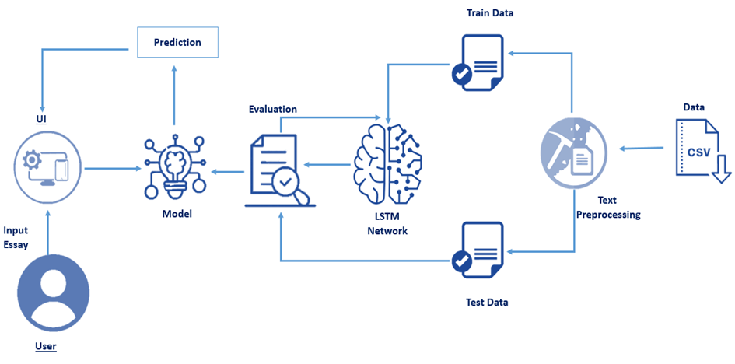
Block diagram

Slide 6
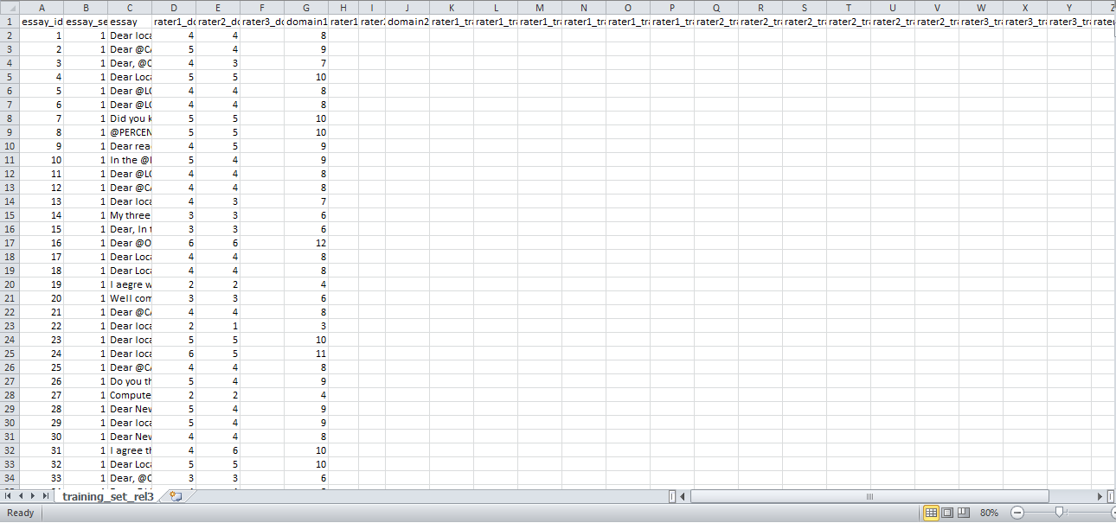
Dataset
‘The Hewlett Foundation: Automated Essay Scoring Dataset’ sourced by ASAP
The dataset includes:
Essay_Set_Descriptions
training_set_rel3.tsv

Slide 7
Data preprocessing
Removing null values
Filtering valid features
Removing special symbols, stop words and punctuation
1
2
3

Slide 8
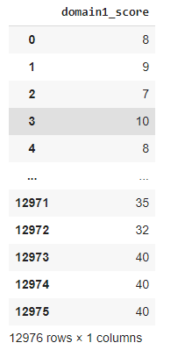
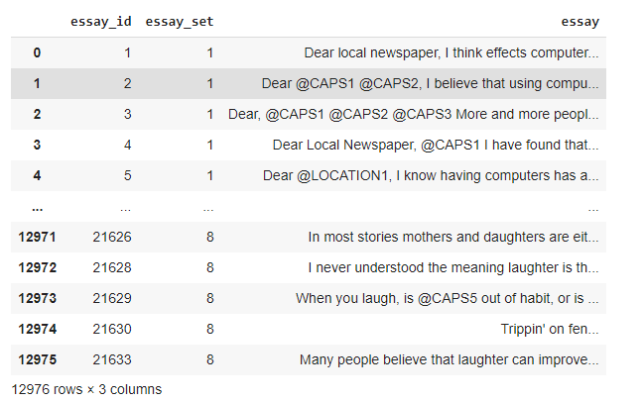
Defining Input and output
Submitted essay
Calculated score

Slide 9
Model training and testing : Nlp and rnn
Converting textual inputs to numeric counterparts - Count Vectorizer
Word2Vec Embedding layer
LSTM layers:
Dense Layers
Train and Test the Model
Splitting data into train and test sets
Establishing RNN
Compiling the model

Slide 10
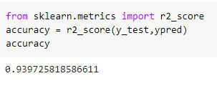
Accuracy

Slide 11
Flask integration

Slide 12
home

Slide 13
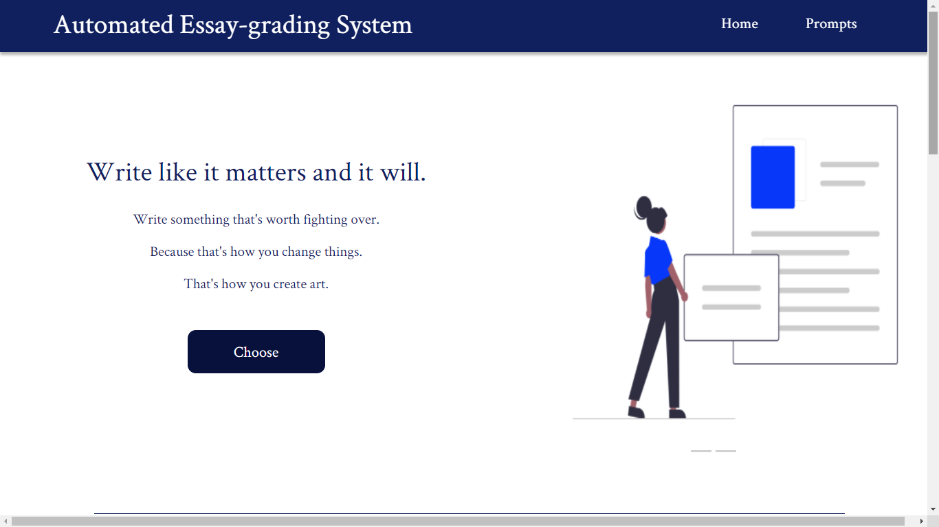

Slide 14
Prompts

Slide 15
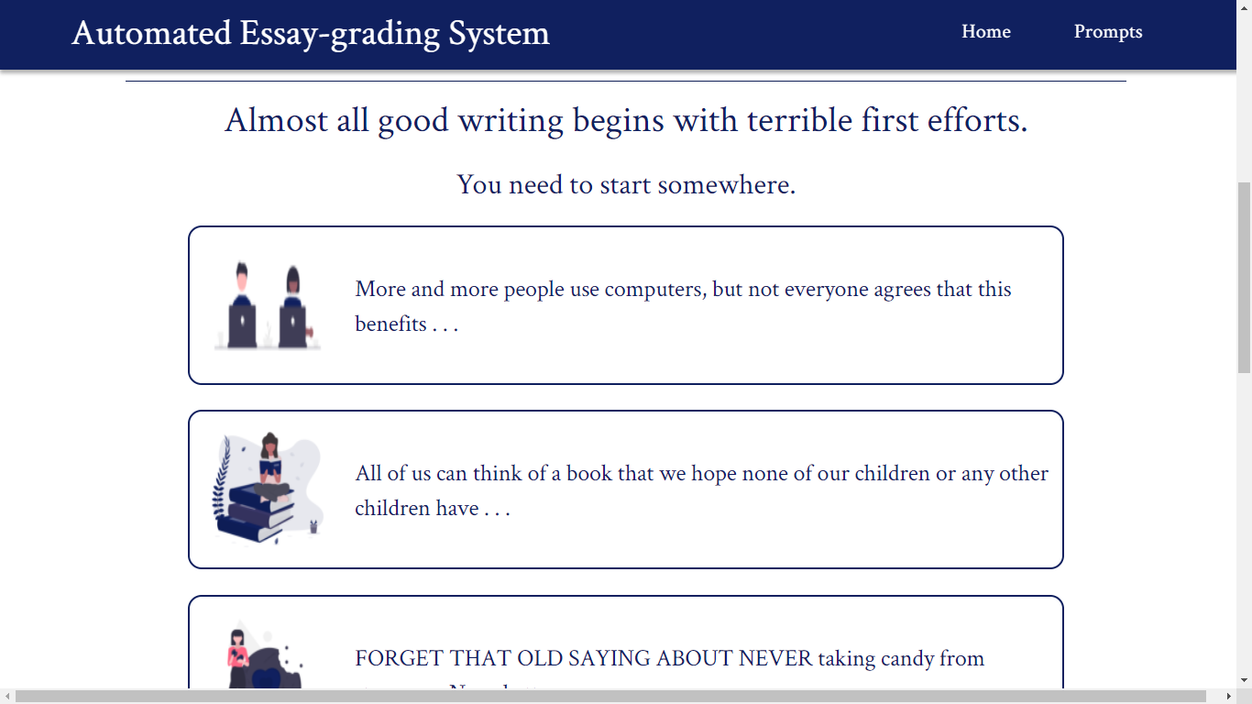

Slide 16
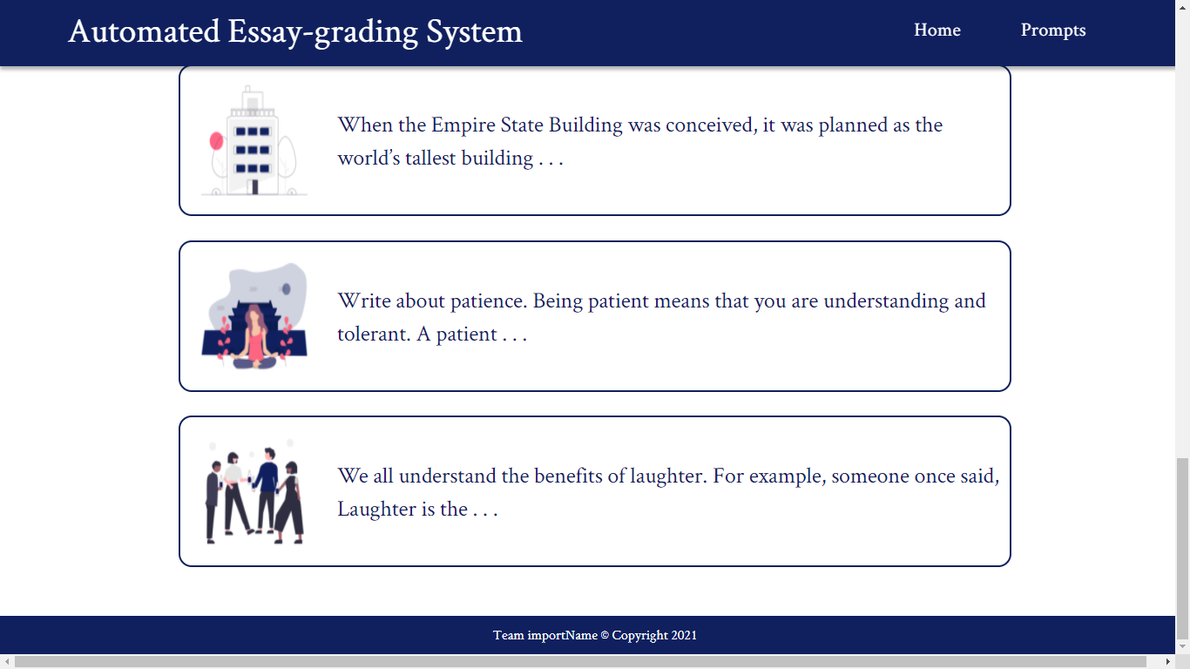

Slide 17
submission

Slide 18
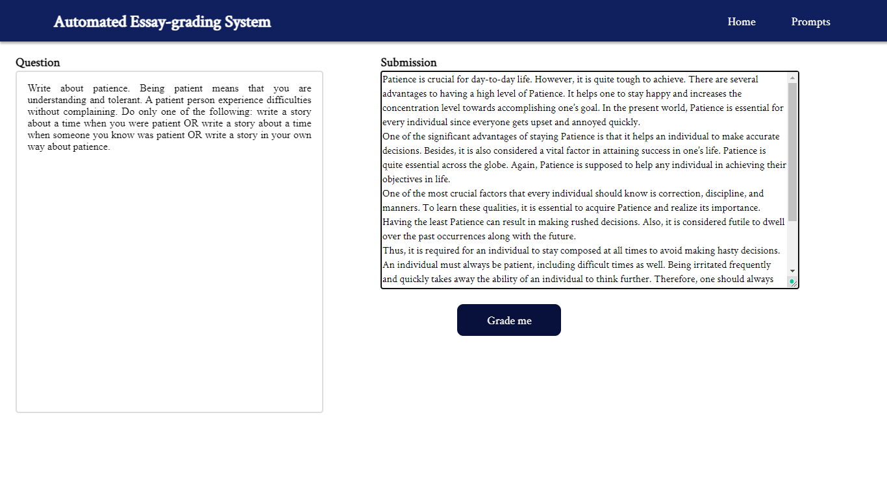

Slide 19
Grade

Slide 20
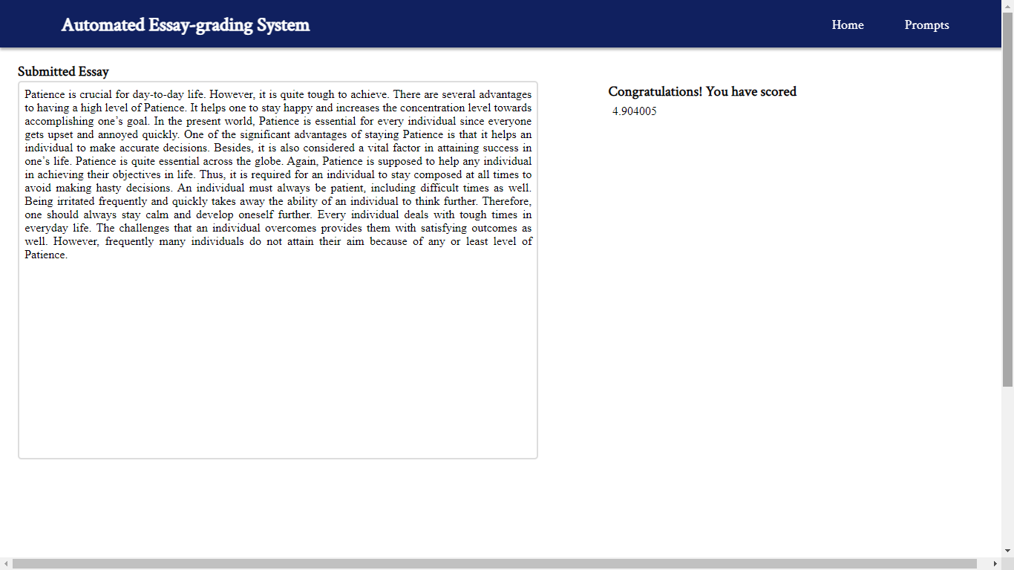

Slide 21

Conclusion
This essay grading system utilizing recurrent neural network model is interpretable and can be transformed to assist the writer with impactful feedback.

Slide 22


