Slide 1
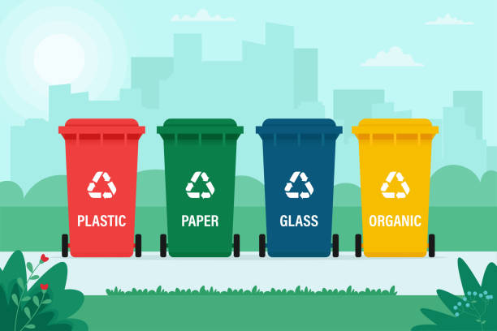
Garbage Classification Using IBM Cloud
PRESENTED BY:
TEAM NO: CSE-006
18UK1A0529 : M.CHANDANAPRIYA
18UK1A0560 : V.SAI HARSHA
18UK1A0550 : SHAIK ABBAS
18UK1A0575 : G.Shiva DHANUSH

Slide 2
OUTLINE
INTRODUCTION
OBJECTIVE
DATA
MACHINE LEARNING APPROACHES
DEEP LEARNING APPROCHES
SOFTWARE REQUIREMENTS
CONCLUSION

Slide 3
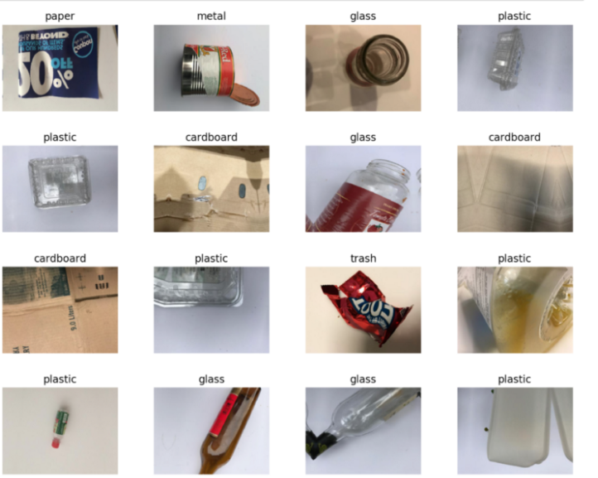
DATA
Garbage classification prediction consists of image dataset:
The data set contains six classes
paper
glass
plastic
metal
cardboard
trash

Slide 4
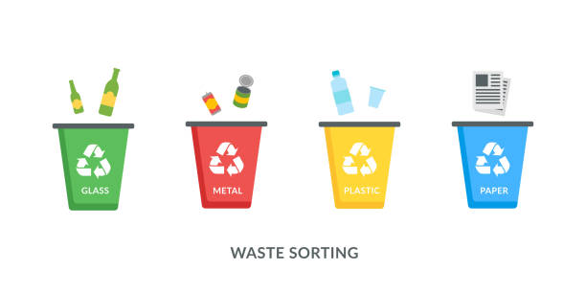
INTRODUCTION :
With the increase in the number of industries in the urban area, the disposal of solid waste is really becoming a big problem, and solid waste includes paper, wood, plastic, metal, glass, etc. The common way of managing waste is burning waste and this method can cause air pollution and some hazardous materials from the waste spread into the air which can cause cancer. Hence it is necessary to recycle the waste to protect the environment and human beings’ health, and we need to separate the waste into different components which can be recycled using different ways. The present way of separating waste/garbage is the hand-picking method, whereby someone is employed to separate out the different objects/materials. The person who separates waste is prone to diseases due to the harmful substances in the garbage. This problem can be overcome by automating the garbage classification process.

Slide 5
OBJECTIVE :
know fundamental concepts and techniques of the Artificial Neural Network and Convolution Neural Networks
Gain a broad understanding of image data.
Work with Sequential type of modeling
Work with Keras capabilities
Work with image processing techniques
know how to build a web application using the Flask framework

Slide 6
DATA VISUALISATION
Data visualization is where a given dataset is presented in a graphical format. It helps the detection of patterns, trends and correlations that might go undetected in text-based data. Understanding your data and the relationship present within it is just as important as any algorithm used to train your machine learning model. Machine learning models will perform poorly on data that wasn’t visualized and understood properly.
To visualize the dataset we need libraries called Matplotlib and Seaborn. The Matplotlib library is a Python 2D plotting library that allows you to generate plots, scatter plots, histograms, bar charts etc.

Slide 7
MODEL BUILDING
Now it's time to build our Convolutional Neural Networking which contains an input layer along with the convolution, max-pooling, and finally an output layer.This activity includes the following steps :
Import the model building Libraries
Initializing the model
Adding CNN Layers
Adding Hidden Layer
Adding Output Layer
Configure the Learning Process
Training and testing the model
Saving the model

Slide 8
DEEP LEARNING ALGORITHMS
Deep learning is a type of machine learning and artificial intelligence (AI) that imitates the way humans gain certain types of knowledge. ... While traditional machine learning algorithms are linear, deep learning algorithms are stacked in a hierarchy of increasing complexity and abstraction.
Examples:
Convolutional Neural Networks
Recurrent Neural Networks
Generative Adversarial Networks

Slide 9
Convolutional Neural Networks
The CNNs can be considered as one of the most efficiently flexible models for specializing in image as well as non-image data.
It is made up of a single input layer, which generally is a two-dimensional arrangement of neurons for analyzing primary image data, which is similar to that of photo pixels.

Slide 10
Recurrent Neural Networks
The RNN puts the knowledge gained from its previous state as an input value for the current prediction. Therefore, it can help in achieving short-term memory in a network, leading to the effective management of stock price changes, or other time-based data system.
LSTMs: Useful in the prediction of data in time sequences, using memory. It has three gates: Input, Output, and Forget.
Gated RNNs: Also useful in data prediction of time sequences via memory. It has two gates— Update and Reset.

Slide 11
Generative Adversarial Networks
It is a combination of two deep learning techniques of neural networks – a Generator and a Discriminator. While the Generator Network yields artificial data, the Discriminator helps in discerning between a real and a false data.
Both of the networks are competitive, as the Generator keeps producing artificial data identical to real data – and the Discriminator continuously detecting real and unreal data. In a scenario where there’s a requirement to create an image library, the Generator network would produce simulated data to the authentic images. It would then generate a deconvolution neural network.

Slide 12
IBM WATSON STUDIO
IBM Acquired soft layer, a public cloud platform, to serve as the foundation for its IaaS offering. In October 2016, IBM rolled the soft layer brand under its Blue mix brand of PaaS offerings, giving users to access both IaaS and PaaS resources from a single console. IBM cloud provides a full-stack, public cloud platform with various products in the catalog, including options for compute, storage, networking, end to end developer solutions for app development, testing and deployment, security databases, and cloud native services.
Creating the IBM cloud account by going to the IBM cloud login page and click create on IBM cloud account. Enter our IBM id and an ID is created based on the email that we enter. Completing the remaining fields with our information and click create account by this the account is created.
Advantages include:
Security and privacy. Much like a private cloud, you can ensure your data remains secure when you are the only organization that uses the private portion of your infrastructure.Potential cost savings. ...Superior flexibility and scalability.

Slide 13
SOFTWARE REQUIREMENTS
Anaconda navigator
Jupyter notebook
Jupiter spyder
Deep learning Tools:
Pandas,
NumPy,Tensorflow,
Keras.

Slide 14
CONCLUSION:
In this project we have presented the Garbage Classification .
We have done the Prediction using Deep Learning Techniques.
For the better results we applied CNN,RNN Layers and proved with 99% accuracy.

