Slide 1

Project AN AUTOMATED PREDICTION MODEL FOR DIABETIC RETINOPATHY USING CNN
Ravulapalli Sai Krishna (21BRS1628)
Sadineni Varun Kumar (21BRS1540)
Bandi Lokeshvardhan (21BAI1654)
TEAM-592538

Slide 2
Contents:
Abstract
System Architecture
Proposed Algorithm
Features
Code
Outputs
Conclusion

Slide 3
ABSTRACT
Diabetic retinopathy is a complication of diabetes, caused by high blood sugar levels damaging the back of the eye (retina). It can cause blindness if left undiagnosed and untreated.
Diabetic Retinopathy (DR) is a leading cause of vision loss in the world. In the past few years, artificial intelligence (AI) based approaches have been used to detect DR. Early detection enables appropriate treatment and thus prevents vision loss.
This project aims towards finding an automatic way to classify a given set of retina images in order to detect the diabetic retinopathy. Deep learning concepts have been used with a convolutional neural network (CNN) algorithm to build a multi-classification model that can detect and classify disease levels automatically.

Slide 4
Convolutional Neural Network
Convolution neural network is mainly used for applications in image and speech recognition as its built-in convolutional layer reduces the high dimensionality of images without losing its information.
The CNN model works in two steps:
Feature extraction
Classification
Feature Extraction is a phase where various filters and layers are applied to the images to extract the information and features out of it and once it’s done it is passed on to the next phase i.e Classification where they are classified based on the target variable of the problem.

Slide 5
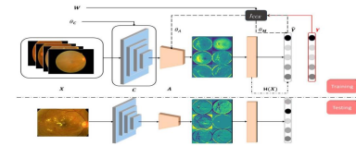
System Architecture:

Slide 6
Proposed Algorithm:
Collect and preprocess data: Collect a dataset of images. Preprocess the images by resizing, normalizing, and augmenting them to create a more diverse dataset for training.
Split the data: Split the dataset into training, validation, and testing sets. The training set will be used to train the model, the validation set to monitor the performance during training and select the best model, and the testing set to evaluate the final model's performance.
Build the CNN model: Create a CNN model with convolutional layers to extract features from the images, pooling layers to reduce the spatial dimensions, and fully connected layers to make the final predictions. You can also use dropout to reduce overfitting.

Slide 7
Compile the model: Compile the model with a suitable loss function, optimizer, and evaluation metrics. The choice of loss function depends on the problem you are trying to solve, while the optimizer determines how the model updates its weights during training.
Train the model: Train the model on the training set using the fit() function. You can use early stopping and reduce learning rate callbacks to prevent overfitting and improve performance.
Evaluate the model: Evaluate the model on the validation set and use the results to tune the hyperparameters of the model. You can also use techniques like confusion matrix, precision, recall, and F1-score to evaluate the model's performance.
Test the model: Test the final model on the testing set to estimate its performance in the real world. You can also visualize the model's predictions on sample images to gain insights into its behavior.
Predict results.

Slide 8
FEATURES:
NUMPY: which stands for Numerical Python, is a library consisting of multidimensional array objects and a collection of routines for processing those arrays.
SK-learn: Scikit-learn is a free machine learning library for Python. It features various algorithms like support vector machine, random forests, and k-neighbours, and it also supports Python numerical and scientific libraries like NumPy and SciPy .
KERAS: Keras is a high-level, deep learning API developed by Google for implementing neural networks. It is written in Python and is used to make the implementation of neural networks easy.

Slide 9
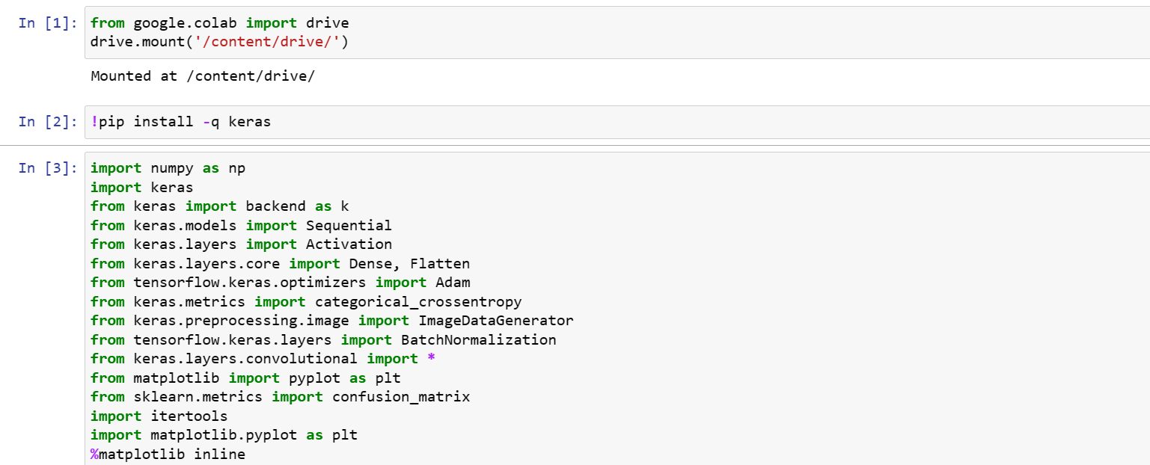
CODE: CREATING A MACHINE LEARNING MODEL: #IMPORTING DEPENDENCIES

Slide 10
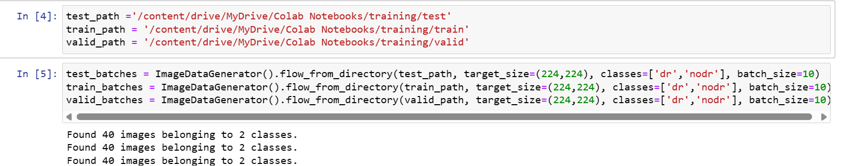
#DATA COLLECTION AND ANALYSIS Setting up the file paths of the training, testing, and validation data. Creating batches of data using the ImageDataGenerator class from Keras

Slide 11
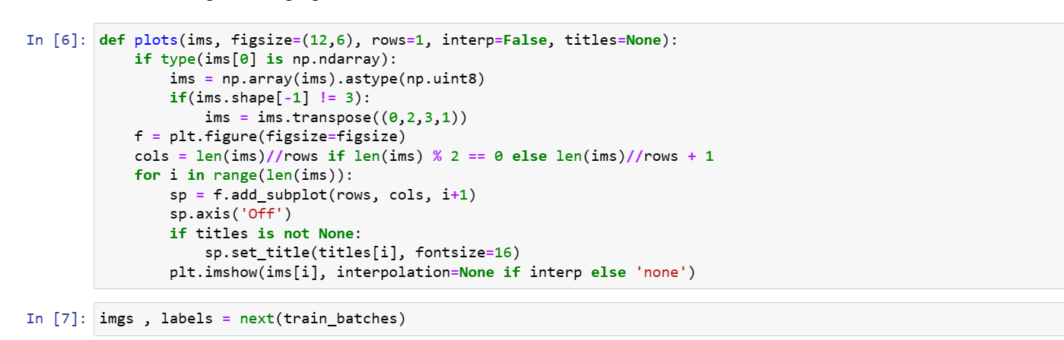
Defining a function named plots for plotting images with their corresponding labels.

Slide 12
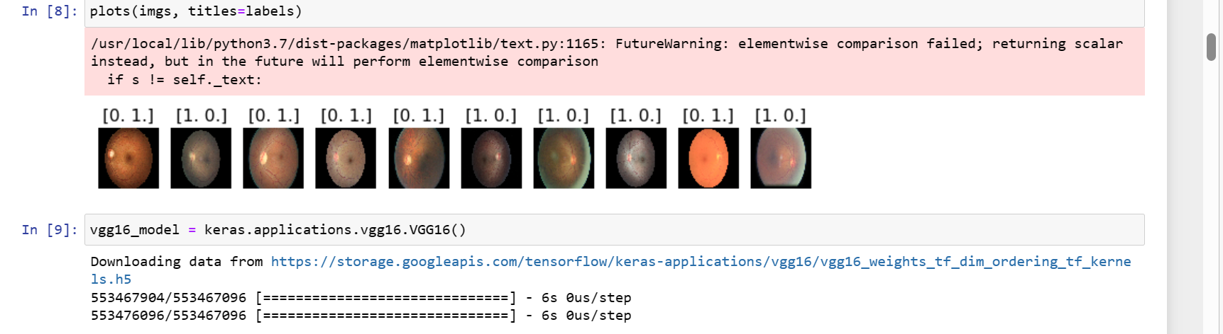
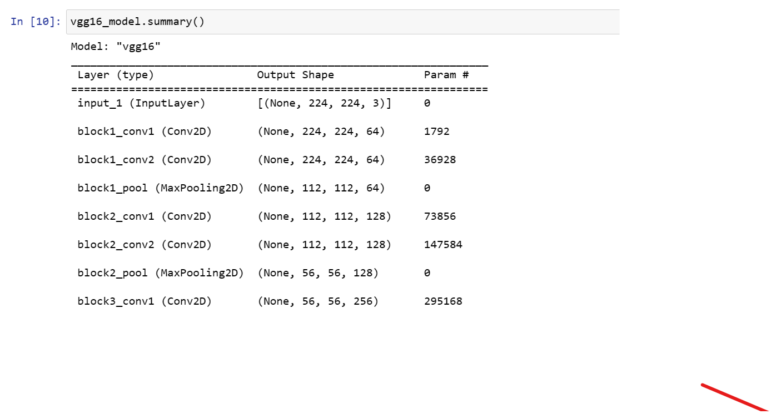
Loading the pre-trained VGG16 model provided by Keras.

Slide 13
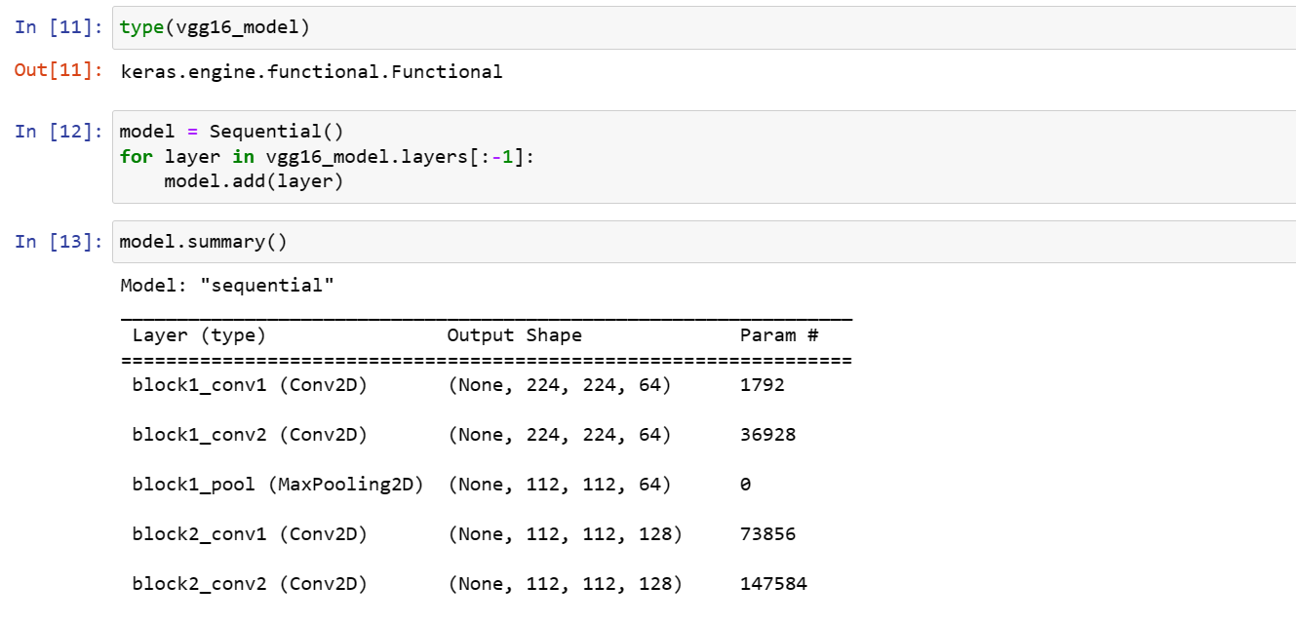

Slide 14
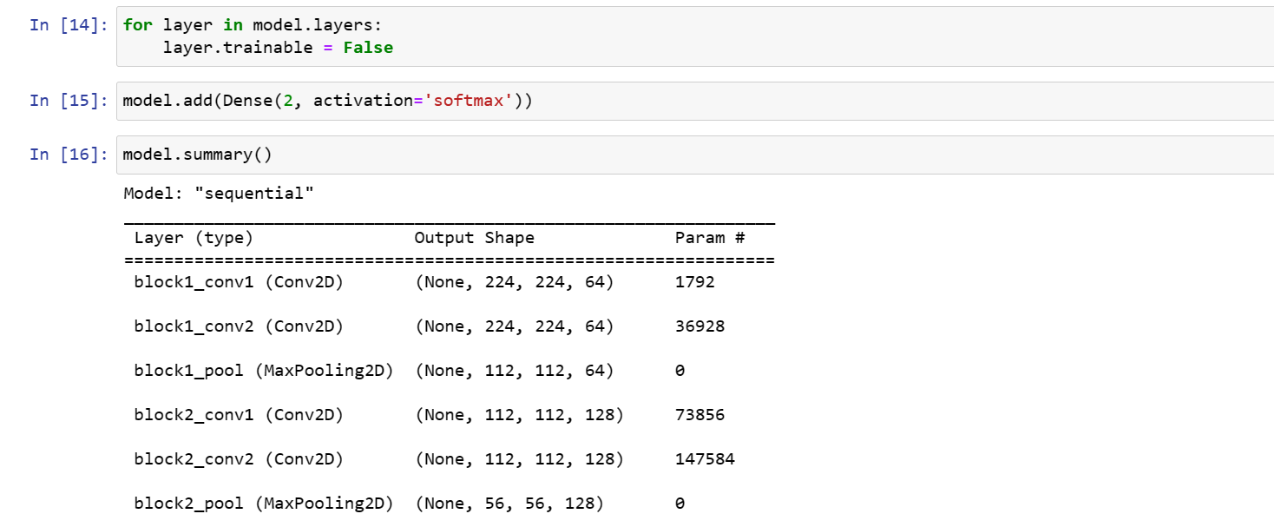
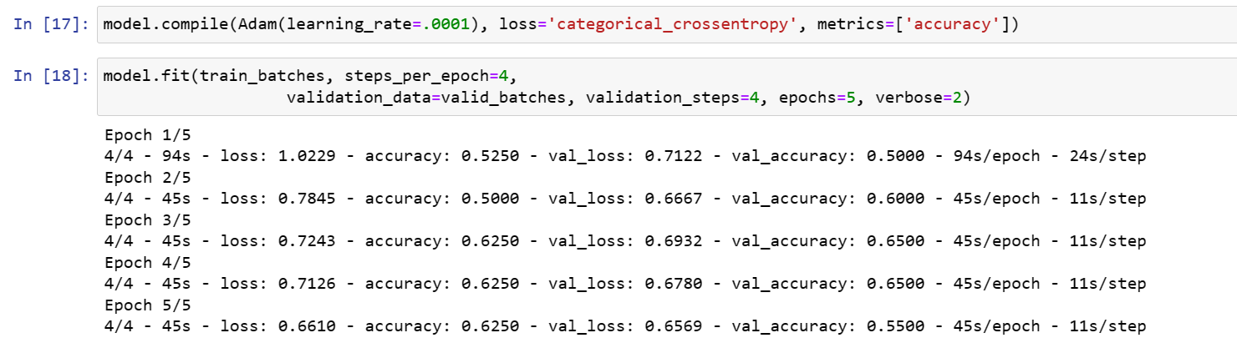
Compiling the model
Fitting the model on the training data and validating on the validation data.

Slide 15
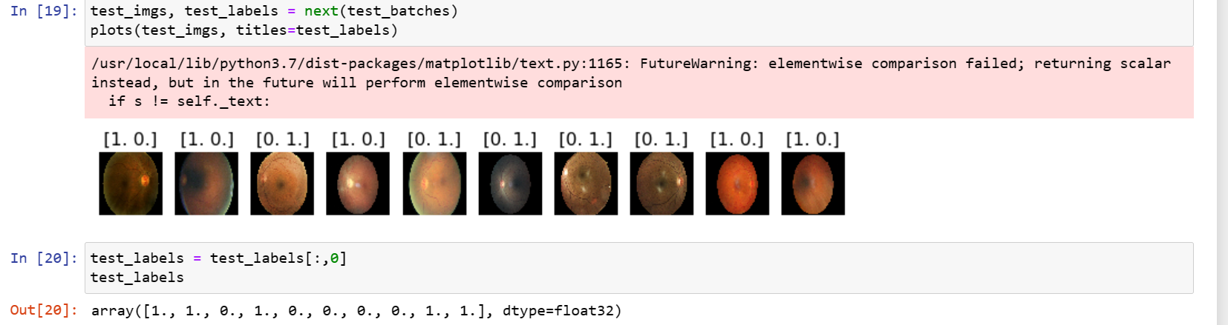
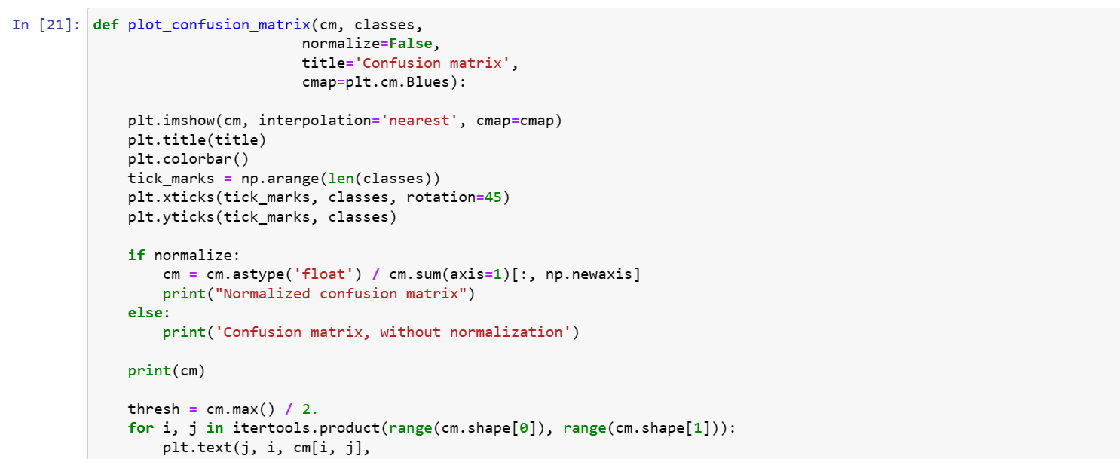

Slide 16
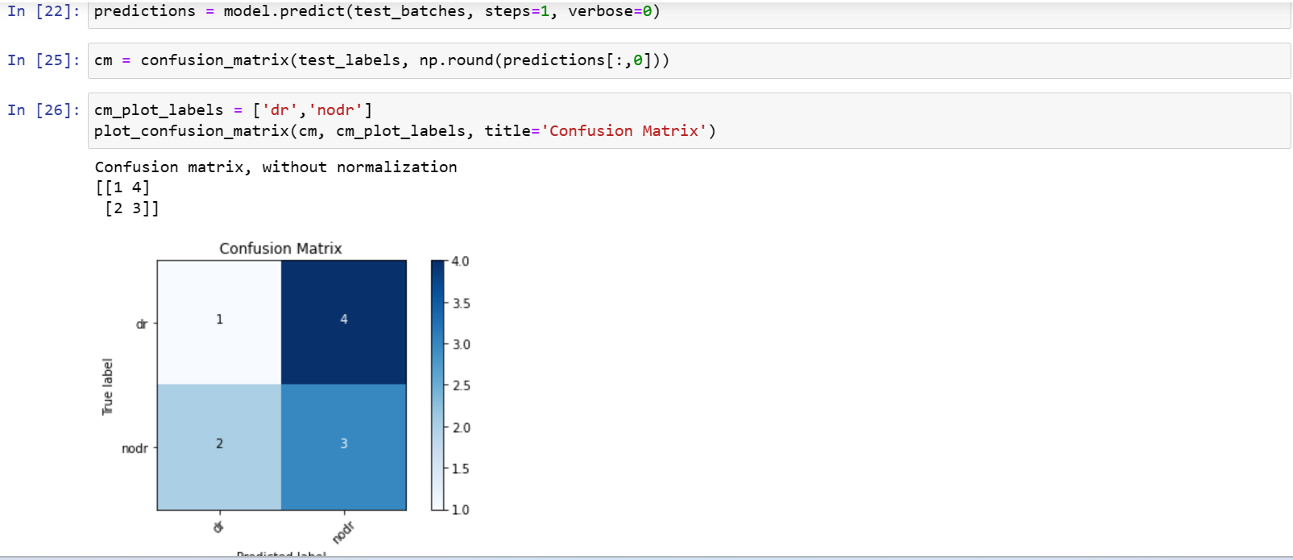
Loading the testing data and making predictions using the predict method of the model. Plotting the confusion matrix of the model's predictions.

Slide 17
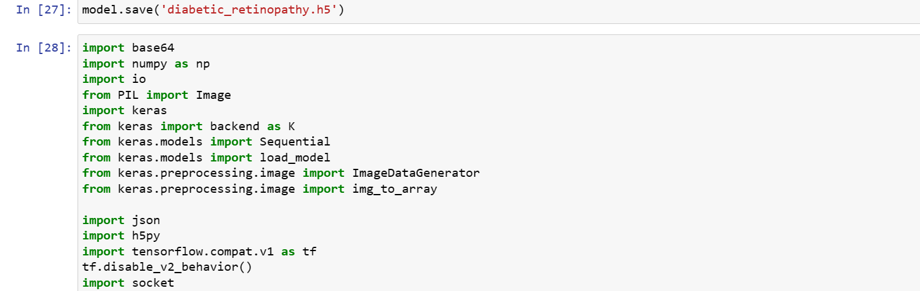

Slide 18
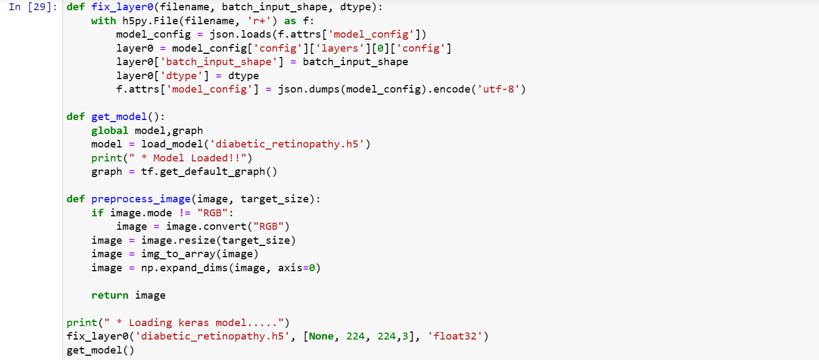
Defining a function named fix_layer0 for fixing the batch input shape and data type of the model.
Defining a function named get_model for loading the pre-trained model.
Defining a function named preprocess_image for preprocessing an image before making a prediction.

Slide 19
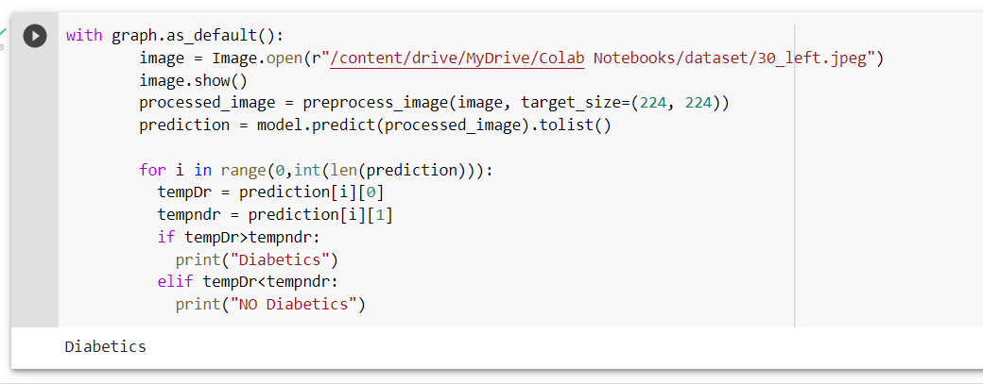
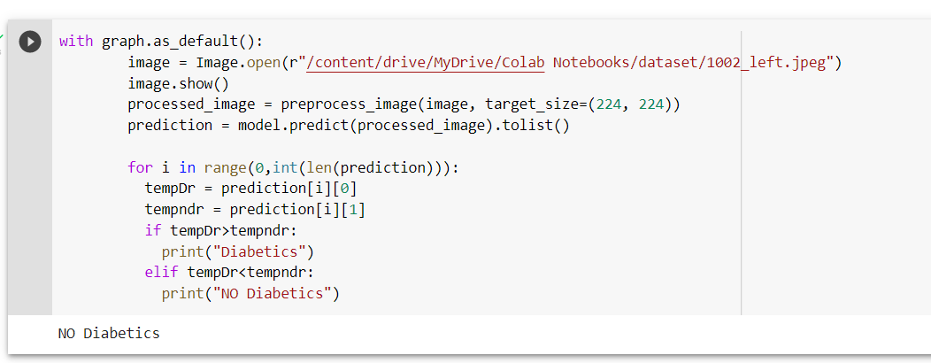
Loading the pre-trained model and predicting the class of an image. OUTPUTS:

Slide 20
CONCLUSION
Automated DR detection systems would greatly benefit the early screening and treatment of DR and prevent vision loss caused by it.
Early detection is essential in the treatment of diabetic retinopathy patients.
This project aims towards finding an automatic way to classify a given set of retina images in order to detect the diabetic retinopathy

Slide 21
THANK YOU
.

