Slide 1
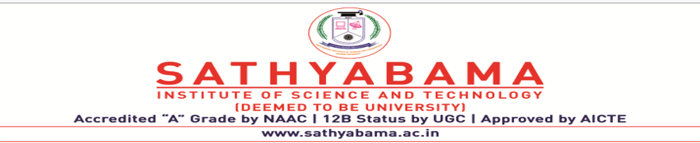
HR PAYROLL AUTOMATION USING ROBOTIC PROCESS AUTOMATION (RPA)
PROJECT SUPERVISOR:- DR. R AROUL CANESSANE
Submitted by – SURYA DEEPTA MAZUMDAR
Register no. - 39110993

Slide 2
CONTENTS
HEADINGS | PG NO.
COURSE CERTIFICATE | 3
INTRODUCTION | 4
OBJECTIVES | 5
SYSTEM ARCHITECTURE | 6
MODULE IMPLEMENTATION | 7
APPLICATION SNAPSHOTS | 16
RESULTS AND DISCUSSION | 19
CONCLUSION AND FUTURE WORK | 20
REFRENCES | 21

Slide 3
COURSE CERTIFICATE
.

Slide 4
INTRODUCTION
• Payroll is a list of Employees who get paid by the company. Payroll also refers to the total amount of money employer pays to the Employees.
• Robotic Process Automation (RPA) is a type of automation technology currently transforming the way businesses operate.
Excel automation streamlines your use of the application by automatically performing tasks.
• Managers today must make better and faster business decisions than ever. Investments which are focusing on information technology are often considered as a critical method of speeding up and improving the management decision making. Yet it has proved distressingly difficult to understand the actual potential of investments in Information Technology. This is particularly common in business areas focusing on Human Resources (HR).

Slide 5
OBJECTIVES
● Gain insights into building blocks of Blue Prism automation.
● Importing MS Excel VBO (Visual Basic for Applications) in Blue Prism.
● Tuning Process Studio with specific needs.
● Working with different stages in the Process studio.
● Build a HR Payroll Excel Automation that works over Microsoft excel.

Slide 6
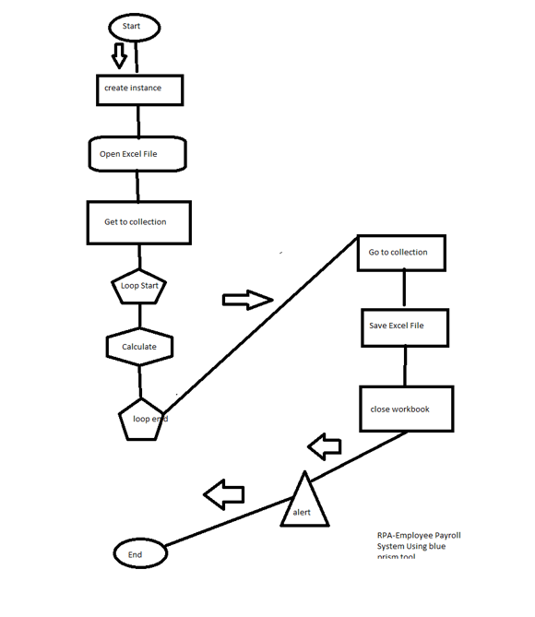
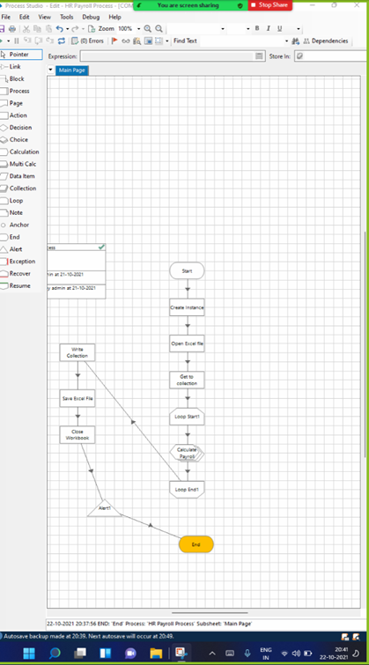
ARCHITECTUE DIAGRAM

Slide 7
MODULE IMPLEMENTATION
● Importing Blue Prism MS Excel VBO (Visual Basic for Applications)
● Binding Process Studio with MS Excel VBO.
● Opening MS Excel Workbook.
● Specifying Blue Prism Stages to work on MS Excel Workbook in Blue Prism.
● Tuning Process Flow with Blue Prism Actions.
● Closing MS Excel Workbook.

Slide 8

FLOW AND IMPLEMENTATION
Idea:
Need to find a new one --“Generally, in the industries monitoring the machine status continuously and maintaining the records of the entire data plays a very important role as that helps the officials to analyze the production factors. This also helps in resolving some of the problems like machine failures, production delays, etc.

Slide 9
HARDWARE & SOFTWARE REQUIREMENTS
The following is the Hardware required to complete this project:
Administration access to install and run Blue Prism
Minimum 10GB free disk space
Windows 8.1 or 10 (64-bit version only) OR Cloud: Get started free, Cloud account required.
The following is the Hardware required to complete this project:
Microsoft Excel installed in your pc
Blue Prism Software

Slide 10
ACTIVITIES
Milestone 1: Configure the Process Studio
Let us create the Process Object bind with MS Excel VBO.
Object studio is mainly used to develop the objects. Inside the object, we have different types of actions as follows:
1. Application Modular to Spy the Elements
2. Initialize page and clean up page.

Slide 11
Activity 1: MS Excel VBO (Import VBO file)
File -> Import -> Browse -> (C:\Program Files\Blue Prism Limited\Blue Prism Automate\VBO\BPA Object-MS Excel). Click Finish.
Activity 2: Creating the Process Object from Object Studio
Process studio has only the Main page. We can call from the process studio. We use the Process studio for developing and testing.

Slide 12
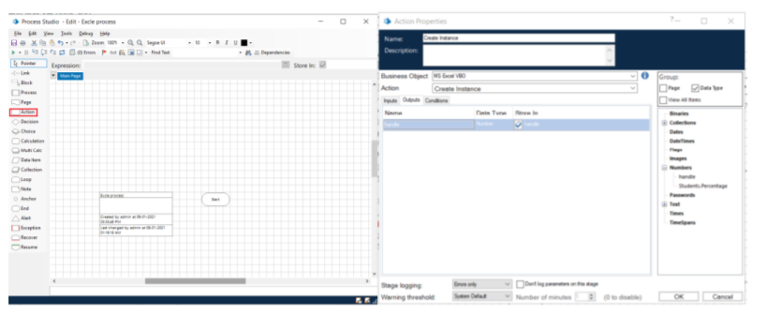
Open Created Process Model (HR Payroll Process)

Slide 13
1. Create Action Stage as “Create Instance” (Business Object = MS Excel VBO; Action = Create Instance).
a. Click on the Outputs tab
I. Create Data Item, type = number, name = “handle”. Drag it into the store in column.
II. Click on ok.
2. Create Action Stage as “Open Excel file” (Business Object = MS Excel VBO; Action = Open Workbook).
a. Click on the Inputs tab
i. Drag “handle” data item into handle Value column.
ii. Set file path of excel file in File Name Value column.
3. Create Action as “Get to collection” (Business Object = MS Excel VBO; Action = Get Workbook As Collection).
a. Click on the Inputs tab
i. Drag “handle” data item into handle Value column.
ii. Drag “Workbook Name” data item into the Workbook Name Value column
iii. Write Worksheet name as “Sheet1”.

Slide 14
4. Drag Loop module, Drag Multi Calculation module. Connect loop start with Multi Calc stage. Open Multi Calculation Properties and create the following fields.
a. [Employee__.SAL RATE BASIC]*0.1
b. ([Employee__.SAL RATE BASIC+Employee__.SAL RATE DA])*0.3
c. [Employee__.SAL RATE BASIC+Employee__.SAL RATE DA+Employee__.SAL RATE HRA]
d. [Employee__.ATTEND P]+[Employee__.ATTEND PL]+[Employee__.ATTEND WO]
e. ([Employee__.SAL RATE BASIC]*[Employee__.ATTEND PD])/31
f. ([Employee__.SAL RATE DA]*[Employee__.ATTEND PD])/31
g. ([Employee_.SAL RATE HRA]*[Employee_.ATTEND PD])/3
h. [Employee_.GROSS BASIC]+ [Employee_.GROSS DA]+ [Employee_.GROSS HRA]+ [Employee_.INCENTIVE]
i. [Employee_.TOTAL GROSS]*0.0075
j. ([Employee_.GROSS BASIC]+ [Employee_.GROSS DA])*0.12
k. [Employee_.ESI AMT]+[Employee_.PF AMT]+[Employee_.TDS]+[Employee_.PT]
l. [Employee_.TOTAL GROSS]-[Employee_.TOT DED]

Slide 15
5. Create Action Stage as “Write collection” (Business Object = MS Excel VBO; Action = Write Collection).
a. Click on the Inputs tab
i. Drag “handle” data item into handle Value column.
ii. Drag “Workbook Name” data item into the Workbook Name Value
column.
iii. Drag “Employee” Collection into the Collection Value column.
iv. Write Worksheet name as “Sheet1”.
v. Write Cell Reference as “A1”.
vi. Set Include Column Names as True

Slide 16
6. Create Action Stage as “Save Excel file” (Business Object = MS Excel VBO; Action = Save Workbook).
a. Click on the Inputs tab.
i. Drag “handle” data item into handle Value column.
ii. Drag “Workbook Name” data item into the Workbook Name Value column.
7. Create Action Stage as “Close workbook” (Business Object = MS Excel VBO; Action = Close Current Workbook).
a. Click on the Inputs tab
b. Drag “handle” data item into handle Value column
c. Do connections as follows.
Activity 3: Testing the Process Object from Object Studio
Click on the Main Page, click on the Green play button to run the ‘Excel Process’ Process object. It shows COMPLETED when there is no error or no failure in the object.
Click on the Main Page, click on the Reset button to reset the cache for rerun the process object as fresh.

Slide 17

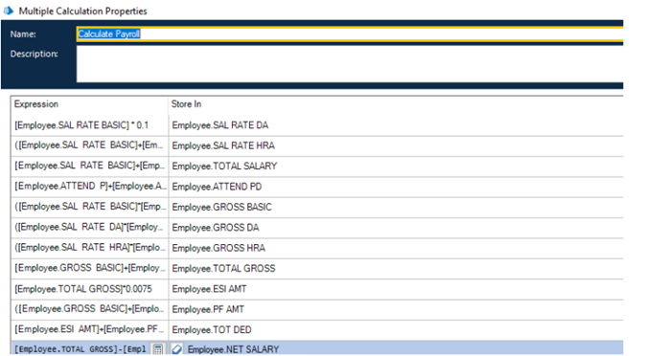
APPLICATION SNAPSHOTS

Slide 18
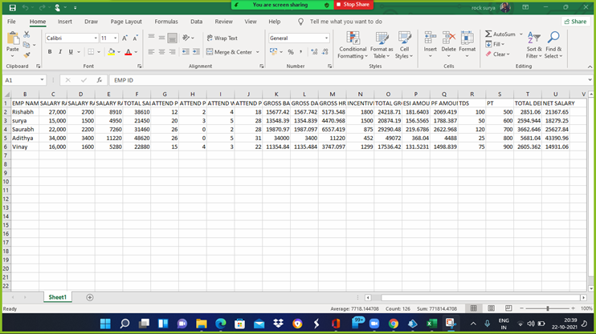
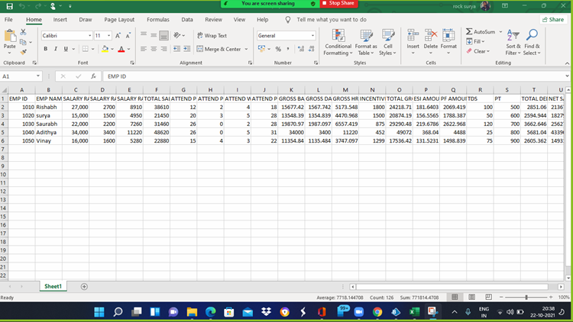

Slide 19
RESULT AND DISCUSSION
Employee Payroll System using Robotic Process Automation in Blue Prism, I have completed the full work-flow of the given activity and calculating the needed payroll of the employees and storing in the attached excel sheet.
After the calculation part of the flow and checking the stored data in the Excel Sheet the next step was to check that the flow runs without any interruption or error till the end stage by saving the excel sheet and to the end of the process.
I have used Blue Prism software for this Employee Payroll System using RPA as it is easy to understand and very efficient and capable of doing work flow using bots and MS Excel to store the final result of the Process.

Slide 20
CONCLUSION
Open the required MS Excel sheet to check whether the blank tables in that sheet have been filled by the bots according to the calculation stage in the blue prism software.
FUTURE WORK:
In future projects I will implement Robotic Process Automation to count the number of leaves taken by an employee per month and to calculate the daily wages regarding the number of leaves in Employee Payroll System using Blue Prism.

Slide 21
BIBLIOGRAPHY AND REFERENCES
Automation of a Business Process Using Robotic Process Automation (RPA)
Robotic Automation Process-The next major revolution in terms of back office operations improvement
Robotic Automation Process – The operating system for the digital enterprise. In: Proceedings of the International Conference on Business Excellence, vol. 12
Understanding the success factors in adopting Business Process Management Software: case studies
Chappell, D.: Introducing Blue Prism: Automating business processes with presentation integration.
Everest Group: Robotic Process Automation Annual Report 2018-Creating Business Value in a Digital-First Word.
Institute for Robotic Process Automation: Introduction to Robotic Process Automation. Accessed 5 March 2019.
Ovum: Robotic Process Automation: Adding to the Process Transformation Toolkit - The role that RPA can play within service providers and enterprises.
RPA Foundation Course – Blue Prism University

