Slide 1

VIRTUAL ASSISTANT
Internal Guide
Dr.Judgi,M.E.,Ph.D.
Head of Department
Dr.S.VIGNESHWARI,M.E,Ph.D.,
Dr.Lakshmanan L, M.E, Ph.D.,

Slide 2
HR PAYROLL AUTOMATION USING BLUE PRISM
PROJECT SUPERVISOR : Dr.Judgi,M.E,Ph.D
NAME OF THE STUDENT:
KAUVERI KAVYASHREE GOBI
38110246

Slide 3
INTRODUCTION
01
SYSTEM ARCHITECTURE
04
OBJECTIVE
02
TABLE OF CONTENTS
05
SOFTWARE AND HARDWARE CONFIGURATION
APPLICATION SNAP SHOTS
03
06
RESULTS AND DISCUSSIONS
07
CONCLUSION

Slide 4
1. INTRODUCTION
Blue Prism’s Enterprise Robotic Process Automation (RPA) platform delivers a secure, scalable digital workforce that works alongside humans increasing productivity, improving experience and delivering true operational agility. The Blue Prism digital workforce is intelligent, connected and easy to control. World-class partner ecosystem ensures seamless integrations with leading Cloud, Virtualization, Analytics and AI platforms. A Secure and Scalable Digital Workforce Operating System, with flexible and dynamic operational capability, full visibility & infrastructure control. Code-free RPA, deployed using a Robotic Operating Model, businesses can scale efficiently, reduce costs, improve customer satisfaction and augment their talent to take on new responsibilities, boosting employee engagement.
How is RPA different from traditional IT automation?
Traditional Automation can make a machine do any task, any step of operational process. RPA, on the other hand, is a form of automation that sticks to the front-end of your system and carries out tasks without having to move to the back-end for anything.

Slide 5
RPA bots work at the level of the UI and interact with systems just as a human would. Robotic Process Automation enables businesses to take action quickly as they mimic the role of an agent. It is system agnostic which means that they can work across application types.
In traditional automation users are required to have the programming skills to use Traditional Automation for automating functionalities. Programming language requirement depends upon the type of automation tool. Users need to remember language syntax and scripting. RPA is code free, allows automation with easy to use flowchart diagram. Traditional automation is comlex when compared to RPA. The integration of different systems is challenging in Traditional Automation due to limitations of API’s. RPA is often called a No-API automation or alternative to ‘manual’ integration for its flexibility, scalability and much simpler process of implementation.
Thus implementing RPA is a better choice for large scale industries to increase digital workforce and supply efficiently as per the demands.

Slide 6
Common Capabilities of RPA :
Opening email and attachments
Logging into web/enterprise applications
Moving files and folders
Reading and writing to databases
Filling in forms
Scraping data from the web
Connecting to system API’s
Extracting structured data
Blue prism - The preferred tool for Robotic Process Automation.
Reusable : Blue Prism’s RPA allows reuse of processes and objects which makes them easy to replicate, while providing maximum return on investment well after setup, boosting the efficiency of employees.

Slide 7
2. Resilient : Blue Prism provides enterprise grade automation resilience by incorporating the ability to manage workloads, ensure business continuity and respond to interruptions.
3. Scalable : Blue Prism RPA is scalable due to its code free feature helping customers define the way work is allocated, managed and scaled.

Slide 8
2.OBJECTIVE
The objective of the project is to build a process for HR Department to manage the Payroll of the employees of a particular company/organization that work over Microsoft excel using Blue prism. Furthermore, to gain insights into building blocks of Blue Prism automation and work with different stages of the process studio. In almost every organization, the responsibility of performing various strategic tasks such as management of the recruitment process, termination process, payroll management etc. lies within the Human resource department. Some of it may include Employee_ monitoring at different levels, payroll management, Employee_ benefits, training, and development, etc. In-order to make this work a lot easier, organizations across the world are investing in HR automation in-order to find out and perform the best human capital decision. Technology has now considered as a potential tool that managers use, both generally, and in human resource functions, to increase the capabilities of the organization.

Slide 9
3.SOFTWARE AND HARDWARE CONFIGURATION
System requirements are to be met in order for the Blue Prism Automation Tool to run smoothly without any hassle. Requirement is a condition or capability possessed by the software or system
component in order to solve a real-world problem. The problems can be to
automate a part of a system, to correct shortcomings of an existing system, to
control a device, and so on.
SOFTWARE REQUIREMENTS:
Internet connection to download and activate Blue Prism
Administration access to install and run Blue Prism
Windows 8.1 or 10
Recommended to use Microsoft .NET Framework 4.7.2 or above
Microsoft Excel version 2013 or above

Slide 10
HARDWARE REQUIREMENTS
At least 10 GB of available hard-disk space
Intel Processor
4GB of Internal Memory
2.0Ghz processor speed with 64bit architecture.
1024x768 or higher resolution monitor.

Slide 11
4.SYSTEM ARCHITECTURE
PROCESS STUDIO : Process Studio is an area where an actual process is created. It looks similar to a traditional flowchart. It allows business logic, control loops, variables, and object calls to be sequenced and tested in a visible business flow. When a page of a process is run, it will run from the main page irrespective of whatever the page you are in. The process area is the area of the screen where processes are designed and tested using the flowchart components in the toolbox. To draw a process, select a drawing object from the toolbox and click the region on the canvas where you want the object to appear. Alternatively, drag and drop the object from the toolbox onto the canvas. A grid is provided in order to make it easier to align objects within the process, and a snap to grid option will align each object placed with the nearest gridline. Both of these options can be enabled or disabled via the View menu.
Different stages in Process Studio are: Link, Block, Process, Page, Action, Decision, Choice, Calculation, Multi Calculation, Data Item, Collection, Loop, Note, Anchor, End, Alert, Exception.

Slide 12
There are various stages in the process flow diagram which are required for HR Payroll Automation. The stages can be Selected, Moved, Resized, Formatted, Cut, Copied/Pasted, Deleted.
Start/End Stage : Any process flow requires start and end stages. Every stage is included between these stages
1.Create Instance Action Stage : An Action Stage allows us to use a business object in a process. The business object used is Microsoft Excel.
2.Open Excel File Action Stage : In the Open Excel File Action Stage, the file path of the business object in the local machine is given as input.
3.Get to Collection Action Stage : New fields are created in this stage by using the declared fields. Fields are column values in excel sheet which comprises collection of values.

Slide 13
4.Calculate Payroll Stage : It is a Calculation Stage, the three main attributes in this stage are Name of the Stage, Description of the Stage and Expression. In the Expression Box, the formula/expression is given in order to populate the result in the excel sheet.
5.Save Excel File Action Stage: The excel file automated by blue prism is saved using the action stage.
6.Close Workbook Action Stage : If the excel file closes succesfully, then the changes made are saved.
7.Alert Stage : An alert stage allows the user to raise bespoke process alerts at strategic points in a process. When an alert stage is executed it will send a customizable message to users. The message is defined as an expression that gives a Text result.

Slide 14
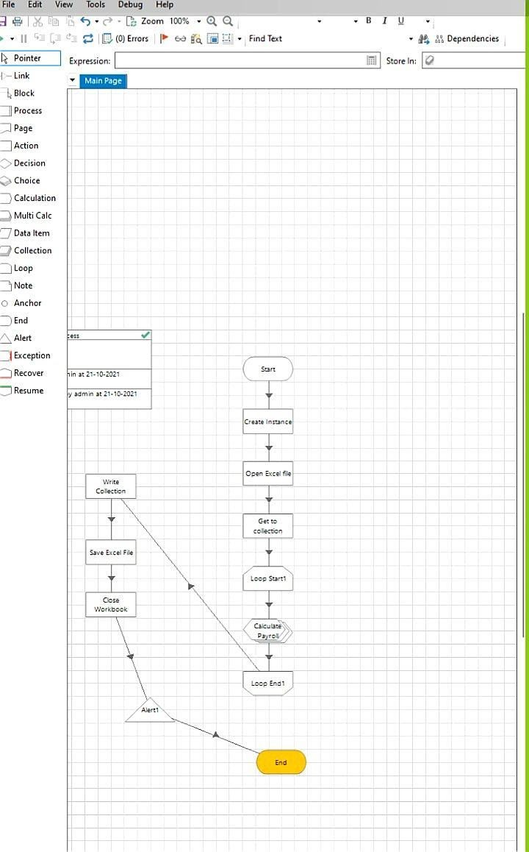
5.APPLICATION SNAP SHOTS
This is the process flow chart of the HR Payroll Automation. The link stage is used to connect every other stage. The different stages are Start/End Stage,
Action Stage, Loop Stage, Calculation Stage and Alert Stage. Process studio has only the Main page. We can call from the process studio. We use the Process studio for developing and testing.

Slide 15
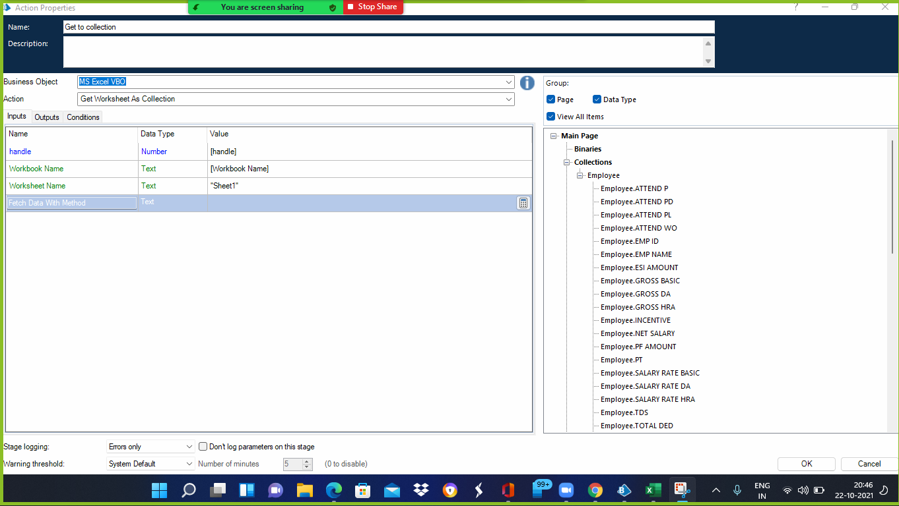
In the Get To Collection Property Stage the business object is given as MS Excel VBO and the handle name as Workbook name. The list of collections are present on the right side of the page.

Slide 16
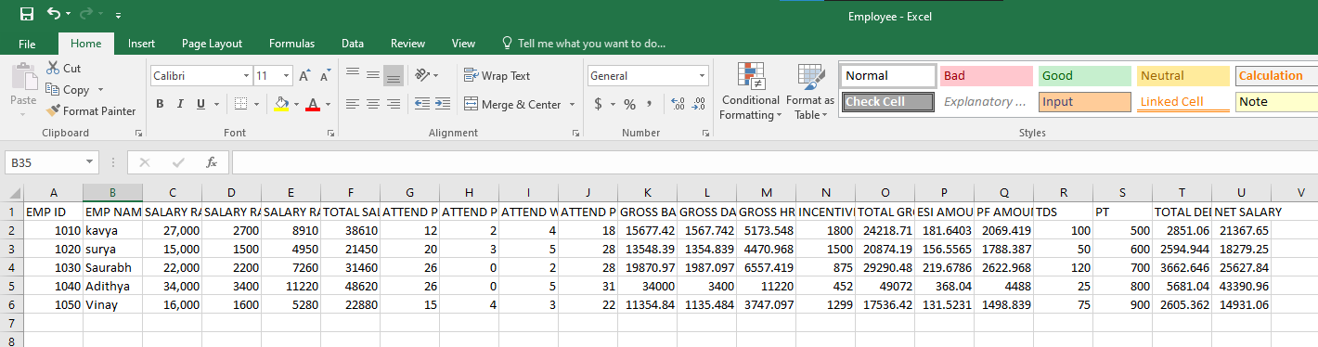
Output Excel File

Slide 17
6.RESULTS AND DISCUSSIONS
Human resource automation using RPA results in reducing all the manual tasks related to time-consuming HR processes such as onboarding, payroll processing, compensation changes, or exit management. This also helps to reduce costs and create a more efficient HR team. Implementing RPA in HR is conducive to optimal results only if implemented and performed in collaboration with the entire team. It is, therefore, essential to gain consistent support from across the departments, including leadership and stakeholders that will be affected by the new technology. This salary management program can be further enhanced by a budget program in future. The prototype automated payroll
system is complete in itself and ready to be implemented but changes and growth in requirements will be a reality on every software project so there is need to timely update them. The same applies to this payroll system.

Slide 18
7.CONCLUSION
HR automation influences people, organizations, and societies in innumerable other ways. Perhaps we can identify some unique effects that Information Technology has on the way we live, learn, work, and play. Nevertheless, the variables studied in this research are sufficient to recognize that the changes caused by HR automation introduce a variety of new issues for individuals and Organizations and radically alter the importance of certain preexisting cultures and practices. Each technology is likely to affect multiple groups of people, whether directly or indirectly. Moreover, the effects of any given technology are rarely only beneficial or only detrimental; they typically create a complex web of consequences that may be both positive and negative. This study and the entire research reveal that evolution of HR process automation is not happening in a vacuum. Information technology has developed into an integral
part of modern Organizations, becoming interrelated with numerous aspects of the work environment. Further advances in information technology will inevitably reverberate in the culture of individuals, as well as organizations.

