Slide 1
Build A Nutrition Image Analysis Dashboard Using IBM
Presented by:
Team no: CSE-002
18UK1A0559- CHENNABOINA VARUN RAHUL
18UK1A0502- AlUGU SAIPRIYA
18UK1A0517- SHASHI
18UK1A0571- DHARIPELLI PRAVEEN

Slide 2
OUTLINE
INTRODUCTION
OBJECTIVE
DATA
IMAGE PREPROCESSING
MODEL BUILDING
SOFTWARE REQUIREMENTS
APPLICATION BUILDING
IBM CLOUD
CONCLUSION

Slide 3
INTRODUCTION
Due to the improvement in people’s standards of living, obesity rates are increasing at an alarming speed, and this is reflective to the risks in people’s health. People need to control their daily calorie intake by eating healthier foods, which is the most basic method to avoid obesity. However, although food packaging comes with nutrition (and calorie) labels, it’s still not very convenient for people to refer. App-based nutrient dashboard systems which can analyze real-time images of the meal and analyze it for nutritional content can be very handy and improve the dietary habits, and therefore, result in a healthy life.
This guided project aims at building a Web App which automatically estimates food attributes such as ingredients and nutritional value by classifying the input image of food. Our method employs the IBM Watson food model for accurate food identification and Food APIs to give the nutritional value of the identified food.

Slide 4
OBJECTIVE
By the end of this project you will:
Know fundamental concepts and techniques of Convolutional Neural Network.
Gain a broad understanding of image data.
Know how to pre-process/clean the data using different data preprocessing techniques.
Know how to build a web application using the Flask framework

Slide 5
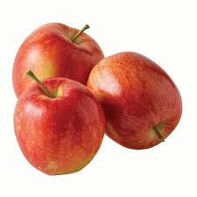
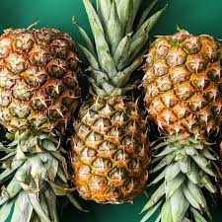
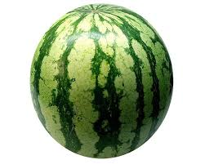
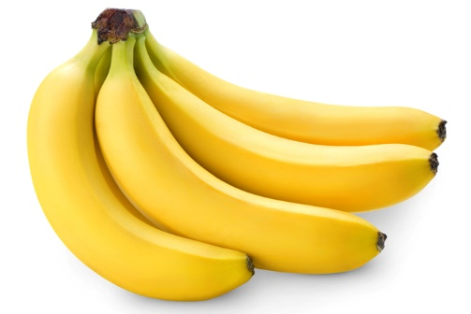
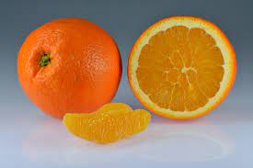
DATA
Collect images of different food items organized into subdirectories based on their respective names as shown in the project structure.
Create folders of types of food items that needs to be recognized.
In this project, we have collected images of 5 types of food items 'apples', 'banana', 'orange', 'pineapple' and 'watermelon', they are saved in the respective sub directories with their respective names. For more accurate results we can collect the images of high resolution and feed the model with more images.

Slide 6
IMAGE PREPROCESSING
In this milestone we will be improving the image data that suppresses unwilling distortions or enhances some image features important for further processing, although perform some geometric transformations of images like rotation, scaling, translation, etc.
Importing the ImageDataGenerator library
Configuring ImageDataGenerator class
Applying ImageDataGenerator functionality to Trainset and Testset

Slide 7
MODEL BUILDING
To build our Convolutional Neural Networking which contains an input layer along with the convolution, max-pooling, and finally an output layer, these are the following steps:
Importing the Model Building Libraries:
A great way to use deep learning to classify images is to build a convolutional neural network (CNN). ... The Keras library in Python makes it pretty simple to build a CNN. Computers see images using pixels. Pixels in images are usually related. Some of the libraries used in our project are NumPy, TensorFlow, etc..,
Initializing the model:
To build a machine learning algorithm, usually you’d define an architecture (e.g. Logistic regression, Neural Network) and train it to learn parameters.
The initialization step can be critical to the model’s ultimate performance, and it requires the right method. To illustrate this, consider the three-layer neural network below. You can try initializing this network with different methods and observe the impact on the learning.

Slide 8
Adding CNN Layers:
The different layers of a CNN. There are four types of layers for a convolutional neural network: the convolutional layer, the Maxpooling layer, the ReLU correction layer and Flatten.
Adding Dense Layers:
A Dense layer feeds all outputs from the previous layer to all its neurons, each neuron providing one output to the next layer. It's the most basic layer in neural networks.
Save the Model
Predicate the Result

Slide 9
APPLICATION BUILDING
Now that we have trained our model, let us build our flask application which will be running in our local browser with a user interface.
In the flask application, the input parameters are taken from the HTML page These factors are then given to the model to predict the type of food and to know the nutrition content in it . In order to know the nutrition content we will be using an API in this project.
Create HTML Pages
Build python code
Task 1: Importing Libraries
Task 2: Creating our flask application and loading our model by using load_model method
Task 3: Routing to the html Page
When “image is uploaded “on the UI, launch function is executed
API Integration
Run the application.

Slide 10
IBM WATSON STUDIO
IBM Acquired soft layer, a public cloud platform, to serve as the foundation for its IaaS offering. In October 2016, IBM rolled the soft layer brand under its Blue mix brand of PaaS offerings, giving users to access both IaaS and PaaS resources from a single console. IBM cloud provides a full-stack, public cloud platform with various products in the catalog, including options for compute, storage, networking, end to end developer solutions for app development, testing and deployment, security databases, and cloud native services.
We Created the IBM cloud account by going to the IBM cloud login page. Then we login to IBM Watson Studio and deployed our model on IBM.
Advantages of deploying model on CLOUD:
Security and privacy. Much like a private cloud, you can ensure your data remains secure when you are the only organization that uses the private portion of your infrastructure.
Potential cost savings.
Superior flexibility and scalability.

Slide 11
SOFTWARE REQUIREMENTS
Anaconda navigator
Jupyter notebook
Machine learning tools: pandas,
numpy,
tensorflow
IBM Watson Studio

Slide 12
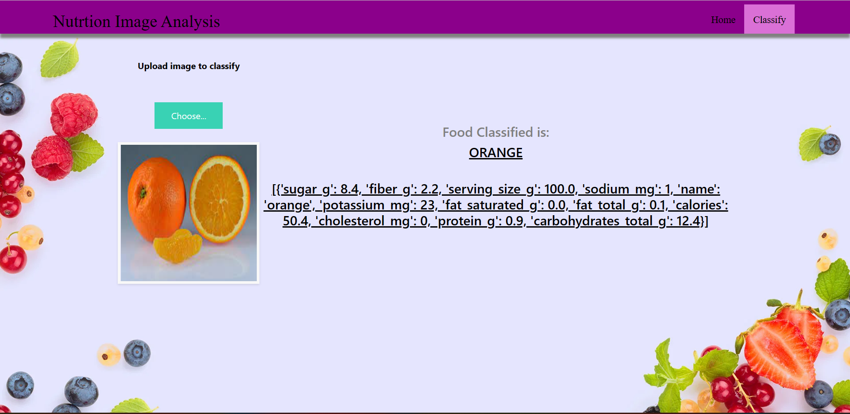
CONCLUSION
After running the application , we can see an USER INTERFACE where we can classify the fruits.

