Slide 1

CLEAN WATER AND SANITATION
TEAM MEMBERS:
Sneha Tingilkar
Donikela Rahul
Md Yakub pasha
M. Madhava

Slide 2
OUTLINE
INTRODUCTION
OBJECTIVE
IBM CLOUD
IBM COGNOS ANALYTICS
DATA SETS

Slide 3
INTRODUCTION
Water is the natural resource that is most threatened by climate change and is a prerequisite for life on earth. According to the World Health Organization, 2.2 billion people around the world do not have safely managed drinking water services, 4.2 billion people do not have safely managed sanitation services, and 3 billion people lack basic handwashing facilities. These services are critical in preventing the spread of COVID-19 and other diseases. Even in areas that have these services, there are vast inequalities in the accessibility, availability, and quality of the services.

Slide 4
OBJECTIVE
So the main objective of this challenge is to ensure sustainable withdrawls and supply of freshwater to address water scatcity and substantially reduce the number of people suffering from water scarcity.
BY THE END OF THIS PROJECT YOU WILL KNOW:
Know fundamental concepts and can work on IBM Cognos Analytics.
Gain a broad understanding of plotting different graphs.
Able to create dashboard.

Slide 5
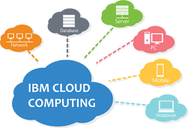
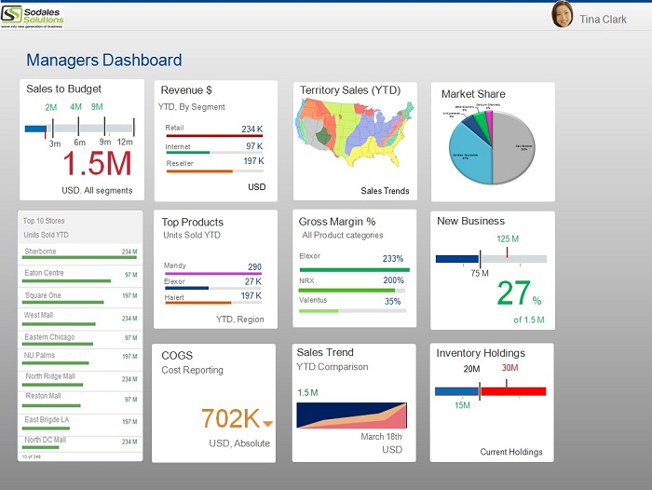
IBM CLOUD
IBM cloud is a suite of cloud computing services from IBM that offers both platform as a service (paas) and infrastructure as a service (iaas). With IBM cloud iaas, organizations can deploy and access virtualized IT resources -- such as compute power, storage and networking -- over the internet.
IBM COGOS ANALYTICS
IBM cognos analytics is a set of business intelligence tools available on cloud or on-premise. The primary focus is in the area of descriptive analytics, to help users see the information in your data through dashboards, professional reporting and self-service data exploration.

Slide 6
DATA SETS
Clean water and sanitation dashboard creation data sets are downloaded from this below given link:
https://data.gov.in/catalog/district-wise-allocation-release-and-expenditure-nrdwp-fund?filters%5Bfield_catalog_reference%5D=87602&format=json&offset=0&limit=6&sort%5Bcreated%5D=desc

Slide 7
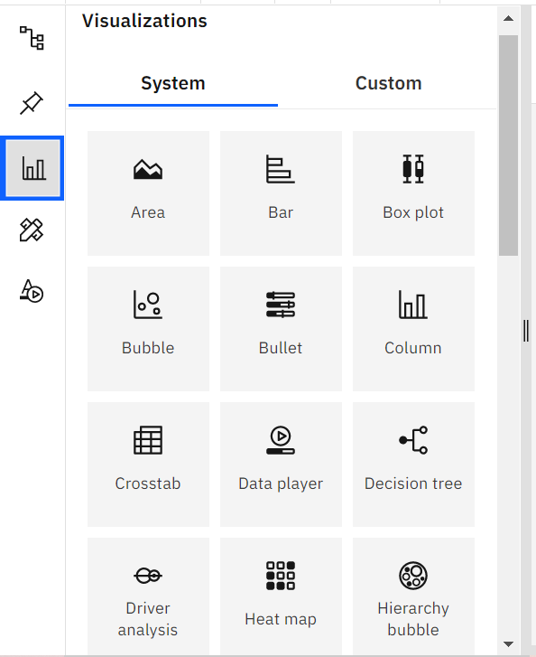
Data visualisation
Data visualization is where a given dataset is presented in a graphical format.
It helps the detection of patterns, trends and correlations that might go and detected in test based data.
Using the e commerce dataset we plan to create various graphs and charts to high light the insights and visualizations.
To visualize the dataset we need ibm cognos analytics dashboard.
This dashboard contains different visualization charts such as bar, area, bubble, column, pie, etc charts

Slide 8
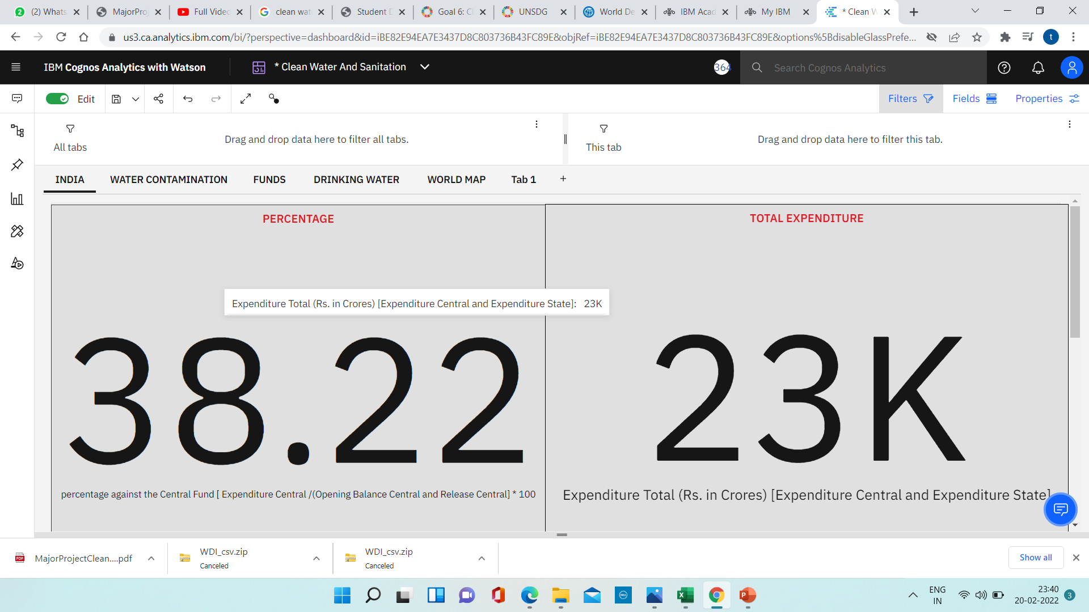
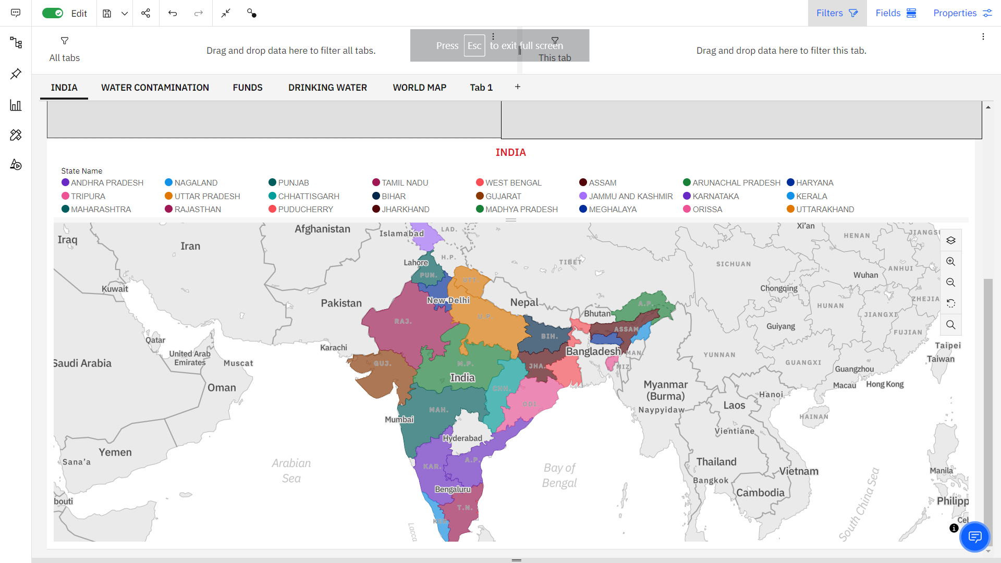
DATA VISUALISATION CHARTS

Slide 9
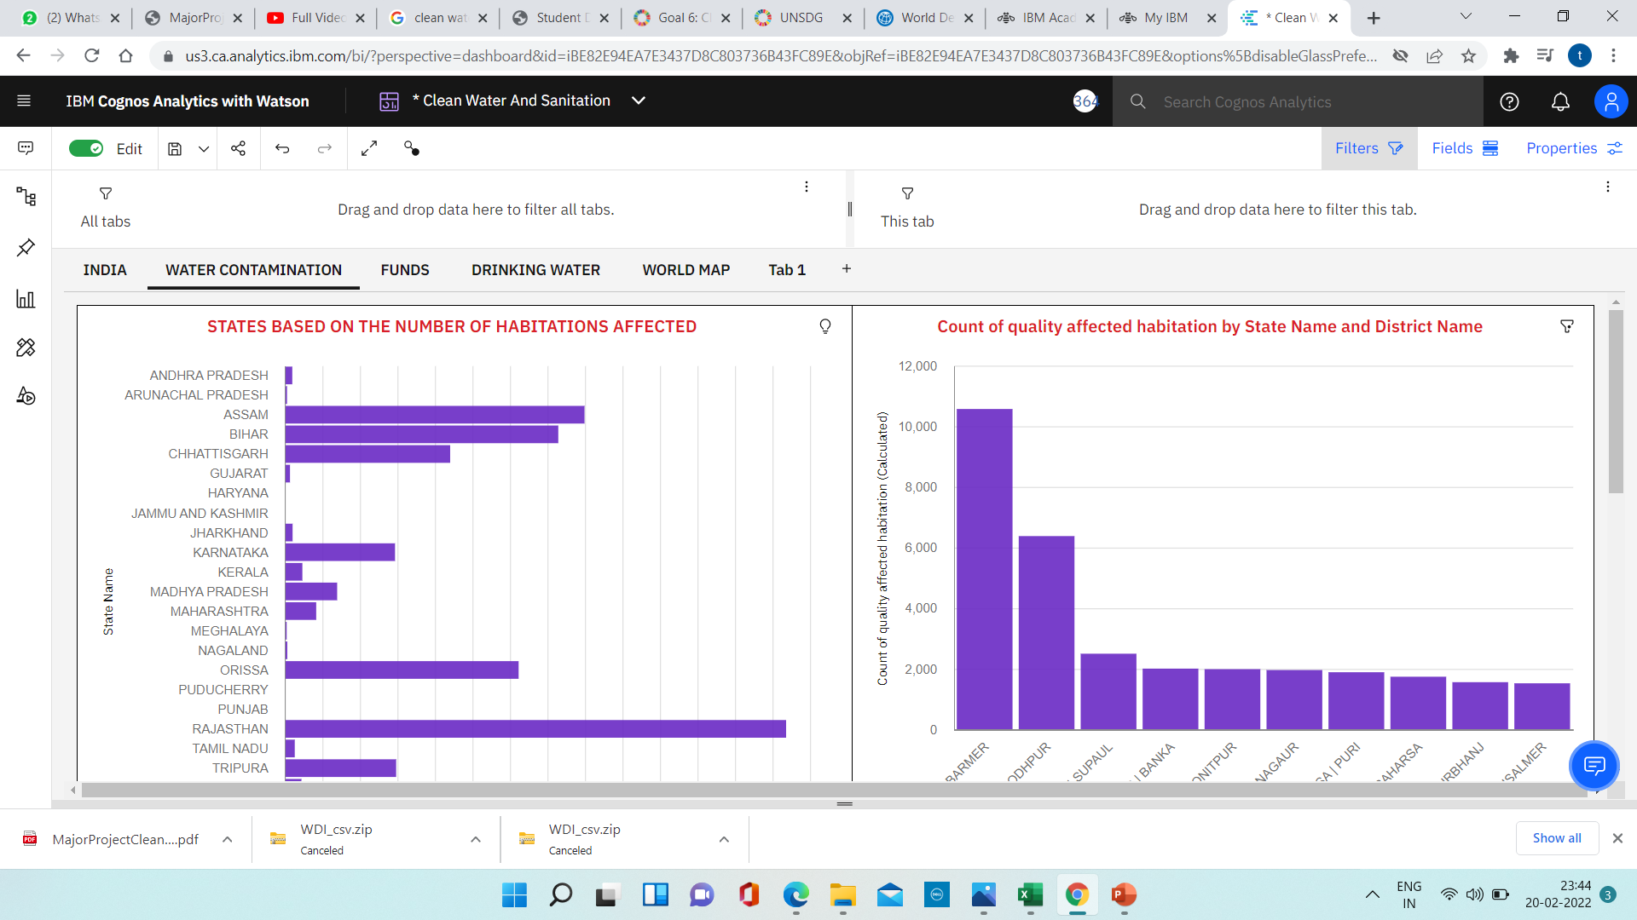
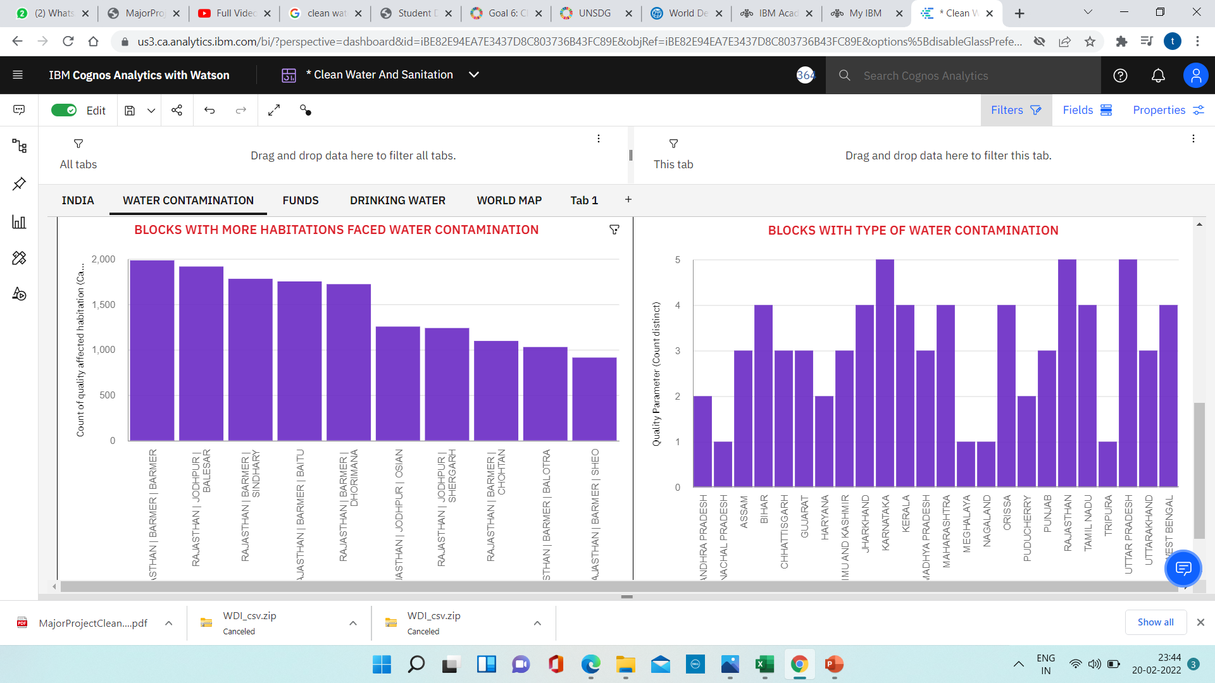
DATA VISUALISATION CHARTS

Slide 10
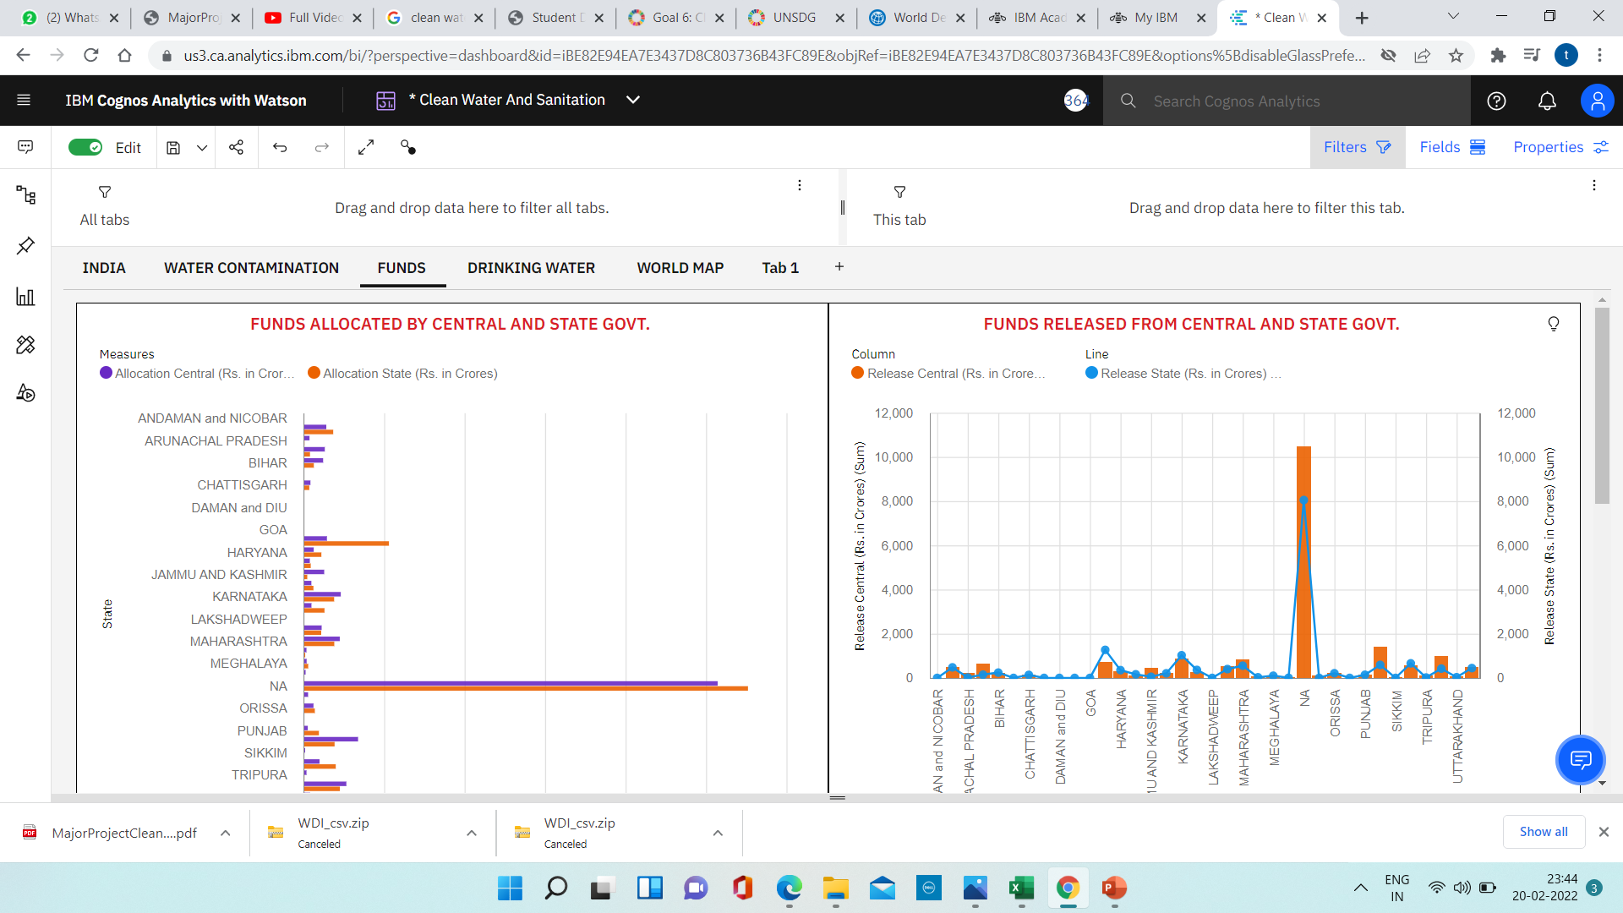
DATA VISUALISATION CHARTS

Slide 11
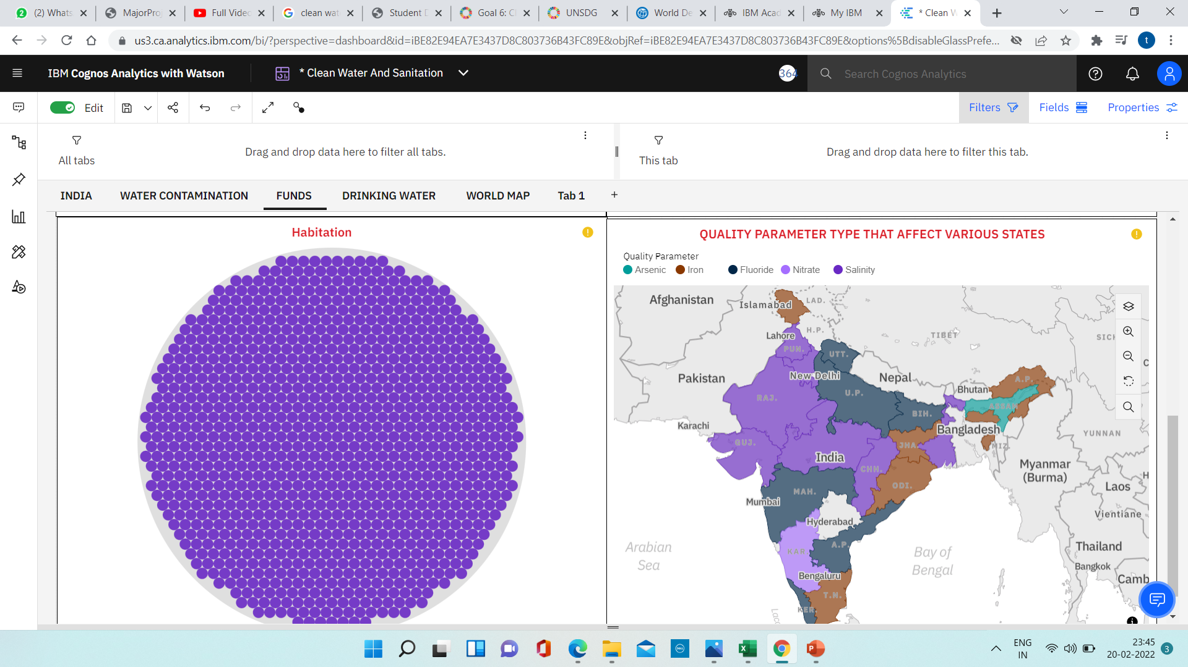
DATA VISUALISATION CHARTS

Slide 12
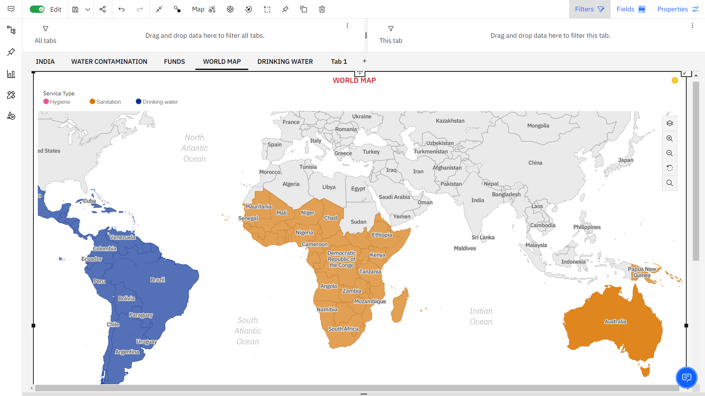
DASHBOARD CREATION

Slide 13
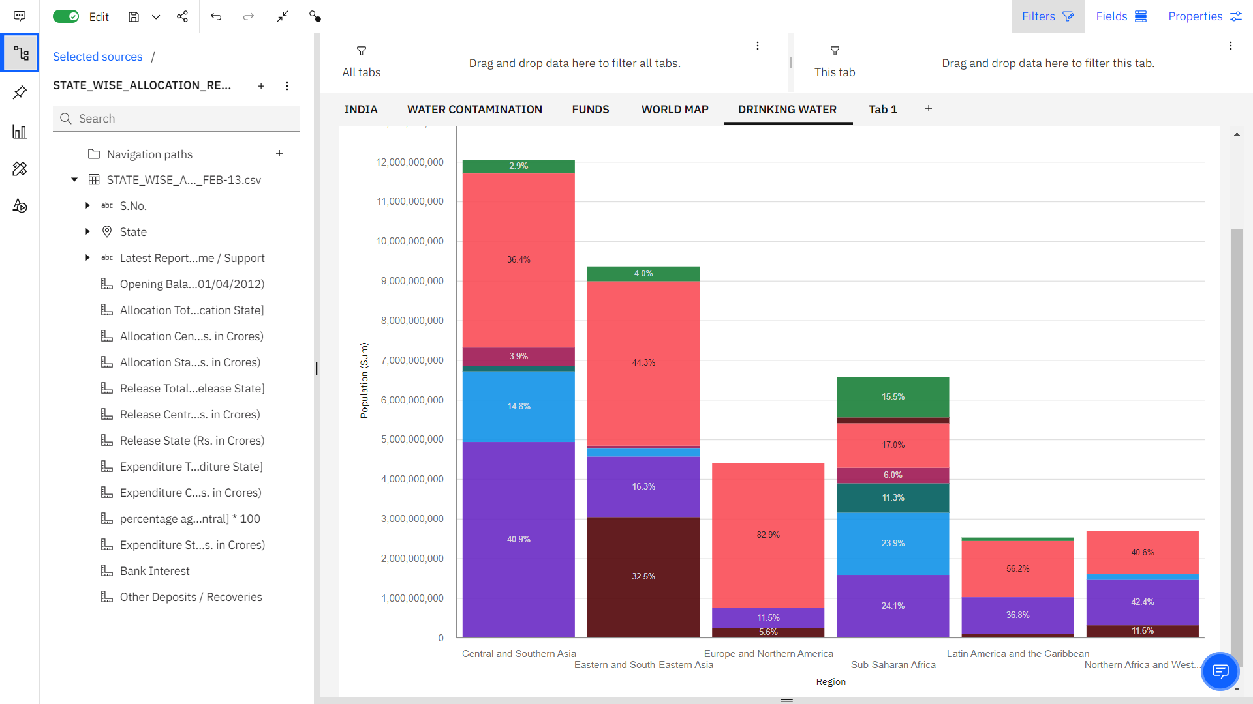
DASHBOARD CREATION

Slide 14
CONCLUSION
In this project we have presented that we will be analyzing some important visualizations, creating a dashboard and by going through these we will get most of the insights of E- commerce.
By the end of this project you will :
Know fundamental concepts and can work on IBM Cognos Analytics.
Gain a broad understanding of plotting different graphs.
Able to create meaningful dashboards

Slide 15


