Slide 1
Flight Delays Prediction Using Machine Learning
Presented by:
Team no: CSE-013
18UK1A0559- CHENNABOINA VARUN RAHUL
18UK1A0502- ALUGU SAIPRIYA
18UK1A0517- GIDDEMARI SHASHIKUMAR
18UK1A0571- DHARIPELLI PRAVEEN

Slide 2
OUTLINE
INTRODUCTION
OBJECTIVE
DATA
DATA VISUALISATION
VISUALIZATION OF GRAPHS
MACHINE LEARNING APPROACHES
SOFTWARE REQUIREMENTS
CONCLUSION

Slide 3
INTRODUCTION
Delay is one of the most remembered performance indicators of any transportation system. Notably, commercial aviation players understand delay as the period by which a flight is late or postponed. Thus, a delay may be represented by the difference between scheduled and real times of departure or arrival of a plane.. Country regulator authorities have a multitude of indicators related to tolerance thresholds for flight delays. Indeed, flight delay is an essential subject in the context of air transportation systems. In 2013, 36% of flights delayed by more than five minutes in Europe, 31.1% of flights delayed by more than 15 minutes in the United States, and 16.3% of flights were canceled or suffered delays greater than 30 minutes in Brazil [45, 5].This indicates how relevant this indicator is and how it affects no matter the scale of airline meshes.
Over the last twenty years, air travel has been increasingly preferred among travellers, mainly because of its speed and in some cases comfort. This has led to phenomenal growth in air traffic and on the ground.
These delays not only cause inconveniences to the airlines but also to the passengers. The result is an increase in travel time which increases the expenses associated with food and lodging and ultimately causes stress among passengers. The airlines are victims of extra costs associated to their crews, aircraft repositioning, fuel consumption while trying to reduce elapse times, and many others which together tamper their reputation and often result in a loss of demand by passengers.
The reasons for these delays vary a lot going from air congestion to weather conditions, mechanical problems, difficulties while boarding passengers, and simply the airlines inability to handle the demand given its capacity.

Slide 4
OBJECTIVE
By the end of this project:
You’ll able to understand the problem to classify if it is a regression or a classification kind of problem.
You will be able to know how to pre-process/clean the data using different data preprocessing techniques.
You will able to analyze or get insights into data through visualization.
Applying different algorithms according to the dataset and based on visualization.
You will be able to know how to build a web application using the Flask framework.

Slide 5
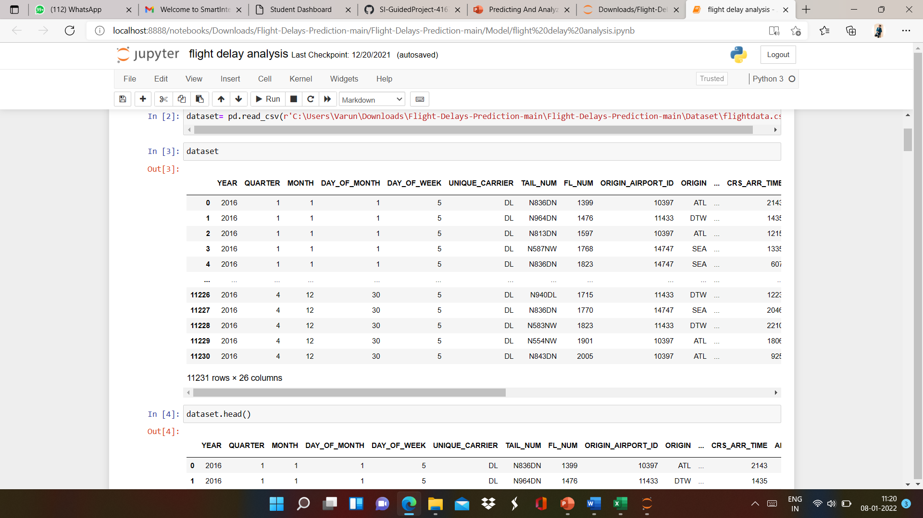
DATA
Flight delay Dataset for determining whether the flight is delay or not.
11231 rows with 26 columns
Fl_Num
Year
Month
Quarter
Day_of_Month
Day_of_Week
Origin
Tail_Num
Origin_Airport_ID
Crs_Arr_Time
Dep_Del15
Arr_Del15
Distance.

Slide 6
DATA VISUALISATION
Data visualization is where a given dataset is presented in a graphical format. It helps the detection of patterns, trends and correlations that might go undetected in text-based data. Understanding your data and the relationship present within it is just as important as any algorithm used to train your machine learning model. Machine learning models will perform poorly on data that wasn’t visualized and understood properly.
To visualize the dataset we need libraries called Matplotlib and Seaborn. The Matplotlib library is a Python 2D plotting library that allows you to generate plots, scatter plots, histograms, bar charts etc.

Slide 7
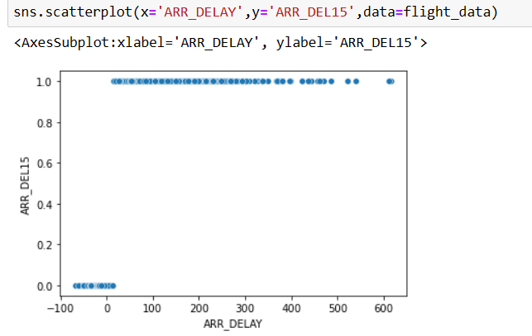
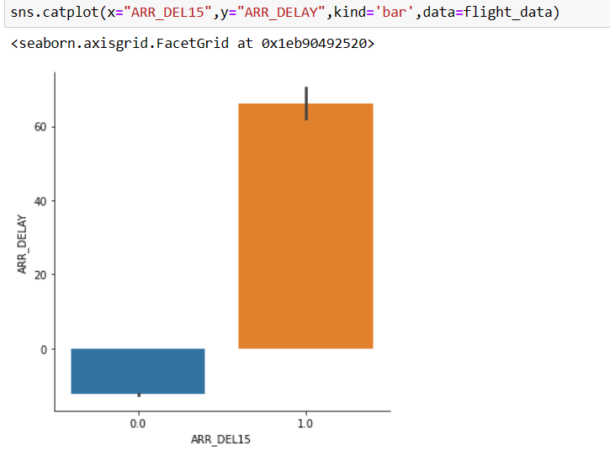
VISUALISATION OF GRAPHS
Scatter Plot between ARR_DELAY and ARR_DEL15
Cat plot between ARR_DELAY and ARR_DEL15

Slide 8
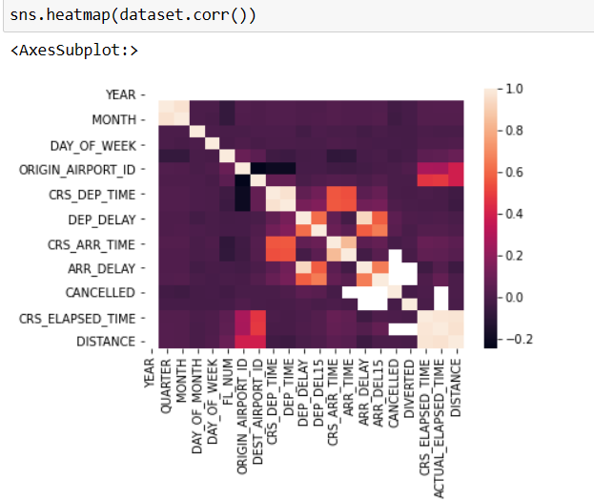
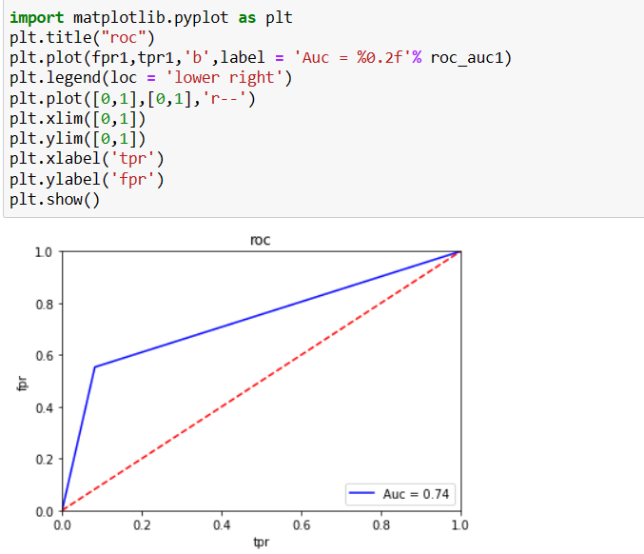
HeatMap finding the correlation between variables
ROC_AUC

Slide 9
MODEL BUILDING
There are several Machine learning algorithms to be used depending on the data you are going to process such as images, sound, text, and numerical values. The algorithms that you can choose according to the objective that you might have it may be Classification algorithms or Regression algorithms.
Example:
1.Linear Regression.
2. Logistic Regression.
3. Random Forest Regression / Classification.
4. Decision Tree Regression / Classification.
You will need to train the datasets to run smoothly and see an incremental improvement in the prediction flight delay.
On our Dataset , we have applied Decision Tree Regression ,KNN to predict the Accuracy.

Slide 10
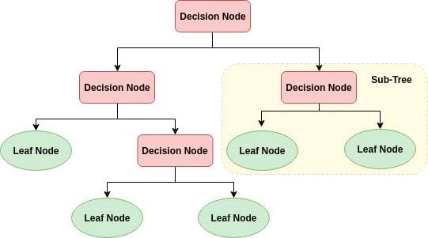
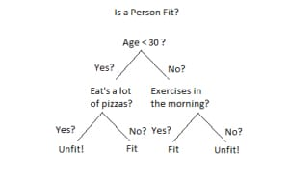
MACHINE LEARNING ALGORITMS
Decision Tree
A decision tree are type of Supervised Machine Learning (that is you explain what the input is and what the corresponding output is in the training data) where the data is continuously split according to a certain parameter. The tree can be explained by two entities, namely decision nodes and leaves. The leaves are the decisions or the final outcomes. And the decision nodes are where the data is split.
Decision trees are able to generate understandable rules.
Decision trees perform classification without requiring much computation.
Decision trees are able to handle both continuous and categorical variables.
Decision trees provide a clear indication of which fields are most important for prediction or classification.

Slide 11
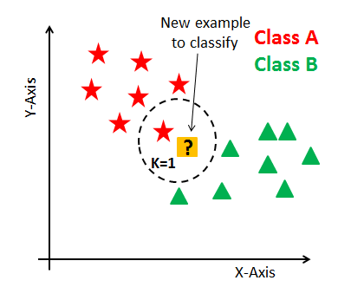
k-nearest neighbor algorithm:
It is a supervised machine learning algorithm. The algorithm can be used to solve both classification and regression problem statements. The number of nearest neighbor's to a new unknown variable that has to be predicted or classified is denoted by the symbol 'K'.
KNN algorithm at the training phase just stores the dataset and when it gets new data, then it classifies that data into a category that is much similar to the new data.
K-Nearest Neighbors (KNN) is one of the simplest algorithms used in Machine Learning for regression and classification problem. KNN algorithms use data and classify new data points based on similarity measures (e.g. distance function). The data is assigned to the class which has the nearest neighbors.

Slide 12
SOFTWARE REQUIREMENTS
Anaconda navigator
Jupyter notebook
Machine learning tools: pandas,
numpy,
matplotlib,
seaborn

Slide 13
CONCLUSION
In this project we have analyzed whether the flight is delay or not based on some input fields given by the person.
Prediction is done using Machine Learning Techniques.
For the better results we used Decision Tree Regression and proved with 86% accuracy.

