Slide 1
Machine Learning Approach For Predictive Maintenance Aircraft Engine Using IBM Watson Studio
PRESENTED BY:
TEAM NO:CSE-004
18UK1A0509 - SAI CHANDANA PALA
18UK1A0572 – KANCHA DINESH
18UK1A0508 – BOINAPALLY DEVIKA
18UK1A0548 – PUNNAM NAGAVARDHAN REDDY

Slide 2
OUTLINE
INTRODUCTION
OBJECTIVE
DATA
TEXT PREPROCESSING
MODEL BUILDING
SOFTWARE REQUIREMENTS
APPLICATION BUILDING
CONCLUSION

Slide 3
INTRODUCTION
Text Generation is a type of Language Modeling problem. Language Modeling is the core problem for a number of natural language processing tasks such as speech to text, conversational system, and text summarization. A trained language model learns the likelihood of occurrence of a word based on the previous sequence of words used in the text. Language models can be operated at character level, n-gram level, sentence level or even paragraph level. In this project, we are creating a language model for generating natural language text by implementing and training state-of-the-art Recurrent Neural Network.

Slide 4
OBJECTIVE
By the end of this project you will:
know fundamental concepts and techniques of natural language processing (NLP)
Gain a broad understanding of text data.
Knowhow to pre-process/clean the data using different data preprocessing techniques.
Know how to build a web application using the Flask framework.

Slide 5
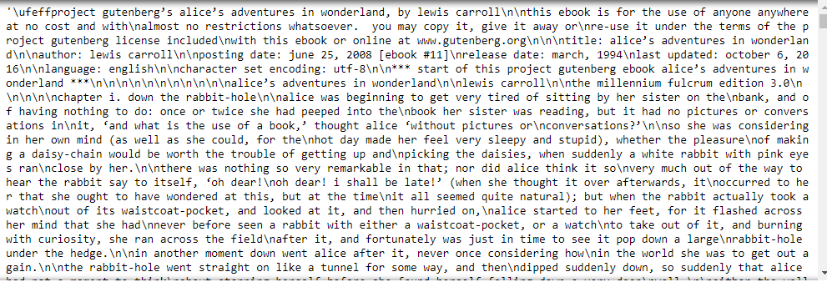
DATA
ML/AI depends heavily on data, without data, it is impossible for a machine to learn. It is the most crucial aspect that makes algorithm training possible. In Machine Learning projects, we need a training data set. It is the actual data set used to train the model for performing various actions.
In this project we have used a dataset named : wonderland.txt

Slide 6
TEXT PREPROCESSING
Text Pre-processing includes the following main tasks
Import the Libraries.
importing the dataset
Clean the data
Create a sliding window

Slide 7
MODEL BUILDING
Model Building Includes:
Importing The Model Building Libraries
Importing the necessary libraries
A great way to use deep learning to classify images is to build a Recurrent Neural Network (RNN). ... The Keras library in Python makes it pretty simple to build a RNN. Some of the libraries used in our project are NumPy, TensorFlow, etc..,
Initializing The Model
Keras has 2 ways to define a neural network:
Sequential
Function API
The Sequential class is used to define a linear initializations of network layers which then, collectively, constitute a model. In our example below, we will use the Sequential constructor to create a model, which will then have layers added to it using the add() method.

Slide 8
Adding LSTM Layers
The model is given an input of 100 character sequences and it outputs the respective probabilities with which a character can succeed the input sequence. The model consists of 3 hidden layers. The first two hidden layers consist of 256 LSTM cells, and the second layer is fully connected to the third layer. The number of neurons in the third layer is same as the number of unique characters in the training set.
return_sequences is True as we need to add another LSTM layer after the current one. input_shape corresponds to the number of time stamps and the number of indicators.
Dropout layer is used to deactivate 20% of the neurons to avoid over fitting and increase the accuracy .
Adding Output Layers
The dense layer is deeply connected neural network layer. It is most common and frequently used layer.
The number of neurons in the third layer is same as the number of unique characters in the training set. The neurons in the third layer, use softmax activation so as to convert their outputs into respective probabilities.
Configure The Learning Process
The compilation is the final step in creating a model. Once the compilation is done, we can move on to training phase.Loss function is used to find error or deviation in the learning process. Keras requires loss function during model compilation process.
Optimization is an important process which optimize the input weights by comparing the prediction and the loss function. Here we are using adam optimizer
Metrics is used to evaluate the performance of your model. It is similar to loss function, but not used in training process.

Slide 9
Train And Save The Model
Now, finally the model is build and then fitted for training.
Model Checkpoint callback is used in combination with training using model.fit() to save a model or weights (in a checkpoint file) at some interval, so the model or weights can be loaded later to continue the training from the state saved.
A few options this callback provides include:
Whether to only keep the model that has achieved the "best performance" so far, or whether to save the model at the end of every epoch regardless of performance.
Definition of 'best'; which quantity to monitor and whether it should be maximized or minimized.
The frequency it should save at. Currently, the callback supports saving at the end of every epoch, or after a fixed number of training batches.
Whether only weights are saved, or the whole model is saved.
The model is trained for 10 epochs and a batch size of 128 sequences has been used. After every epoch, the current model state is saved if the model has the least loss encountered till that time. We can see that the training loss decreases in almost every epoch till 10 epochs and probably there is further scope to improve the model.

Slide 10
Test The Model
The trained model can be used for different applications like generating texts as well as predicting the next word, .The best model with the least loss (as we obtained in the last epoch of training) is loaded and the model is built After taking the input, the characters are converted into indexes using char_to_int dictionary.
The initial 100 character seed used for generating text is the first few characters of the famous children book 'The Cat in the Hat' by Dr. Seuss.
Starting with the initial seed next 100 characters are generated by shifting the 100 character input window for generating the next character(Prediction).
Reshape the inputs and predict using model_predict predefined function. Then argmax function which is a predefined function in NumPy is used to return the indices of the characters and the indexes are converted into respective characters and the text is generated.

Slide 11
SOFTARE REQUIREMENTS
Anaconda navigator
Jupyter notebook
Machine learning tools: pandas,
numpy,
tensorflow

Slide 12
APPLICATION BUILDING
Now that we have trained our model, let us build our flask application which will be running in our local browser with a user interface.
In the flask application, the input parameters are taken from the HTML page These factors are then given to the model to predict the type of food and to know the nutrition content in it . In order to know the nutrition content we will be using an API in this project.
Create HTML Pages
Build python code
Task 1: Importing Libraries
Task 2: Creating our flask application and loading our model by using load_model method
Task 3: Routing to the html Page
Run the application.

Slide 13
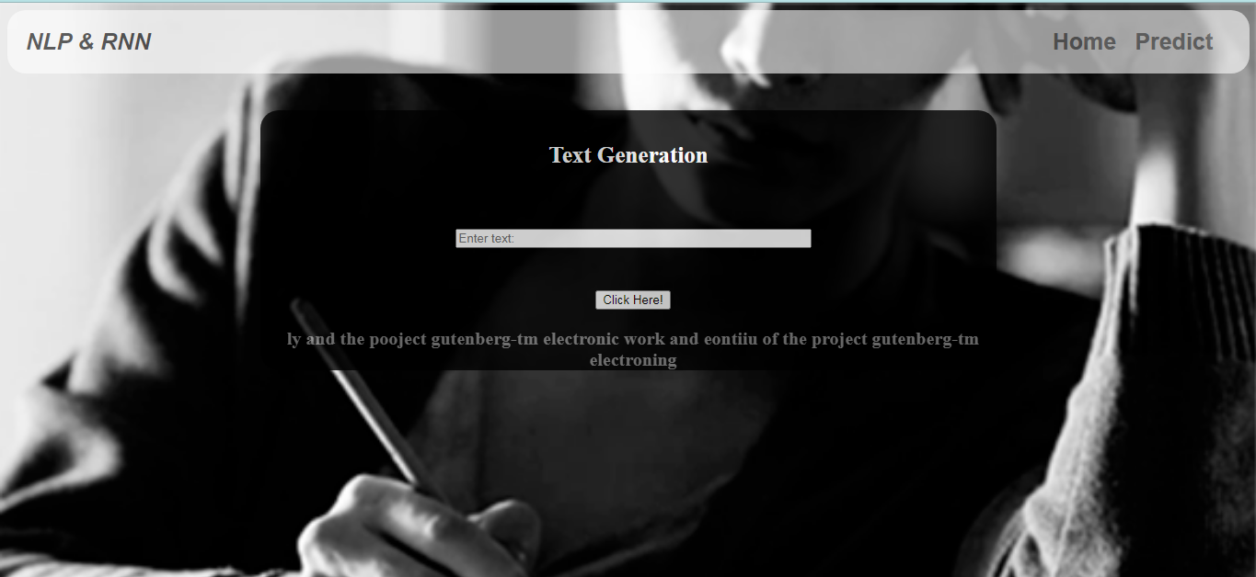
CONCLUSION
After running the application , we can see an USER INTERFACE where we can PREDICT THE TEXT.

Slide 14
THANK YOU

