Slide 1
Power Consumption Analysis for House holds
By: Sandeep, Vinay, Udith, Uber, Sai Kumar

Slide 2
What is Power Consumption Analysis?
As the name suggests, the analysis of power consumption is power consumption analysis.
It is very vital in this growing world to keep a tick on the usage of power and save the resources for future.

Slide 3
The Dataset
Given the rise of smart electricity meters and the wide adoption of electricity generation technology like solar panels, there is a wealth of electricity usage data available.
This data represents a multivariate time series of power-related variables, that in turn could be used to model and even forecast future electricity consumption

Slide 4
The data in dataset
Global_active_power: The total active power consumed by the household (kilowatts).
Global_reactive_power: The total reactive power consumed by the household (kilowatts).
Voltage: Average voltage (volts).
Global_intensity: Average current intensity (amps).
Sub_metering_1: Active energy for kitchen (watt-hours of active energy).
Sub_metering_2: Active energy for laundry (watt-hours of active energy).
Sub_metering_3: Active energy for climate control systems (watt-hours of active energy).

Slide 5
Problem Statement
Energy should be used in most productive way as possible, how ever it’s not the case in the world right now
There has been reckless wastage of power and managing it is mandatory for a better future.
After finding approx. global active power using this app the specific guidelines can be implemented.

Slide 6
Problem Solution
After finding the global active power , there can be many alterations made to the usage of power in specific places mainly considering the sub_metering values and hence saving power.

Slide 7
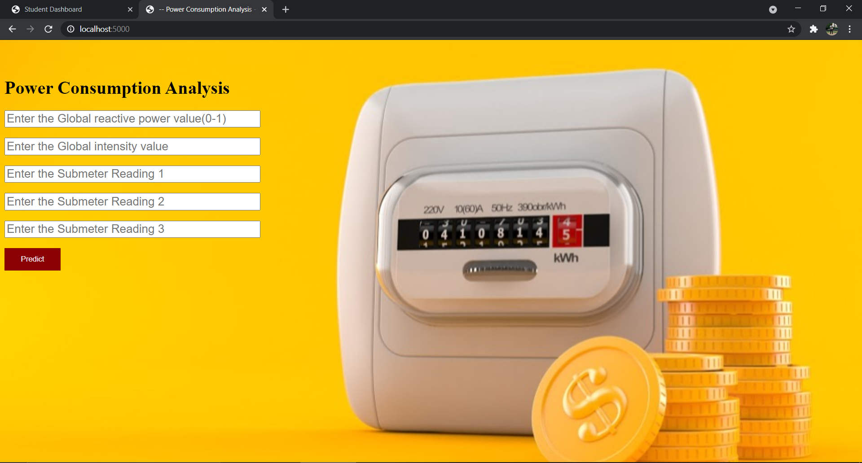
App on local host using flask:

Slide 8
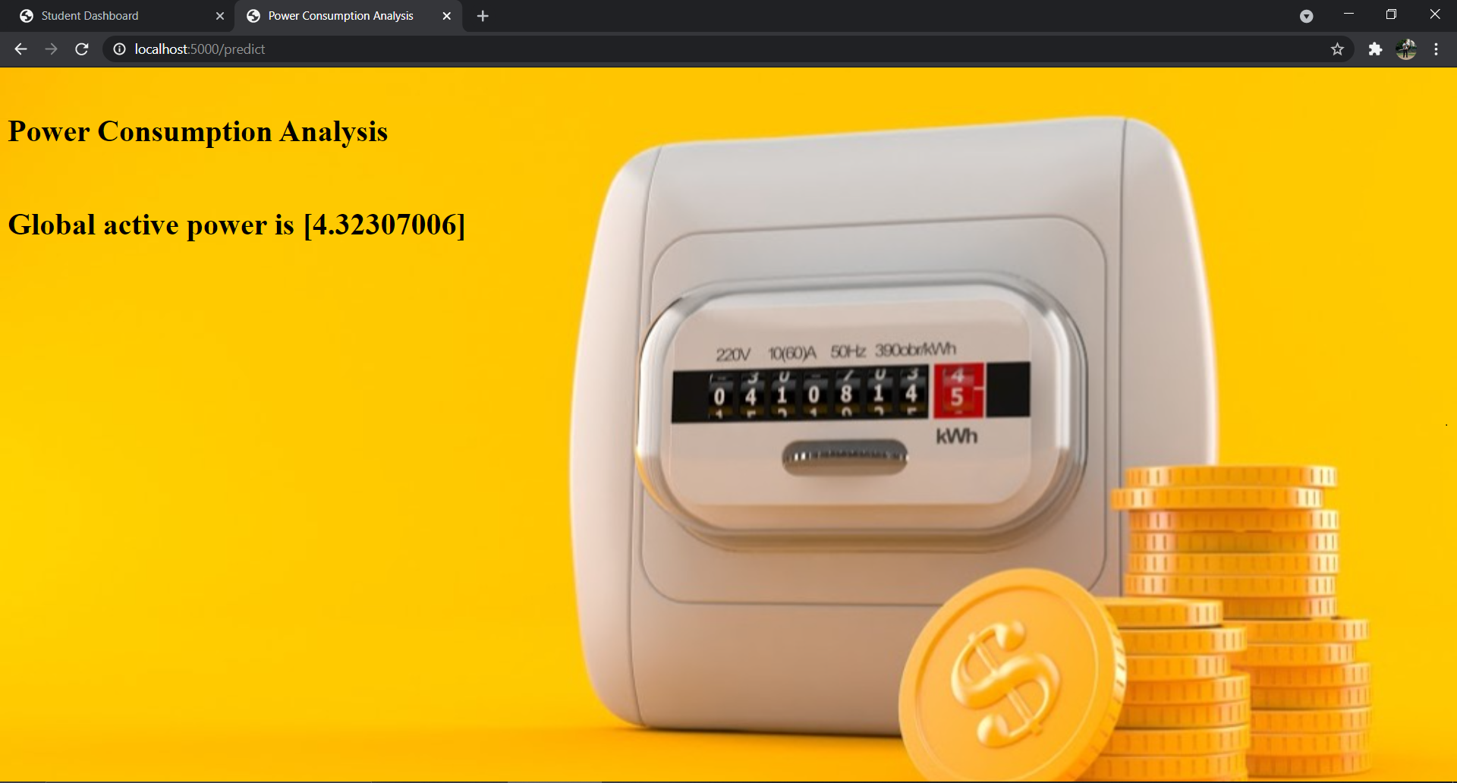
Output:

Slide 9
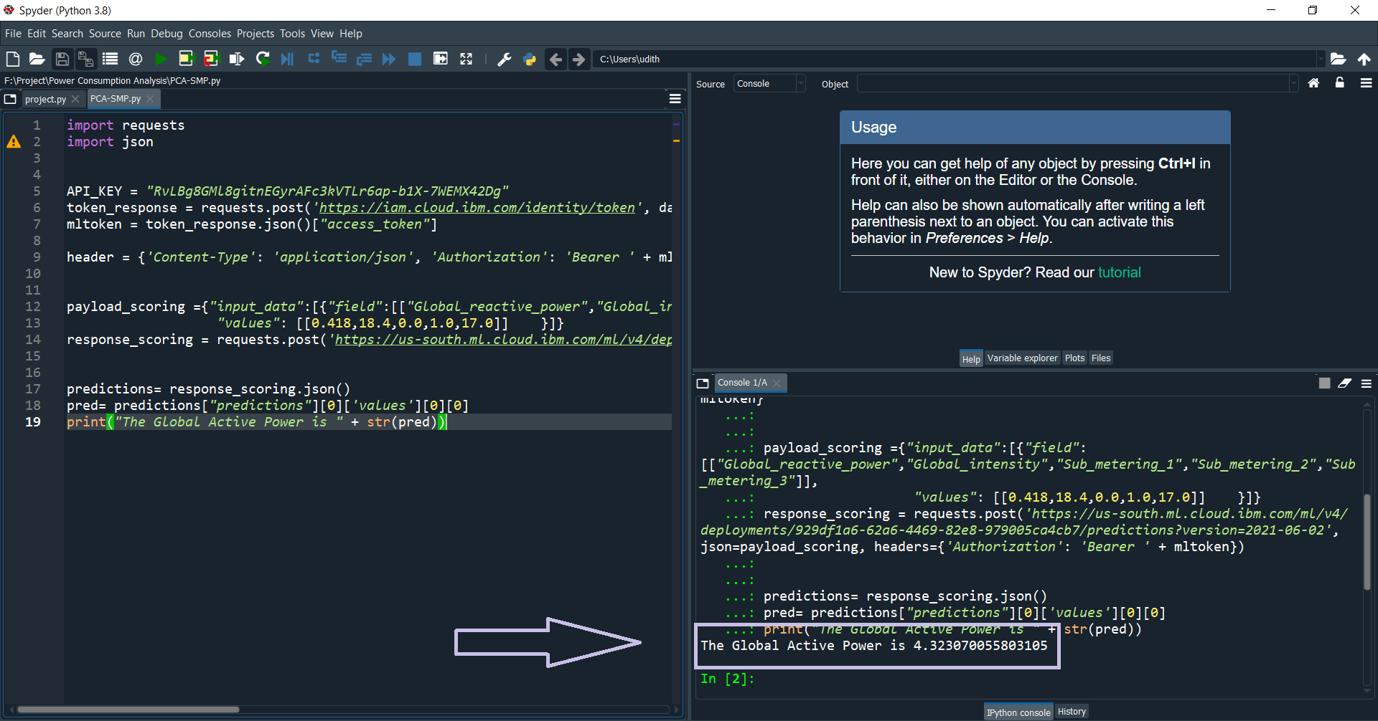
Output after integrating with IBM Watson Machine Learning Service

Slide 10

THANK YOU
Project by: EEE-03-
Sandeep -19R11A0230
Vinay -19R11A0232
Udith -19R11A0233
Uber -19R11A0240
Sai Kumar-19R11A0251

Slide 11
GitHub isn’t allowing to upload the files larger than 25MB ma’am/sir. So here is the drive link for our project demo video: https://drive.google.com/file/d/1xbiPhMiso8bD9PX6lqpC3esZsvvNjcDl/view?usp=sharing

