Slide 1

Machine learning project
Topic:- Natural gas price prediction
Project Supervisor :- Dr. D. Usha Nandhi. M.E., Ph.D.,
Name of the Student :- Mr.Avula Nanda Gopal.
Register Number :- 39110101.

Slide 2
Presentation Outline
Course Certificate
Introduction
Objectives and scope
System Architecture / Ideation Map
Methodology
Data visualization
Results and Discussions
Conclusion & Future work
References

Slide 3
Course Certificate
Acknowledgement :
Board of management of sathyabama
Hod of CSE department,
Dr.L.Lakshmanan, M.E.,Ph.D.,
Dr. T. Sasikala M.E., Ph.D
Dean
Dr. A. JESUDOSS, M.E., Ph.D.,

Slide 4
Introduction:-
This machine learning model helps us to predict the price of the gas in a given area.
Machine learning helps people to do more work as they learn to work like a human.
Machine learning is widely used in AI which is a dominant force in development.
This project uses machine learning algorithm for predicting the price of natural gas.
Forecasting natural gas prices is a powerful and essential tool which has become more important for different stakeholders in the natural gas market, allowing them to make better decisions for managing the potential risk, reducing the gap between the demand and supply, and optimizing the usage of resources based on accurate predictions.

Slide 5
Objectives and Scope
The project is about predicting the price of natural gas using machine learning.
We try to achieve a result above 90% score as they depict how good our machine is.
We try to achieve this by removing most of the null values in the data sheet.
Scope:-
The machine can predict from seven different cover types in four different wilderness areas. Therefore the result varies from 1 to 7.

Slide 6
Ideation Map
Collecting the data.
Analyzing the data and removing the null values.
Visualizing the analyzed data
Training the machine using train-split algorithm.
Predicting the value using natural gas price prediction.

Slide 7
Software Requirements
Software Requirements
• Operating System - Windows OS
• Coding Language - Python
• Tool - Jupyter Notebook
• Libraries - pandas, matplotlib

Slide 8
Methodology
Steps involved in this project :
Collection of data and analysing the data.
Accuracy of the model is important so removing of the null values is important, thus analyzing is important.
The analysed data is then used to train our model.
Using the train – test split algorithm to train our algorithm.
Using the trained model to predict the price of the gas.
Using the algorithm to predict the rate of natural gas the result.
Calculation of the accuracy value, which if higher than 90% tells us that our model work great.

Slide 9
This project uses,
Data sheet from the cognibot.
Inbuilt libraries in python like
Numpy
Matplotlib
Pandas
Inbuilt fuctions like
Seaborn
Random classifier
Train-test split
Classification report
Confusion
The inbuilt libraries are used to analyse the data i.e.
Numpy is used to work with arrays
Matplotlib is used to visualize the analysed data
Pandas helps us to retrieve data from data sheet into the mark-up

Slide 10
The inbuilt functions used in predicting the result i.e.
Sklearn_model_selection is used to run the test split algorithm which is used to analyse the data sheet which improves the accuracy of the model
sklearn_ensemble to use the random classifier algorithm which is used to predict the result
Sklearn_metrics is used to create the classification and confusion report which tells us how good our model performs

Slide 11
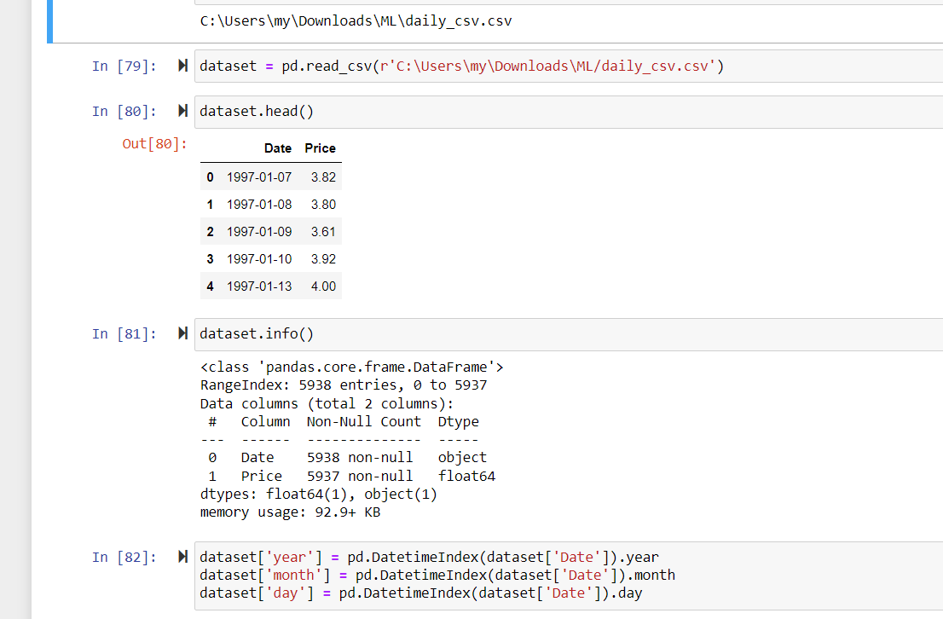
The machine learning model accuracy depends a lot on the data used so analysation of the data is important.
Once the null values are removed from the data sheet we use this data to train our data.

Slide 12
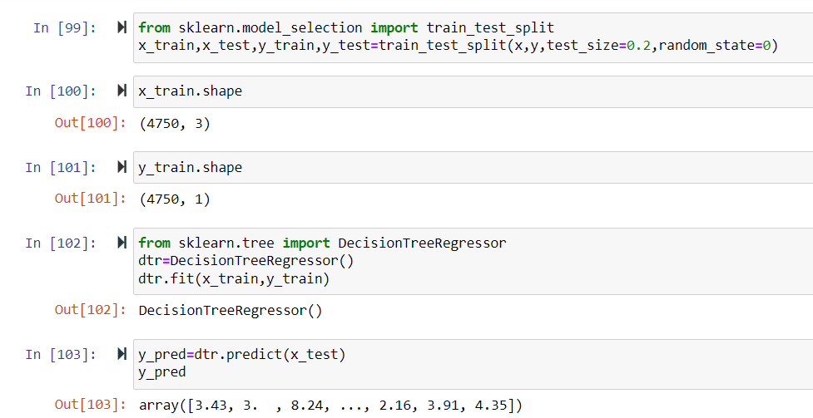
Training the machine :
We use the train test split algorithm to train the model with data.
This algorithm divides the data into 2 uneven parts.
The model is trained with the larger part of then it tries to predict the result using the remaining part of the data.
The model then trains itself from the second part of the data sheet reducing the work load on us.

Slide 13
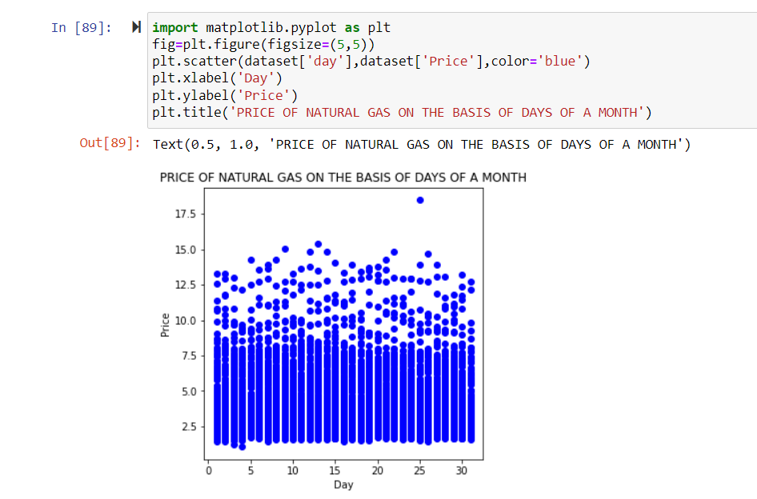
Data visualization:-

Slide 14
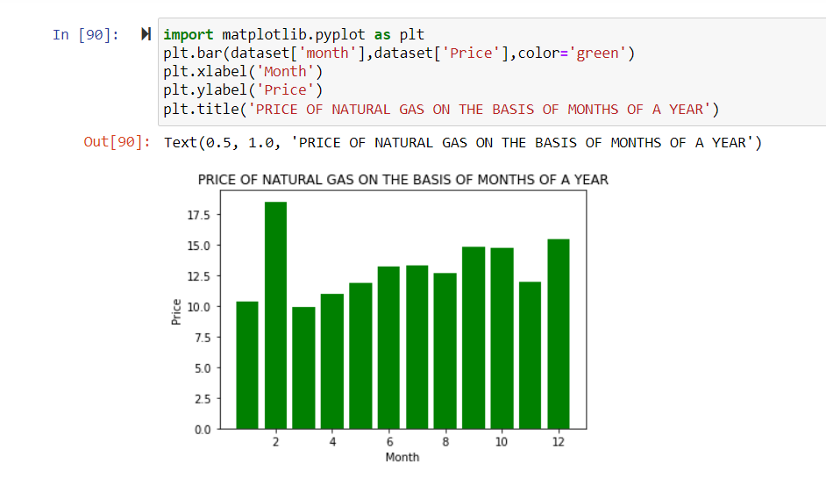

Slide 15
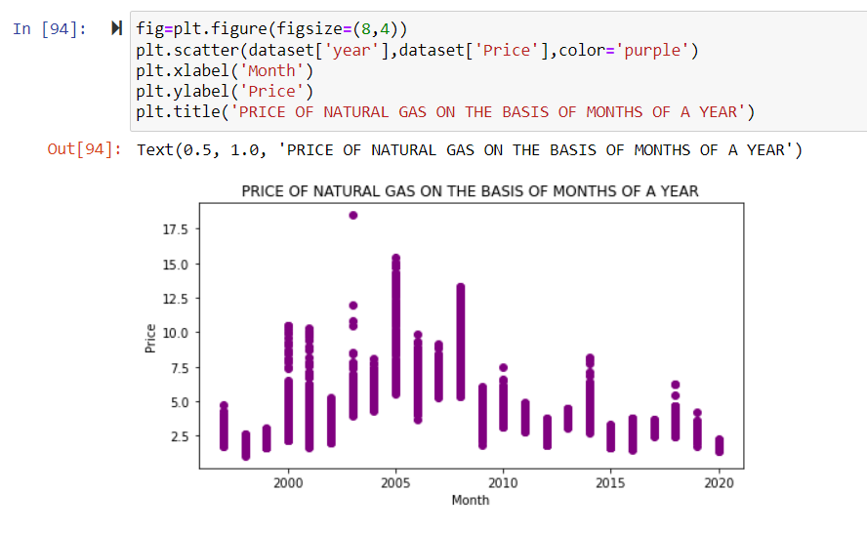
Hea

Slide 16
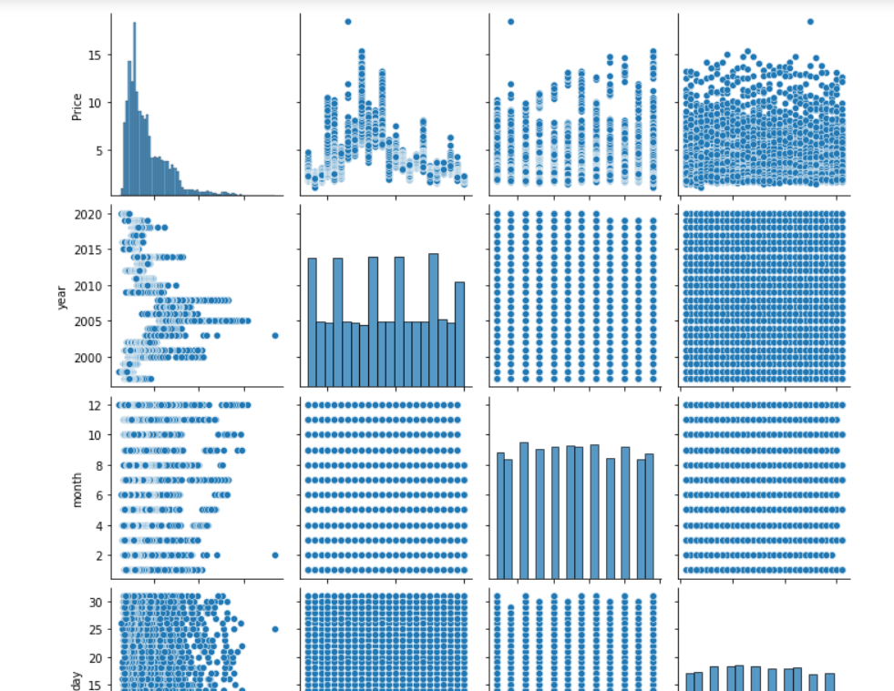
Box plot and bar plot

Slide 17
Results and Discussion
In our project we used predict() function of scikit-learn to predict our model taking X_test inside to predict() function and called it y_predict.
i.e. y_predict=predict(X_test)
For our sake we checked the length of our y_predict which gave us 1,45,253 which is equal to the length of X_test before training and predicting our model.
These predictions tell us how well our model performed and how well they predicted the final result.
Finally we can see that the model has an accuracy score of more than 97% which tells us that our model performs well with a training score of 1.
We further use precision, recall ,classification report, confusion matrix to see how good our model works after the prediction

Slide 18
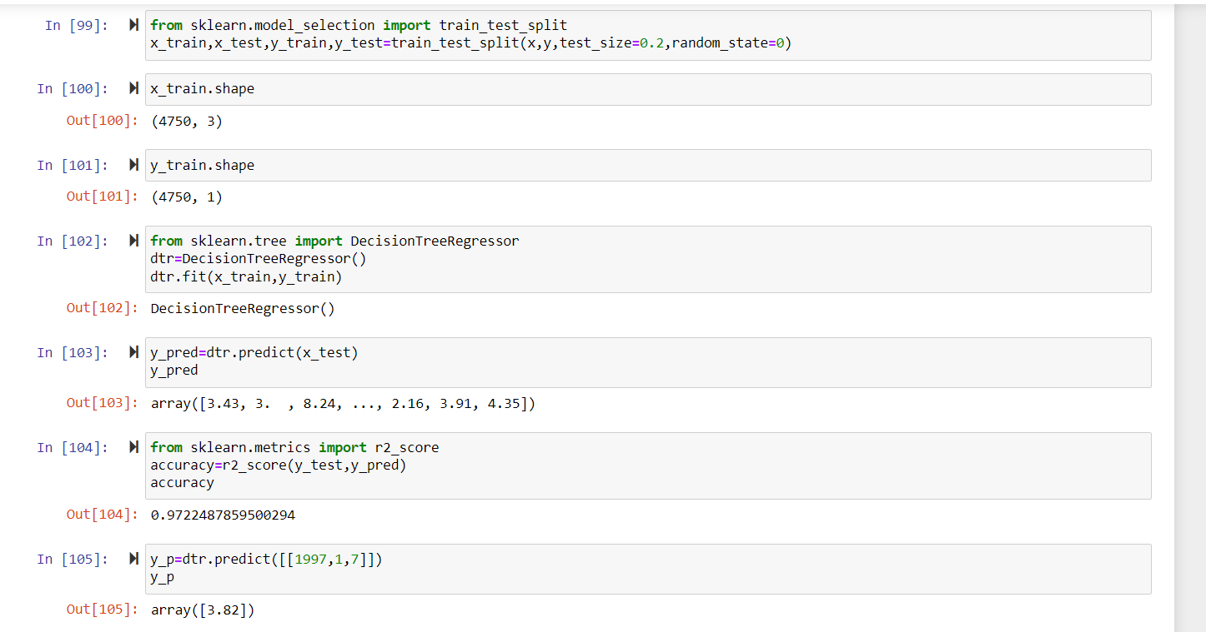
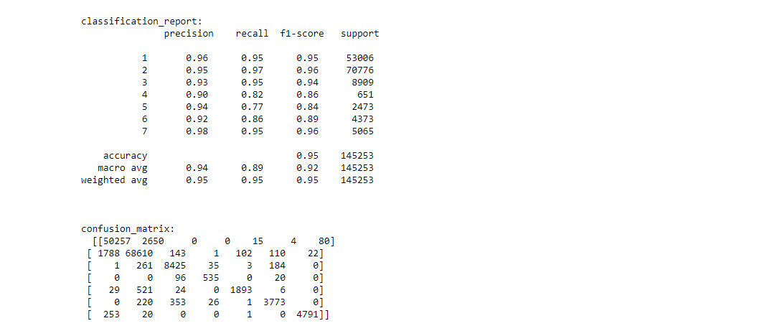
Results of the trained model

Slide 19
Conclusion
Our model was able to use the data properly and achieve a respectable result
As the accuracy score of the prediction is 97% we can say that the model works good and has achieved the goal we visualized
The accuracy of the model can be still improved if the data is more analysed which is out the scope as it requires much precision in collection of the data
The random classifier has an attribute named n-estimators which increases the accuracy when increased, but its tough to use as the model takes more time than usual

Slide 20
References
[1] D.A. Leatherman, Colorado State Forest Service entomologist (retired); 2/99. http://www.ext.colostate.edu/pubs/insect/05528.html Revised 9/11.
[2] Blackard, Jock A., Dean, Denis J. “Comparative accuracies of artifical neural networks and discriminant analysis in predicting foorest cover types from cartogrpahic variables”. Computers and Electronics in Agriculture (1999).
[3] Bache, K. Lichman, M. UCI Machine Learning Repository. Irvine, CA: University of California, School of Information and Computer Science (2013).
[4] Milgram, Jonathan, et al. “’One Against One’ or ’One Against All’: Which One is Better for Handwriting Recognition with SVMs?”HAL (2006)

