Slide 1
Liver Patient Analysis Using Machine Learning
SUBMITTED BY
V. ESWAR VENKATA NAGA SAI

Slide 2
Presentation Outline
Introduction
Objective
Data set
System Architecture / Ideation Map
Methodology & Project Implementation
Modules implementation
Algorithm
Results and Discussions
Conclusion
References

Slide 3
Introduction
Liver diseases averts the normal function of the liver. Mainly due to the large amount of alcohol consumption liver disease arises. Early prediction of liver disease using classification algorithms is an efficacious task that can help the doctors to diagnose the disease within a short duration of time.
Discovering the existence of liver disease at an early stage is a complex task for the doctors. The main objective of this project is to analyze the parameters of various classification algorithms and compare their predictive accuracies so as to find out the best classifier for determining the liver disease.
This project focuses on the related works of various authors on liver disease such that algorithms were implemented using Weak tool that is a machine learning software written in Java.

Slide 4
Various attributes that are essential in the prediction of liver disease were examined and the dataset of liver patients were also evaluated. This paper compares various classification algorithms such as Random Forest, Logistic Regression and Separation Algorithm with an aim to identify the best technique. Based on this study, Random Forest with the highest accuracy outperformed the other algorithms and can be further utilised in the prediction of liver disease recommended to the user.
Problem Statement:
Given a dataset containing various attributes of 584 Indian patients, use the features available in the dataset and define a supervised classification algorithm which can identify whether a person is suffering from liver disease or not. This data set contains 416 liver patient records and 167 non- liver patient records.The data set was collected from north east of Andhra Pradesh, India. This data set contains 441 male patient records and 142 female patient records. Any patient whose age exceeded 89 is listed as being of age "90".

Slide 5
Objective
Project Objective:
(1)Finding the problem to classify if it is a regression or a classification kind of problem.
(2)Able to know how to pre-process / clean the data using different data pre-processing techniques.
(3) To analyze or get insights of data through visualization.
(4)Applying different algorithms according to dataset and based on visualization.
(5) You will be able to know how to find the accuracy of the model.

Slide 6
(6) To build a web application using the Flask framework.
Scope of the Project:
This project focuses on the related works of various authors on liver disease such that algorithms were implemented using Jupyter that is a machine learning software written in Python. Various attributes that are essential in the prediction of liver disease were examined and the dataset of liver patients were also evaluated. This project compares various classification algorithms such as Random Forest, Support Vector Machine and KNN classification Algorithm with an aim to identify the best technique.

Slide 7
DATA SET
ML depends heavily on data, without data, a machine can't learn. It is the most crucial aspect that makes algorithm training possible. In Machine Learning projects, we need a training data set. It is the actual data set used to train the model for performing various actions.
Data were collected from the University of California Irvine Machine Learning Repository. The data set was included with laboratory reports of blood donors and non-blood donors with Hepatitis C and demographic information such as age and sex.

Slide 8
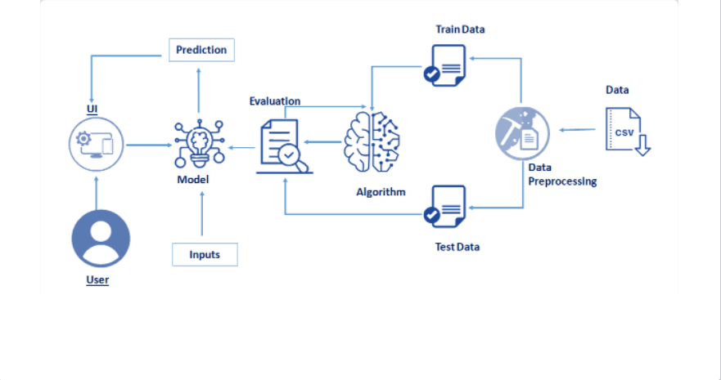
System Architecture / Ideation Map

Slide 9
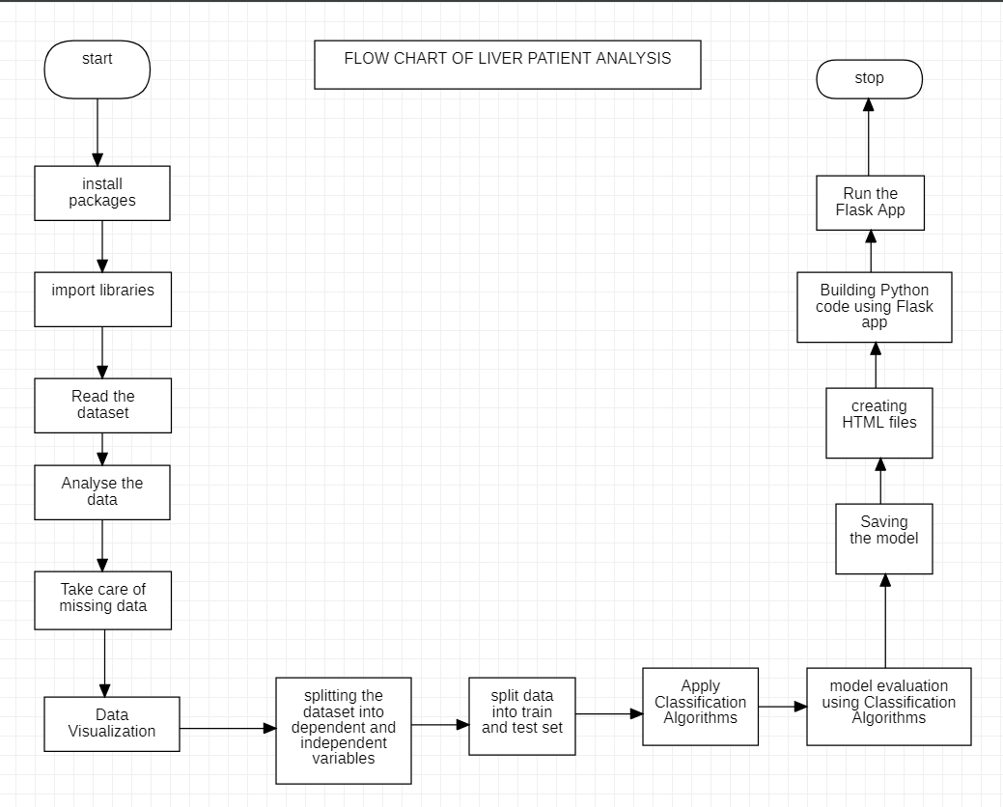
Methodology and Project Implementation

Slide 10
The methodology follows the best practices in the literature and in the industry, including different phases .
Packages Installation
Dataset Collection
Data Pre-Processing
Model Building
Application Building

Slide 11
Hardware and Software requirements
Software Requirements:
Jupyter Notebook - Project environment
Numpy – Used to convert 1D arrays to 2D arrays
Pandas – Convert dataset into data-frame
Matplotlib , Seaborn – Used to visualize the dataset
SkLearn module – To import all types ML algorithms
Hardware requirements:
A computer provided with good internet connection.
Any operating system

Slide 12
Module Implementation or Construction
Packages Installation
To build Machine learning models you must require the following packages NumPy: It is an open-source numerical Python library. It contains a multidimensional array and matrix data structures and can be used to perform mathematical operations
Scikit-learn:It is a free machine learning library for Python. It features various algorithms like support vector machine, random forests, and k-neighbours, and it also supports Python numerical and scientific libraries like NumPy and SciPy
Matplotlib and Seaborn: Matplotlib is mainly deployed for basic plotting. Visualization using Matplotlib generally consists of bars, pies, lines, scatter plots and so on. Seaborn: Seaborn, on the other hand, provides a variety of visualization patterns. It uses fewer syntax and has easily interesting default themes.
Pandas: It is a fast, powerful, flexible and easy to use open source data analysis and manipulation tool, built on top of the Python programming language. Pickle: The pickle module implements serialization protocol, which provides an ability to save and later load Python objects using special binary format.

Slide 13
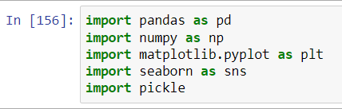
DATA-PREPROCESSING
Importing The Libraries
The first step is usually importing the libraries that will be
needed in the program.
The required libraries to be imported to Python script are:
Reading The Dataset
You might have your data in .csv files, .excel files or .tsv files or something else. But the goal is the same in all cases. If you want to analyse that data using pandas, the first step will be to read it into a data structure that’s compatible with pandas.
Let’s load a .csv data file into pandas. There is a function for it, called read_csv().We will need to locate the directory of the CSV file at first (it’s more efficient to keep the dataset in the same directory as your program).

Slide 14
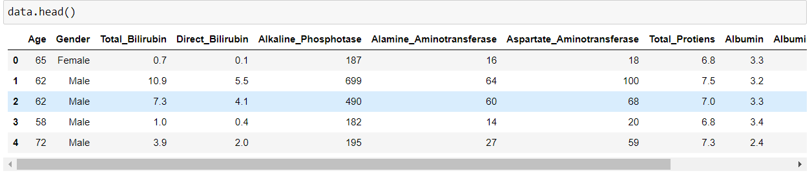
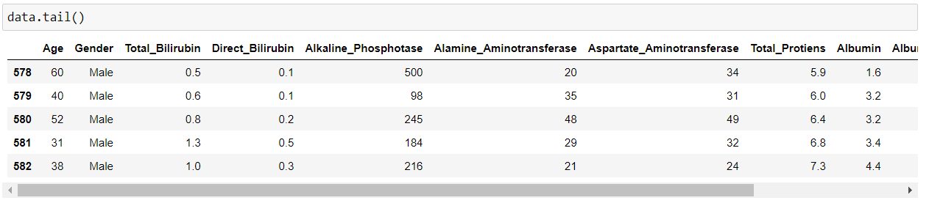
Exploratory Data Analysis
Exploratory data analysis is an approach to analyzing data sets to summarize their main characteristics, often with visual methods and used for determine how best to manipulate data sources to get the answers you need, making it easier for data scientists to discover patterns, spot anomalies, test a hypothesis, or check assumptions.
head() :To check the first five rows of the dataset, we have a function called head( ).
Tail(): To check the last five rows of the dataset, we have a function called tail().

Slide 15
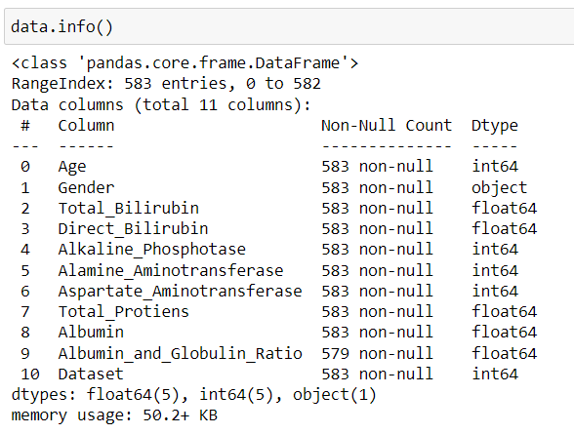
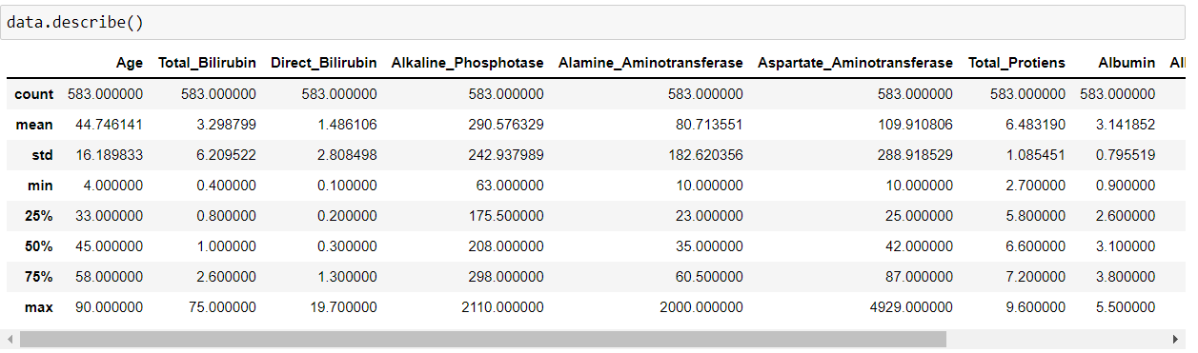
The information is stored in a DataFrame or Python object affects what we can do with it and the outputs of calculations as well. There are two main types of data those are numeric and text data types.
Numeric data types include integers and floats.
Text data type is known as Strings in Python, or Objects
in Pandas. Strings can contain numbers and / or characters.
or example, a string might be a word, a sentence,
or several sentences. Will see how our dataset is, by using the info() method.
describe(): functions are used to compute values like
count, mean, standard deviation and IQR and give a
summary of numeric type data.

Slide 16
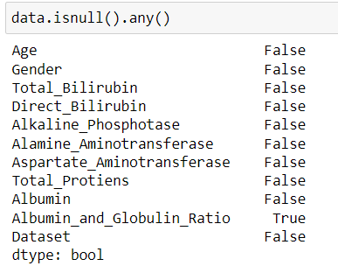
Checking For Null Values And Handling Null Values
1. After loading it is important to check the complete information of data as it can indication many of the hidden information such as null values in a column or a row
2.Check whether any null values are there or not. if it is present then following can be done,
a. Imputing data using Imputation method in sklearn
b. Filling NaN values with mean, median and mode using fillna() method.
We will be using isnull().any() method to see which column has missing values.
This isnull().any() method return two values, False and True.
False return that Column has No Null Values.
True return that Column has Null values.
We can see that there are null values in the
Albumin_and_Globulin_Ration Column.

Slide 17
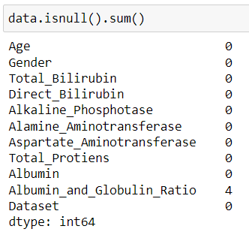
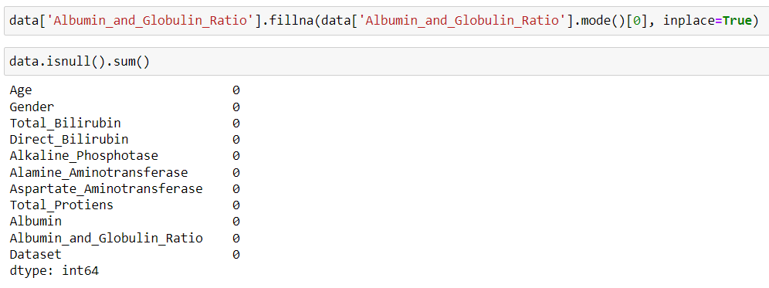
Let us check how many numbers of null records present in the Closing Value column using sum() function.
We can notice that, there are 4 null values are there in the column Albumin_and_Globulin_Ratio. Now will handle or fill that null values with the help of fillna() method.

Slide 18
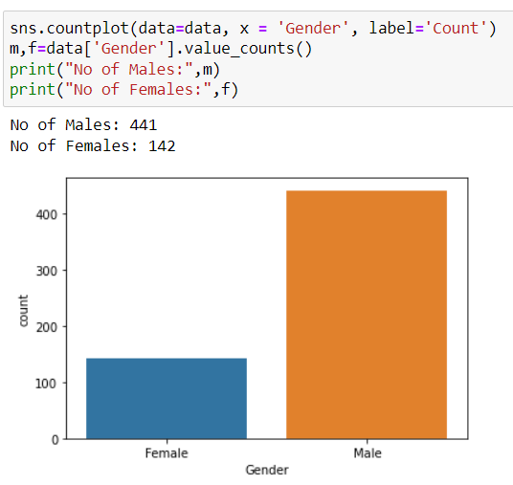
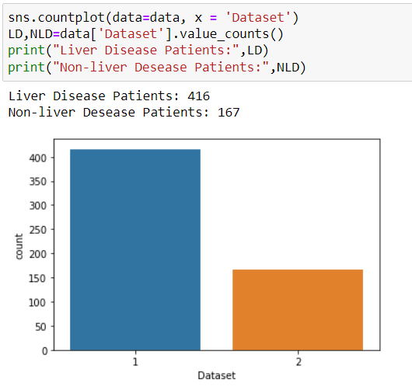
Data Visualization
Data visualization is where a given data set is presented in a graphical format. It helps the detection of patterns, trends and correlations that might go undetected in text-based data.
Understanding your data and the relationship present within it is just as important as any algorithm used to train your machine learning model. In fact, even the most sophisticated machine learning models will perform poorly on data that wasn’t visualized and understood properly.
To visualize the dataset we need libraries called Matplotlib and Seaborn.
The Matplotlib library is a Python 2D plotting library which allows you to generate plots, scatter plots, histograms, bar charts etc.
Let’s visualize our data using Matplotlib and seaborn library.
1. Bar plot between Gender and Count 2. Bar Plot which describe about the total number of disease.

Slide 19

Splitting The Dataset Into Dependent And Independent Variable
In machine learning, the concept of dependent variable (y) and independent variables(x) is important to understand. Here, Dependent variable is nothing but output in dataset and independent variable is all inputs in the dataset.
With this in mind, we need to split our dataset into the matrix of independent variables and the vector or dependent variable. Mathematically, Vector is defined as a matrix that has just one column.
To read the columns, we will use iloc of pandas (used to fix the indexes for selection) which takes two parameters — [row selection, column selection].
Let’s split our dataset into independent and dependent variables.
1. The independent variable in the dataset would be considered as 'x'.
2. The dependent variable in the dataset would be considered as 'y'.
Now we will split the data of independent variables.
In the above code we are creating array or list of the independent variable x with our selected columns and for dependent variable y we are only taking the dependent or output or target column.

Slide 20
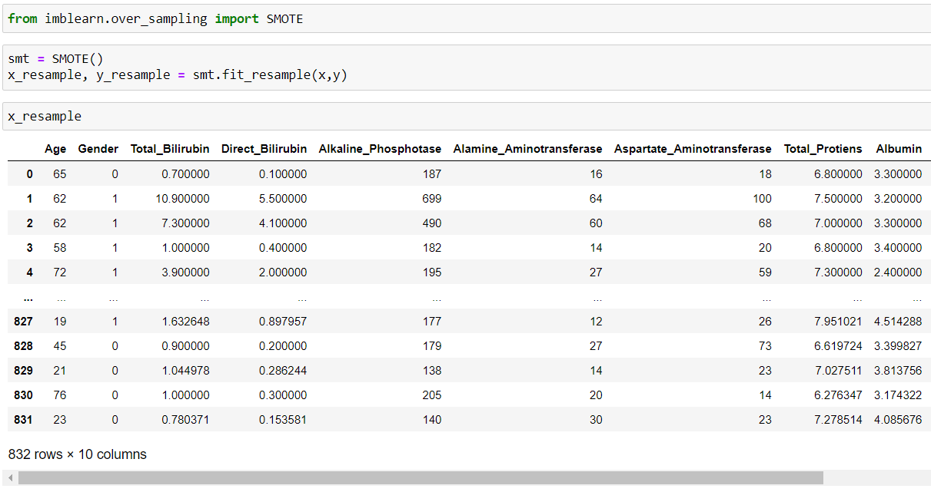
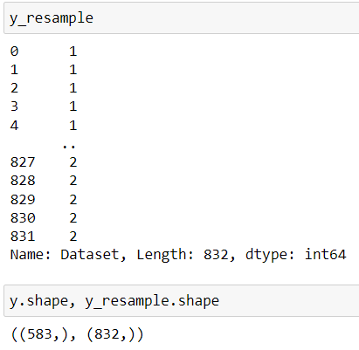
Due to misbalancing of data we import imblearn and use SMOTE to increase the accuracy.

Slide 21
Split The Dependent And Independent Features Into Train Set And Test Set
When you are working on a model and you want to train it, you obviously have a dataset. But after training, we have to test the model on some test dataset. For this, you will a dataset which is different from the training set you used earlier. But it might not always be possible to have so much data during the development phase. In such cases, the solution is to split the dataset into two sets, one for training and the other for testing.
But the question is, how do you split the data? You can’t possibly manually split the dataset into two sets. And you also have to make sure you split the data in a random manner. To help us with this task, the Scikit library provides a tool, called the Model Selection library. There is a class in the library which is, ‘train_test_split.’ Using this we can easily split the dataset into the training and the testing datasets in various proportions.
The train-test split is a technique for evaluating the performance of a machine learning algorithm.
Train Dataset: Used to fit the machine learning model.
Test Dataset: Used to evaluate the fit machine learning model.

Slide 22
Model Building
Predictive modeling is a mathematical approach to create a statistical model to forecast future behavior based on input test data.
Steps involved in predictive modeling:
Algorithm Selection:
When we have the structured dataset, and we want to estimate the continuous or categorical outcome then we use supervised machine learning methodologies like regression and classification techniques. When we have unstructured data and want to predict the clusters of items to which a particular input test sample belongs, we use unsupervised algorithms. An actual data scientist applies multiple algorithms to get a more accurate model.
Train Model:
After assigning the algorithm and getting the data handy, we train our model using the input data applying the preferred algorithm. It is an action to determine the correspondence between independent variables, and the prediction targets.
Model Prediction:
We make predictions by giving the input test data to the trained model. We measure the accuracy by using a cross-validation strategy or ROC curve which performs well to derive model output for test data.

Slide 23
Model building includes the following main tasks
Training and testing the model
Evaluation of Model
Save the model
Predicting the output using the model
Train And Test The Model Using Classification Algorithms
There are several Machine learning algorithms to be used depending on the data you are going to process such as images, sound, text, and numerical values. The algorithms that you can choose according to the objective that you might have may be Classification algorithms are Regression algorithms.
Now we apply classification algorithms on our dataset.
Support Vector Machine
Random Forest Classification.
3. KNN Classification

Slide 24


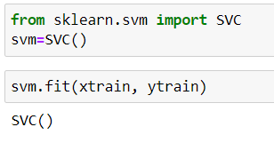
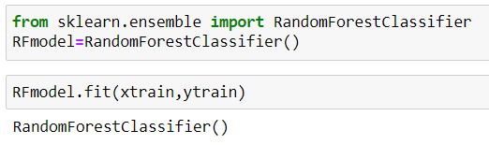
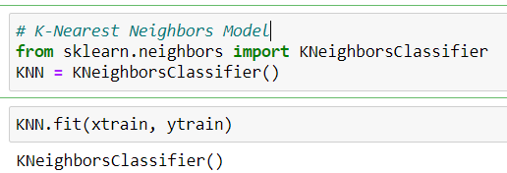
Build the model
We’re going to use x_train and y_train obtained above in train_test_split section to train our regression model. We’re using the fit method and passing the parameters as shown below.
Import the Classification algorithms
Initialize the model
3. Training model with our data.
SVC Model
Random Forest Model K-Nearest Neighbors Model

Slide 25
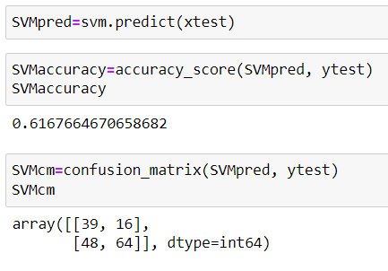
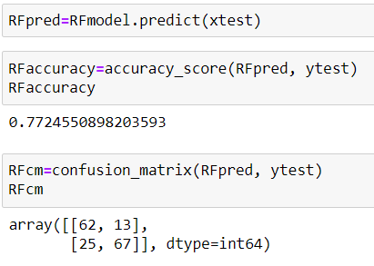
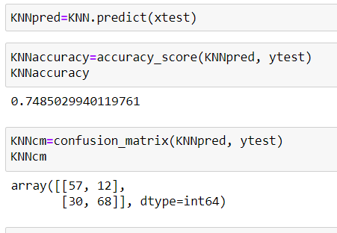
Model Evaluation
Finally, we need to check to see how well our model is performing on the test data.
Evaluation Metrics:
accuracy_score and confusion matrix of SVM is
accuracy_score and confusion matrix of random forest
Accuracy_score and confusion matrix of KNN
algorithm

Slide 26

As we can see that the accuracy_score of the Random Forest Algorithm is higher compare to KNN and SVM algorithms, we are proceeding with the Random Forest Model.
Save The Model
After building the model we have to save the model.
Pickle is used for serializing and de-serializing Python object structures, also called marshalling or flattening. Serialization refers to the process of converting an object in memory to a byte stream that can be stored on disk or sent over a network. Later on, this character stream can then be retrieved and de-serialized back to a Python object.
This is done by the below code
Here, RFmodel is our Random Forest Model Classification class, saving as liver_analysis1.pkl file. Wb is the write binary in bytes.

Slide 27
Application Building
Create An HTML File
We use HTML to create the front-end part of the webpage.
Here, we created 2 html pages- home.html, index.html.
home.html displays the home page.
index.html accepts the values from the user and displays the prediction.
Build Python Code
Let us build flask file ‘Liver_Flask_App.py’ which is a web framework written in python for server-side scripting.
Let’s see step by step procedure for building the backend application.
App starts running when “__name__” constructor is called in main.
render_template is used to return html file.
“GET” method is used to take input from the user.
“POST” method is used to display the output to the user.

Slide 28
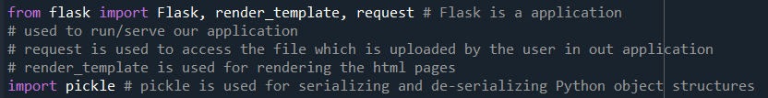

Importing Libraries
Libraries required for the app to run are to be imported. Creating our flask app and loading the model
Now after all the libraries are imported, we will be creating our flask app. and the load our model into our flask app.
Routing to the html Page:
@app.route is used to route the application where it should route to.
‘/’ URL is bound with the home.html function. Hence, when the home page of the web server is opened in the browser, the html page is rendered. Whenever you enter the values from the html page the values can be retrieved using POST Method.
Here, “home.html” is rendered when the home button is clicked on the UI and “index.html” is rendered when the predict button is clicked.

Slide 29
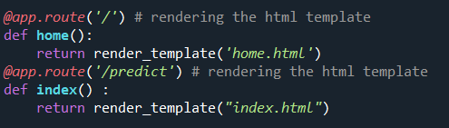
Firstly, we are rendering the home.html template and from there we are navigating to our prediction page that is upload.html. We enter input values here and these values are sent to the loaded model and the resultant output is displayed on index.html.
Run The App
Run the application from anaconda prompt
Open new anaconda prompt from the start menu
Navigate to the folder where your python script is.
Now type “python app.py” command
It will show the local host where your app is running on http://127.0.0.1.5000/
Copy that local host URL and open that URL in the browser. It does navigate me to where you can view your web page.
Enter the values, click on the predict button and see the result/prediction on the web page.

Slide 30
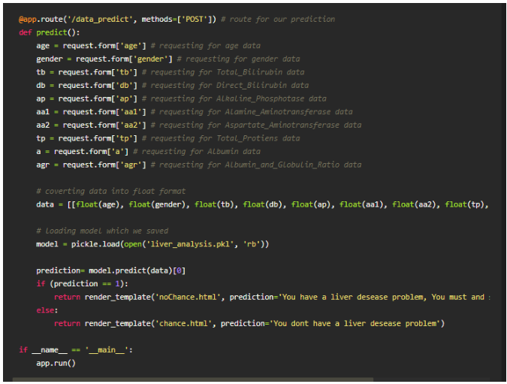

Slide 31
Algorithms used in this project
Since this is a classification problem with binary response, the method we attempt to try includes Support Vector Machine, neural network, random Forest and k-nearest neighbors algorithms.
Support Vector Machine:
Support Vector Machine (SVM) is a supervised machine learning algorithm which can be used for both classification or regression challenges. However, it is mostly used in classification problems. Support Vectors are simply the co-ordinates of individual observation. The goal of a support vector machine is not only to draw hyperplanes and divide data points, but to draw the hyperplane the separates data points with the largest margin, or with the most space between the dividing line and any given data point.

Slide 32
Random Forest:
The classification method we will try here is random forest. This method is good for prediction but a little bit difficult to interpret.
Since we are facing the binary category, Random Forest is a good classification method to try.
Random Forest will grow a big tree without trimming, then, take majority vote of the results of all the trees.
The process of this method is:
Take a sample of size n from the training dataset.
Randomly choose p variables from all the variables available.
Train a single big tree on the sample dataset and using p variables.
Repeat the step above B times.
Take a majority vote of the results for all of the B trees.

Slide 33

K-NN:
Regular linear regression makes assumptions about the structure of the data (high bias), but its predictions are stable (low variance). We need a more flexible model that makes fewer assumptions.
In contrast to linear regression methods, the k-nearest neighbor methods implement non-linear boundaries to our training and test data.
The k-NN method uses the average outcome value of its k nearest neighbors based on Euclidian distance.

Slide 34
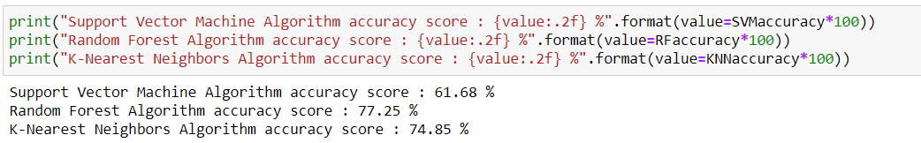
Measurement and Analysis
One of the first desires that probably comes to mind is efficiency. When building your app,you want to be able to reach as many people as you can. You also want to reach them on a consistent basis in a way that doesn’t involve you spending all your time sending emails to everyone.
This method is much more implemented day by day and used in daily life.
It will reduce the potential for errors.
Interpretation of Results

Slide 35
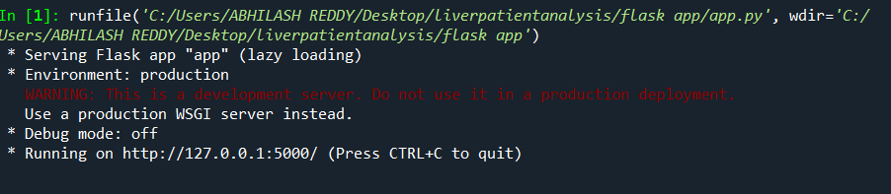
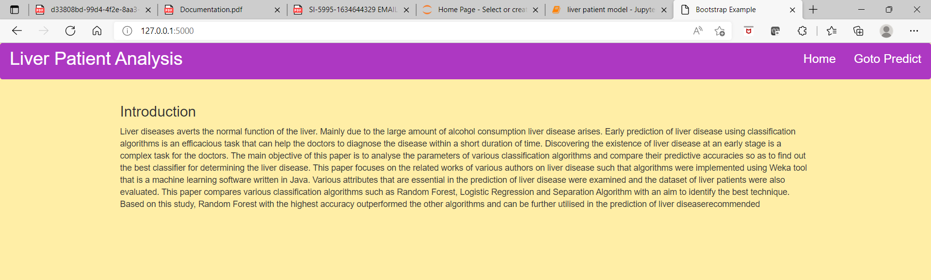
Results and Discussion
After running the flask app the output will be
http://127.0.0.1:5000/ copy this and paste this local browser and click enter.
This is our home page where we get to know the summary of the project

Slide 36
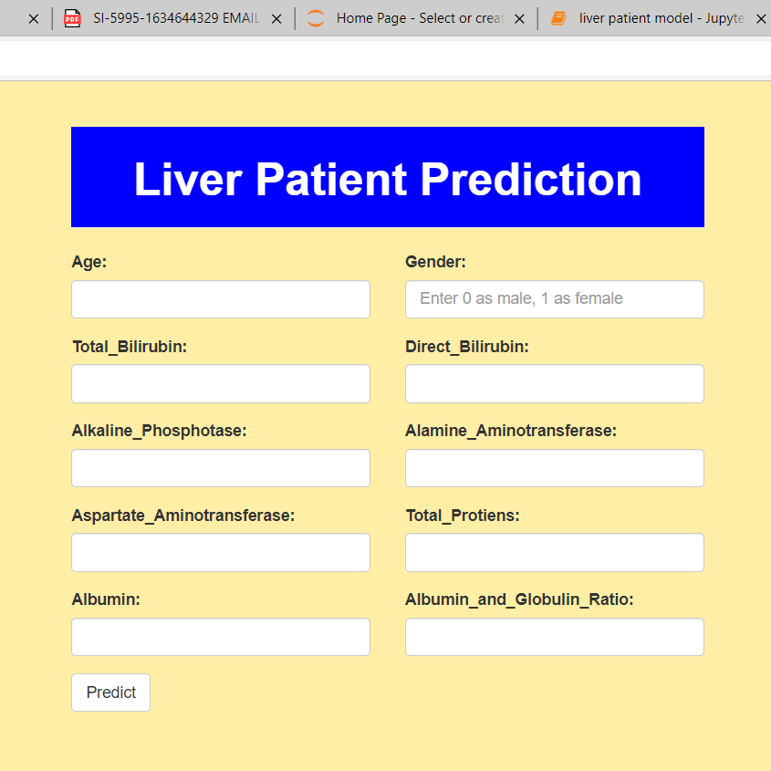
Prediction Page:

Slide 37
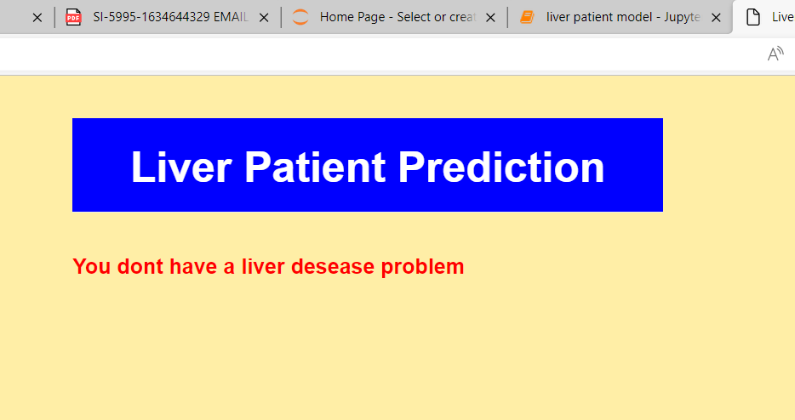
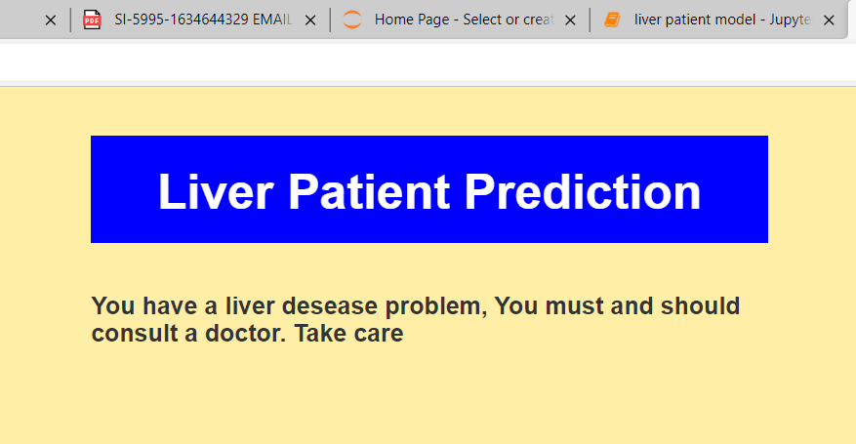
As we see the predicted output is displayed on the User Interface

Slide 38
This project focuses on the related works of various authors on liver disease such that algorithms were implemented using 654ewsw7 that is a machine learning software written in Python. Various attributes that are essential in the prediction of liver disease were examined and the dataset of liver patients were also evaluated. This project compares various classification algorithms such as Random Forest, Support Vector Machine and KNN classification Algorithm with an aim to identify the best technique.
Based on this study, Random Forest with the highest accuracy outperformed the other algorithms and can be further utilised in the prediction of liver disease recommended to the user.

Slide 39
Conclusion
Prompt and timely detection of liver disease prediction plays a vital role in increasing life span of patient. In this paper, an attempt is made to detect the presence of liver disease using Support vector machine, Random Forest , K-NN classification methods of Machine Learning.
Liver disease is detected by clinicians who are well trained in identifying significant observations and classifying them as normal or abnormal using background information and other context clues. ML algorithms can be trained to detect the possibility of liver disease in a similar way to assist healthcare workers. Using the correlation of each variable with the risk of liver disease to train the model, ML methods were able to identify which blood donors were healthy and which had liver disease with high accuracy.

Slide 40
The machine learning algorithms presented in this study can support medical experts but are not the alternative when making decisions from ML classifiers for diagnostic pathways. These methods can reduce many of the limitations that occur in healthcare associated with inaccuracy in diagnoses, missing data, cost, and time. Application of the ML methods can help reduce the total burden of liver disease on public health worldwide by improving recognition of risk factors and diagnostic variables.
More importantly, for chronic liver disease, detecting liver disease at earlier stages or in hidden cases by ML could decrease liver-related mortality, transplants, and/or hospitalizations. Early detection improves prognosis, since treatment can be given before progression of the disease to later stages. Invasive tests, such as biopsy, would occur less in this case as well. Although this study focused on hepatitis and chronic liver disease variables for ML training, it can be hypothesized that the methods can be used to distinguish other types of liver disease from healthy individuals. Applying all of the mentioned methods to other areas of medicine could open the doors for AI/ML facilitated diagnosis.

Slide 41
References
[1] | W. Raghupathi, V. Raghupathi, Big data analytics in healthcare: promise and potential, Health information science and systems (2014), 2-3.
[2] | Charleonnan, T. Fufaung, T. Niyomwong, W Chokchueypattanakit, Suwannawach, N. Ninchawee “Predictive Analytics for Chronic Kidney Disease Using Machine Learning Techniques” MITiCON2016.
[3] | Pianykh, O.S.; Guitron, S.; Parke, D.; Zhang, C.; Pandharipande, P.; Brink, J.; Rosenthal, D. Improving healthcare operations management with machine learning. Nat. Mach. Intell. 2020, 2, 266–273.
[4] | J. Kang, T. Lee, I. Yap, K. Lun, Analysis of cost-effectiveness of different strategies for hepatocellular carcinoma screening in hepatitis B virus carriers. Journal of gastroenterology and hepatology 7(1992),463- 468.

Slide 42
THANK YOU

