Slide 1

SMS SPAM DETECTION
Project Supervisor: Mrs.N.S.USHA, B.E,M.E,(Ph.D) CSE
NAME : Mulgapaka Ashish
REG NO : 39110650
SEC : B5
BRANCH : BE-CSE

Slide 2
Presentation Outline
Course Certificate
Introduction
Objectives
Ideation Map
Module Implementation
Application Snapshots
Results and Conclusion
References

Slide 3
Course Certificate

Slide 4
Introduction
Today, internet and social media have become the fastest and easiest ways to get information. In this age, reviews, opinions, feedbacks, messages and recommendations have become significant source of information.
Thanks to advancement in technologies, we are now able to extract meaningful information from such data using various Natural Language Processing (NLP) techniques.
NLP , a branch of Artificial Intelligence (AI), makes use of computers and human natural language to output valuable information.
NLP is commonly used in text classification task such as spam detection and sentiment analysis, text generation, language translations and document classification.

Slide 5
Objectives
Knowledge on Machine Learning Algorithms.
Knowledge on Python Language with Machine Learning
Knowledge on Statistics and Graphs and their relations
Knowledge on Natural Language Processing (NLP).
Real Time Analysis of Project
Building an ease of User Interface (UI)
Navigation of ideas towards other projects(creativeness)
Knowledge on building ML Model..
You will be able to know how to find the accuracy of the model.
How to Build web applications using the Flask framework.

Slide 6
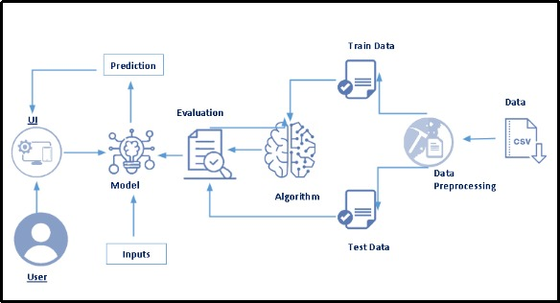
IDEATION MAP

Slide 7
Module Implementation
Load/Create a dataset.
Clean the dataset.
Train and test the model using Multinomial Naïve Bayes.
Model Evaluation.
Saving the model.
Building a Flask application.

Slide 8

Application Snapshots

Slide 9
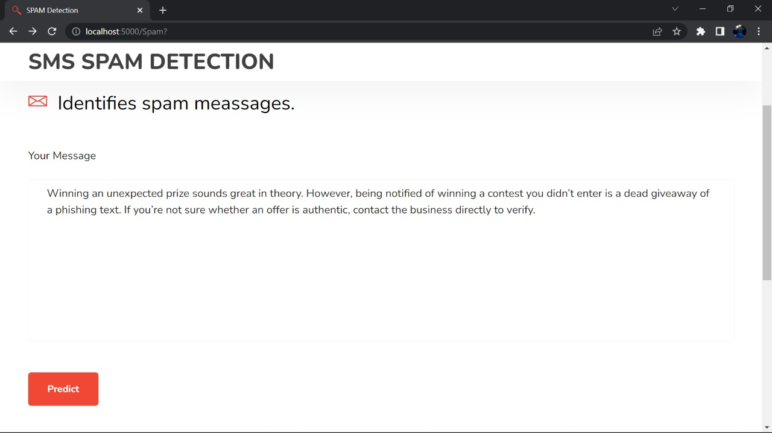

Slide 10
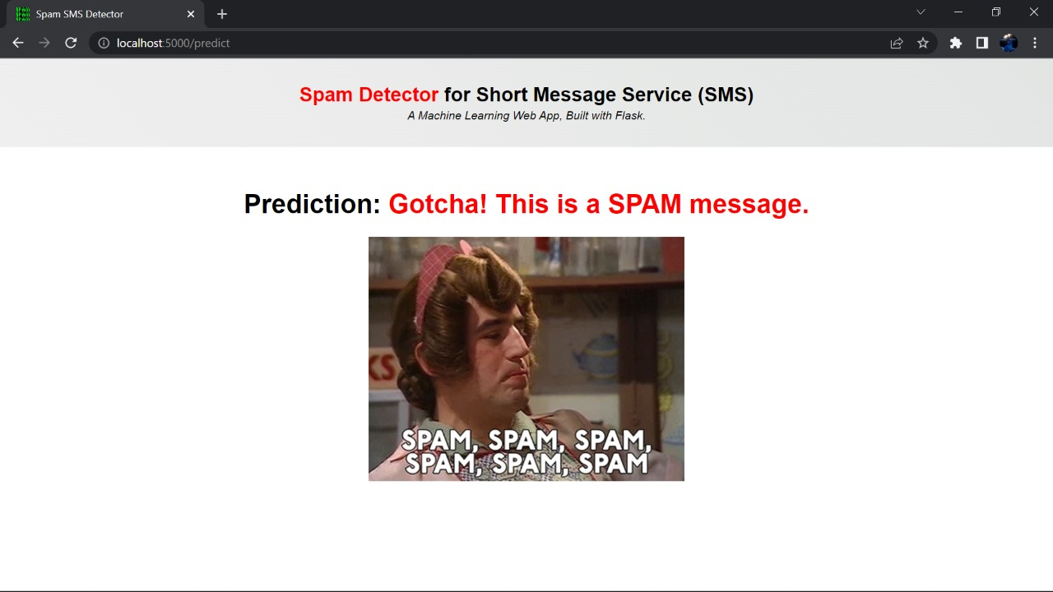

Slide 11
Results and Conclusion
Spam SMS is one of the major issues in wireless communication world and it grows day by day.
Spam messages include advertisements, free services, promotions, awards, etc.
To tackle this problem it is needful to use a smarter technique which correctly identifies Spam SMS.
Natural language processing technique is useful for Spam SMS identification.
It analyses text content and find patterns which are used to identify Spam and Non-Spam SMS.

Slide 12
REFERENCE
Naïve Bayes - https://scikit-learn.org/stable/modules/naive_bayes.html
Flask - https://flask.palletsprojects.com/en/2.1.x/
Bootstrap - https://getbootstrap.com/docs/4.1/getting-started/introduction/
HTML, CSS, JS - https://developer.mozilla.org/en-US/

