Slide 1

Emerging Methods For Early Detection Of Forest Fires Using IBM Watson
BY:
B. Anusha (19481A0529)​ B. Bhuvana sri (19481A0532)​ G. Naveen Kumar (19481A0562)​ G. Bhavana (19481A0522)​

Slide 2
Abstract:
Forest fires are a major environmental issue, creating economic and ecological damage while endangering human lives. There are typically about 100,000 wildfires in the United States every year. Over 9 million acres of land have been destroyed due to treacherous wildfires. It is difficult to predict and detect Forest Fire in a sparsely populated forest area and it is more difficult if the prediction is done using ground-based methods like a Camera or Video-Based approach. The goal of the project is to develop a forest fire detection system that can identify forest fires in their early phases using image processing and convolution neural networks(CNN).

Slide 3
Objectives
To Classify images using a Convolutional Neural Network.
The user interacts with a web camera to read the video.
Once the input image from the video frame is sent to the model, if the fire is detected it is showcased on the console and an alert message will be sent to the Authorities.

Slide 4
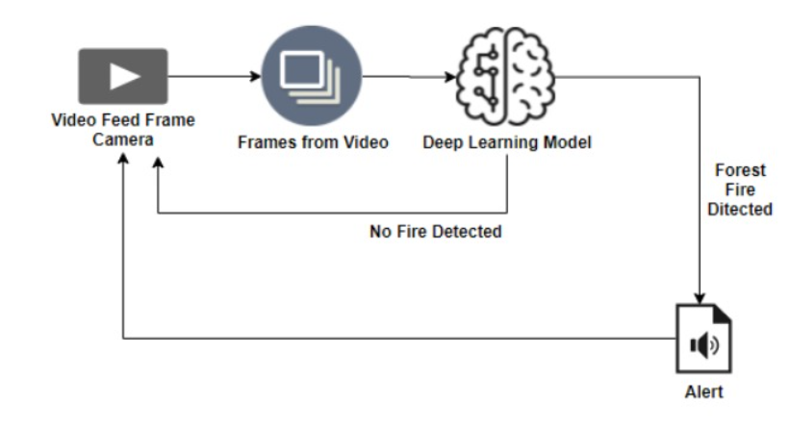
Technical Architecture

Slide 5
Requirements:
Jupyter Notebook
Spyder
HTML
Flask – python framework
Forest with and without fire dataset

Slide 6
Implementation
The proposed system is implemented using jupyter notebook and Flask.
The dataset contain 2 classes - forest, with fire forest.
The steps involved in implementation are:
Data Collection
Image Preprocessing
Model Building
Video Analysis

Slide 7
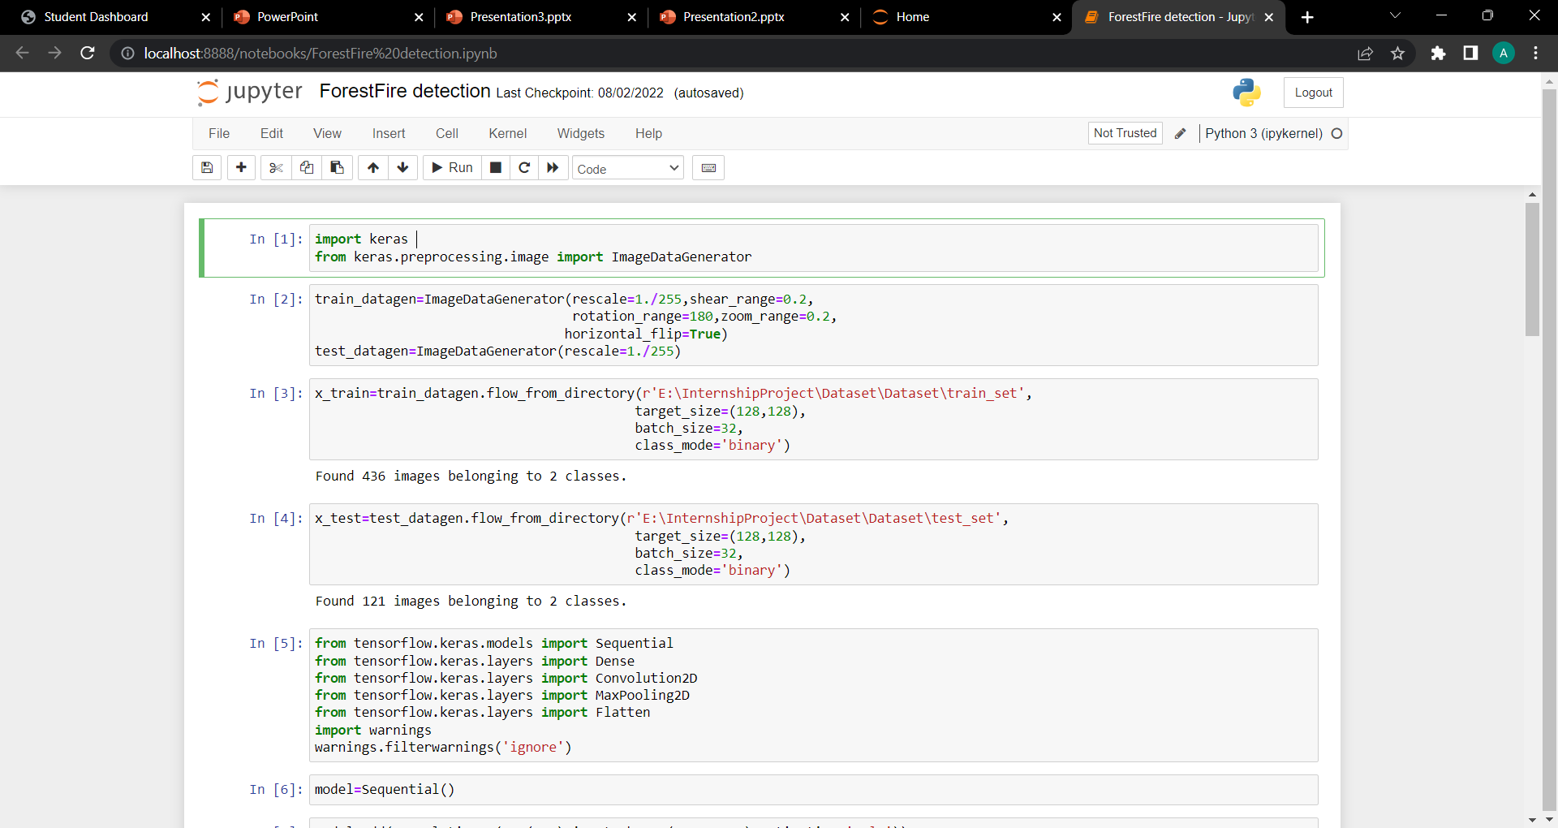
Image Preprocessing

Slide 8
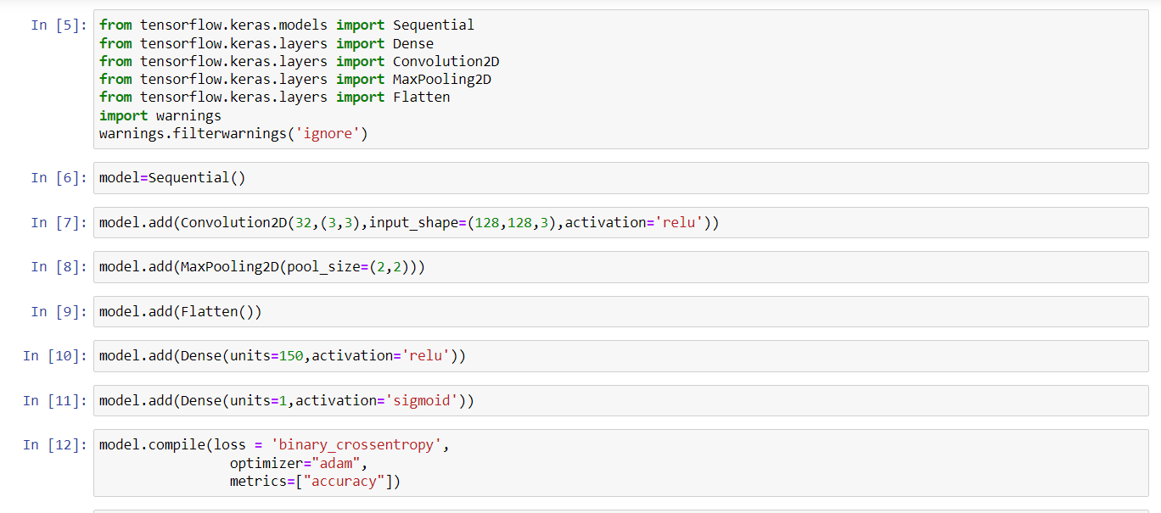
Model Building

Slide 9
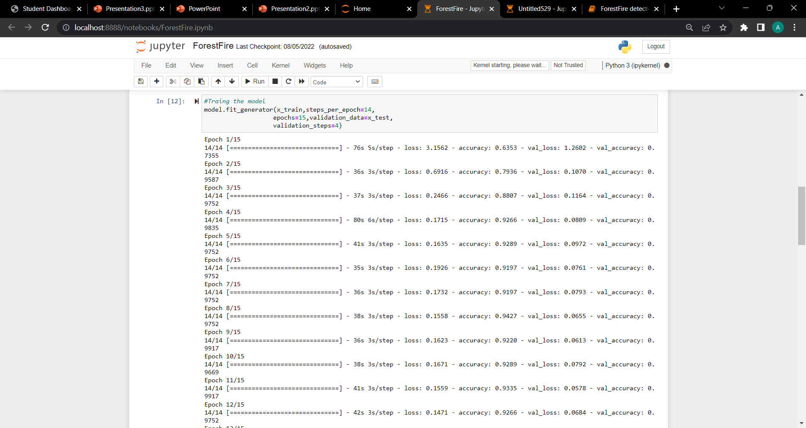
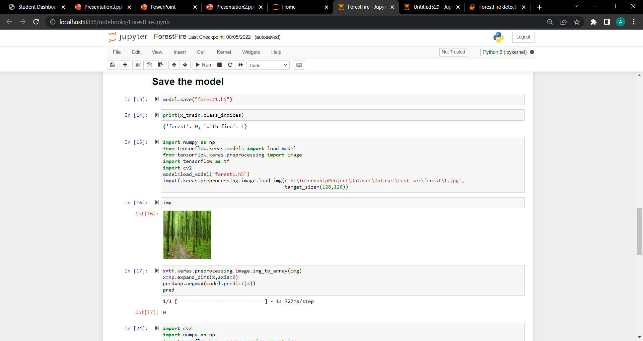

Slide 10
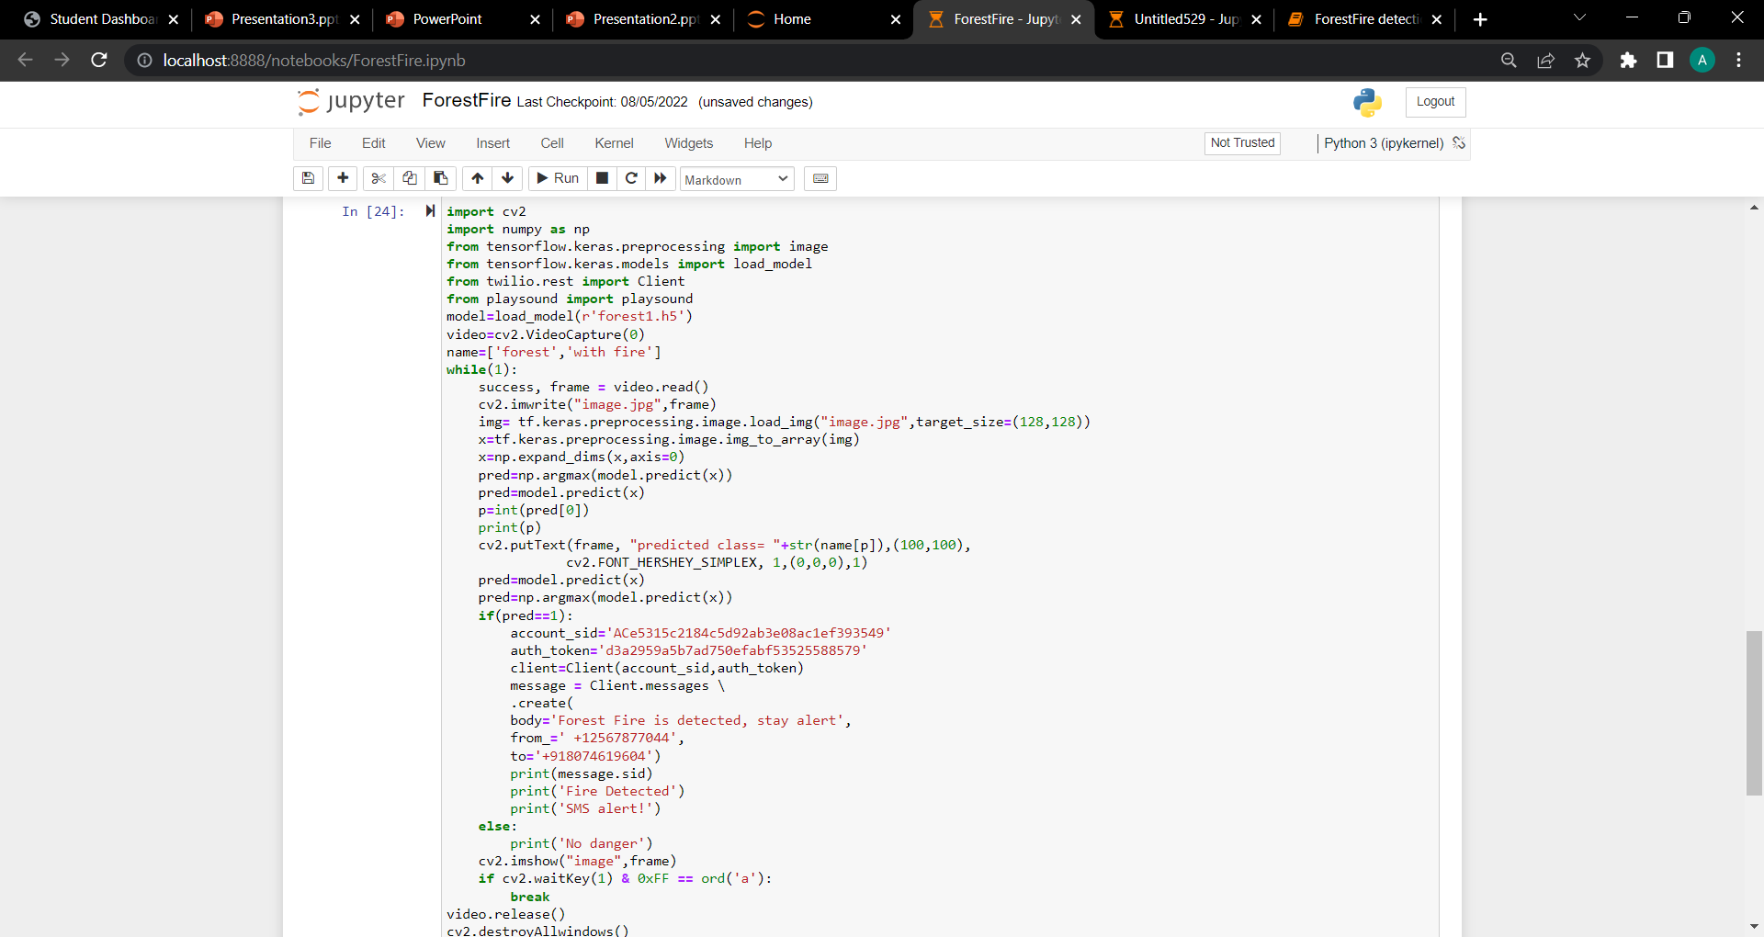
Video Analysis

Slide 11
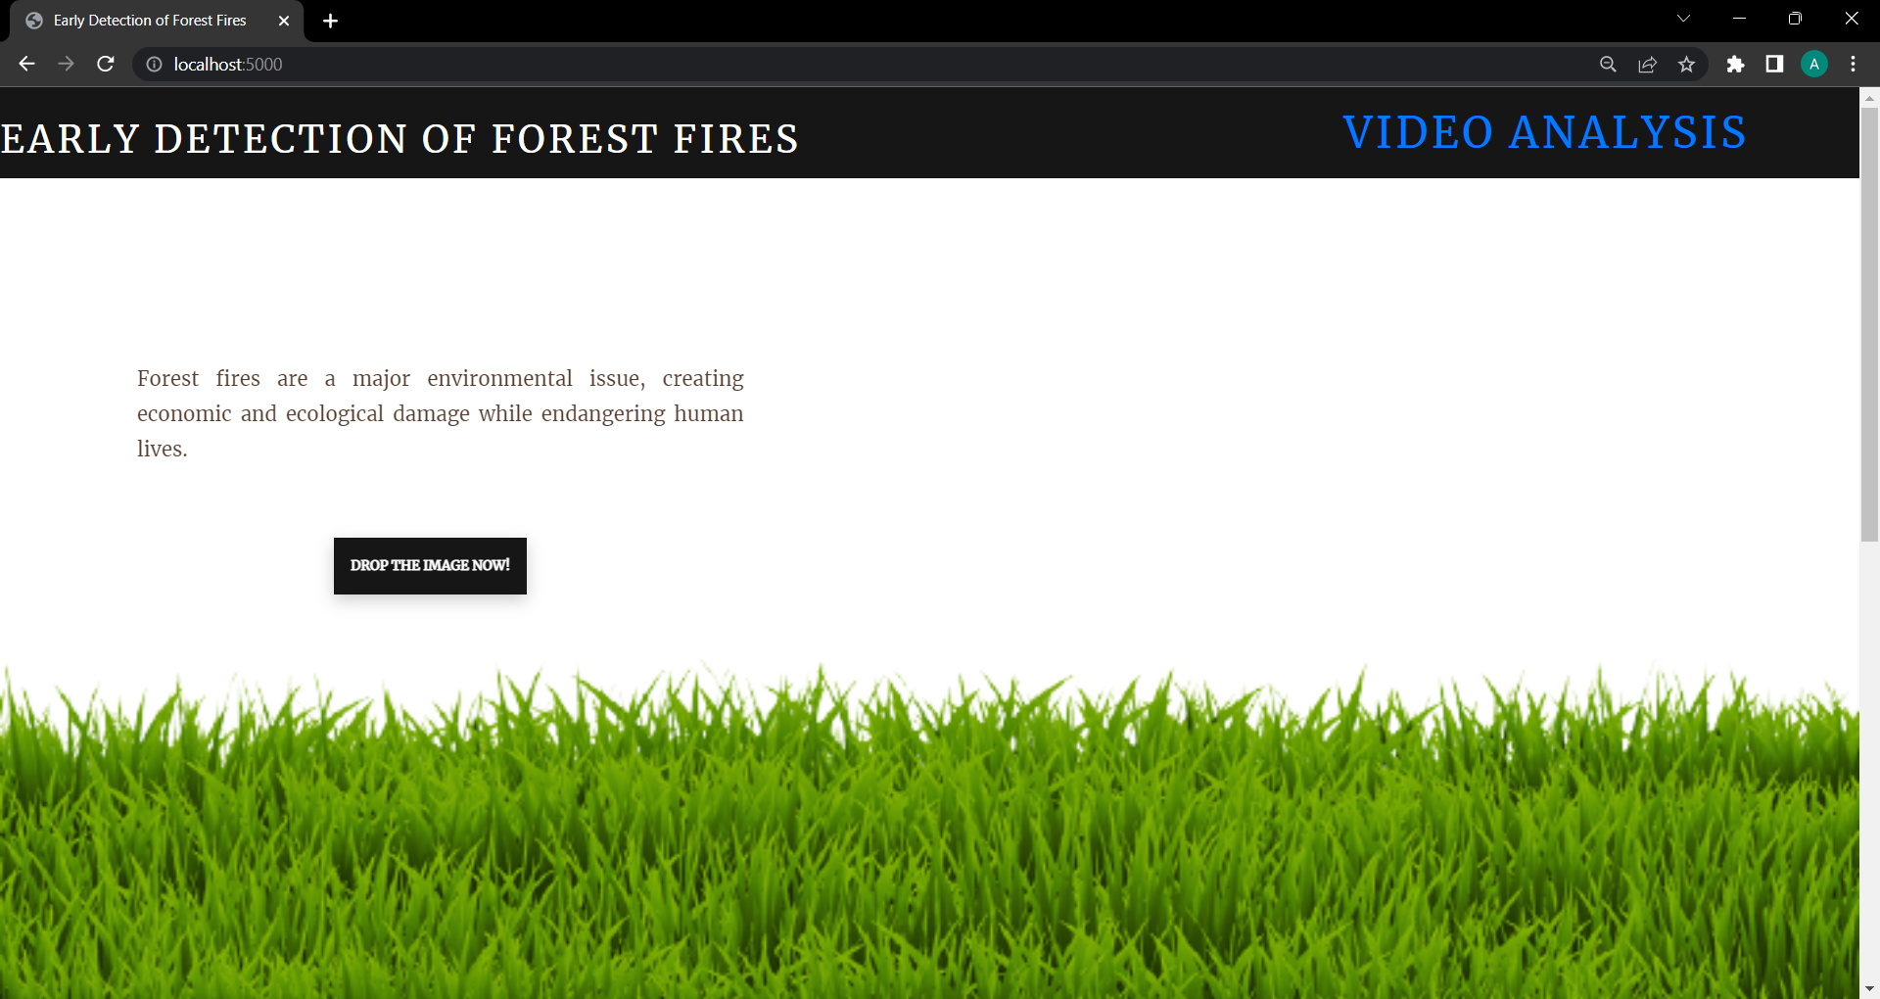
Output

Slide 12
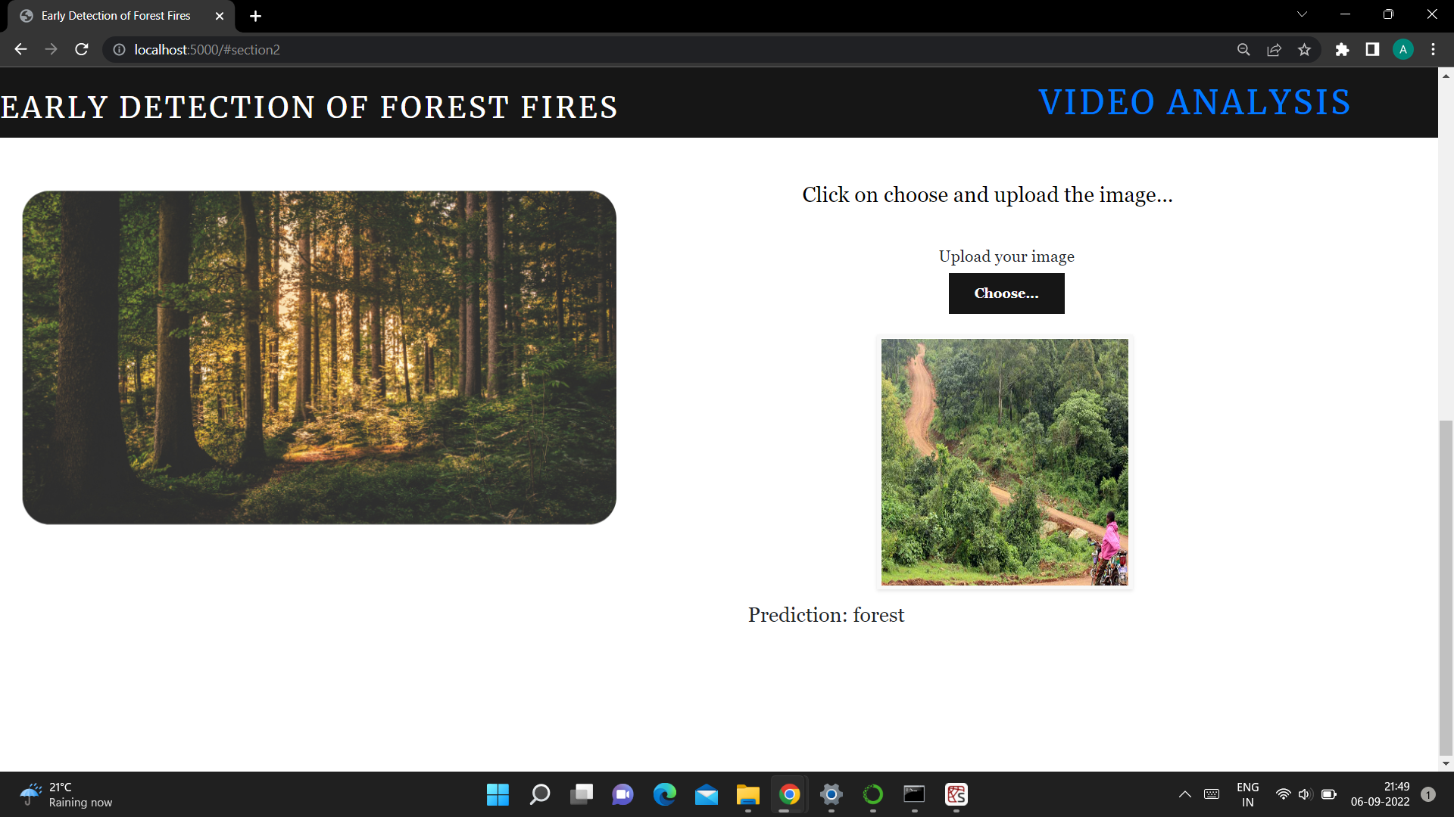
Classified as With forest

Slide 13
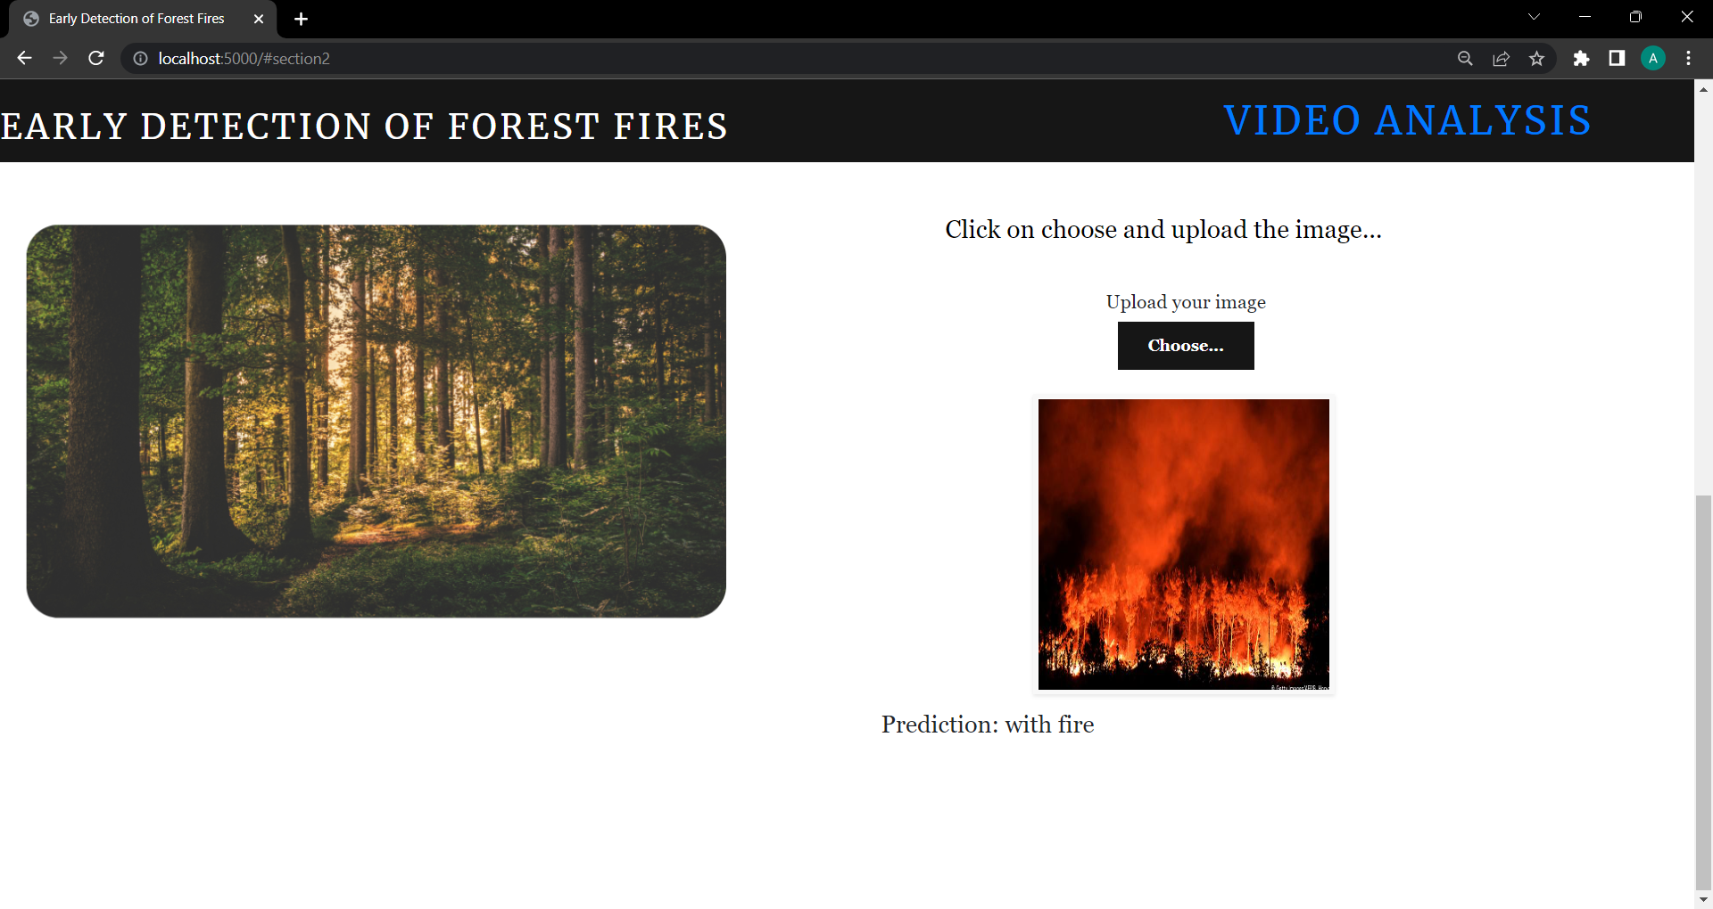
Classified as with fire

Slide 14
THANK YOU

