Slide 1
SMS Analysis using Watson Knowledge Studio
Team Members -
Vatturi Paritosh
Mahesh Chandra
Vudhanthi Neeraja
Aqsa Zareen
Dinesh Reddy

Slide 2
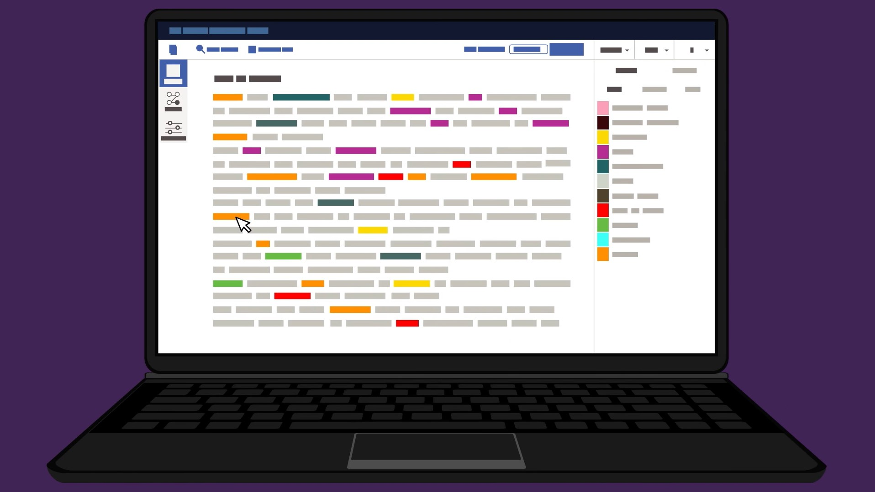

Introduction
If you receive huge amounts of unstructured data in the form of text (emails, social media conversations, chats), you’re probably aware of the challenges that come with analyzing this data.
Manually processing and organizing text data takes time, it’s tedious, inaccurate, and it can be expensive if you need to hire extra staff to sort through text.
This tedious work can be elimated by using a method called Text Analysis.

Slide 3
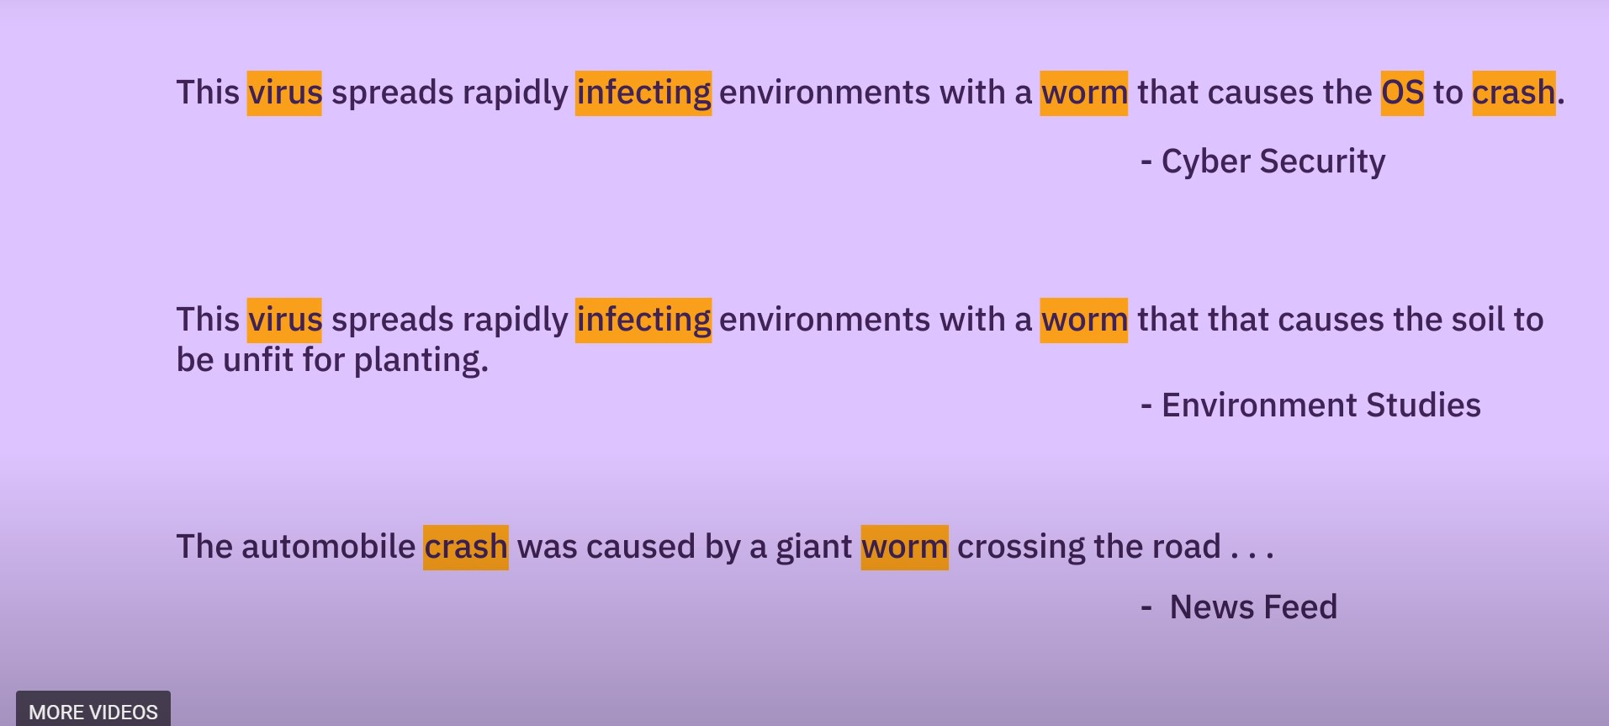
What is Text Analysis?
Text analysis is a machine learning technique that allows companies to automatically understand text data, such as tweets, emails, support tickets, product reviews, and survey responses.
You can us text analysis to extract specific information, like keywords, names, or company information from thousands of emails, or categorize survey responses by sentiment and topic.
Text analysis tools allow businesses to structure vast quantities of information, like emails, chats, social media, support tickets, documents, and so on, in seconds rather than days, so you can redirect extra resources to more important business tasks.

Slide 4
Text Analysis Methods & Techniques
There are basic and more advanced text analysis techniques, each used for different purposes
Text Classification
Entity Extraction
Language Detection
Sentiment Analysis
Word Sense Disambiguation

Slide 5
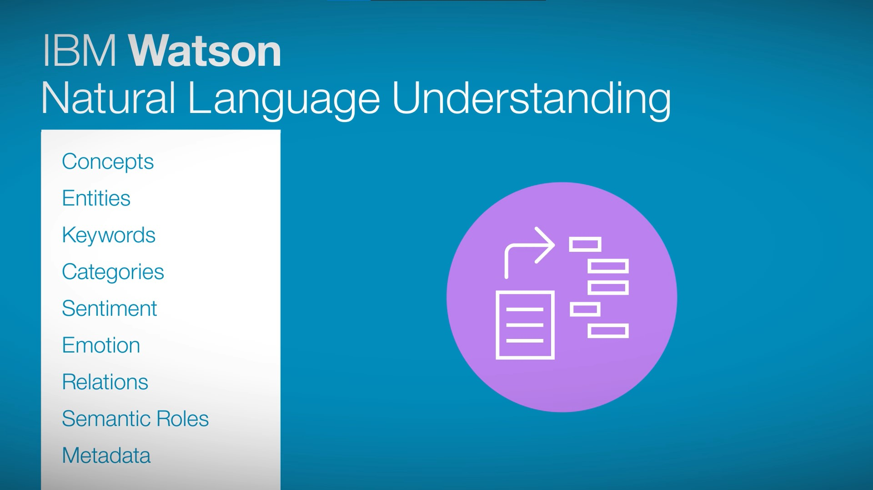
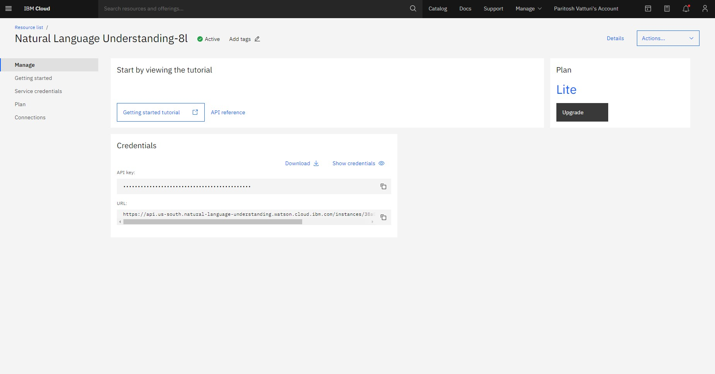
Watson Natural Language Understanding
Natural-language understanding (NLU) or natural-language interpretation is a subtopic of natural-language processing in artificial intelligence that deals with machine reading comprehension.
The IBM Watson Natural Language Understanding service enables developers to extract insights from unstructured text to power a new generation of cognitive applications.
It is used to analyze text and extract meta-data like keywords, concepts, sentiments, relations, keywords, categories, semantic rules or any domain specific customizations.
Natural Language Understanding service created

Slide 6
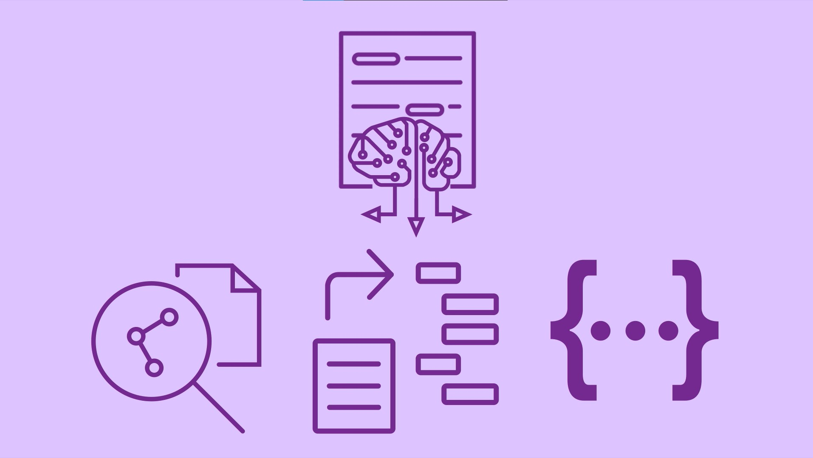
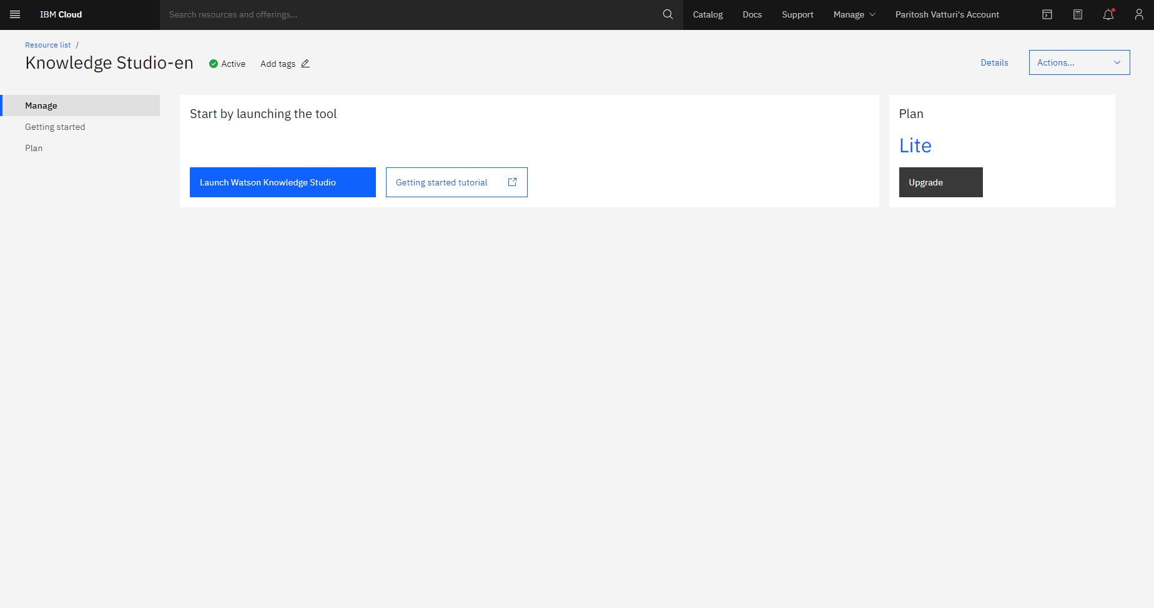
Watson Knowledge Studio
Its is an interface where we can teach the IBM Watson the language of our domain with custom models that identify entities and relationships unique to our industry.
Its is used to build models in a collaborative environment designed for both developers and domain experts, without needing to write code.
We can create machine learning models that understand linguistic meaning or a rule based model that finds entities and models based on your domain
We can train our models to identify certain entites and define custom relation types.
Knowledge Studio service created

Slide 7
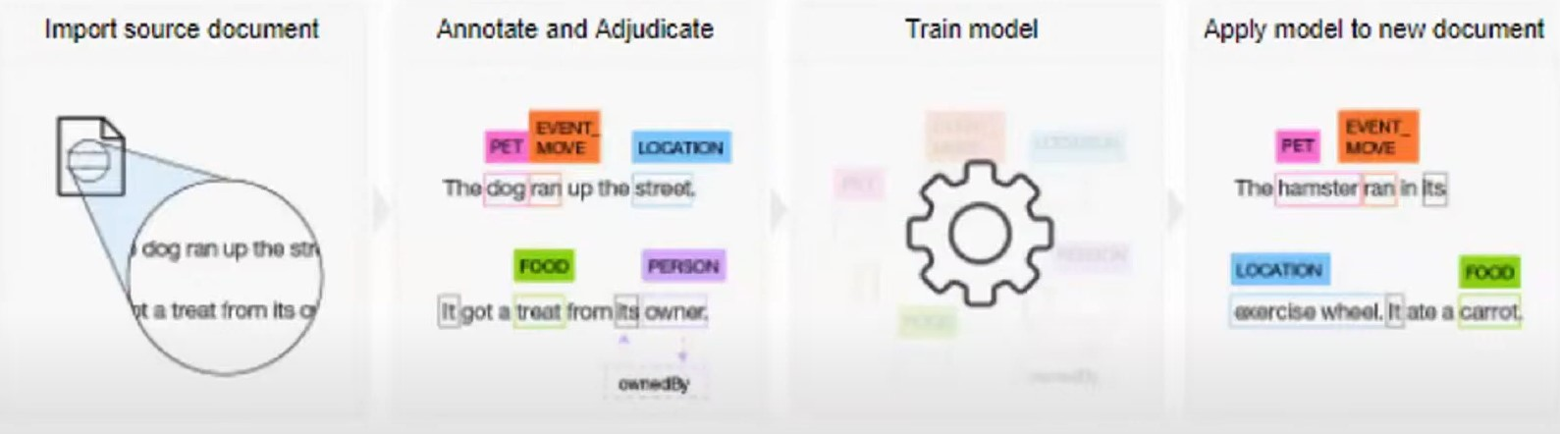
Building a Custom Machine Learning Model
Step 1 - Importing the source document
Step 2 - Annotate and adjudicate
Step 3 - Train the model
Step 4 - Apply model to the new document

Slide 8
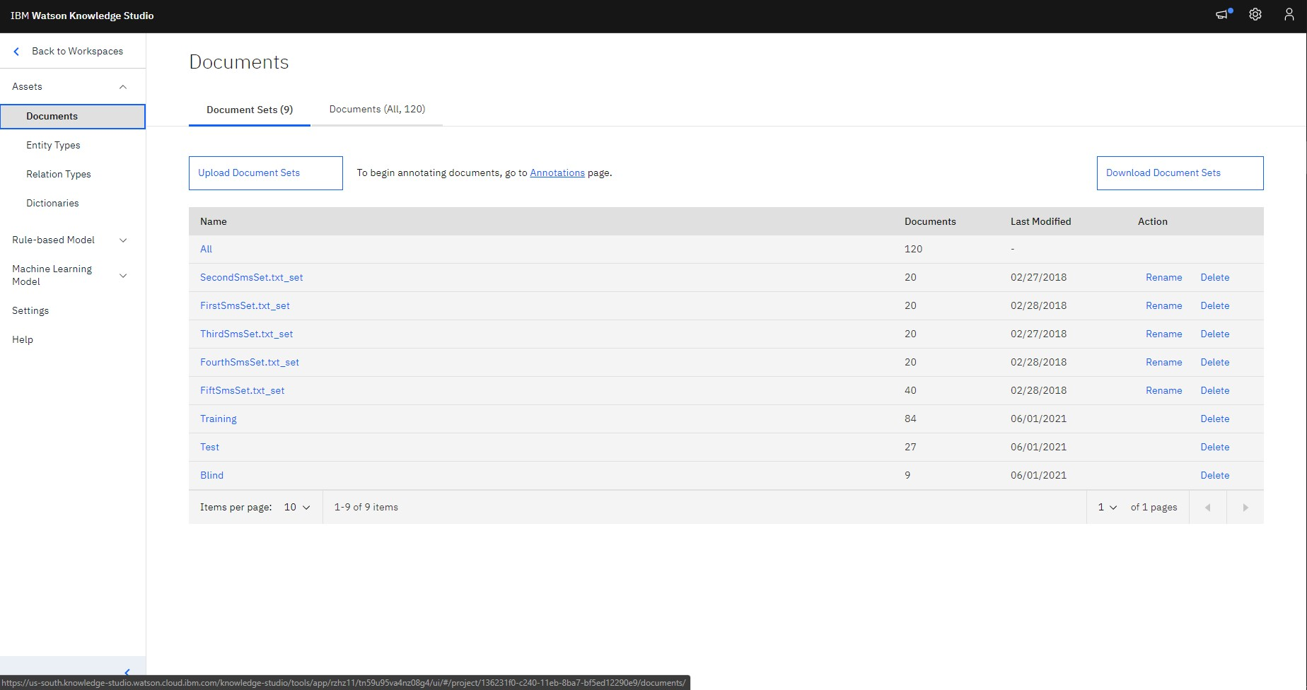
Step 1 - Importing Source Document
The source document is domain dependent.
We need to collect the entities and prepare a dataset.
Then the collected data is uploaded to the model using Watson Knowledge Studio.

Slide 9
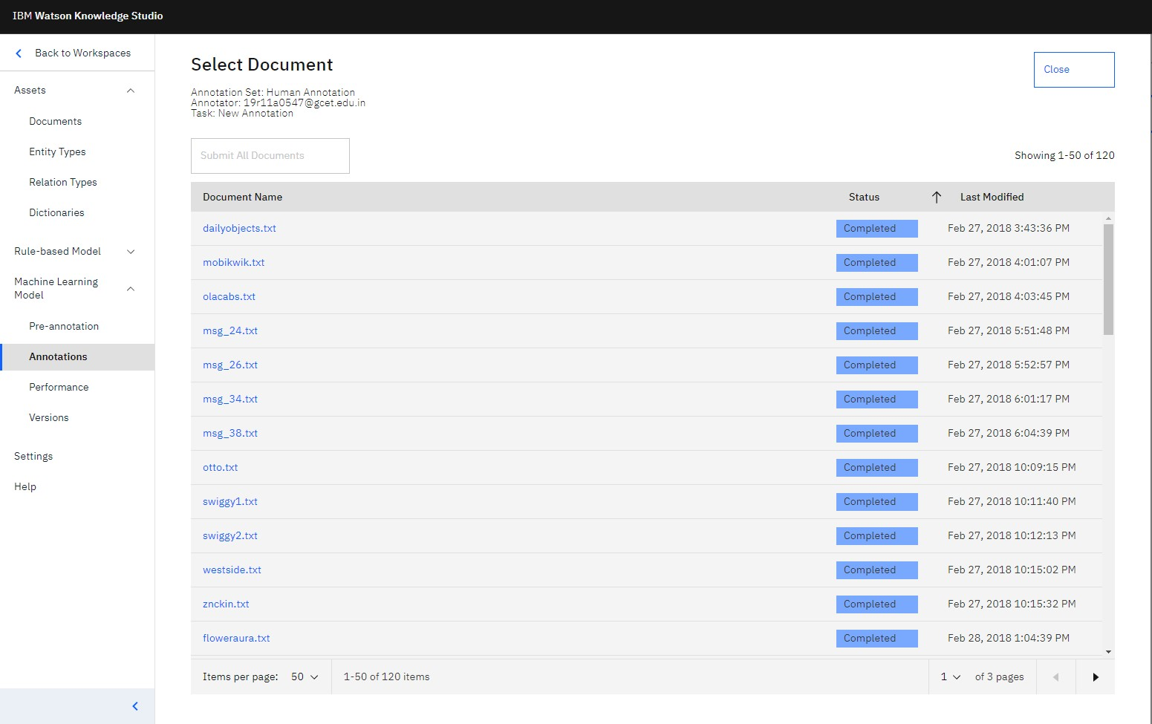
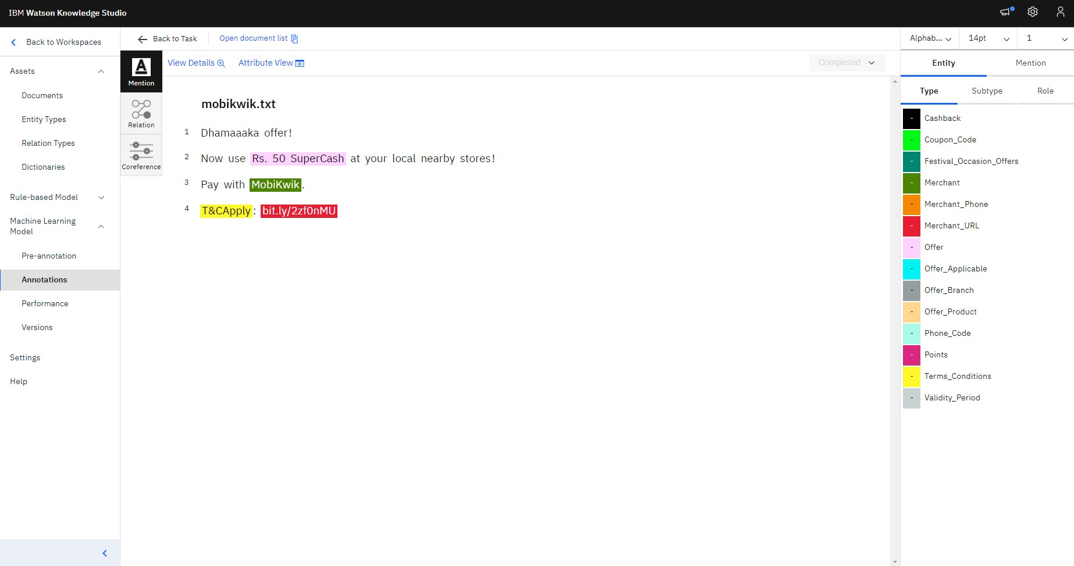
Step 2 - Annotate and Adjudicate
Text annotation in machine learning is the process of associating labels to a digital file or document and its content.
This is an Natural Language Processing method where different types of sentence structures are highlighted by various criteria.
Annotated documents Example data automatically annotated by NLU

Slide 10
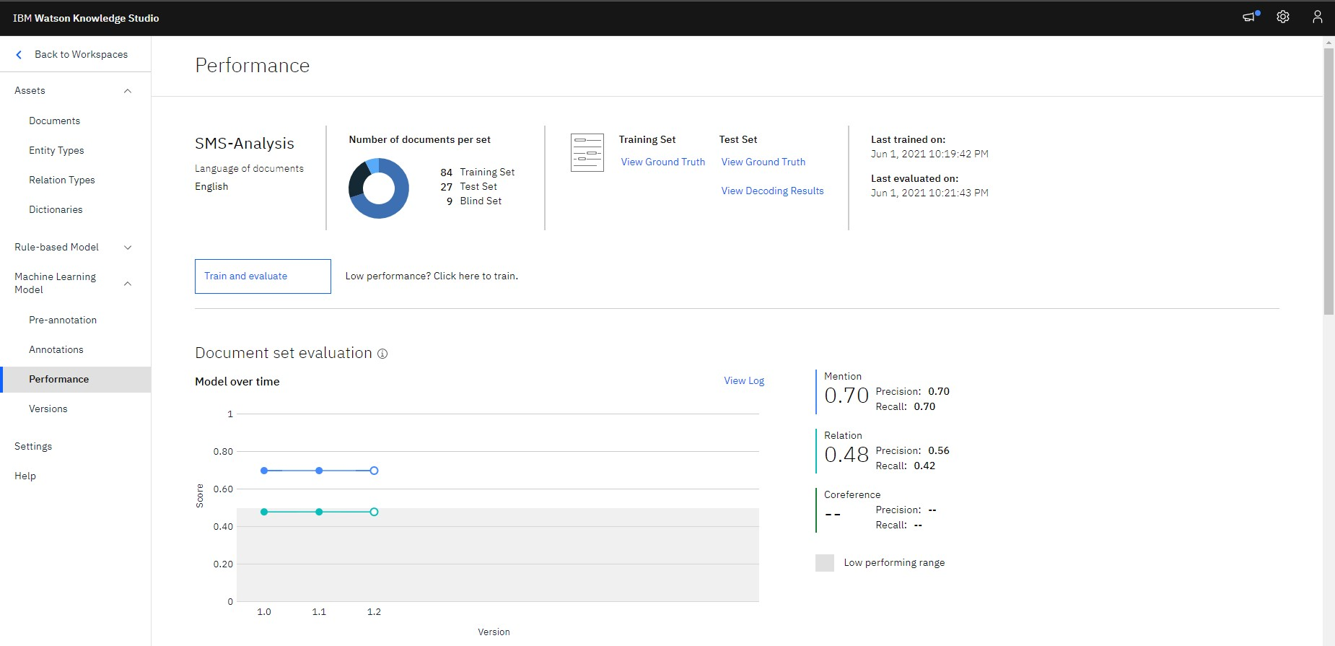
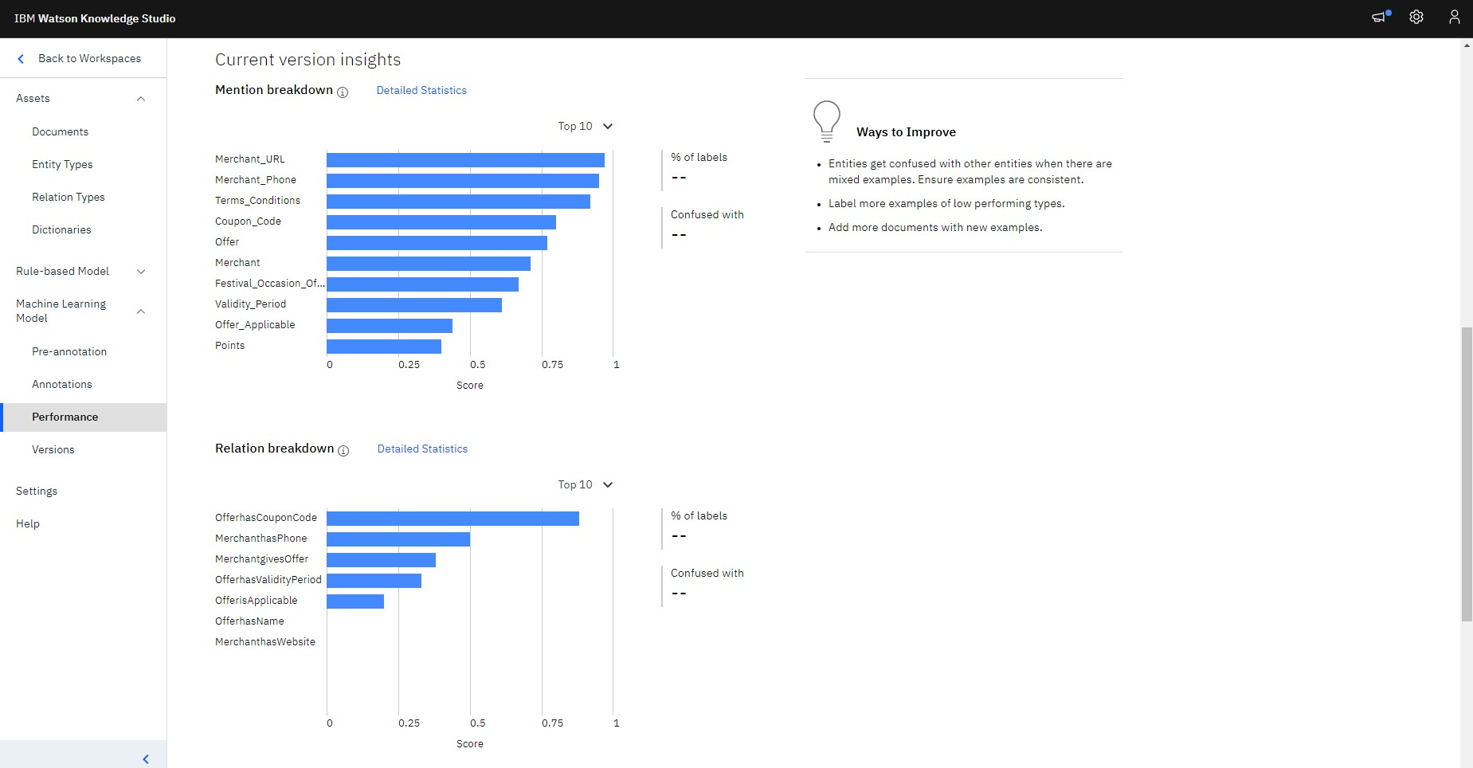
Step 3 - Train and Evaluate
The annotated data is divided into 70% training set, 23% test set and 7% as blind sets.
The data is then trained, evaluated and performance characteristics are noted.
Create a new version and then deploy the newly trained machine model.
Trained data
Performance characteristics

Slide 11
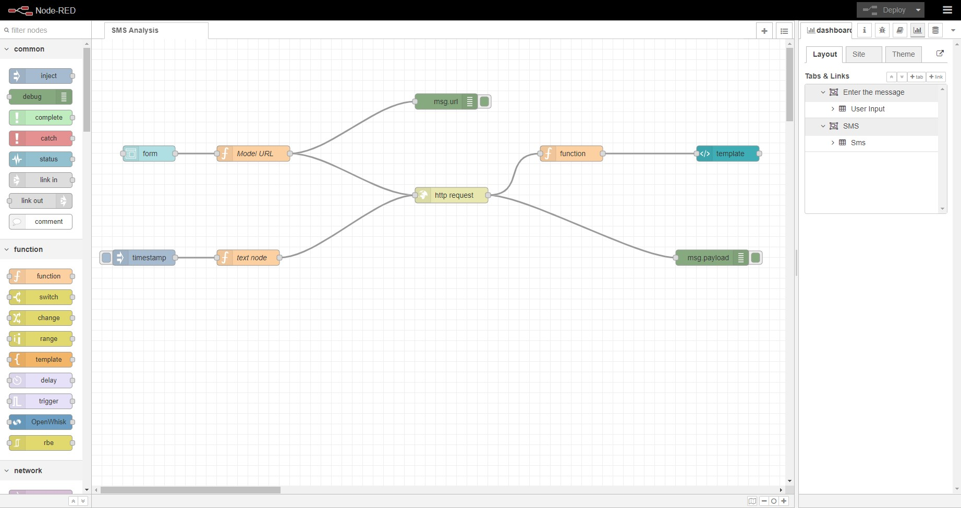
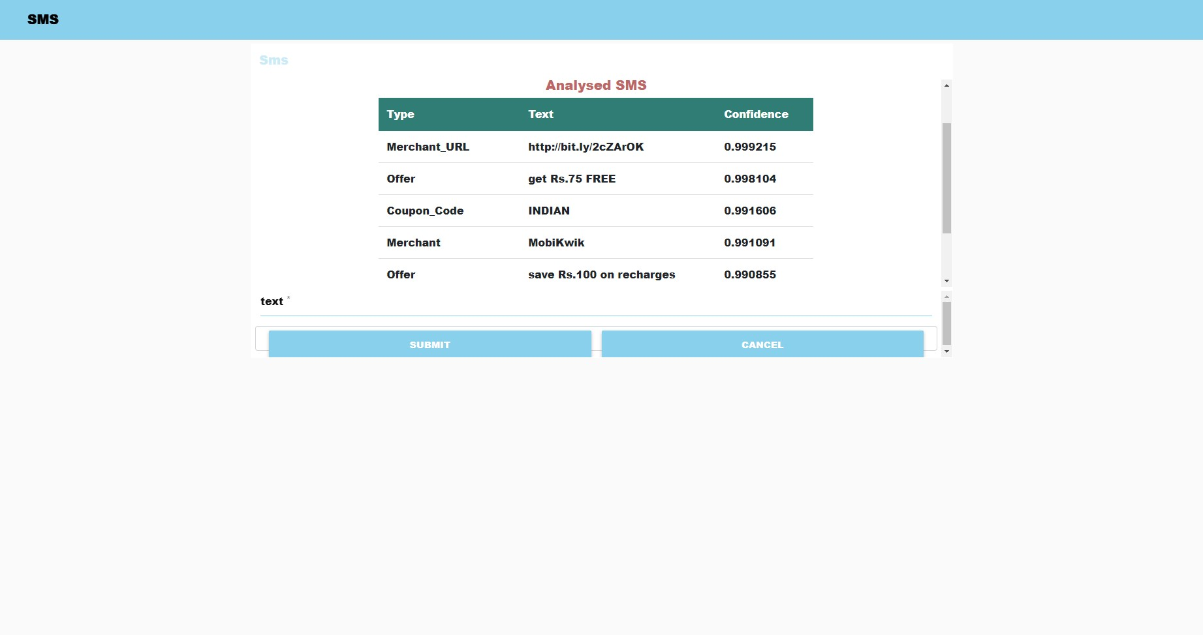
Step 4 - Apply model to new document
Create an application using the Node-Red service.
Use the trained model and provide basic authentication.
Deploy the application.
Node red application
Output - Model applied to a sample SMS

Slide 12
Thank You

