Slide 1

A gesture based tool for sterile browsing of radiology images cnn and open cv

Slide 2
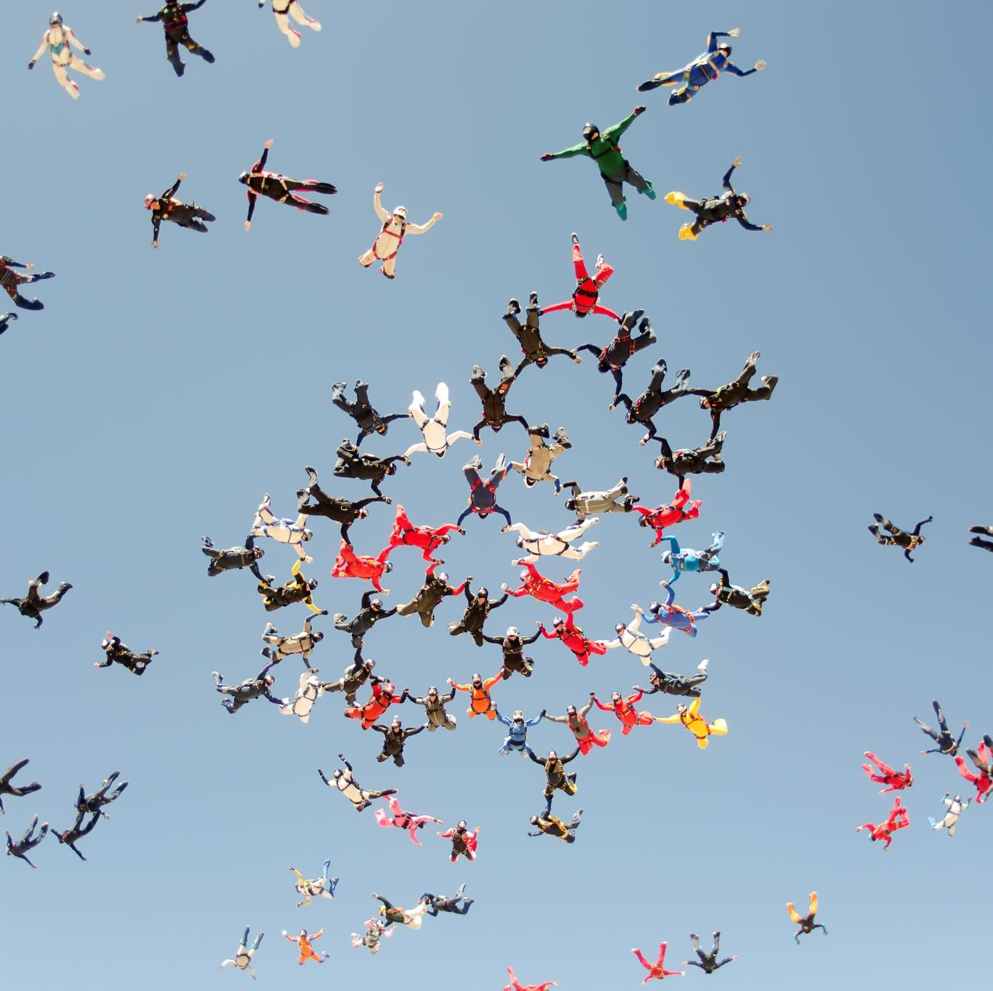
Team : cSE - 19
Manisha – 19R11A05J2
Abhignu – 19R11A05J3
Rakesh – 19R11A05J6
Ashvitha – 19R11A05J7
Vikram – 19R11A05J8

Slide 3
Introduction
Humans are able to recognize body and sign language easily. This is possible due to the combination of vision and synaptic interactions that were formed along brain development.
In this project Gesture based Desktop automation, First the model is trained pre trained on the imahes of different hand gestures, such as showing numbers with fingers as 1,2,3,4.
This model uses the integrated webcam to capture the video frame. The image of the gesture captured in the video frame is compared with the pre trained model and the gesture is identified.
If the gesture predicts is 1 then images is blurred; 2 then image is resized; 3 then images is rotated etc

Slide 4
Project objectives
Know
Know fundamental concepts and techniques of Convolutional Neural Network (CNN)
Gain
Gain a broad understanding of image data.
Know
Know how to pre-process/clean the data using different data pre-processing techniques.
Know
Know how to build a web application using Flask framework.

Slide 5

Image pre-processing
In this we will be improving the data that supresses unwilling distortions or enhances some image features important for further processing, although perform some geometric transformations of images like rotation, scaling, translation etc.

Slide 6

Import the image data generator library
Image data augmentation is a technique that can be used t artificially expand the size of a training dataset by creating modified versions of images in the dataset.
The keras deep learning neural network library provides the capability to fit models using image data augmentation via the ImageDataGenerator class

Slide 7
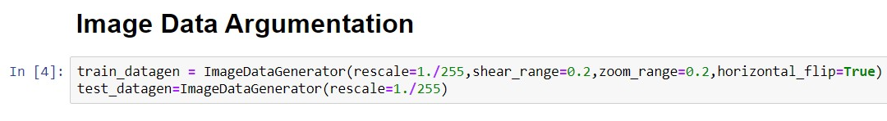
Configure image data generator class
ImageDataGenerator class is instantiated and the configuration for the types of data augmentation
There are five main types of data augmentation techniques
Image shifts via the width_shift_range and height_shift_range arguments
Image flips via the horizontal_flip and vertical_flip arguments
Image rotations via the rotation_range arguments
Image brightness via the brightness_range arguments
Image zoom via the zoom_range argument

Slide 8
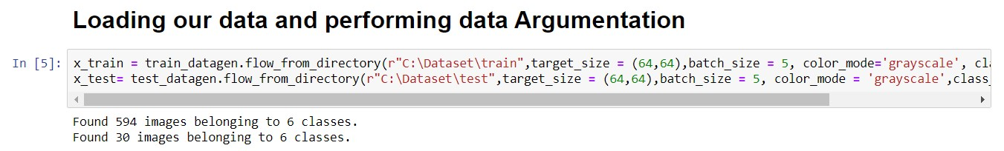
Applying image data generator functionality to trainset and to testset
This function will return batches of images from the subdirectories 0,1,2,3,4,5 together with labels 0 to 5 {‘0’ : 0, ‘1’ : 1, ‘2’ : 2, ‘3’ : 3, ‘4’ : 4, ‘5’ : 5 }

Slide 9

Model Building
Time to build our Convolutional Neural Networking which contains a input layer along with convolution, maxpooling and finally an output layer

Slide 10
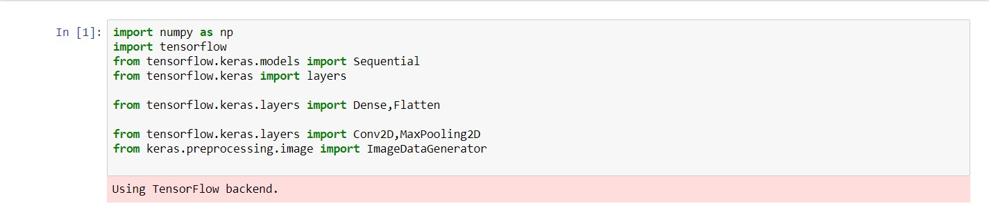
Importing the model building libraries

Slide 11

Initializing the model
Sequential model is a linear stack of layers.
You can create a sequential model by passing a list of layer instances to the constructor from keras models import Sequential from keras

Slide 12
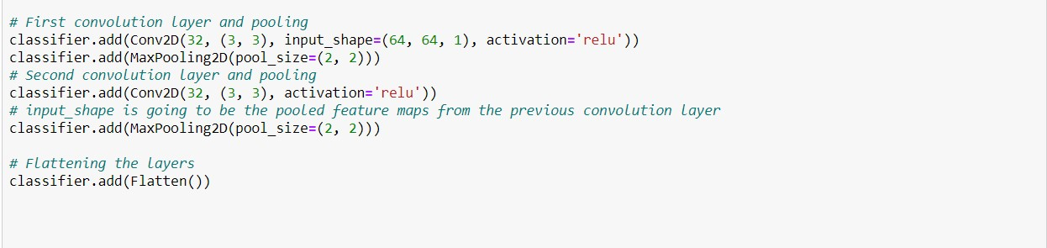
Adding Cnn layers
We are adding a convolution layer with activation function as “relu” and with a small filter size (3,3) and number of filters (32) followed by a max pooling layer
Maxpool layer is used to downsample the input
Flatten layer flattens the output

Slide 13
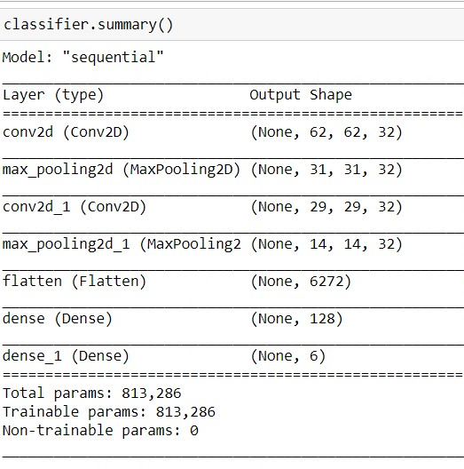

Adding dense layers
Dense layer is deeply connected neural network layer. It is most common and frequently used layer.
Understanding the model is very important phase to properly use it for training and prediction purposes.
Keras provides a simple method, summary to get the full information about the models and its layers.

Slide 14
Configure the learning process
The compilation is the final step in creating the model. Once the compilation is done, we can move on to the training process.
Optimization is an important process which optimize the input weights by comparing the prediction and the loss function
Metrics is used to evaluate the performance of your model. It is similar to loss function, but not used in training process

Slide 15

Train the model
Fit_generator functions are used to train a deep learning neural network
Arguments
Steps_per_epoch : It specifies the total number of steps taken from the generator as soon as one epoch is finished and next epoch has started.
Epochs : an integer and number of epochs we want to train our model for
Validation_data can be either
An inputs and targets list
A generator
An inputs, targets and sample_weights list which can be used to evaluate the loss and metrics for any model after any epoch has ended.

Slide 16
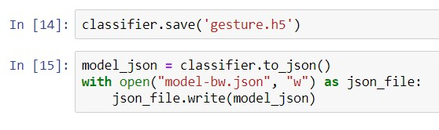
Save the model
The model is saved with .h5 extension.
An H5 file is a data file saved in the Hierarchical Data Format (HDF)
It contains multidimensional arrays of scientific data

Slide 17
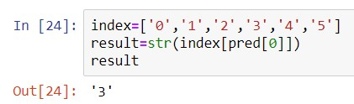
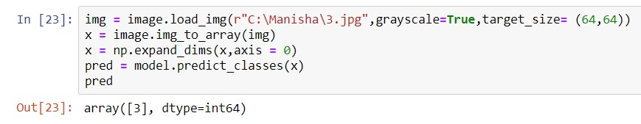

Test the model
Evaluation is a process during development of the model to check whether the model is best fir for the given problem and corresponding data

Slide 18
Application building
After the model is trained in this particular milestone, we will be building our flask application which will be running in out local browser with a user interface

Slide 19
Create html pages
We use HTML to create the front end part of the web page
Here, we created 3 HTML pages – home.html, intro.html and index6.html
Home.html displays the home page
Intro.html displays the introduction about the hand gesture recognition
Index6.html accepts the input from the user and predicts the values.
We also use JavaScript-main.js and CSS-main.css to enhance our functionality and view of HTML pages

Slide 20
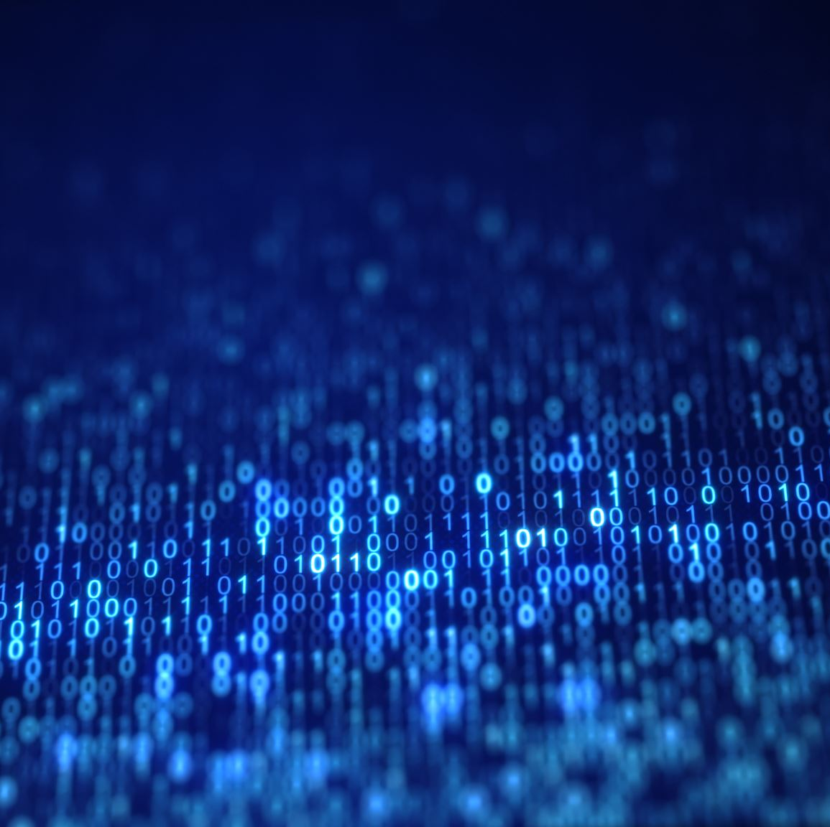
Build Python code

Slide 21
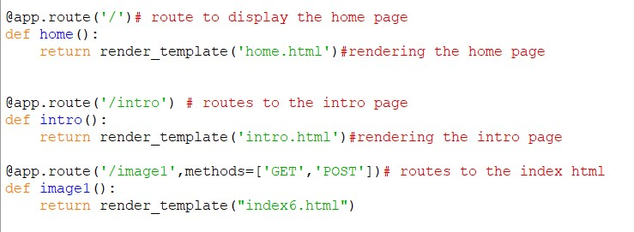
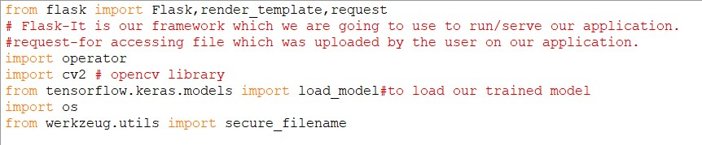
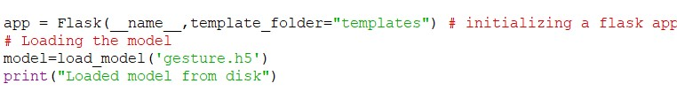
Code
Importing Libraries
Creating our flask applications and loading our model
Routing to the html page

Slide 22
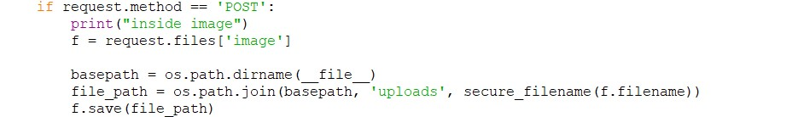
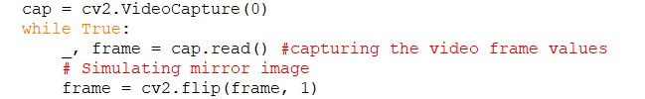
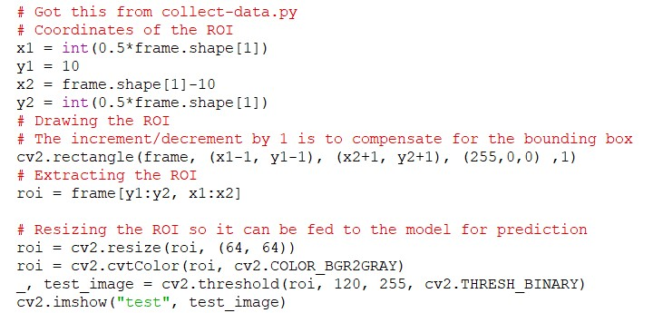
CODE
Getting our input and storing it
Grab the frames from the web cam
Creating ROI

Slide 23
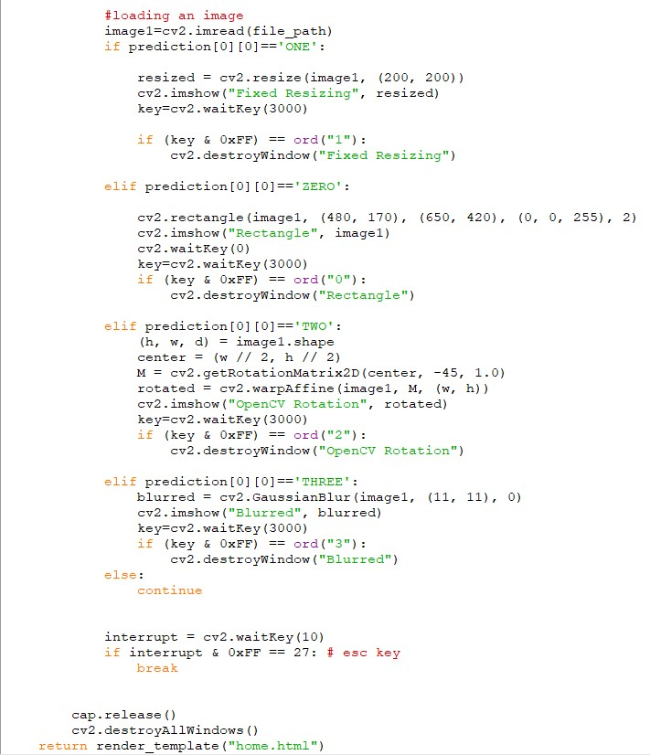
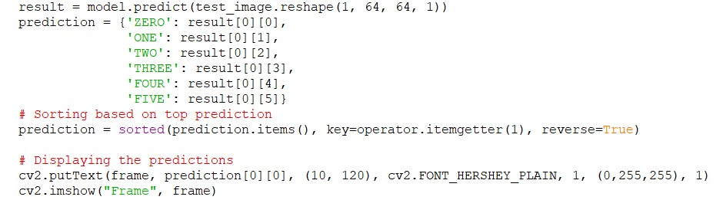
CODE
Predicting our results

Slide 24
Running the application

Slide 25

Home page

Slide 26
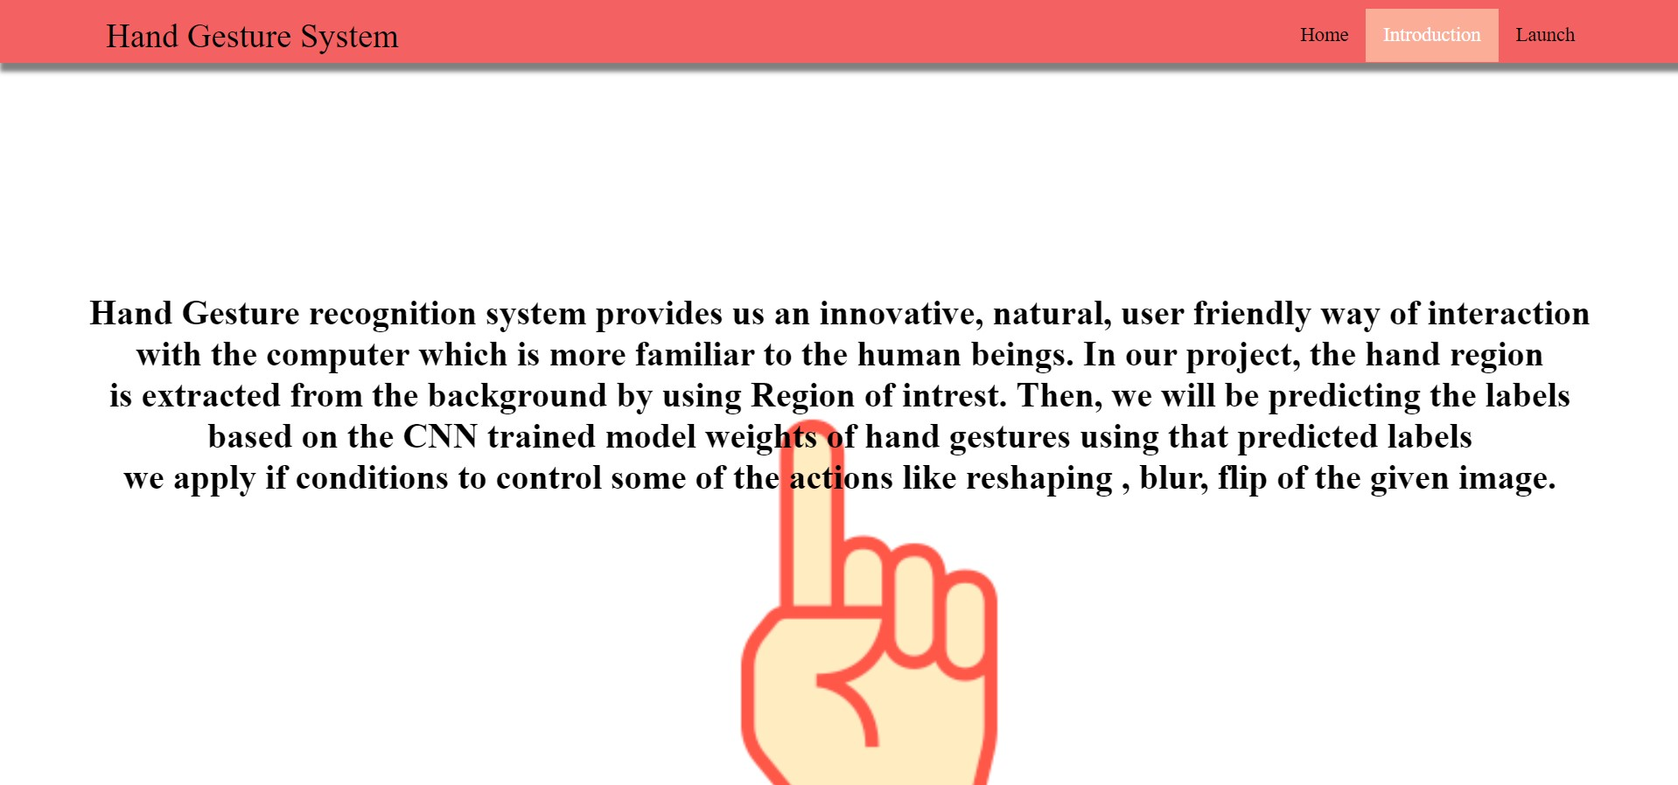
Introduction page

Slide 27
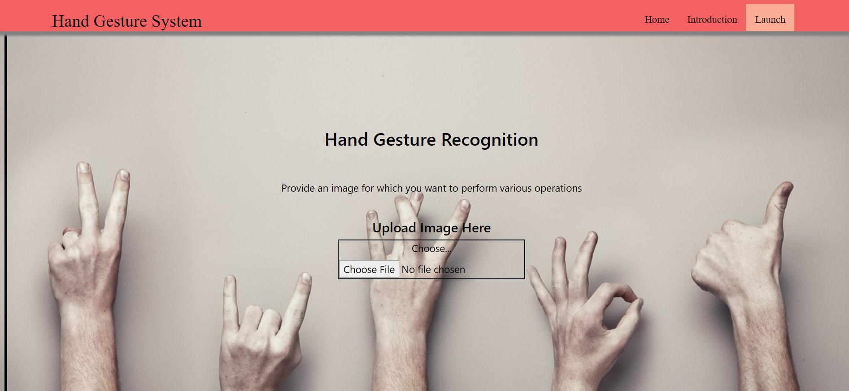
Prediction page

Slide 28

Thank you

