Slide 1
AUTOMATED TEMPERATURE CHECK-UP
By CODE LINGUISTS…

Slide 2
ABSTRACT
In this peak time of pandemic, we need to restrict the victims of COVID-19 as much as possible. In order to enter any crowded place, we need to make sure that everybody is safe and protected from virus. In the verge of controlling it one of the primary methods is by checking the temperature of humans.
This prototype helps to restrict the people whose body temperature is beyond the normal reading and thus useful for the society at this moment.
We hope to this system that it performs given task.

Slide 3
Working (Block Diagram)
IBM IOT
INPUT
MESSAGE
PAYLOAD
OBJECT TEMPERATURE
SWITCH
If(obj temp>38)
IBM IOT
OUTPUT
DOOR OPEN
FUNCTION
MESSAGE PAYLOAD
DOOR CLOSE
TEXT TO SPEECH
PLAY AUDIO

Slide 4
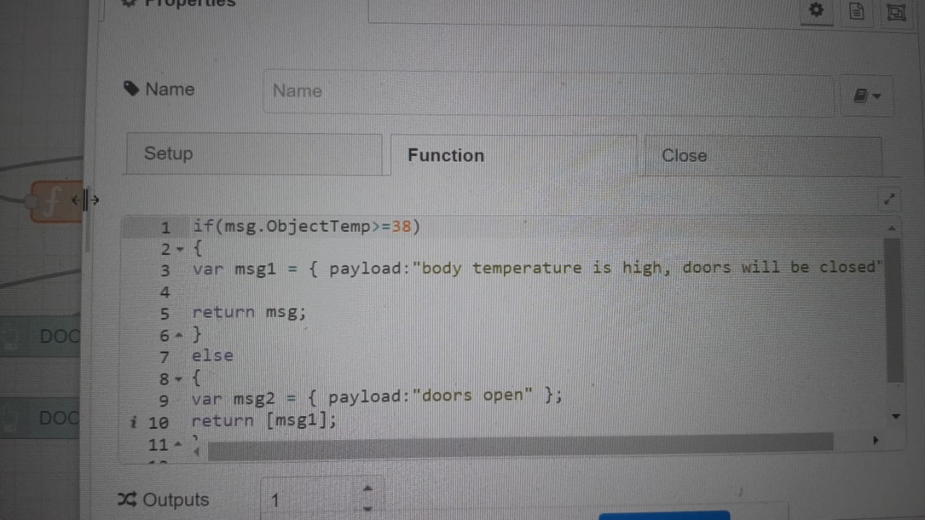
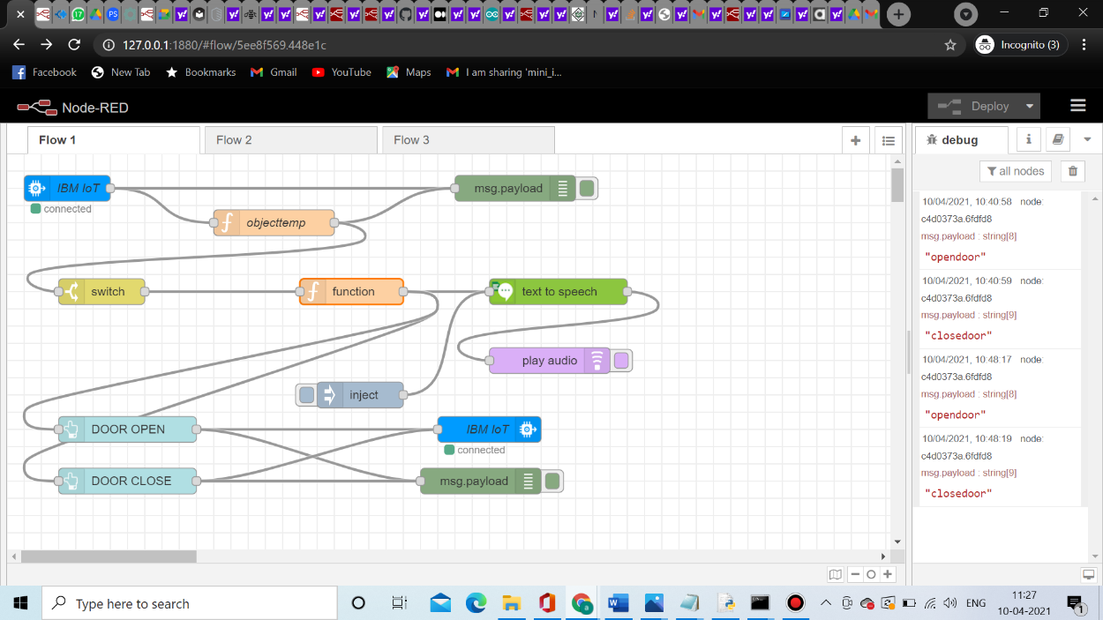
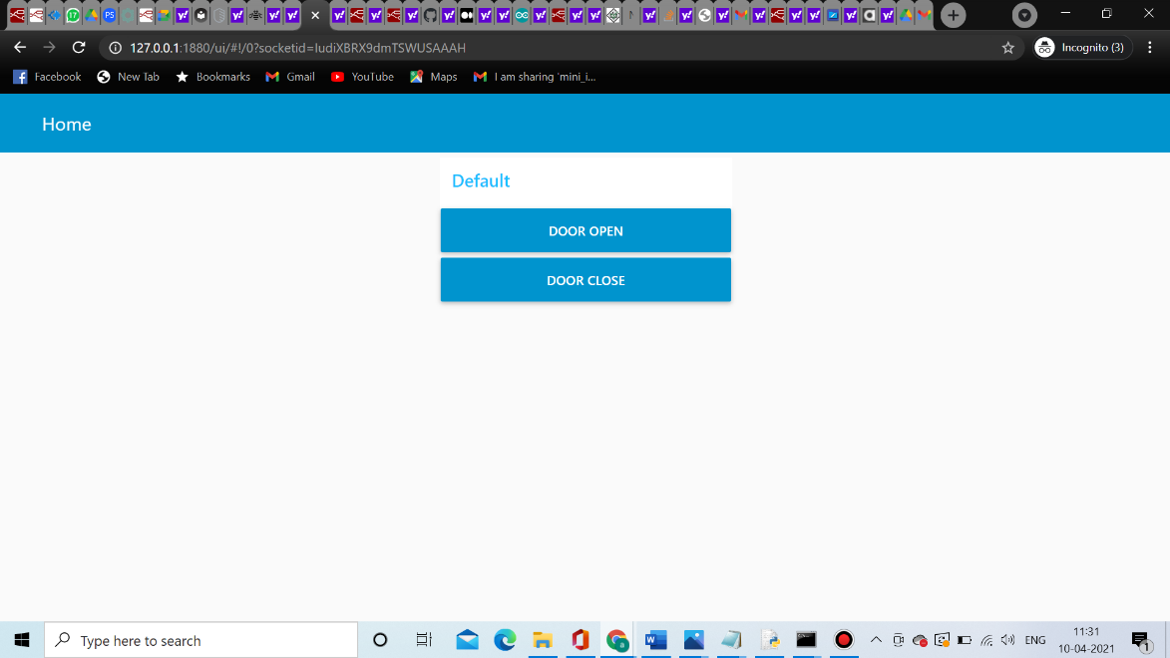
Process

Slide 5
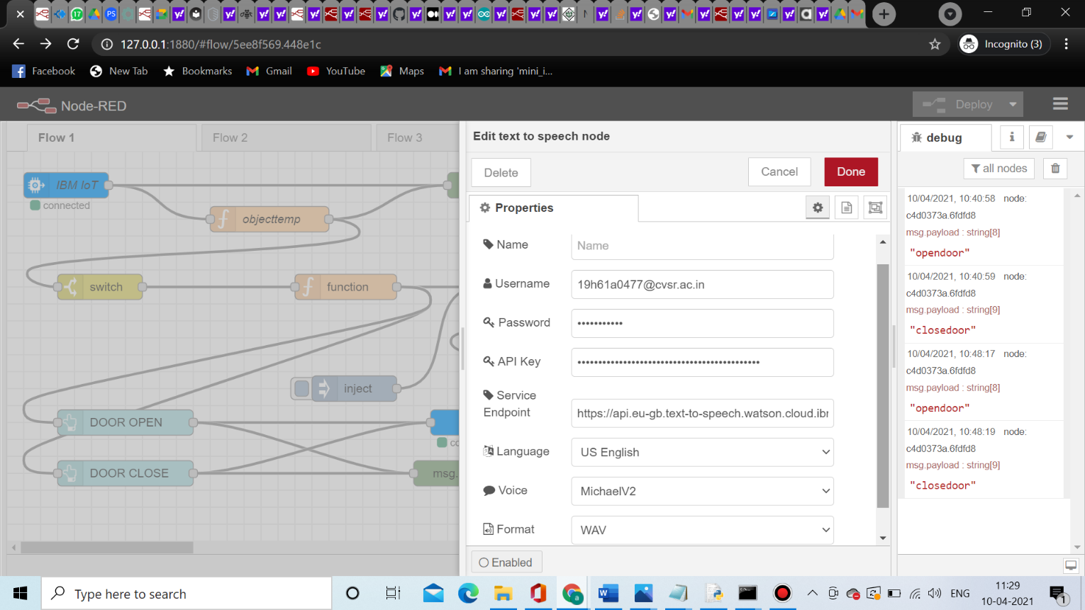
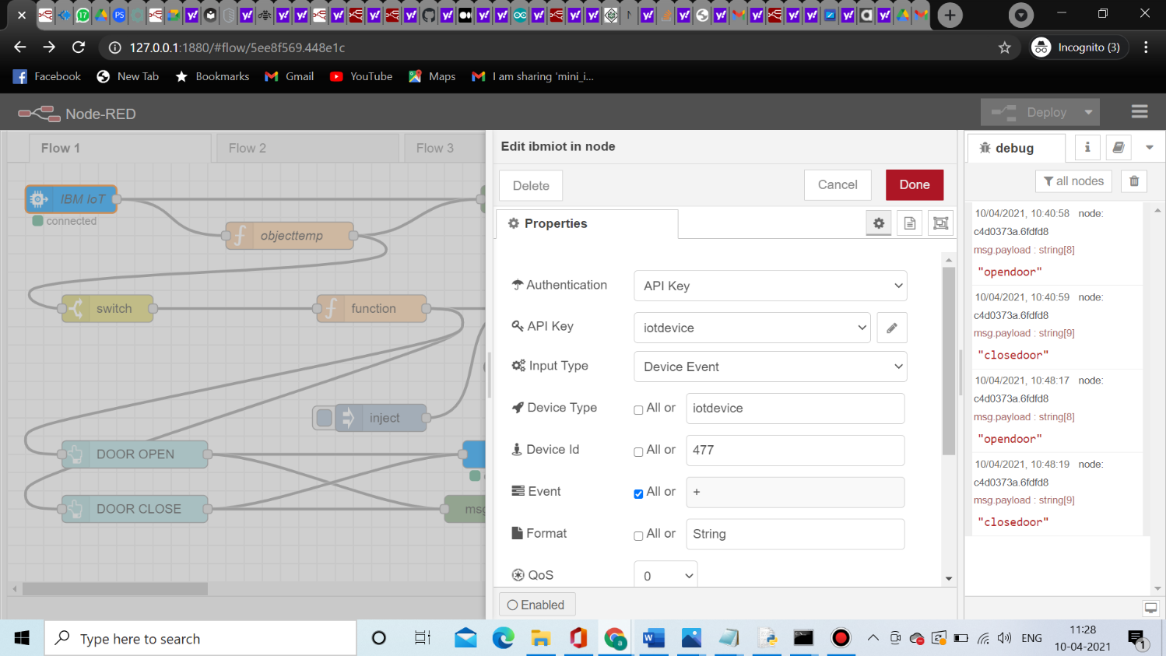

Slide 6
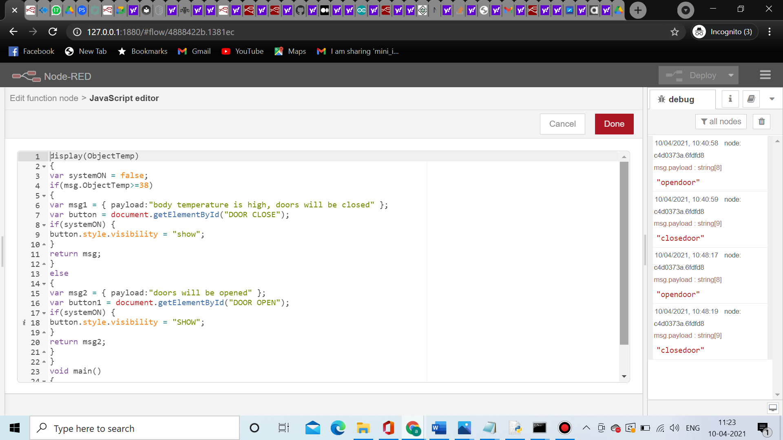
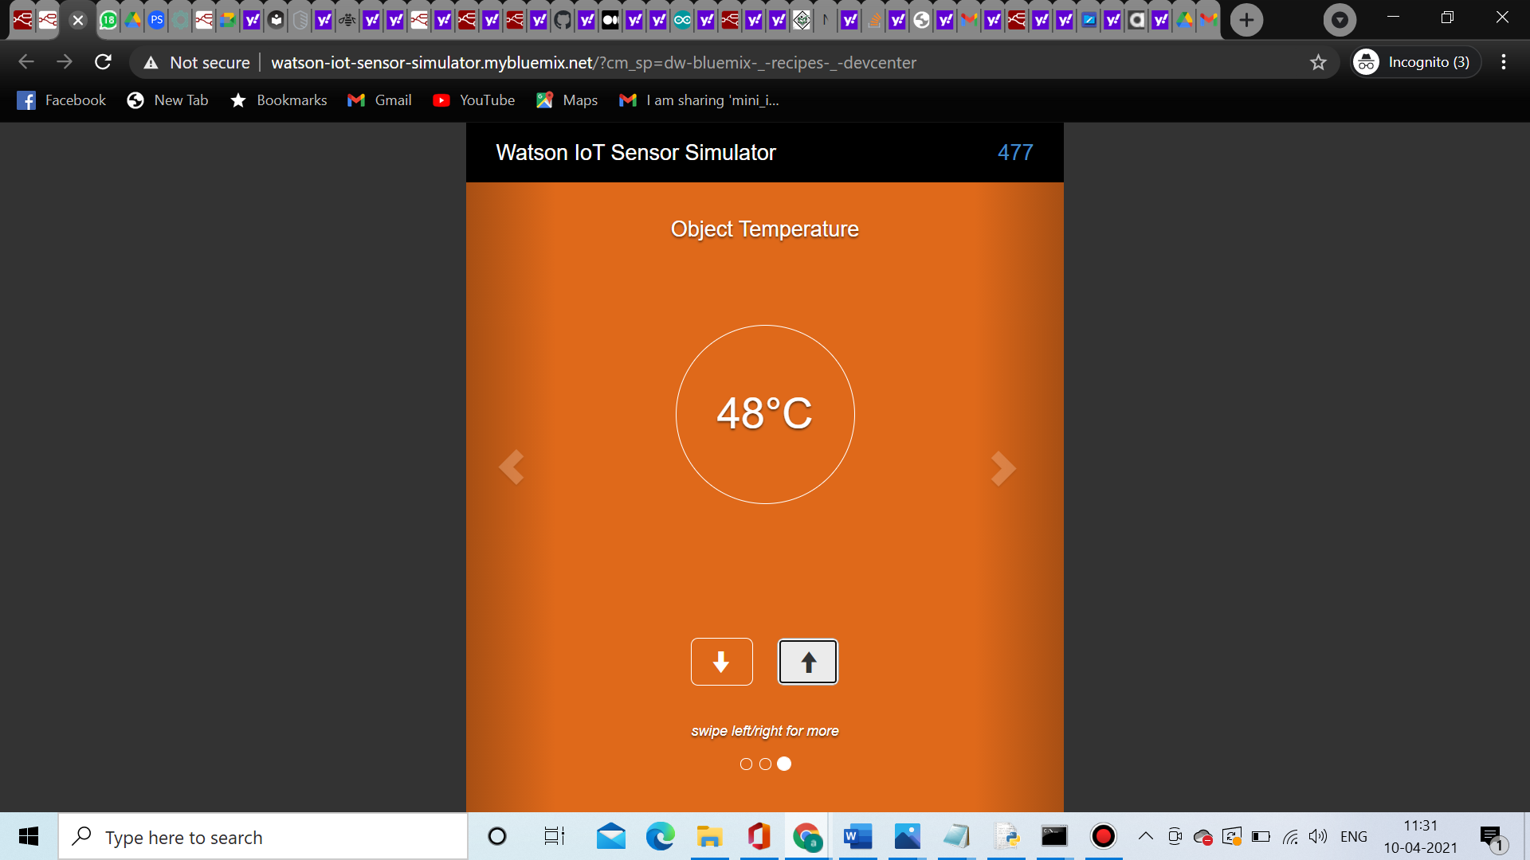

Slide 7
Working
Automated temperature checkup uses temperature sensors as its main component. The temperature sensors works on the principle of voltage across the diode terminals. The human body temperature is 38 degrees Celcius. If the temperature is less than or equal to 38 degrees Celcius, then the doors will be open and entry is allowed. If the temperature exceed 38 degrees Celcius, then the doors will be closed, an audio message will be heard and entry is restricted. Initially, an input is taken through the sensor which is sent to the IBM IoT input device, the object temperature is sent into the switch, where the temperature is checked and the following action is performed according to the condition. If the switch condition is satisfied, the code in the function block is executed and the doors will be closed along with a audio message. If not the doors will open and the output is given to the msgpayload.

