Slide 1

Introduction to iot(internet of things)

Slide 2
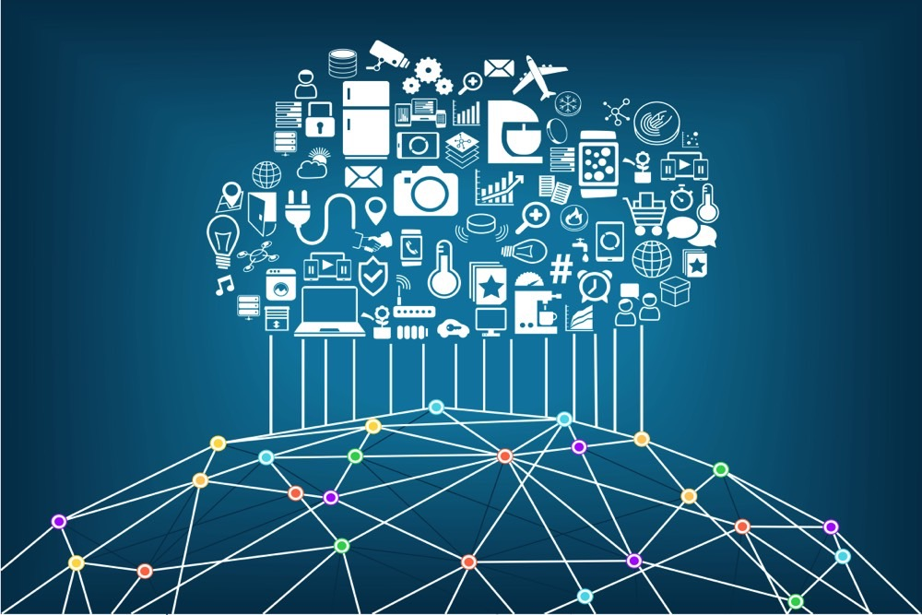
Internet of Things (IoT) is the networking of physical objects that contain electronics embedded within their architecture in order to communicate and sense interactions amongst each other or with respect to the external environment. In the upcoming years, IoT-based technology will offer advanced levels of services and practically change the way people lead their daily lives. Advancements in medicine, power, gene therapies, agriculture, smart cities, and smart homes are just a very few of the categorical examples where IoT is strongly established.
Over 9 billion ‘Things’ (physical objects) are currently connected to the Internet, as of now. In the near future, this number is expected to rise to a whopping 20 billion.

Slide 3
Components Required For IOT
Low-power embedded systems – Less battery consumption, high performance are the inverse factors play a significant role during the design of electronic systems.
Cloud computing – Data collected through IoT devices is massive and this data has to be stored on a reliable storage server. This is where cloud computing comes into play. The data is processed and learned, giving more room for us to discover where things like electrical faults/errors are within the system.
Availability of big data – We know that IoT relies heavily on sensors, especially real-time. As these electronic devices spread throughout every field, their usage is going to trigger a massive flux of big data.
Networking connection – In order to communicate, internet connectivity is a must where each physical object is represented by an IP address. However, there are only a limited number of addresses available according to the IP naming. Due to the growing number of devices, this naming system will not be feasible anymore. Therefore, researchers are looking for another alternative naming system to represent each physical object.

Slide 4
PESTICIDES AND ITS USAGE
Pesticides are chemical substances that are meant to kill pests. In general, a pesticide is a chemical or a biological agent such as a virus, bacterium, antimicrobial, or disinfectant that deters, incapacitates, kills, pests.
This use of pesticides is so common that the term pesticide is often treated as synonymous with plant protection product. It is commonly used to eliminate or control a variety of agricultural pests that can damage crops and livestock and reduce farm productivity. The most commonly applied pesticides are insecticides to kill insects, herbicides to kill weeds, rodenticides to kill rodents, and fungicides to control fungi, mould, and mildew.

Slide 5
PROBLEMS CAUSED BY EXCESSIVE USAGE OF PESTICIDES
1. Environmental Effects
As basically the function of pesticide is to kill pest by poisoning them the side effect of it might not far from it. It is reported that the usage of chemical fertilizer (read more : iron used in plant for growth and fertilizer) and pesticide contaminated and poison the soil, water, turf, and other vegetation. In addition to kill the pest, it is also kill another unwanted animal to kill such as birds, fish and other animal who has direct contact to it.
2. Human health
In recent study conducted in 2001, shows that the chemical pesticides has things to do with cardiovascular- and endocrine-related effects. This study started in 1976 where during the production of 2,4,5 T,a herbicide there is indication it is resulted a dioxin. This compound could damage on liver function, immune function, neurologic impairment, and reproductive. (read more : chemical elements of human body)
3. Surface water contamination
When farmers or pesticide user use the product by spraying it to the treated plants, the pesticide could reach surface water from treated plants and soil. Several cases have been reported due to this cause, according to U.S. Geological Survey (USGS) they observation resulted that more than 90 percent of water and fish samples from all streams contained one, or more often, several pesticides.
4. Ground water contamination
As well as surface water contamination, pesticide also contaminated the ground water with the chemical that should not be in it (read more : chemicals in water). This is a very bad situation where the source of life that is water is toxicated by the pesticides.
Once the water has been contaminated, it needs a complex and expensive source to clean it up. This catastrophic situation is found in India where according to USGS 58% of drinking water were contaminated with Organo Chlorine pesticides above the EPA standards.
5. Soil fertility effect
An excessive treatment of pesticide and chemical fertilizer could decrease the amount of micro organism. This decline will incur big losses as the soil were no longer hold any nutrients as stated by soil scientist Dr. Elaine Ingham, “If we lose both bacteria and fungi, then the soil degrades.
Overuse of chemical fertilizers and pesticides have effects on the soil organisms that are similar to human overuse of antibiotics. Indiscriminate use of chemicals might work for a few years, but after awhile, there aren’t enough beneficial soil organisms to hold onto the nutrients”.

Slide 6
USAGE OF IOT TO RESOLVE THIS ISSUE
We have come up with the IOT device which can control the excessive usage of these pesticides.
PEST CONTROLLER
This allows the user to only use specific amount of pesticides without putting excessive amount
The specific range is given to the device, in which it works only in that range,
If excessive amount is put into it shows an message, indicating the overuse
With this the user will have a note on the amount of pesticides he/she should use
It also shows the PH level and nutrients required for the soil.

Slide 7
BENEFITS OF PEST CONTROLLER
IT COVERS ALL THE ENVIRONMENTAL HAZARDS CAUSED BY PESTICIDES
WE,PEOPLE CONSUMING PRODUCT CONTAINING PESTICIDES,IS HARMFUL FOR OUR BODY,SO USING THESE IN LIMIT CAN HELP REDUCE THIS
IT IS ECONOMICALLY BENFICIAL TO FARMERS UPTO AN EXTENT

Slide 8
THANK YOU
- THE ALPHA
G.TARUNI
CH.SUCHARITHA
P.VAISHNAVI
S.TRIYA

