Slide 1


Slide 2

INVENTORY MANAGEMENT SYSTEM
FOR RETAILERS
Project Made by:
Chahat Tandon 4BD17CS029

Slide 3
Agenda
1
Introduction
2
Problem Statement
3
Propositions
4
Need for the study
5
Conclusion

Slide 4
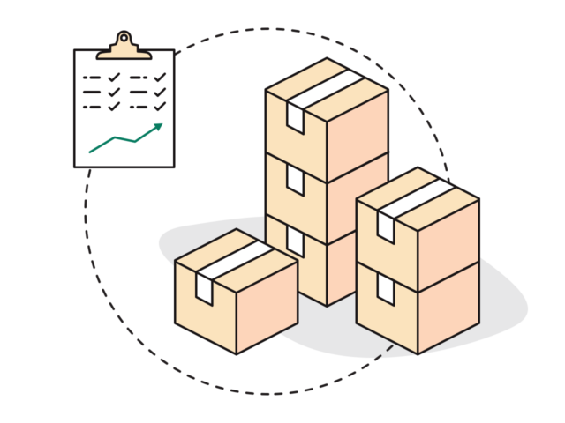
Inventory Management:
Inventory management is the process of ordering, handling, storing, and using a company’s non-capitalised assets – AKA its inventory. For some businesses, this involves raw materials and components, while others may only deal with finished stock items ready for sale.

Slide 5
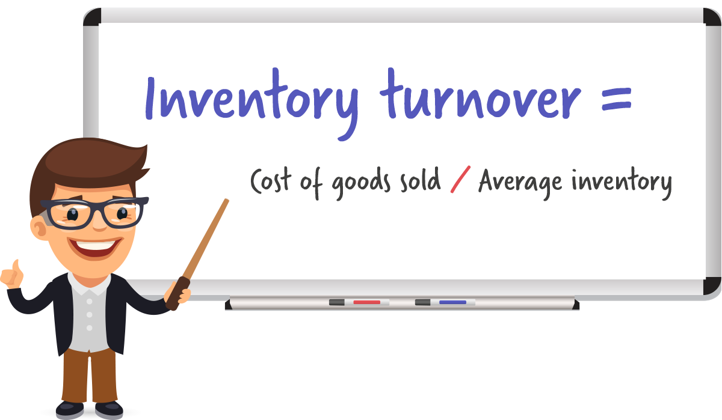
Problem Statement:
The usual iterated waterfall model is too rigid an approach to developing web applications.

Slide 6

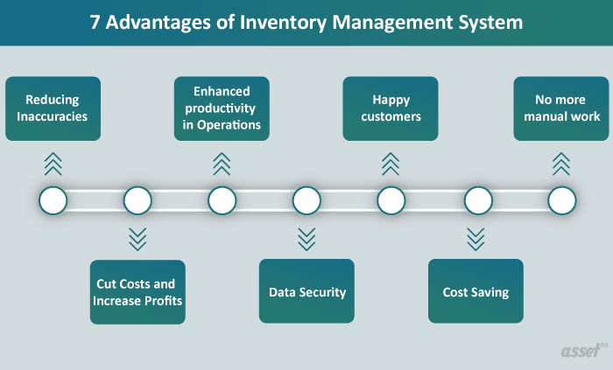
Basic Advantages:
Solution:
An agile approach for web application development has been proposed that applies the concept of agile modeling, adopts a standard software architecture and is heavily based on frameworks, speeding up system analysis, design and implementation.

Slide 7
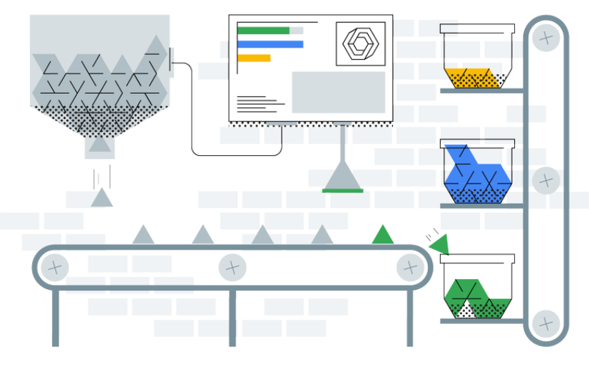
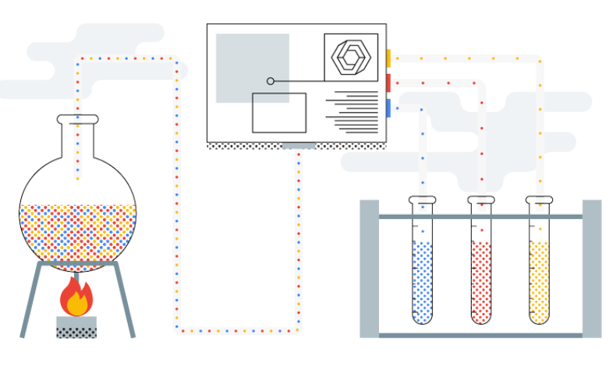
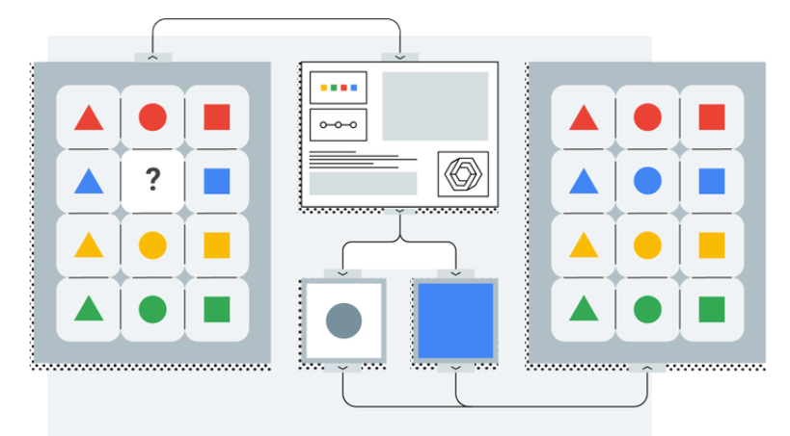
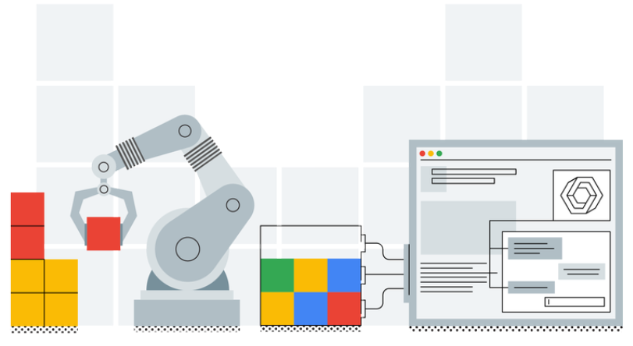
Proposed model:
Stock Management
Tracking of inventory details
Easy-user
Interface
Email Alerts

Slide 8



Hardware and Software requirements
Software Stack
Hardware Stack
Intel Core i7
8 GB RAM
1TB HDD
• Distribution Software: Anaconda
Framework: Flask
Scripting language: Python, HTML, Javascript
Tools identified
Text Editor/ IDE:
• Jupyter Notebook
Spyder
Most models require feature data to at least be scaled to comparable values
Otherwise features with larger magnitudes will have more weight than they should

Slide 9

Creative and easy to use Model
Inventory management at it’s best
Conclusion :
Out of Stock alerts
Email Alerts
SMTP allows sending various email alerts to the registered mail addresses.

Slide 10
Thankyou.

