Slide 1
Bhargavi Allam
Student, Gitam-Visakhapatnam
Machine learning Intern, TheSmartBridge
LinkedIn-www.linkedin.com/in/bhargavi-allam

Slide 2
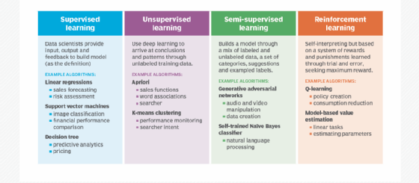
Machine learning

Slide 3
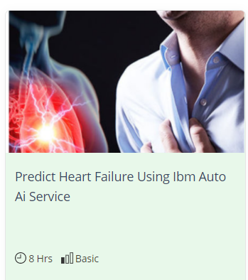
HEART FAILURE PREDICTION USING AUTO AI EXPERIMENT

Slide 4


Slide 5
Risk factors
Risks which can be altered
Risks which cant be altered
Smoking
Physical exercise
Gender
Age
Patient’s family history

Slide 6
Proposed solution
Factors
IBM services
Age
Smoking
BMI
Gender
Family history
Cholesterol
Physical exercise
Palpitations per day
Heartbeat per minute
IBM Watson studio
IBM Machine Learning
Node-Red
IBM cloud object storage
IBM Cloud Object Storage

