Slide 1
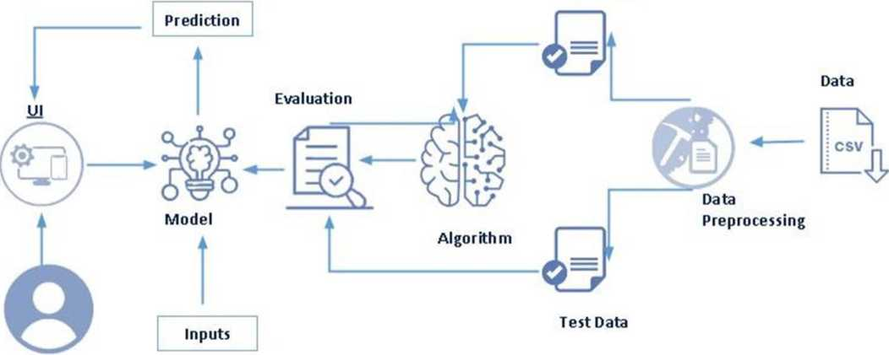
Smart Lender - Applicant Credibility Prediction
for Loan Approval Using Machine Learning
Project Description
One of the most important factors which affect our country’s economy and financial condition is the credit system governed by the banks. The process of bank credit risk evaluation is recognized at banks across the globe. “As we know credit risk evaluation is very crucial, there is a variety of techniques are used for risk level calculation. In addition, credit risk is one of the main functions of the banking community.
The prediction of credit defaulters is one of the difficult tasks for any bank. But by forecasting the loan defaulters, the banks definitely may reduce their loss by reducing their non-profit assets, so that recovery of approved loans can take place without any loss and it can play as the contributing parameter of the bank statement. This makes the study of this loan approval prediction important. Machine Learning techniques are very crucial and useful in the prediction of these types of data.
We will be using classification algorithms such as Decision tree, Random forest, KNN, and xgboost. We will train and test the data with these algorithms. From this best model is selected and saved in pkl format. We will be doing flask integration and IBM deployment
Technical Architecture:
Train Data
User
Figure 1 : Technical Architecture of Project

Slide 2
Prerequisties
To complete this project, you must require the following software, concepts, and packages
> Anaconda navigator:
• Refer to the link to download the anaconda navigator
• Link : https://youtu.be/1ra4zH2G4o0
> Python packages:
• Open anaconda prompt as administrator
• Type “pip install numpy” and click enter.
• Type “pip install scikit-learn” and click enter.
• Type “pip install pandas” and click enter.
• Type ”pip install matplotlib” and click enter.
• Type ”pip install pickle-mixin” and click enter.
• Type ”pip install seaborn” and click enter.
• Type “pip install Flask” and click enter.
Prior Knowledge
• ML Concepts
o Supervised learning: https://www.iavatpoint.com/supervised-machine-learning o Unsupervised learning: https://www.iavatpoint.com/unsupervised-machine-learning o Decision tree: https://www.iavatpoint.com/machine-learning-decision-tree-classification-algorithm o Random forest: https://www.iavatpoint.com/machine-learning-random-forest-algorithm o KNN: https://www.iavatpoint.com/k-nearest-neighbor-algorithm-for-machine-learning o Support vector machine algorithm: https://www.iavatpoint.com/machine-learning-support-vector-machine-algorithm
o Logistic Regression: https://www.iavatpoint.com/logistic-regression-in-machine-learning o Naive Bayes Classifier : https://www.iavatpoint.com/machine-learning-naive-bayes-classifier o Gradient boosting: https://www.iavatpoint.com/gbm-in-machine-learning o Multi-layer Perceptron: https://www.iavatpoint.com/multi-layer-perceptron-in-tensorflow o Evaluation metrics: https://www.analyticsvidhya.com/blog/2019/08/11-important-model-
evaluation-error-metrics/
o Flask Basics : https://www.youtube.com/watch7vMi4I CvBntO

Slide 3
Project Objectives By the completion of this project
• You’ll be able to understand the problem to classify if it is a regression or a classification kind of problem.
• You will be able to know how to pre-process/clean the data using different data pre-processing techniques.
• Applying different algorithms according to the dataset and based on visualization.
• Real-Time Analysis of Project
• How to build web applications using the Flask framework.
Project Flow
^ Install Required Libraries.
^ Data Collection.
• Collect the dataset or Create the dataset ^ Data Preprocessing.
• Import the Libraries.
• Importing the dataset.
• Understanding Data Type and Summary of features.
• Take care of missing data
• Data Visualization.
• Drop the column from DataFrame& replace the missing value.
• Splitting the Dataset into Dependent and Independent variables.
• Splitting Data into Train and Test.
^ Model Building
• Training and testing the model
• Evaluation of Model.
• Saving the Model.
^ Application Building
• Create an HTML file

Slide 4
• Build a Python Code
^ Final UI
• Dashboard Of the flask app.
Project Structure
Create the Project folder which contains files as shown below
* * ♦ T
Name * | Type | □ ate Modified
& .ipynb_chetkponnts | File Folder | 01-04-2022 17:50
IS IBM | File Folder | 05-04-202214:4£
& static | File Folder | 01-04-2022 15:18
> B us | File Fold ef | 01 -04-202215:52
+ app1 py | py File | 04-04-2022 15:29
[ff] Loan Prediction using Ml.ipyitb | ipynb File | 04-04-2022 15:22
IS loan_prcdkticn.csv | esv File | 31 -03-202212:46
0 rdf pkl | pkl File | 04-04-2022 15:20
Q) icalel.pkl | pkl File | 04-04-2022 1 Sd)2
• We are building a flask application which needs HTML pages stored in the templates folder and a python script app.py for scripting.
• rdf.pkl is our saved model. Further we will use this model for flask integration.
• Training folder contains model training files and training_ibm folder contains IBM deployment files.
Data Collection
> ML depends heavily on data, without data, it is impossible for an “AI” to learn. It is the most crucial aspect that makes algorithm training possible. In Machine Learning projects, we need a training data set. It is the actual data set used to train the model for performing various actions.
Activity 1: Download The Dataset
There are many popular open sources for collecting the data. Eg: kaggle.com, UCI repository, etc.
In this project we have used loan_prediction.csv data. This data is downloaded from kaggle.com. Please refer the link given below to download the dataset.
Dataset Link: https://www.kaggle.com/code/bhavikbb/loan-prediction-dataset
As we have understood how the data is collected lets pre-process the collected data.

Slide 5
Visualizing And Analyzing The Data
> As the dataset is downloaded. Let us read and understand the data properly with the help of some visualization techniques and some analyzing techniques.
Note: There is n number of techniques for understanding the data. But here we have used some of it. In an additional way, you can use multiple techniques.
Activity 1 : Importing The Library
> Import the necessary libraries as shown in the image
> Import the required libraries for the model to run. The first step is usually importing the libraries that will be needed in the program.
import pandas as pd import numpy as np import pickle
import matplotlib.pyplot as pit %matplotlib inline import seaborn as sns import sklearn
from sklearn.tree import DecisionTreeClassifier
from sklearn.ensemble import GradientBoostingClassifier, RandomForestClassifier from sklearn.neighbors import KNeighborsClassifier from sklearn.model_selection import RandomizedSearchCV import imblearn
from sklearn.model_selection import train_test_split from sklearn.preprocessing import StandardScaler
from sklearn.metrics import accuracy_score, classification_report, confusion_matrix, fl_score
Activity 2 : Reading The Dataset
• Our dataset format might be in .csv, excel files, .txt, json, etc. We can read the dataset with the help of pandas.
• In pandas, we have a function called read_csv() to read the dataset. As a parameter, we have to give the directory of the CSV file.

Slide 6
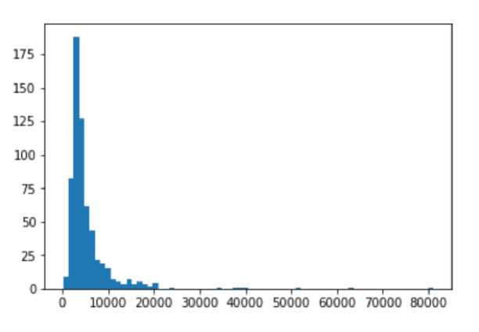
data | = pd.read_csv( |  | ¹ loan_ | prediction.cs\ | O
data
 | l oan ID | Gender | Married Dependents |  | Education | Self_Employed | Applicantlncome | Coapplicantlncome | LoanA mount | L
0 | LP001002 | Male | No | 0 | Graduate | No | 5849 | 00 | NaN | 3
1 | LP001003 | Male | Yea | 1 | Graduate | No | 4583 | 1508 0 | 1280 | 3
2 | LP001005 | Male | Yea | 0 | Graduate | Yes | 3000 | 00 | 660 | 3
3 | LP001006 | Male | Yes | 0 | Not Graduate | No | 2583 | 2358 0 | 1200 | 3
4 | LP001008 | Male | No | 0 | Graduate | No | 6000 | 0.0 | 141 0 | 3
609 | LP002978 | Female | No | 0 | Graduate | No | 2900 | 00 | 71.0 | 3
610 | LP002979 | Male | Yea | 3* | Graduate | No | 4106 | 00 | 400 | 1
611 | LP002983 | Male | Yea | 1 | Graduate | No | 8072 | 240 0 | 2530 | 3
612 | LP002984 | Male | Yes | 2 | Graduate | No | 7583 | 0.0 | 1870 | 3
613 | LP002990 | Female | No | 0 | Graduate | Yea | 4583 | 00 | 1330 | 3
614 rt | Mt ■ 13 CO | luans
Activity 3 : Uni-Variate Analysis
> In simple words, univariate analysis is understanding the data with single feature. Here we have displayed two different graphs such as distplot and countplot.
> Seaborn package provides a wonderful function distplot. With the help of distplot, we can find the distribution of the feature. To make multiple graphs in a single plot, we use a subplot.
pit.figure(figsize=(12,5)) pit.subplot(121)
sns.distplot(data['ApplicantIncome'], color='r') pit.subplot(122)
sns.distplot(data[‘Credit_History*]) pit.show()

Slide 7
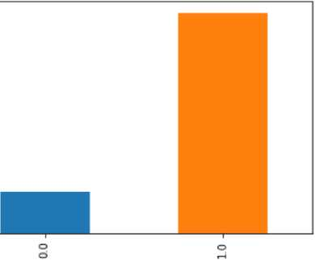
• In our dataset, we have some categorical features. With the count plot function, we are going to count the unique category in those features. We have created a dummy data frame with categorical features. With for loop and subplot, we have plotted the below graph.
• From the plot we came to know, Applicants' income is skewed towards the left side, whereas credit history is categorical with 1.0 and 0.0
Activity 4 : Bivariate Anaysis
pit
pit
sns
pit
pit
figure(figsize»(18,4))
subplot(1,4,1)
countplot(data['Gender *])
subplot(1,4,2)
countplot(data['Education’]
show()
400 300 200 100 0
From the above graph, we can infer the analysis such as
• Segmenting the gender column and married column based on bar graphs.
• Segmenting the Education and Self-employed based on bar graphs, for drawing insights such as educated people are employed.
• The loan amount term is based on the property area of a person holding.
Activity 5 : Descriptive Analysis
Descriptive analysis is to study the basic features of data with the statistical process. Here pandas have a worthy function called describe. With this describe function we can understand the unique, top, and frequent values of categorical features. And we can find mean, std, min, max and percentile values of continuous features.

Slide 8
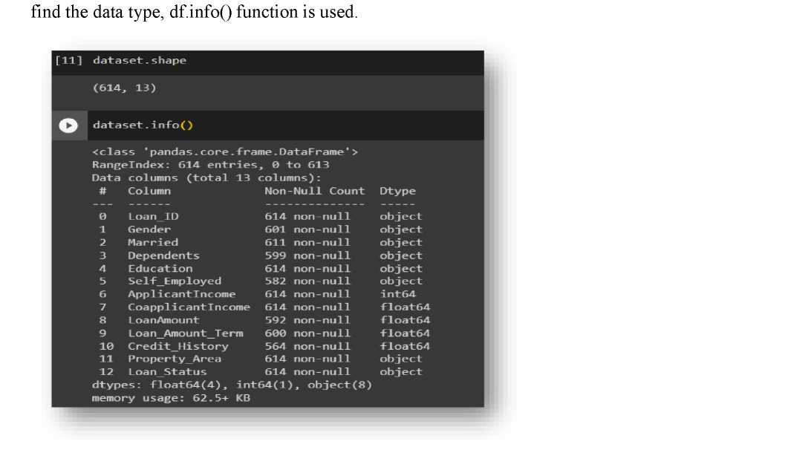
dataset.describe()
 | ApplicantIncome | CoapplicantIncome | LoanAmount | Loan_Amount_T e rm | Credit_History
count | 614.000000 | 614.000000 | 592.000000 | 600.00000 | 564.000000
mean | 5403.459283 | 1621.245798 | 146.412162 | 342.00000 | 0.842199
std | 6109 041673 | 2926.248369 | 85.587325 | 65.12041 | 0.364878
min | 150.000000 | 0.000000 | 9.000000 | 12.00000 | 0.000000
25% | 2877.500000 | 0.000000 | 100.000000 | 360.00000 | 1.000000
50% | 3812 500000 | 1188.500000 | 128.000000 | 360.00000 | 1.000000
75% | 5795.000000 | 2297.250000 | 168.000000 | 360.00000 | 1.000000
max | 81000.000000 | 41667.000000 | 700.000000 | 480.00000 | 1.000000
Data Preprocessing
As we have understood how the data is let's pre-process the collected data.
The download data set is not suitable for training the machine learning model as it might have so much of randomness so we need to clean the dataset properly in order to fetch good results. This activity includes the following steps.
• Handling missing values
• Handling categorical data
• Handling outliers
• Scaling Techniques
• Splitting dataset into training and test set
Note: These are the general steps of pre-processing the data before using it for machine learning. Depending on the condition of your dataset, you may or may not have to go through all these steps.
Activity 1 : Checking For Null Values
• Let’s find the shape of our dataset first, To find the shape of our data, df.shape method is used. To

Slide 9
• For checking the null values, df.isnull() function is used. To sum those null values we use .sum() function to it. From the below image we found that there are no null values present in our dataset. So we can skip the handling of the missing values step.
dataset.isnullQ. | sumO
LoanID | Q
Gender | 13
Married | 3
Dependents | 15
Education | a
Self Employed | 32
ApplicantIncome | a
Coapplicantlncome | a
LoanAmount | 22
Loan_Amount_Term | 14
Credit_History | sa
Pro p e rty Area | a
LoanStatus | a
dtype: int64
• From the above code of analysis, we can infer that columns such as gender, married, dependents, self-employed, loan amount, loan amount tern, and credit history are having the missing values, we need to treat them in a required way.
dataset['Gender']=dataset['Gender'].fillna(dataset['Gender¹].mode()[0])
dataset['Married']=dataset['Married¹].fillna(dataset['Married'].mode()[0])
dataset[‘Dependents']=dataset['Dependents'].fillna(dataset['Dependents’].mode()[8])
dataset['Self_Employed']=dataset['Self_Employed'].fillna(dataset['Self_Employed'].mode()[0])
dataset['LoanAmountTerm']=dataset[*LoanAmountTerm'].fillna(dataset['LoanAmotintTerm'].mode()[0])
dataset['LoanAmount']=dataset['LoanAmount'].fillna(dataset['LoanAmount'].mode()[0])
dataset['Credit_History']=dataset['Credit_History'].fillna(dataset['CreditHistory'].mode()[0])
We will fill the missing values in numeric data type using the mean value of that particular column and categorical data type using the most repeated value.
Activity 2 : Handling Categorical Values:
As we can see our dataset has categorical data we must convert the categorical data to integer encoding or binary encoding.
To convert the categorical features into numerical features we use encoding techniques. There are several techniques but in our project, we are using manual encoding with the help of list comprehension.
• In our project, Gender , married, dependents, self-employed, co-applicants income, loan amount , loan amount term, credit history With list comprehension encoding is done.

Slide 10
dataset['Gender']=dataset['Gender'].map({'Female':1,'Male':0})
dataset['PropertyArea']=dataset['PropertyArea'].map({'Urban':2,’Semiurban':1,'Rural':0}) dataset['Married']=dataset['Married'].map({'Yes':1,'No':0})
dataset['Education']=dataset['Education'].map({'Graduate':1,'Not Graduate':0}) dataset['LoanStatus']=dataset['LoanStatus'].map({'Y':1, 'N':0})
Converting string datatype into integer data type
data['Gender']=data['Gender'].astype(’int64')
data['Married']=data['Married'].astype('int64')
data['Dependents’]=data['Dependents’].astype('int64’)
data[’ Self _E«tployed']=data['Self_Employed'].astype('int64’)
data[’CoapplicantIncome']=data['Coapplicantlncome'].astype('int64’)
data['LoanAmount']=data[’LoanAmount'].astypef'int64’)
data['Loan_Amount_Terti*]=data["Loan_Amount_Term'].astype('int64')
data['Credit_History’]-data['Credit_History'].astype(’int64’)
Activity 3 : Balancing The Dataset:
Data Balancing is one of the most important step, which need to be performed for classification models, because when we train our model on imbalanced dataset ,we will get biased results, which means our model is able to predict only one class element
For Balancing the data we are using SMOTE Method.
SMOTE: Synthetic minority over sampling technique, which will create new synthetic data points for under class as per the requirements given by us using KNN method.
from imblearn.combine import SMOTETomek smote s SMOTETomek(0.90)
C:\Users\HP\AppOata\Roaming\Python\Python39\site-packages\imblearn\utils\_validation.py:587: Futurewarning: Pass sa*pling_strategy keyword args. From version 0.9 passing these as positional arguments will result in an error warnings.warn(
y * data['Loan_Status’]
x = data.drop(columns=[¹Loan_Statu5*],axis=i) x_bal,y_bal = smote.fit_re5ample(x,y)
print(y.value_counts{)) p rint(y_ba1.value_counts()) ¹
1 422
0 192
Name: Loan_Status_{J} dtype: int64
1 151
0 jes
Name: Loan_Status, dtype: int64

Slide 11
From the above picture, we can infer that previously our dataset is having 492 class 1, and 192 class items, after applying smote technique on the dataset the size has been changed for minority class.
Activity 4 : Scaling The Data
Scaling is one the important process, we have to perform on the dataset, because of data measures in different ranges can leads to mislead in prediction
Models such as KNN, Logistic regression need scaled data, as they follow distance based method and Gradient Descent concept.
sc=5tandardScaler() x_bal=sc. ■fi.t_transfora(x_bal)
x_bal = pd.DataFrame(x_bal,columns-names)
We will perform scaling only on the input values
Once the dataset is scaled, it will be converted into array and we need to convert it back to dataframe.
Activity 5 : Splitting Data Into Test and Train:
Now let’s split the Dataset into train and test sets
Changes: first split the dataset into x and y and then split the data set
Here x and y variables are created. On the x variable, df is passed by dropping the target variable. And on y target variable is passed. For splitting training and testing data, we are using the train_test_split() function from sklearn. As parameters, we are passing x, y, test_size, and random_state.
X_train, X_test, y_train, y_test = train_test_split( x_bal, y_bal, tes1:_size=0.33, random_state=42)
Model Building
Now our data is cleaned and it’s time to build the model. We can train our data on different algorithms. for this project, we are applying four classification algorithms. The best model is saved based on its performance.
Xgboost Model
A function named xgboost is created and train and test data are passed as the parameters. Inside the function, the GradientBoostingClassifier algorithm is initialized and training data is passed to the model with .fit() function. Test data is predicted with .predict() function and saved in a new variable. For evaluating the model, a confusion matrix and classification report are done

Slide 12
pip install xgboost
Requirement already satisfied: xgboost in d:\anaconda\lib\site-packages (1.7.5)
Requirement already satisfied: scipy in d:\anaconda\lib\site-packages (from xgboost) (1.9.1) Requirement already satisfied: numpy in d:\anaconda\lib\site-packages (from xgboost) (1.21.5) Note: you may need to restart the kernel to use updated packages.
import xgboost as xgb
model=xgb.XGBClassifier() model.fit(x_train,y_train)
XGBClassifier(base_score=Nonej booster=None, callbacks=None, colsample_bylevel=None, colsample_bynode=None_{J} colsample_bytree=None, early_stopping_rounds=None, enable_categorical=False, eval_metric=None, feature_types=None, gamma=None, gpu_id=None, grow_policy=Nonej importance_type=None, interaction_constraints=None^ learning rate=None. max_bin=None, maxcatthreshold=None, maxcat_toonehot=None, max_delta_step=Nonej maxdepth=None, maxleaves=Nonej min_child_weight=None, missing=nan, monotone_constraints=None, n_estimators=100, n_jobs=None, num_parallel_tree=None_{J} predictor=None, random_state=None, ...)
pred=model.predict(x_test)
pred
array( [1, 1, 1, 0, 1, 0, 1, 1, 0, 1, 1, 1, 1, 1, 1, 1, 0, 1, 1, 0, <d, 1,
1, 1, 1, 0, 1, 1, 0, 0, 1, 0, 1, 1, 1, 0, 1, 1, 1, 1, 1, 0, 1, 1,
1, 1, 1, 1, 0, 1, 1, 1, 1, 1, 0, 0, 1, 1, 1, 1, 0, 1, 1, 0, 1, 1,
1, 1, 1, 1, 1, 1, 1, 0, 1, 1, 0, 0, 1, 0, 0, 1, 1, 1, 1, 0, 1, 1,
1, 1, 1, 1, 1, 0, 1, 0, 1, 1, 1, 1, 0, 1, 1, 1, 1, 1, 1, 1, 1, 0,
0, 0, 1, 1, 0, 0, 1, 1, 1, 1, 1, 0, 1])
ytest
array( [1, <d, 1, 0, 1, 0, 1, 1, 0, 1, 1, 1, 1, 1, 1, 0, 0, 1, 1, 0, 0, 1,
1, 1, 1, 1, 1, 1, 0, 0, 1, 1, 1, 1, 1, 0, 1, 1, 1, 1, 1, 0, 1, 1,
1, 1, 1, 1, 0, 1, 1, 1, 1, 1, 1, 1, 1, 0, 1, 1, 1, 0, 1, 0, 1, 1,
1, 1, 1, 1, 0, 1, 1, 1, 1, 1, 0, 0, 1, 0, 1, 0, 0, 1, 0, 1, 1, 1,
1, 1, 1, 0, 0, 0, 1, 0, 1, 1, 1, 1, 1, 1, 1, 0, 1, 1, 1, 1, 1, 0,
1, 0, 0, 1, 0, 1, 1, 1, 1, 1, 1, 0, 1])
from sklearn.metrics import accuracy_score, classification_report, confusion_matrix
accuracy_score(y_test,pred)
0.8130081300813008

Slide 13
print(classificationreport(ytest,pred))
 | precision | recall | fl-score | support
e | 0.66 | 0.64 | 0.65 | 33
l | 0.87 | 0.88 | 0.87 | 90
accuracy |  |  | 0.81 | 123
macro avg | 0.76 | 0.76 | 0.76 | 123
weighted avg | 0.81 | 0.81 | 0.81 | 123
confusion_matrix(y_test,pred)
array([[21, 12],
[11, 79]], dtype=int64)
Application Building
In this section, we will be building a web application that is integrated to the model we built. A UI is provided for the uses where he has to enter the values for predictions. The enter values are given to the saved model and prediction is showcased on the UI.
This section has the following tasks
• Building HTML Pages
• Building serverside script
Activity 1 : Building Html Pages
For this project create three HTML files namely
• home.html
• predict.html
• submit.html
and save them in the templates folder.
Let’s see how our home.html page looks like:
Welcome to Loan Prediction
This model predicts whether someone can payback their loan based on their historical data prediction
Now when you click on predict button from top right corner you will get redirected to predict.html

Slide 14
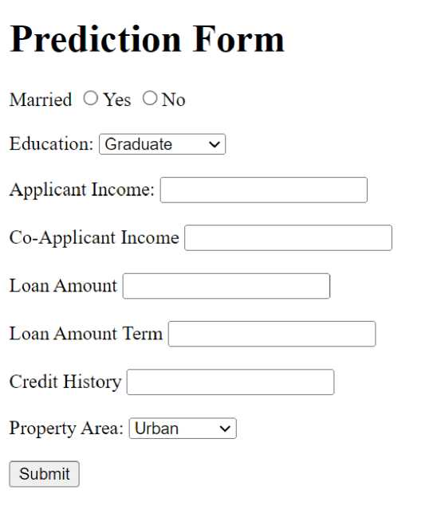
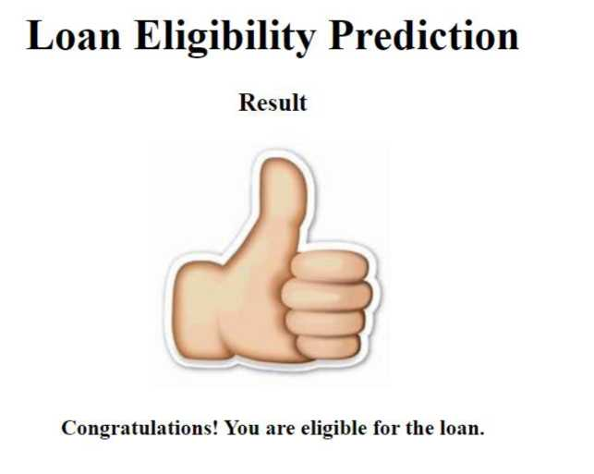
Lets look how our predict.html file looks like:
Now when you click on submit button from left bottom corner you will get redirected to submit.html . Lets look how our submit.html file looks like:

Slide 15

Activity 2 : Build Python code
import the libraries
from flask import Flask, request, rendertemplatej urlfor
import pickle
import numpy as np
import json
import requests
Load the saved model. Importing the flask module in the project is mandatory. An object of Flask
class is our WSGI application. Flask constructor takes the name of the current module (_name_) as
an argument.
app = Flask{_name_)
with open('Loanpredict. pkl'¹ r b') as file: model = pickle.load(file)
Render HTML page:
@app.route{"/") def f():
return render_template("Home.html")
Here we will be using declared constructor to route to the HTML page which we have created earlier.
def prediction():
return rendertemplate("prediction.html")
lln the above example, 7’ URL is bound
with home.html function. Hence, when the home page of the web server is opened in browser, the html
page will be rendered. Whenever you enter the values from the html page the values can be retrieved
using POST Method.
Retrieves the value from UI:
(Sapp. noute("/submit. html", methods=[ "GET", "POST" ]) def submit():
if request.method == ’POST':
varl = request.form["Married“] var2 « request.form["Education”] var3 « request.form["Applicant Income"] var4 = request.form[''Co-Applicant Income"] var5 = request.form["Loan Amount"] var6 = request.form["Loan Amount Term"] var7 « request.form["Credit History"] var8 « request.form["Property Area"]
predict_data = np.array([varl, var2, var3, var4, var5j var6, var7, var8]).reshape(lj -1) predict = model.predict(predict_data) if (predict == 1):
return render_template(’submit.html', pre="YES”) elif(predict == 0):
return render_template(’submit.html', pre="No")
Here we are routing our app to predict() function. This function retrieves all the values from the HTML page using a Post request. That is stored in an array. This array is passed to the model.predict()

Slide 16
function. This function returns the prediction. And this prediction value will be rendered to the text that we have mentioned in the submit.html page earlier.
Main Function:
if _name_=="_main_
# app.run(host='8.9.9.0', pO’rt=B000_{J} debug=True) # running the app
port=int(os.environ.get( 'PORT',5909))
app.run(debug=^{r}alse)
Run The Application
• Open the anaconda prompt from the start menu
• Navigate to the folder where your python script is.
• Now type “python app.py” command
• Navigate to the localhost where you can view your web page.
• Click on the predict button from the top left corner, enter the inputs, click on the submit button, and see the result/prediction on the web.

