Slide 1
Systems Development Methodology Options
Alan Dennis, Barbara Haley Wixom, and Roberta Roth
© Copyright 2011 John Wiley & Sons, Inc.
2-1
Notes:
This chapter discusses how organizations evaluate and select projects to undertake from the many available projects. Once a project has been selected, the project manager plans the project. Project management involves selecting a project methodology, creating the project work plan, identifying project staffing requirements, and preparing to manage and control the project. These steps produce important project management deliverables, including the work plan, staffing plan, standards list, project charter, and risk assessment.
However, because in final year of the programme we will cover project management, at this level we will only cover System Development methodology options. We will describe various approaches to the SDLC that can be used to structure a development project.

Slide 2
Project Methodology Options
A methodology is a formalized approach to implementing the SDLC (i.e., it is a list of steps and deliverables)
- Waterfall Development
- Parallel Development
- V-model (variation of the Waterfall Development)
- Rapid Application Development (RAD)
- Iterative Development
- System prototyping
- Agile Development
© Copyright 2011 John Wiley & Sons, Inc.
2-2
Notes:
There are many different systems development methodologies, and they vary in terms of the progression that is followed through the phases of the SDLC.

Slide 3
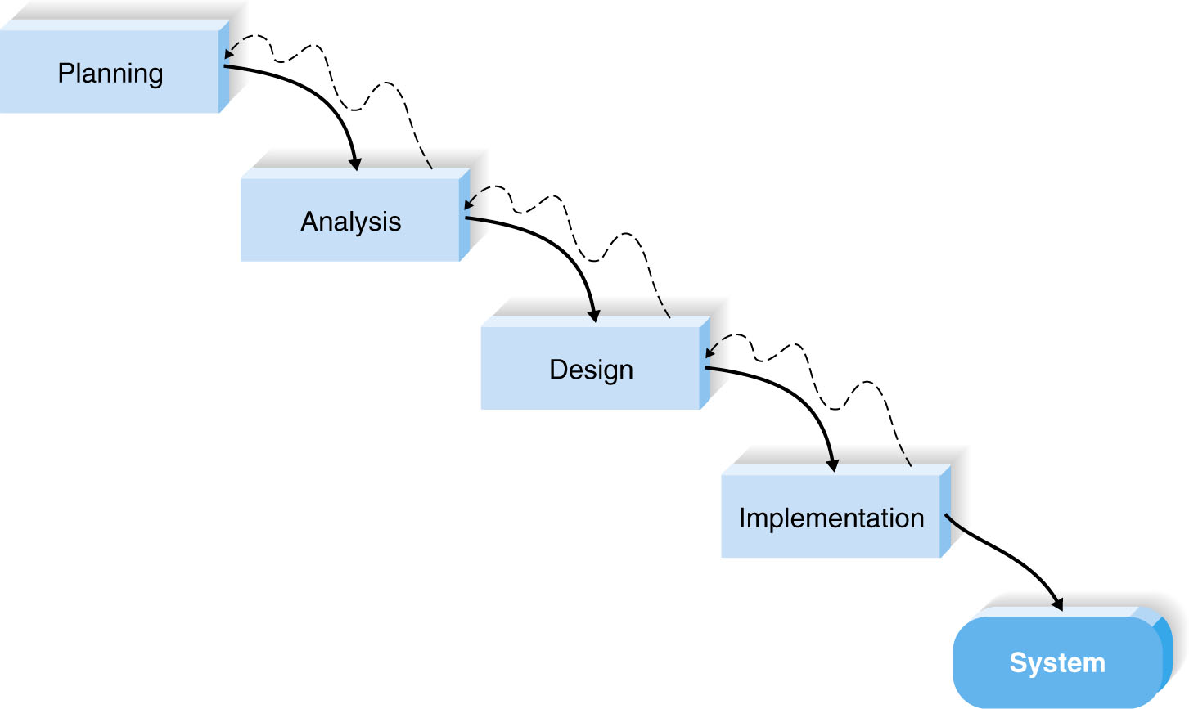
Waterfall Development
© Copyright 2011 John Wiley & Sons, Inc.
2-3
Notes:
With waterfall development, analysts and users proceed sequentially from one phase to the next. The key deliverables for each phase are typically voluminous (often, hundreds of pages) and are presented to the approval committee and project sponsor for approval as the project moves from phase to phase. End of one phase leads to the start of next phase. While it is possible to go backward through the phases (e.g., from design back to analysis), it is quite difficult. (Imagine yourself as a salmon trying to swim upstream in a waterfall).
Waterfall development methodologies have the advantages of identifying requirements long before programming begins and limiting changes to the requirements as the project proceeds.
The key disadvantages are that the design must be completely specified before programming begins, a long time elapses between the completion of the system proposal in the analysis phase and the delivery of system, and testing is treated almost as an afterthought in the implementation phase. In addition, the deliverables are often a poor communication mechanism, so important requirements may be overlooked in the volumes of documentation. If the project team misses an important requirement, expensive post-implementation programming may be needed. Users may forget the original purpose of the system, since so much time has elapsed between the original idea and actual implementation.

Slide 4
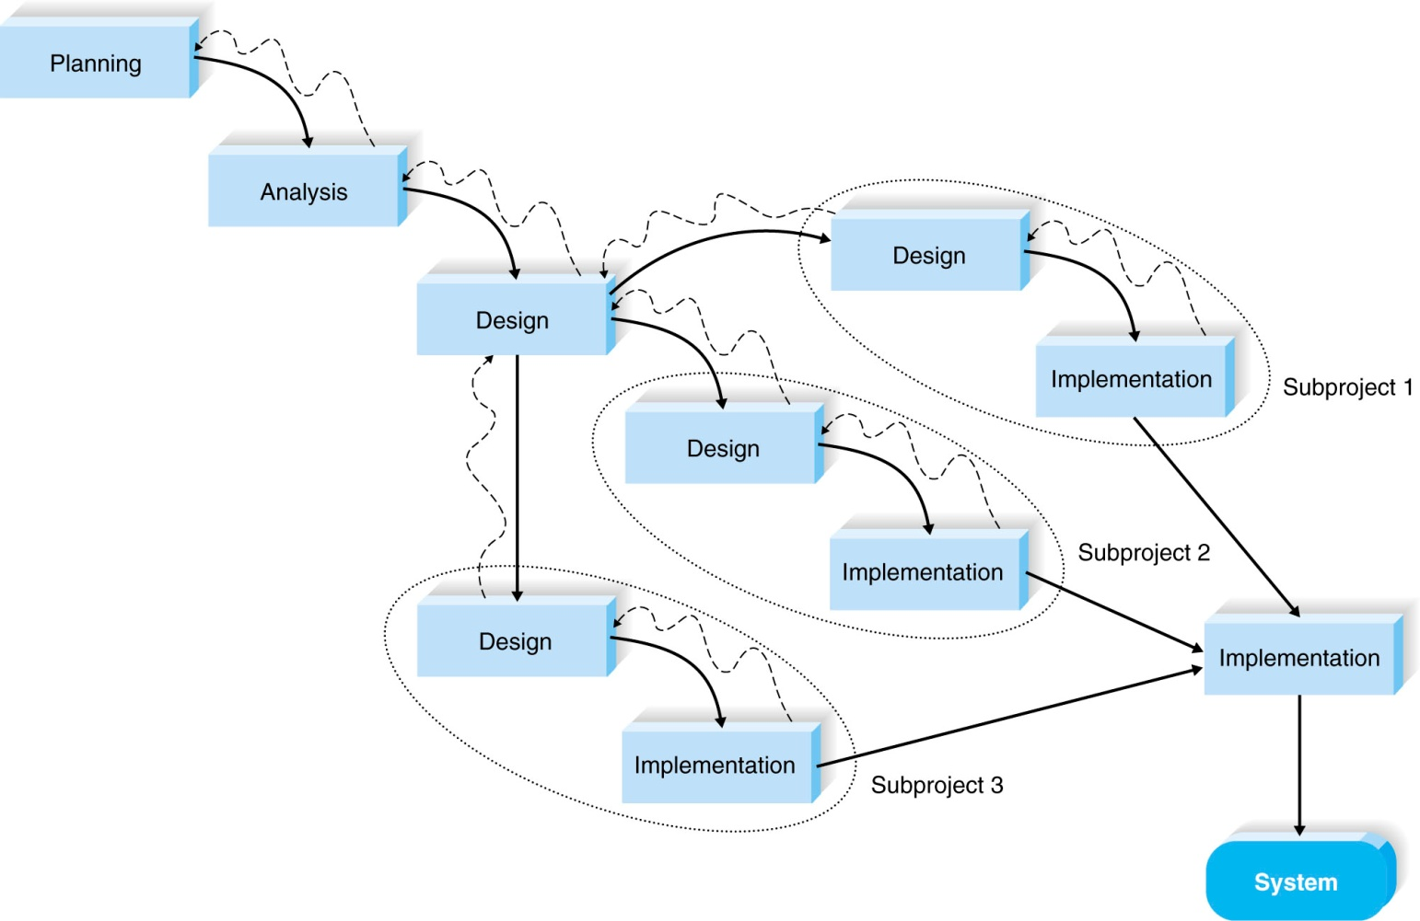
Parallel Development
© Copyright 2011 John Wiley & Sons, Inc.
2-4
Notes:
There are two important variants of waterfall development. The parallel development methodologies evolved to address the lengthy time frame of waterfall development.
For parallel development, instead of doing the design and implementation in sequence, a general design for the whole system is performed. Then the project is divided into a series of subprojects that can be designed and implemented in parallel. Once all subprojects are complete, there is a final integration of the separate pieces, and the system is delivered. Parallel development reduces the time required to deliver a system, so changes in the business environment are less likely to produce the need for rework.
The approach still suffers from problems caused by voluminous deliverables.
It also adds a new problem: If the subprojects are not completely independent, design decisions in one subproject may affect another, and at the project end, integrating the subprojects may be quite challenging.

Slide 5
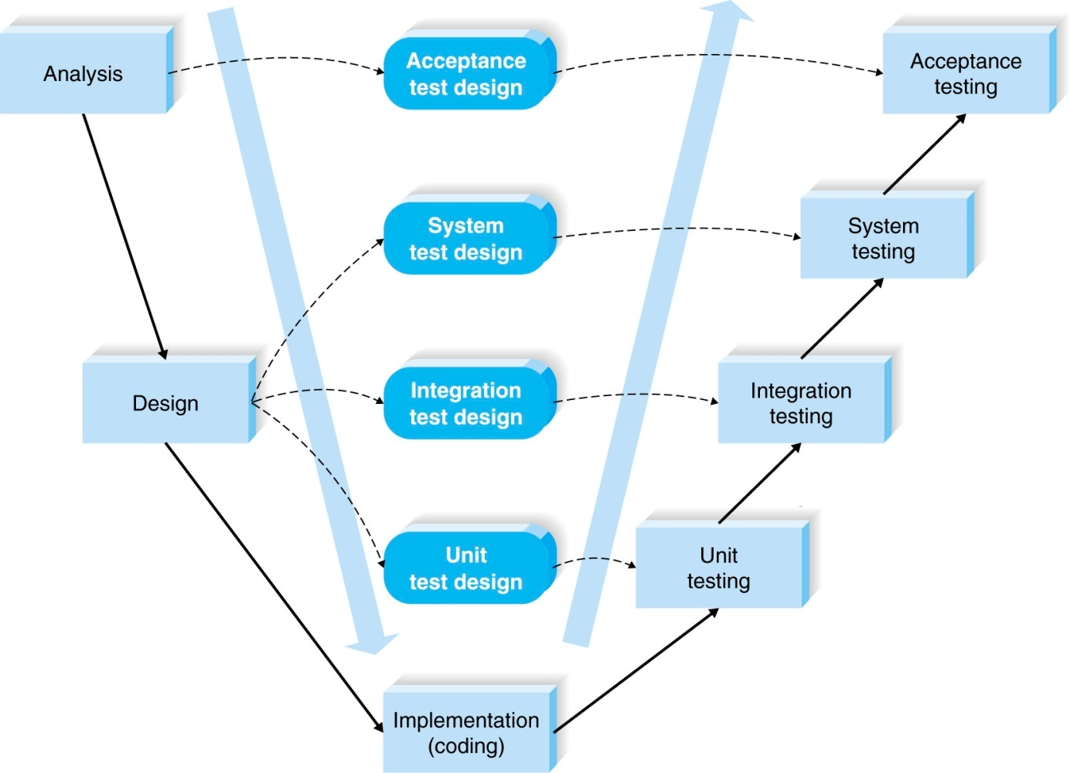
V-model
© Copyright 2011 John Wiley & Sons, Inc.
2-5
Notes:
The V-model is another variation of waterfall development that pays more explicit attention to testing. As shown in Figure 2-4, the development process proceeds down the left-hand slope of the V, defining requirements and designing system components. At the base of the V, the code is written. On the upward-sloping right side of the model, testing of components, integration testing, and, finally, acceptance testing are performed.
A key concept of this model is that as requirements are specified and components designed, testing for those elements is also defined. In this manner, each level of testing is clearly linked to a part of the analysis or design phase, helping to ensure high quality and relevant testing and maximize test effectiveness.
The V-model is simple and straightforward and improves the overall quality of systems through its emphasis on early development of test plans. Testing focus and expertise is involved in the project earlier rather than later; plus, the testers gain knowledge of the project early. It still suffers from the rigidity of the waterfall development process, however, and is not always appropriate for the dynamic nature of the business environment.

Slide 6
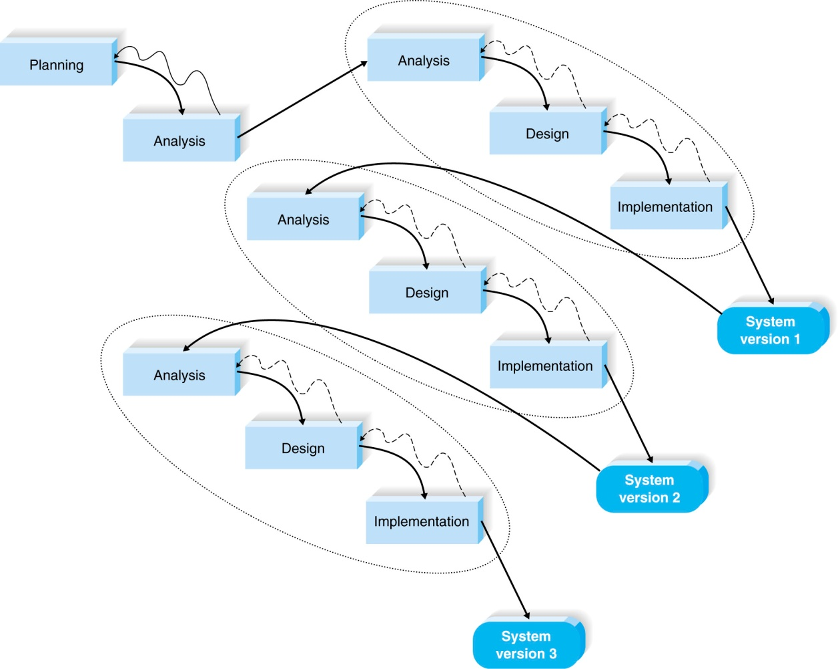
Rapid Application Development: Iterative Development
© Copyright 2011 John Wiley & Sons, Inc.
2-6
Notes:
Rapid application development is a collection of methodologies that emerged in response to the weaknesses of waterfall development and its variations. RAD incorporates special techniques and computer tools to speed up the analysis, design, and implementation phases in order to get some portion of the system developed quickly and into the hands of the users for evaluation and feedback.
While RAD can improve the speed and quality of systems development, it may also introduce a problem in managing user expectations. As systems are developed more quickly and users gain a better understanding of information technology, user expectations may dramatically increase and system requirements may expand during the project (sometimes known as scope creep or feature creep).

Slide 7
Rapid Application Development: Iterative Development
© Copyright 2011 John Wiley & Sons, Inc.
2-7
Notes:
Iterative development breaks the overall project into a series of versions that are developed sequentially. The most important
and fundamental requirements are bundled into the first version of the system. This version is developed quickly by a mini-waterfall process, and once implemented, the users can provide valuable feedback to be incorporated into the next version of the system.
Iterative development gets a preliminary version of the system to the users quickly so that business value is provided. Since users are working with the system, important additional requirements may be identified and incorporated into subsequent versions. The chief disadvantage of iterative development is that users begin to work with a system that is intentionally incomplete. Users must accept that only the most critical requirements of the system will be available in the early versions and must be patient with the repeated introduction of new system versions.

Slide 8
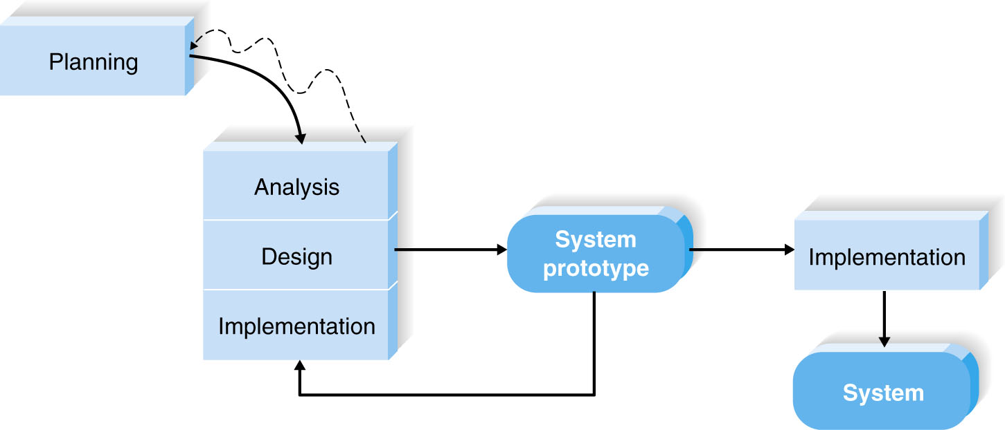
Rapid Application Development: System Prototyping
© Copyright 2011 John Wiley & Sons, Inc.
2-8
Notes:
System prototyping performs the analysis, design, and implementation phases concurrently in order to quickly develop a simplified version of the proposed system and give it to the users for evaluation and feedback. The system prototype is a “quick and dirty” version of the system and provides minimal features. Following reaction and comments from the users, the developers reanalyze, redesign, and reimplement a second prototype that corrects deficiencies and adds more features. This cycle continues until the analysts, users, and sponsor agree that the prototype provides enough functionality to be installed and used in the organization. System prototyping very quickly provides a system for users to evaluate and reassures users that progress is being made. The approach is very useful when users have difficulty expressing requirements for the system. A disadvantage, however, is the lack of careful, methodical analysis prior to making design and implementation decisions. System prototypes may have some fundamental design limitations that are a direct result of an inadequate understanding of the system’s true requirements early in the project.

Slide 9
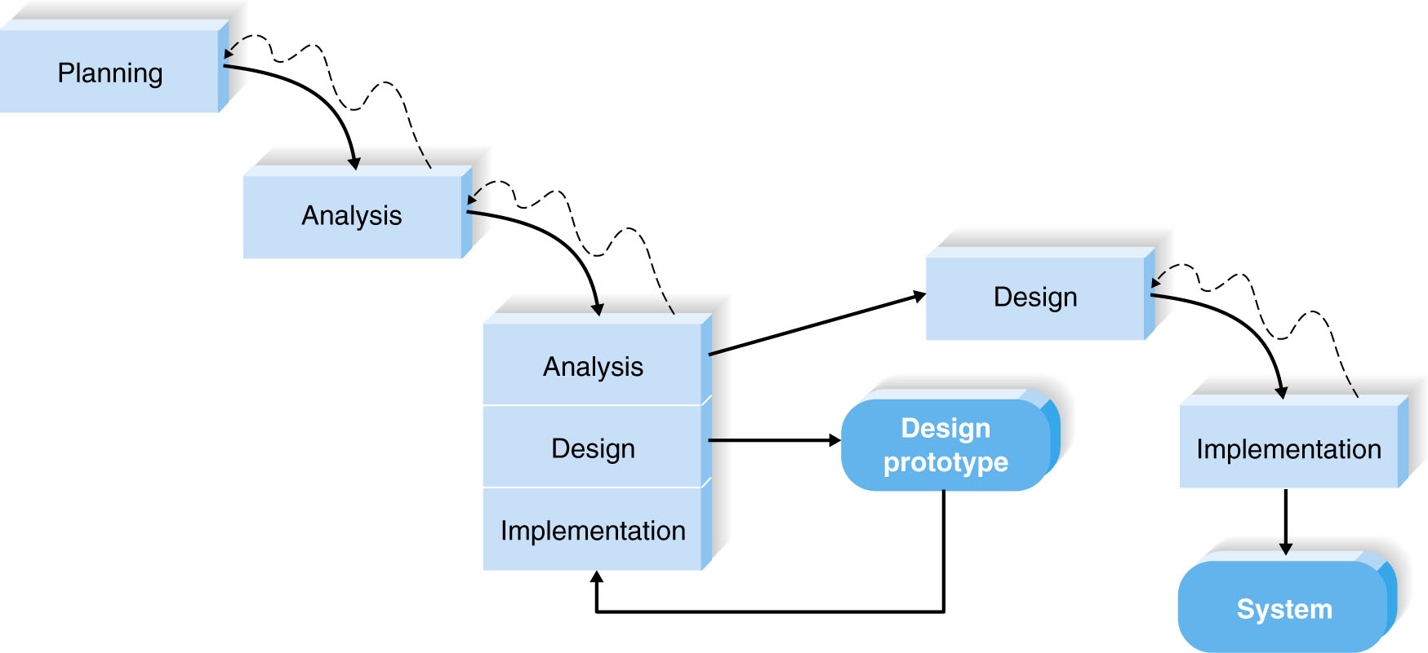
Types of prototyping
Throwaway prototyping
© Copyright 2011 John Wiley & Sons, Inc.
2-9
Notes:
Throwaway prototyping includes the development of prototypes, but uses the prototypes primarily to explore design alternatives rather than as the actual new system (as in system prototyping). It has a fairly thorough analysis phase that is used to gather requirements and to develop ideas for the system concept.
A design prototype is not intended to be a working system. It contains only enough detail to enable users to understand the issues under consideration. (consider a series of mock-up screens appear to be a system, but they really do nothing)

Slide 10
Agile Development
A group of programming-centric methodologies that focus on streamlining the SDLC.
Includes face-to-face communication
Extreme programming – emphasizes customer satisfaction and teamwork.
Scrum9,
dynamic systems development method
© Copyright 2011 John Wiley & Sons, Inc.
2-10
Notes:
Agile development is a group of programming-centric methodologies that focus on streamlining the SDLC.
Much of the modeling and documentation overhead is eliminated; instead, face-to-face communication is preferred. A
project emphasizes simple, iterative application development in which every iteration is a complete software project, including planning, requirements analysis, design, coding, testing, and documentation. Cycles are kept short (one to four weeks), and the development team focuses on adapting to the current business environment.
There are several popular approaches to agile development, including extreme programming (XP)8, Scrum9, and dynamic systems development method (DSDM)

Slide 11
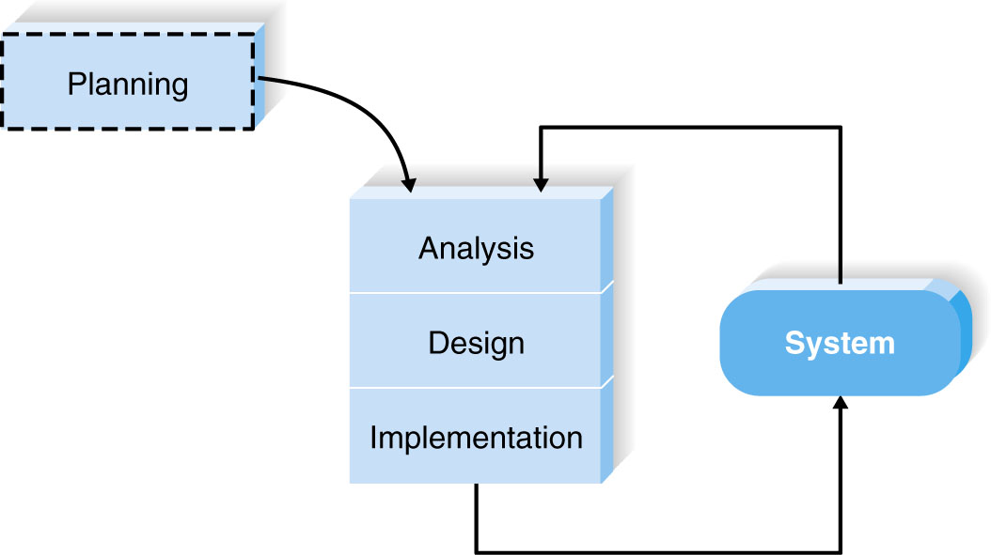
Extreme Programming
© Copyright 2011 John Wiley & Sons, Inc.
2-11
Notes:
Extreme programming11 emphasizes customer satisfaction and teamwork. Communication, simplicity, feedback, and courage are core values. Developers communicate with customers and fellow programmers. Designs are kept simple and clean. Early and frequent testing provides feedback, and developers are able to courageously respond to changing requirements and technology.

Slide 12
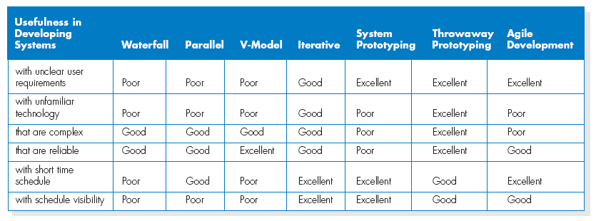
Selecting the Appropriate Development Methodology
© Copyright 2011 John Wiley & Sons, Inc.
2-12

Slide 13
Factors to consider in selecting the development methodology
Important factors to consider in selecting the development methodology
- Clarity of User Requirements
- Familiarity with Technology
- System Complexity
- System Reliability
- Short Time Schedules
- Schedule Visibility
© Copyright 2011 John Wiley & Sons, Inc.
2-13

Slide 14
Test Quizes
What are the key factors in selecting a methodology
© Copyright 2011 John Wiley & Sons, Inc.
2-14

Slide 15
Test Quizzes
Describe the major elements and issues with system prototyping.
© Copyright 2011 John Wiley & Sons, Inc.
2-15

Slide 16
Quiz
How can prototyping be used to collect system requirements
How can we use prototyping to validate a system
© Copyright 2011 John Wiley & Sons, Inc.
2-16

