Slide 1
Vectors
Contents
1. Basics of Vector

Slide 2
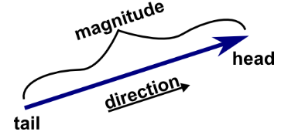
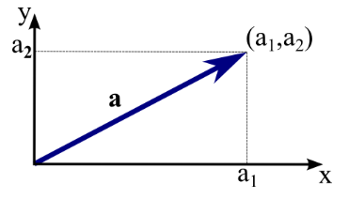


Basics of Vectors
Vector, fundamental element of Linear algebra. is an object, magnitude and direction are the properties.
Magnitude = Length of the vector
Direction = Arrow
Ex1: force -> strength of the force is magnitude,
Ex2: velocity -> speed of the velocity is magnitude
Operations on Vector
Addition, Subtraction, Multiplication by scalar
Two different ways to multiply two vectors together: Dot product, Cross product
Cumulative law: a + b = b + a
Associative law: (a + b) + c = a + (b +c)
Vectors in geometric plane
Vector a = (a1, a2) is two dimensional vector
Length of a,
Three dimensional vector b = (b1, b2, b3)
||a|| =
Reference : https://mathinsight.org/vector_introduction

Slide 3
Basics of Vectors in Python

