Slide 1
Average daily DJF 2m temperature 1980-1986 (°C)
CESM Uniform 1 deg
CESM VarRes 28km
CESM VarRes 14km
NARR 32km
PRISM 4km

Slide 2
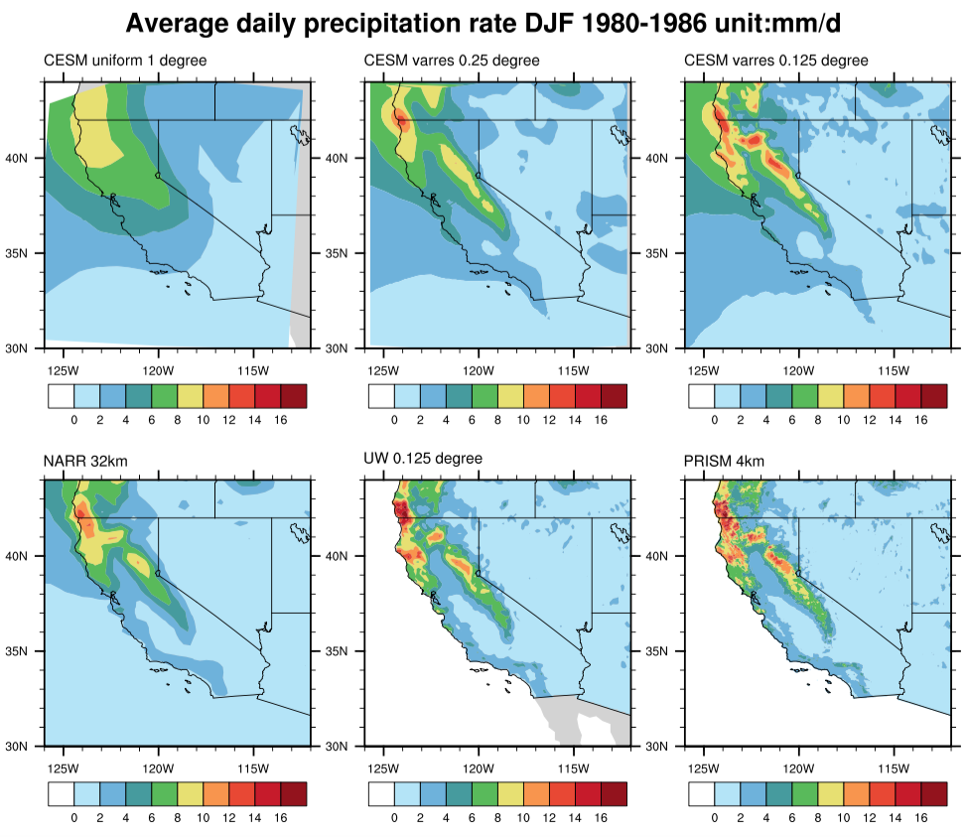
Average daily DJF precipitation rate 1980-1986 (mm/d)
CESM Uniform 1 deg
CESM VarRes 28km
CESM VarRes 14km
NARR 32km
UW 28km
PRISM 4km

Slide 3
Average DJF Snow Water Equivalent 1980-1986 (mm)
CESM Uniform 1 deg
CESM VarRes 28km
CESM VarRes 14km
NCEP 35km
DAYMET 1km

Slide 4
Average DJF Snow Water Equivalent 1980-1986 (mm)
CESM Uniform 1°
CESM VarRes 28km
CESM VarRes 14km
NCEP 35km
DAYMET 1km

