Slide 1

KAFKA EAGLE
A EASY AND HIGH-PERFORMANCE MONITORING SYSTEM
AUTHOR : SMARTLOLI
UPDATE : 2019.07.14

Slide 2
Part I
The Background of Kafka Eagle
01
MENU
Part II
Design Architecture of Kafka Eagle
02
Part III
The Advantages of Kafka Eagle
03
Part IV
Follow-up Planning of Kafka Eagle
04

Slide 3
01
Part I
The Background of Kafka Eagle

Slide 4
Open Source
IM Support
01
Open source Kafka monitoring system has too few functions or suspension of maintenance.
03
Some monitoring system can not satisfy integration with existing IM, such as wechat or dingding.
Apache Kafka
Convenience
Apache Kafka does not officially provide monitoring systems or pages.
02
It is difficult to configure and use the existing monitoring system.
04

Slide 5
02
Part II
Design Architecture of Kafka Eagle

Slide 6
Visualization
1. Topic list, rate, consumer
2. Cluster heathy
3. TBD
01
Collector
1. Zookeeper
2. Kafka jmx & external topic
3. Kafka api (2.x+)
ACLs
06
02
1. Topic create,detele etc
2. User manage
Kafka Eagle
Storage
Alert
05
03
1. MySQL
2. SQLite
1. E-Mail
2. WeChat
3. DingDing
04
Metrics
1. Consumer application
2. Cluster heathy

Slide 7
03
Part III
The Advantages of Kafka Eagle

Slide 8
Download
QuickStart
https://www.kafka-eagle.org/
ke.sh start
Step 1
Step 2
Step 3
Step 4
Install
Visit
https://docs.kafka-eagle.org/
http://ip:port/ke

Slide 9
The kafka eagle system has favorable
user interface, powerful
function modules.
Cluster
Consumers
Metrics
Topic
Alarm
Kafka Eagle
Dashboard
System

Slide 10
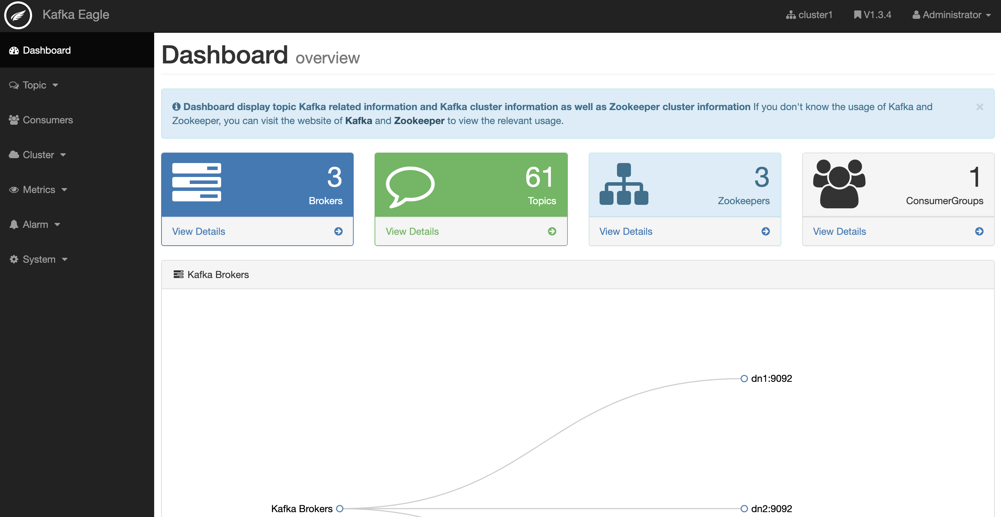
Show the scale of
clusters, themes,
consumers, etc.
Show kafka cluster
survival nodes.

Slide 11
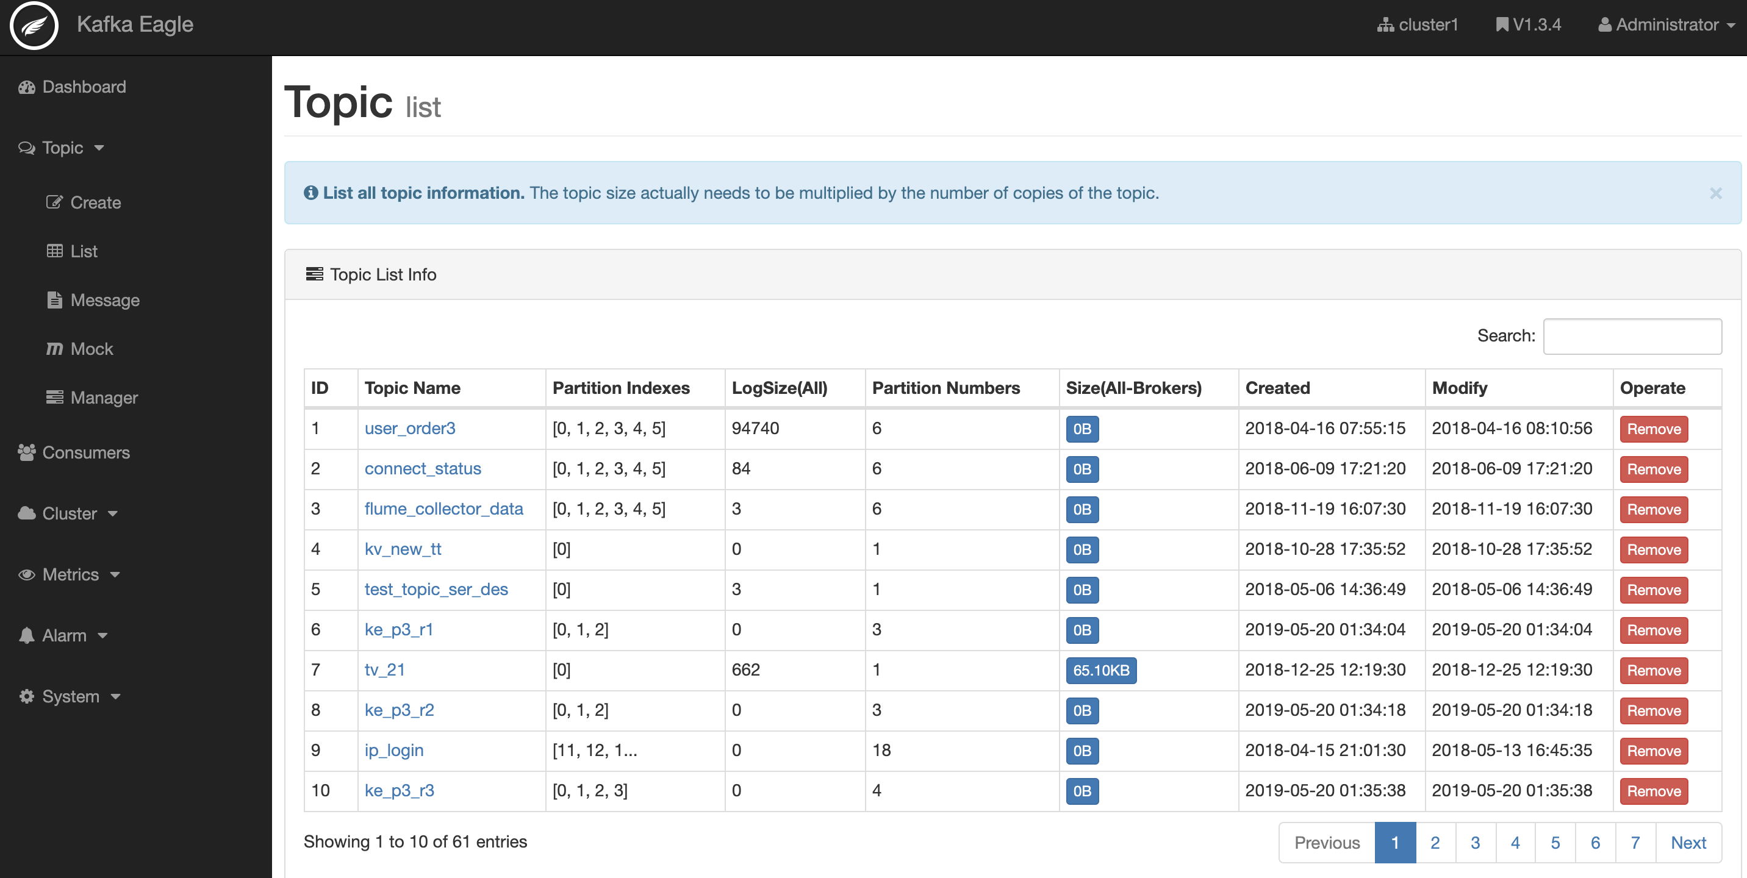
1. Create topic.
2. List topic.
3. SQL query.
4. Mock data.
5. Config topic.

Slide 12
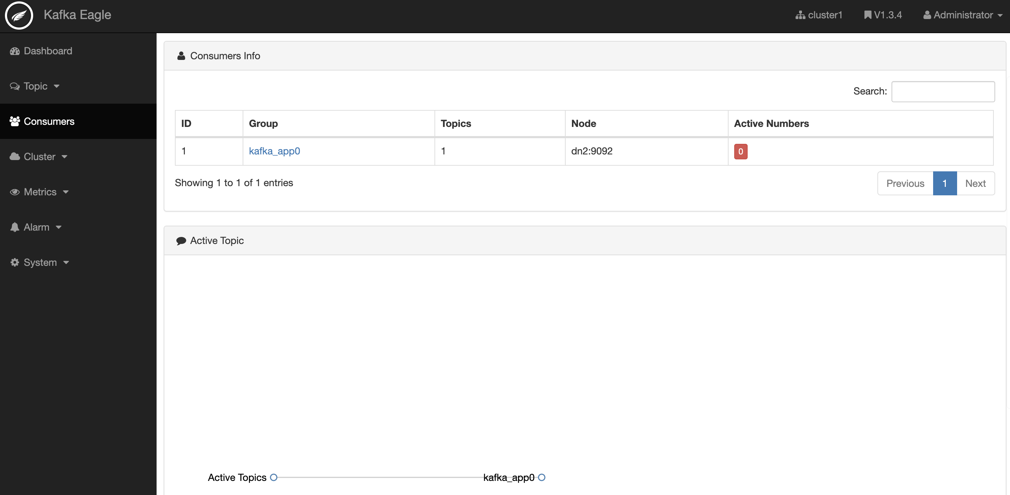
Display consumer
group application
details.
Display consumer
active topics details.

Slide 13
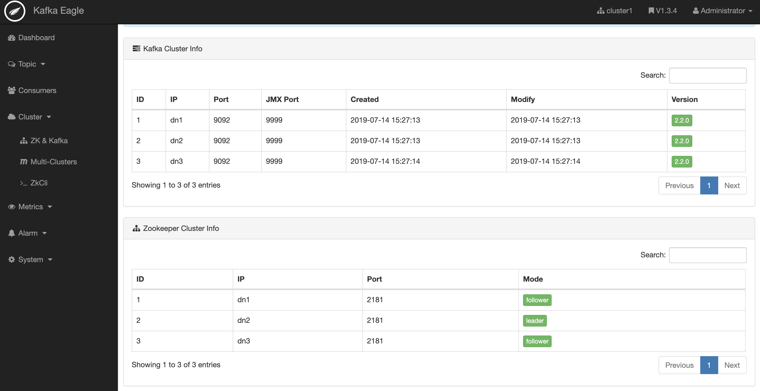
1. Show details.
2. Multi-cluster.
3. ZK client.

Slide 14
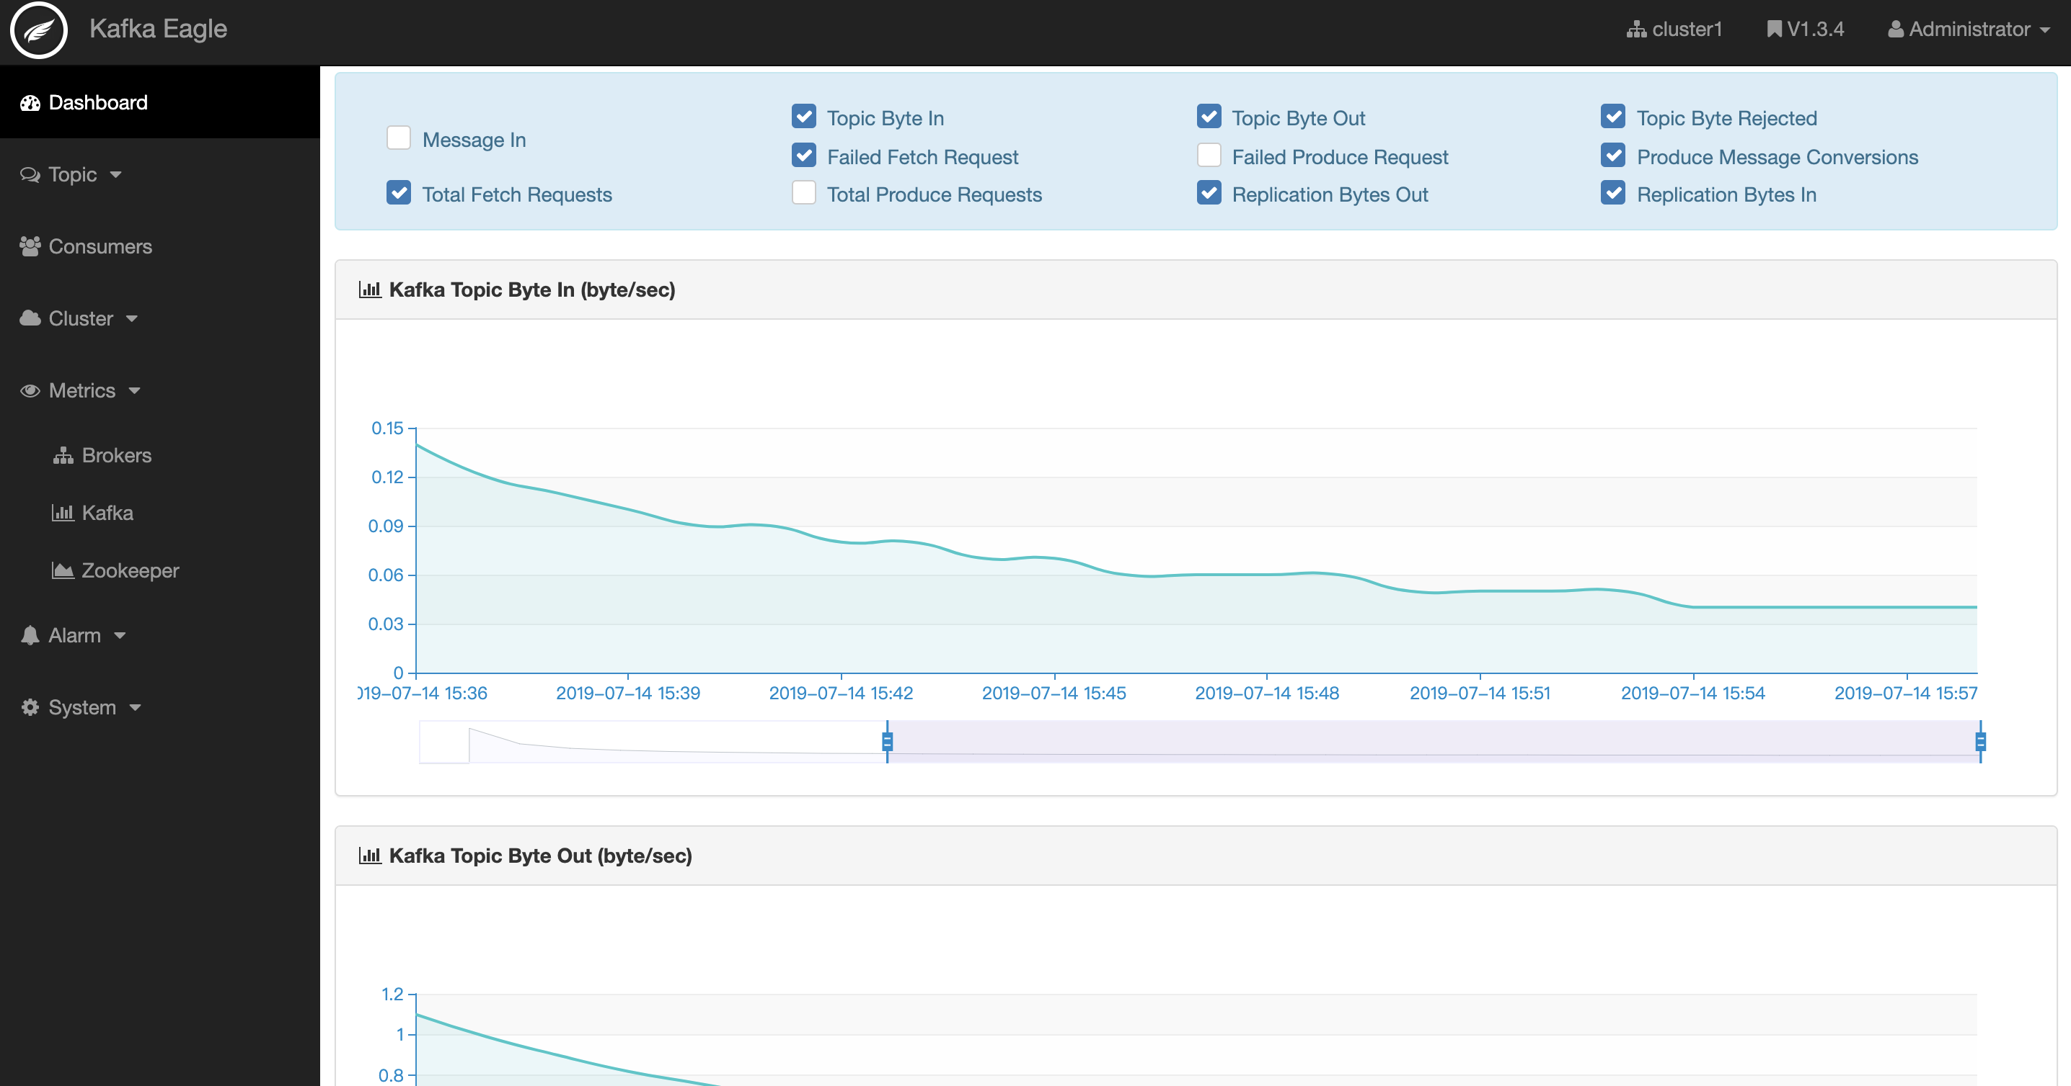
1. Broker mbean.
2. Kafka metrics.
3. ZK metrics.

Slide 15
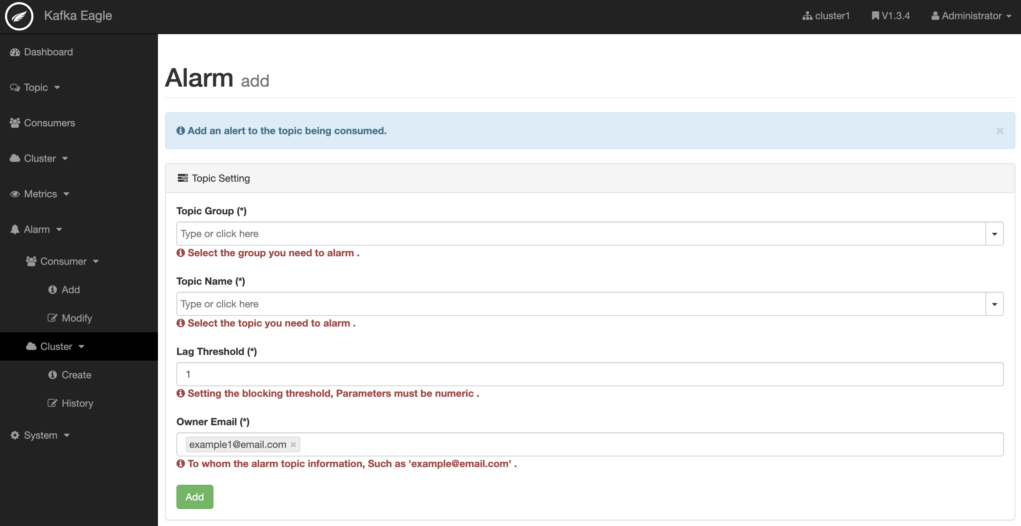
1. Add lag alarm.
2. Modify lag.
3. Add cluster.
4. Modify cluster.

Slide 16
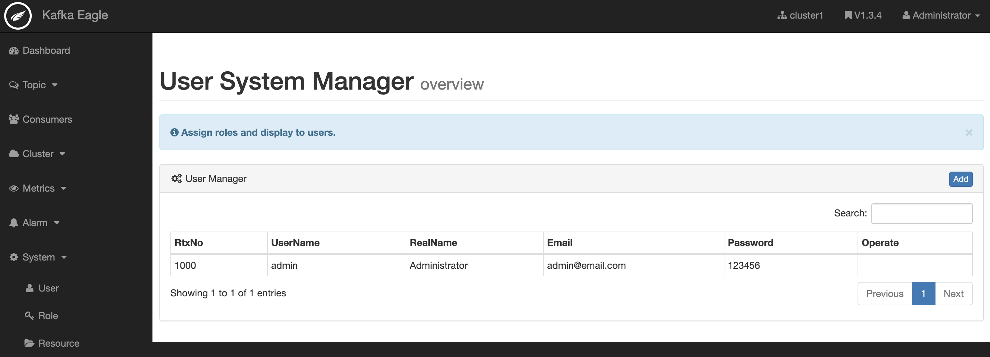
1. Add user.
2. Assign role.
3. Manage res.

Slide 17
04
Part IV
Follow-up Planning of Kafka Eagle

Slide 18
Dimension 1
Dimension 2
Dimension 3
Dimension 4
QAP
DSR
PPL
PHB
Continuous optimization of system modules of Kafka Eagle.
Collect Github issues problems and fix them.
Developing new functions of Kafka Eagle system for actual needs.
Organize and file the user manual of Kafka Eagle system.
Kafka Eagle follow-up plan is divided into four dimensions.

Slide 19
http://www.kafka-eagle.org/
https://github.com/smartloli/kafka-eagle/
Kafka Eagle
ME
https://www.cnblogs.com/smartloli/
Blog
Hadoop: https://item.jd.com/12455361.html
Kafka: https://item.jd.com/12371763.html
Publish Books

Slide 20
2
0
1
9
THANK YOU FOR WATCHING
http://www.kafka-eagle.org/
AUTHOR : SMARTLOLI
UPDATE : 2019.07.14

