Slide 1
abstract
SMART MEDICINE DISPENSER
SUBMITTED BY
VRINDA.L
PREETHA.S
NEENU.M.S
URMILA.S.R

Slide 2
CONTENTS
ABSTRACT
INTRODUCTION
LITERATURE SURVEY
ARDUINO IDE
3D PRINTING
MODULES
REFERENCE

Slide 3
ABSTRACT
intro1
This project presents the architecture and implementation of an automatic medication dispenser specifically for users who take medications without close professional supervision.
By relieving the users from the error-prone tasks of interpreting medication directions and administrating medications accordingly, the device can improve rigor in compliance and prevent serious medication errors.
By taking advantage of scheduling flexibility provided by medication directions, the device makes the user’s medication schedule easy to adhere.

Slide 4
INTRODUCTION
intro1
Medication errors are known to occur throughout the medication use process of ordering, transcription, dispensing, and administration.
Next to prescription errors, administration errors (i.e., errors due to failures to compliant to medication directions) are the most prevalent.
The smart medication dispenser described in this project is designed to prevent this type of errors.

Slide 5
LITERATURE SURVEY
intro1
ACCESSED CONTROLLED PILL DISPENSER(2006)
The device has an access controlled input (proximity sensor and key)
Output is dispensed only when the key is valid
Dispenser is divided into separate levels for each type of medicine
Has a sliding mechanism with a solenoid, armature and a spring to dispense each pill at each level to outside

Slide 6
INTERACTIVE MEDICATION DISPENSER(2008)
Medication schedule is read from the user on a computer via simple GUI
The schedule is then uploaded to pill box and the pill box can be carried anywhere
Time for medications are notified by an alert system consisting of LEDs and vibration motor
A report of the dosage of medication is send as email, sms, or voice mail to any number of recipients

Slide 7
SMART MEDICATION DISPENSER(2008)
It eliminates the cases of misunderstanding of medication directions of the doctor by using computerized physician order entry (CPOE)
medication schedule specifications that guide the operations of the dispenser is generated from the CPOE

Slide 8

ARDUINO IDE
intro1
Arduino is an open-source electronics platform based on easy-to-use hardware and software.
It senses the environment by receiving inputs from many sensors, and affects its surroundings by controlling lights, motors, and other actuators.
You can tell your Arduino what to do by writing code in the Arduino programming language and using the Arduino development environment.

Slide 9
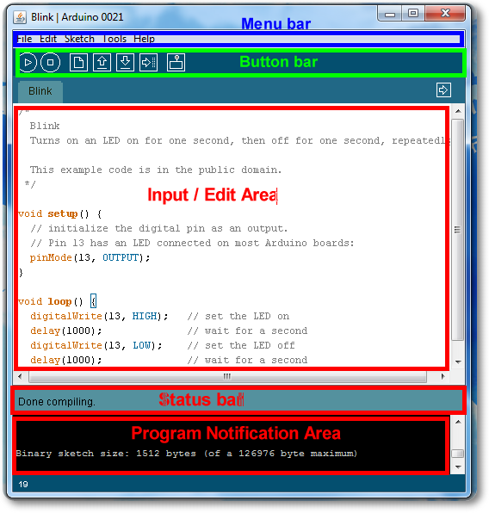

Slide 10
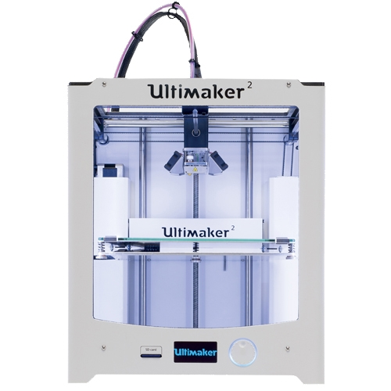
3D PRINTER
intro1
The Ultimaker 2 is an aesthetically pleasing 3D printer with premium features and high-quality results.
Lightning-fast print speeds and the superior precision of the Ultimaker 2 work together to craft impressively detailed creations

Slide 11
3D PRINTING PHASES
intro1
3D Printing usually consists of three phases.
Design Specifications - Defining model specifics.
3D Model Generation CAD (STL) - Using Blender or FreeCAD. Google Sketchup is a good option but its limited to Mac and Windows.
Slicing (Conversion of STL to GCode ) - Here you may use Cura and select machine as Ultimaker 2
The GCode is to be tranferred to target machine (Ultimaker) and then print is to be made on the desired material .

Slide 12
MODULES
intro1
Dispensing module
Sensing module
Communication module

Slide 13
DISPENSING MODULE PARTS
intro1
Dispensing module parts
Servo motor
Arduino Uno board
Cartridge

Slide 14
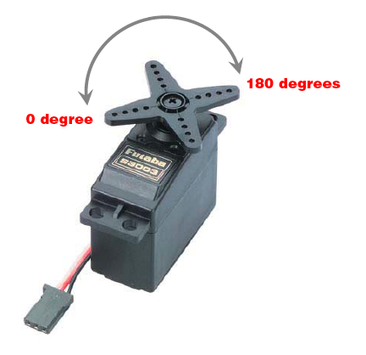
SERVO MOTOR
intro1
Simple dc motor which is controlled for specific angular rotation
Normal range -0 to 180
3 pins
ground
power
control

Slide 15
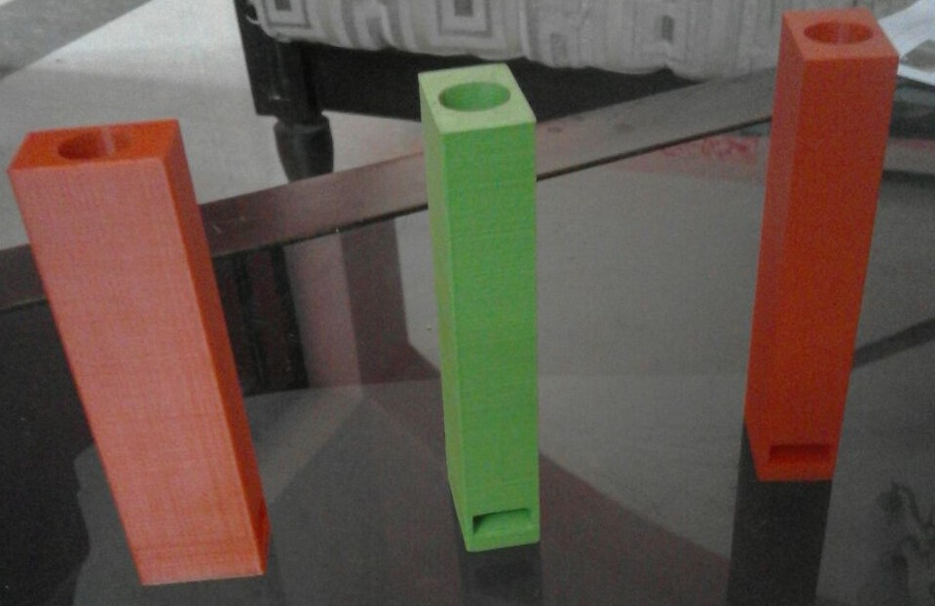
CARTRIDGE
intro1
Cartridges 3D printed according to system specifications
3D printer used is Ultimaker

Slide 16
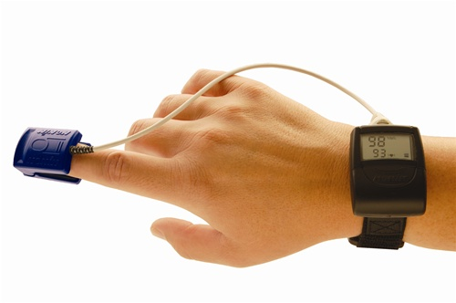
SENSING MODULE
intro1
Wireless Pulse oximeter

Slide 17
PHOTOPLETHYSMOGRAPHY-PPG
intro1
PRINCIPLE- Optical detection of blood volume changes in the microvascular bed of the tissue
Sensor system
Light source(red and IR LEDs)
Light detectors

Slide 18
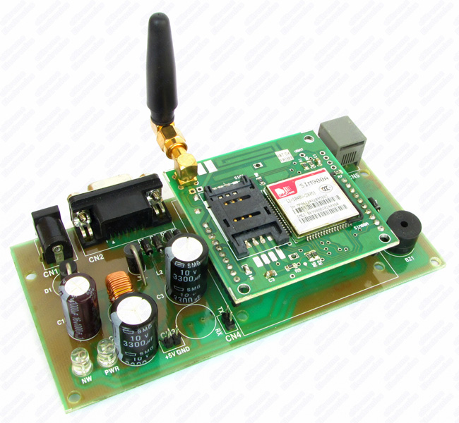
GSM MODULE
intro1
Assembles a GSM/GPRS modem with standard communication interfaces like RS-232 (Serial Port), USB etc., so that it can be easily interfaced with a computer or a microprocessor / microcontroller based system.
The power supply circuit is also built in the module that can be activated by using a suitable adaptor

Slide 19
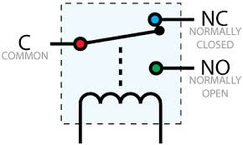
AUDIO MODULE(RELAY)
intro1

Slide 20
REFERENCES
intro1
Accessed Controlled Pill Dispenser
James Abrams,Vahe Barsoumian
Interactive Medication Dispenser
Jonathan Breitbart,Kathleen Lu,Srikanth Narayan
Smart Medication Dispenser
P. H. Tsai, C. Y. Yu, C. S. Shih, Member, IEEE, and J. W. S. Liu, Fellow, IEEE
Construction of a medication reminder synchronization system
KeeHyun Part, Seung Hyeol Lin
Design of automatic mediaction dispenser
S.Mukund,N.K.Srinath

