Slide 1
IHE China Connectathon
集成模式介绍

Slide 2
Agenda
  REWF (静息心电工作流)
  ECG (检索心电图显示)
  DRPT (可显示的报告)

Slide 3
REWF – 静息心电工作流
这个集成模式描述了有关数字心电图系统的工作流程，包括对患者的登记、预约、检查、报告、数据存储等处理。它也包括对那些能够接入网络的采集设备的处理，比如便携式心电图机或者其他专用心电图机。静息心电集成模式能够满足处理单独的或者紧急的心电图检查，而且也能够处理来自其他医院或者社区的心电图，此外可用于临床教学和研究。
预约登记
静息心电图采集
封装报告提交
报告流程

Slide 4
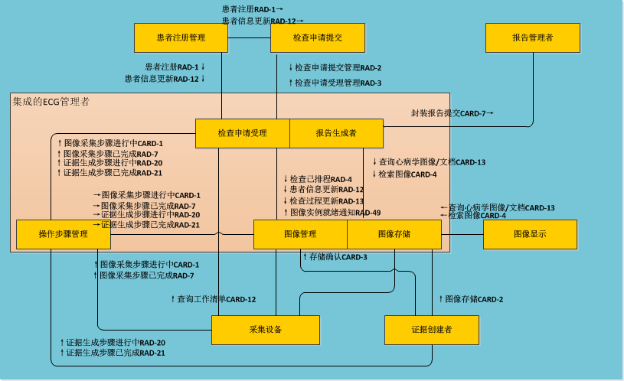

Slide 5
角色
ADT: 管理患者入院，出院，转移信息
Order Placer：输入检查指令，并分发给不同的Order Filler
Integrated ECG Manager：管理采集静息心电工作流
Acquisition Modality：生成图像信息
Evidence Creator：根据原始图像生成衍生的信息文件
Report Manager:报告管理
Image Display：显示图像

Slide 6
1.预约登记
REWF静息心电工作流

Slide 7
Integrated
ECG Manager
Acquisition Modality
Evidence Creator
ADT
Order Placer
Register/Admit
Patient
Patient Registration[RAD-1]
Patient Registration
[RAD-1]
Create and
Schedule Order
Placer Order
Mgmt [RAD-2]]
Query Enhanced Modality
Worklist [CARD-12]
Select
Workitem

Slide 8
查询工作列表－Query Enhanced Modality Worklist CARD-12
这个事务是基于查询设备工作列表(RAD-5)事务,此事务采用DICOM协议标准Modality Worklist SOP Class ，修改如下
基于患者的查询 (Patient Based Query)
  患者姓名(0010，0010)
  患者ID(0010，0020)
  访问号(Accession Number)(0008，0050)
  请求过程ID(Requested Procedure ID)(0040，1001)
  入院 ID(Admission ID)(0038，0010)
宽泛查询(Broad Query)
  预约的过程开始时间(Scheduled Procedure Step Start Time) (0040，0002)
  设备(0008，0060)
  站点应用程序名称(Scheduled Station AE Title)(0040，0001)
  ( Scheduled Procedure Step Location)(0040,0011)
Notes:
基于患者的查询

Slide 9
2.静息心电图采集
REWF静息心电工作流

Slide 10
Integrated
ECG Manager
Acquisition Modality
Evidence Creator
Order Placer
Select Workitem
MPPS In Progress [CARD-1]
Acquire ECG
Create Evidence
MPPS Completed [RAD-7]
Filler Order
Mgmt [RAD-3]
Image Stored [CARD-2]
Evidence Stored [CARD-2]
Storage Commitment [CARD-3]
Storage Commitment Response
[CARD-3]
Delete
Ecg

Slide 11
图像采集步骤进行中－MPPS In Progress[CARD-1]
这个事务是基于查询设备工作列表(RAD-6)事务,修改如下
使用DICOM的N-CREATE 消息实现
Multi-Modality Procedure Update Option

Slide 12
图像/证据存储－ Modality Image/Evidence Stored [CARD-2]
图像/证据存储添加一个新的部分，静息心电图工作流应当支持DICOM两个SOP类
SOP Class UID | SOP Class Name
1.2.840.10008.5.1.4.1.1.9.1.2 | General ECG Waveform Storage
1.2.840.10008.5.1.4.1.1.88.22 | Enhanced SR
证据创建角色应使用增强SR SOP类心电图报告模板3700来创建和存储心电图报告，包括测量和解释等。
Resting ECG Report Template
3700 ECG Report

Slide 13
存储确认－Storage Commitment [CARD-3]
这个事务是基于查询设备工作列表(RAD-10)事务,添加了一个选项
由设备（Modality）通知图像管理者（IM）将图像的所有权从设备转移到图像管理者
在之前的设备图像保存成功后进行此事务
使用DICOM N-ACTION和N-EVENT-REPORT完成所有权的转移
针对移动设备的Storage Commitment附加选项，(IM)在重新连接后在发送N-EVENT-REPORT
在这之后，设备可以清除本机的图像信息，图像管理者负责维护图像信息

Slide 14
3.封装报告提交
REWF静息心电工作流

Slide 15
Integrated
ECG Manager
Report Manager
Encapsulated Report Submission [CARD-7]

Slide 16
封装报告提交－ Encapsulated Report Submission [CARD-7]
ITI-TF-2: 3.12.4.2.2对波形信息进行了定义
包括至少病人的名字和病人的ID
包括采集日期与时间
最小波形保真度，参见ANSI / AAMI EC -11 - 1991标准
对电压、时间尺度、采样频率、基线等进行描述
解释信息，如“未经证实的报告”、“确认报告”
信息来源必须支持应用程序pdf/cda格式，信息源可能另外支持图像/ svg + xml MIME类型的格式。
HL7中OBX段消息对离散结果信息进行了定义，如RR间期、PR间期、QT间期、QRS时限等信息。

Slide 17
4.报告流程
REWF静息心电工作流

Slide 18
Integrated
ECG Manager
Image Display
Evidence Creator
Order Placer
Select ECG
to Overread
Query Cardiology Images/Evidence
[CARD-13]
Retrieve Images/Evidence
[CARD-4]
Display ECGs
Compare, measure,
interpret, sign ECG
Modality Image/Evidence Stored
[CARD-2]
Creator PPS In Progress [RAD-20]
Creator PPS Completed [RAD-21]
Filler Order
Mgmt [RAD-3]
Storage Commitment [CARD-3]
Storage Commitment Response
[CARD-3]
Delete
Evidence

Slide 19
查询心病学图像/文档－Query Cardiology Images/Evidence [CARD-13]
这个事务是基于查询图像[RAD-14]和查询证据[RAD-44]事务
Integrated
ECG Manager
Image Display
C-FIND-RQ
C-FIND-RSP

Slide 20
获取图像－Retrieve Images/Evidence
这个事务是基于检索图像[RAD-16] 事务
Integrated
ECG Manager
Image Display
Retrieve Images/ Evidence
(C-MOVE)
Store Images/ Evidence
(C-STORE)
View Images/
Evidence

Slide 21
获取图像－Retrieve Images/Evidence
应当支持两个SOP类
SOP Class UID | SOP Class Name
1.2.840.10008.5.1.4.1.1.9.1.2 | General ECG Waveform Storage
1.2.840.10008.5.1.4.1.1.88.22 | Enhanced SR
使用增强SR SOP类心电图报告模板3700来创建和存储心电图报告，包括测量和解释。
Resting ECG Report Template
3700 ECG Report

Slide 22
获取图像－Retrieve Images/Evidence
Displayable Information | Source Value/ Derivation
Type of Waveform Group (Rhythm vs. Median beat) | Value taken from Multiplex Group Label (0037,0020)
Channel/ Lead Name | Value taken from Channel Source Sequence (003A,0208)::Code Meaning (0008,0104)
Channel Status | Value taken from Channel Status (003A,0205).
Voltage scale | Derived from Channel Sensitivity (003A,0210) and display gain. Gain is normally 10mm/mV.
Time scale | Derived from Sampling Frequency (003A,001A) and display speed. Waveform speed is normally 25 mm/s.
Frequency content | Waveform bandwidth. Values taken from Filter Low Frequency (003A,0220), Filter High Frequency (003A,0221), and Notch Filter Frequency (003A,0222) (if present).
Acquisition time | Value taken from Acquisition DateTime (0008,002A)

Slide 23
Actors | Transactions
ADT Patient Registration | Patient Registration [RAD-1] Patient Update [RAD-12]
Order Placer | Patient Registration [RAD-1] Patient Update [RAD-12] Placer Order Management [RAD-2] Filler Order Management [RAD-3]
Integrated ECG Manager | Patient Registration [RAD-1] Patient Update [RAD-12] Placer Order Management [RAD-2] Filler Order Management [RAD-3] Encapsulated Report Submission [CARD-7] Retrieve Image/Evidence [CARD-4] Query Cardiology Images/Evidence [CARD-13] MPPS In Progress [CARD-1] MPPS Completed [RAD-7] Storage Commitment [CARD-3] Query Enhanced Modality Worklist [CARD-12] Creator PPS In Progress [RAD-20] Modality Image/Evidence Stored [CARD-2] Creator PPS Completed [RAD-21]
Acquisition Modality | MPPS In Progress [CARD-1] Modality Process Step Complete [RAD-7] Query Enhanced Modality Worklist [CARD-12] Storage Commitment [CARD-3] Modality Image/Evidence Stored [CARD-2]
Evidence Creator | Creator PPS In Progress [RAD-20] Creator PPS Completed [RAD-21] Modality Image/Evidence Stored [CARD-2] Storage Commitment [CARD-3]
Report Manager | Encapsulated Report Submission [CARD-7]
Image Display | Query Cardiology Images/Evidence [CARD-13] Retrieve Image/Evidence [CARD-4]

Slide 24
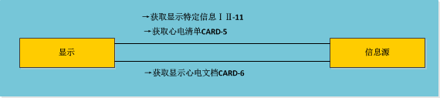
ECG – 检索心电图显示
此集成模式是针对心电图的检索和显示。

Slide 25
获取心电清单－Retrieve ECG List [CARD-5]
Display
Information Source
Request For ECG List
Response With ECG List
请求心电图列表
请参阅ITI-TF-2: 3.11.4.1.2,消息语义请求特定的信息。
ITI-TF-2: 3.11.4.1.2 表列出了web服务请求类型为ITI-11。
requestType value | Description
SUMMARY-CARDIOLOGY-ECG | List of ECG documents

Slide 26
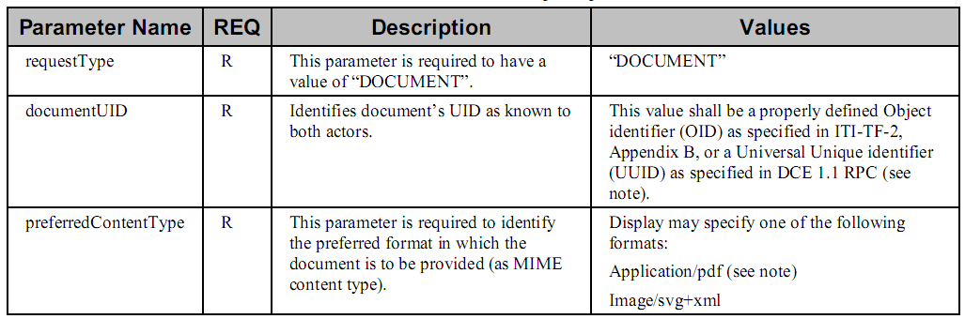
获取显示心电文档－Retrieve ECG Document for Display
请求心电图文档
web服务请求应当包括下列参数

Slide 27
获取显示心电文档－Retrieve ECG Document for Display
交付心电图文档
包括至少病人的名字和病人的ID
包括采集日期与时间
最小波形保真度，参见ANSI / AAMI EC -11 - 1991标准
对电压、时间尺度、采样频率、基线等进行描述
解释信息，如“未经证实的报告”、“确认报告”
信息来源必须支持应用程序/ pdf格式，信息源可能另外支持图像/ svg + xml MIME类型的格式。

Slide 28
Actors | Transactions
Display | Retrieve Specific Info for Display [ITI-11] Retrieve ECG List [Card-5] Retrieve ECG Document for Display [Card-6]
Information Source | Retrieve Specific Info for Display [ITI-11] Retrieve ECG List [Card-5] Retrieve ECG Document for Display [Card-6]

Slide 29
DRPT –可显示的报告
可显示的报告集成模式支持对临床报告的创建，修改、科室内外的传输以及阅读。

Slide 30
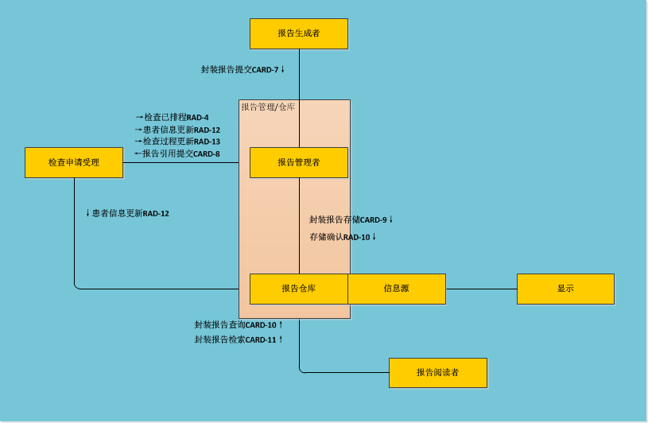

Slide 31
Report
Creator
Report
Manager
Report Repository/
Info Source
Report
Reader
Display
DSS/OF
[RAD-4]
Procedure Scheduled
Exam
Ordered
Create
Report
[CARD-7]
Encapsulated
Report Submission
[CARD-9]
Encapsulated
Report Storage
Release
Report
[RAD-10] Storage
Commitment
Retrieve Specific Info for Display [ITI-11]
Retrieve Document for Display
[ITI-12]
[CARD-10]
Encapsulated
Report Query
Update
Demographics
[CARD-11]
Encapsulated
Report Retrieve
[RAD-12] Patient Update

Slide 32
封装报告存储－Encapsulated Report Storage [CARD-9]
Report
Repository or
Image Archive
Report
Manager
Report Storage (Encapsulated
Document C-STORE)

Slide 33
封装报告查询－Encapsulated Report Query [CARD-10]
Report
Repository
Report
Reader
Query Reports (C-FIND)
Query Responses (C-FIND)

Slide 34
封装报告获取－Encapsulated Report Retrieve [CARD-11]
Report
Repository
Report
Reader
Retrieve Reports (C-MOVE)
Store Reports (C-STORE)
View Reports

Slide 35
谢谢

