Slide 1
SMART PET FEEDING
Group G ANGEL GABRIEL MEELA Jean Baptiste HABANABAKIZE Denyse NYIRAMUGISHA

Slide 2
Do you own a pet? Has he or she ever disturbed you early in the morning to beg you for food? Or maybe you couldn't get home quite on time, so you had to make your pet wait till you get home to feed them? Well, now we have came up with an idea to build an automated pet feeder that can be controlled away from home.

Slide 3
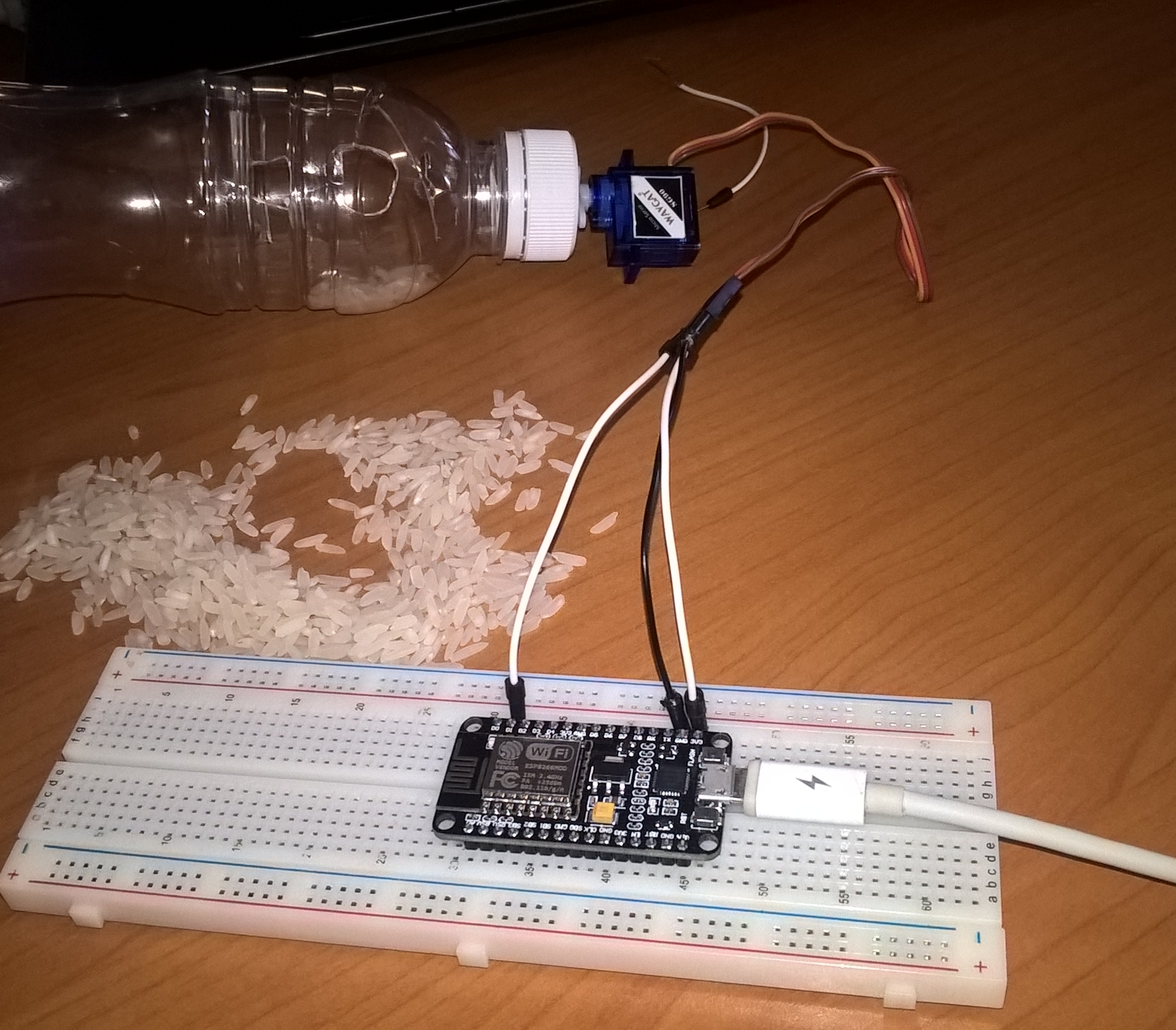
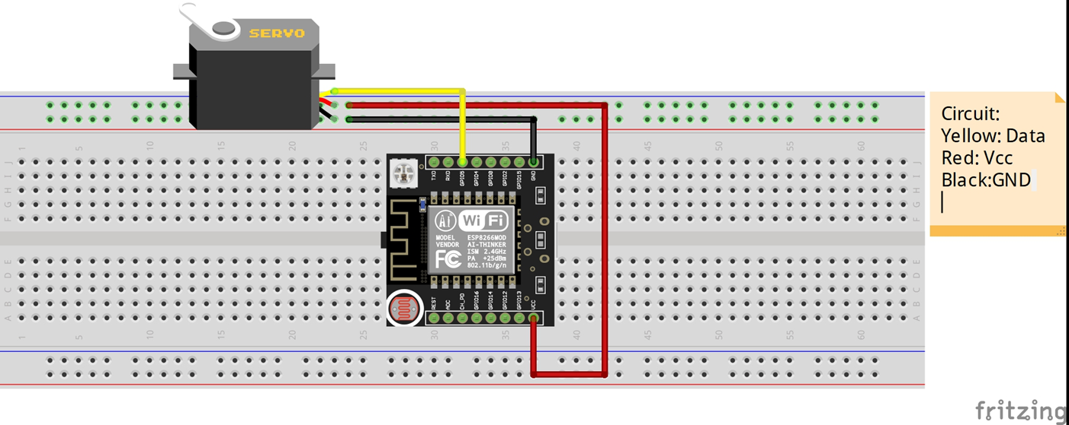

Slide 4

Devices and Software to be used
Devices
Software
Servo Motor x 1
Nodemcu x 1
USB Cable x 1
Jumper Wires
Breadboard x 1
Water bottle x 1
Arduino IDE
ARDUINO Libraries
MQTTBox
More about Codes

