Slide 1
Intracranial EEG Reconstruction Electrode Labeling
Draft version 1.0, 06/30/17

Slide 2
To-do list
Determine system requirements to install VoxTool
PC computers in hospital
Python, Python Charm IDE (?)
Install VoxTool on computers for:
EEG fellows. Kate, EMU and new EEG reading room?
Kate
Jacqueline
Update Litt Lab mac mini’s version
May need IS ticket for install on Hospital PCs
Add how-to-open-VoxTool slides, if needed
Does VoxTool have a usermanual? Has it been published yet?
LK: No manual yet but we can write one once I package voxTool into a standalone application
Lohith, could you please discuss the threshold on it’s slide
LK: Next version of voxTool will have a threshold bar. For now, details are added to the slide.
Location of input images (xnat/cfn)

Slide 3
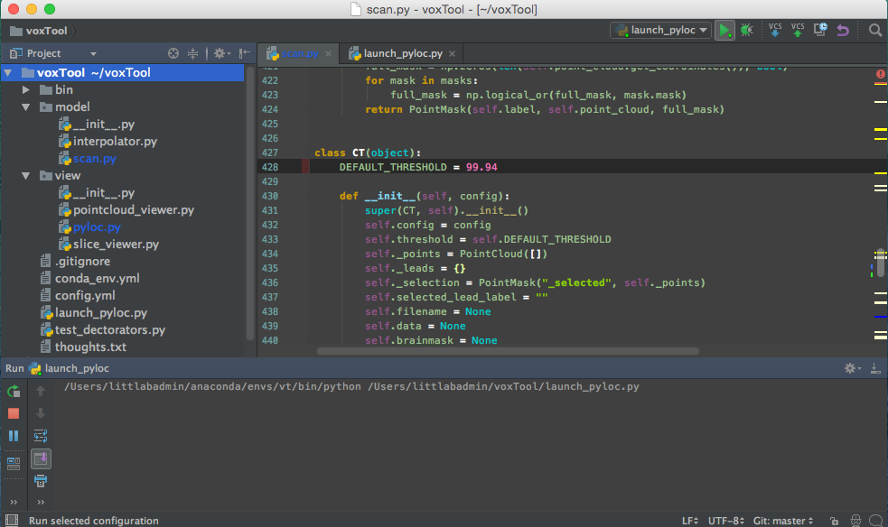
Threshold and Play
Set threshold within range (99.93 to 99.97) or use default 99.94
Click play to launch the VoxTool interface

Slide 4
How to choose a threshold
Thresholds should be adjusted such that all electrodes should be easily visible in the 3D window (center window)
Surgical Staples and wires will cause significant artifacts if the threshold is set too low (e.g. 99.0)
High thresholds may remove some electrodes that are significantly attenuated in the image
Pick a threshold which ensures all electrodes are visible and easily navigated to in the 3D window while minimizing artifacts that may hinder you from clicking on each electrode
Keep in mind some electrodes will overlap and should not be considered “missing” when choosing a threshold
Both of these electrodes can be assigned the same centroid

Slide 5
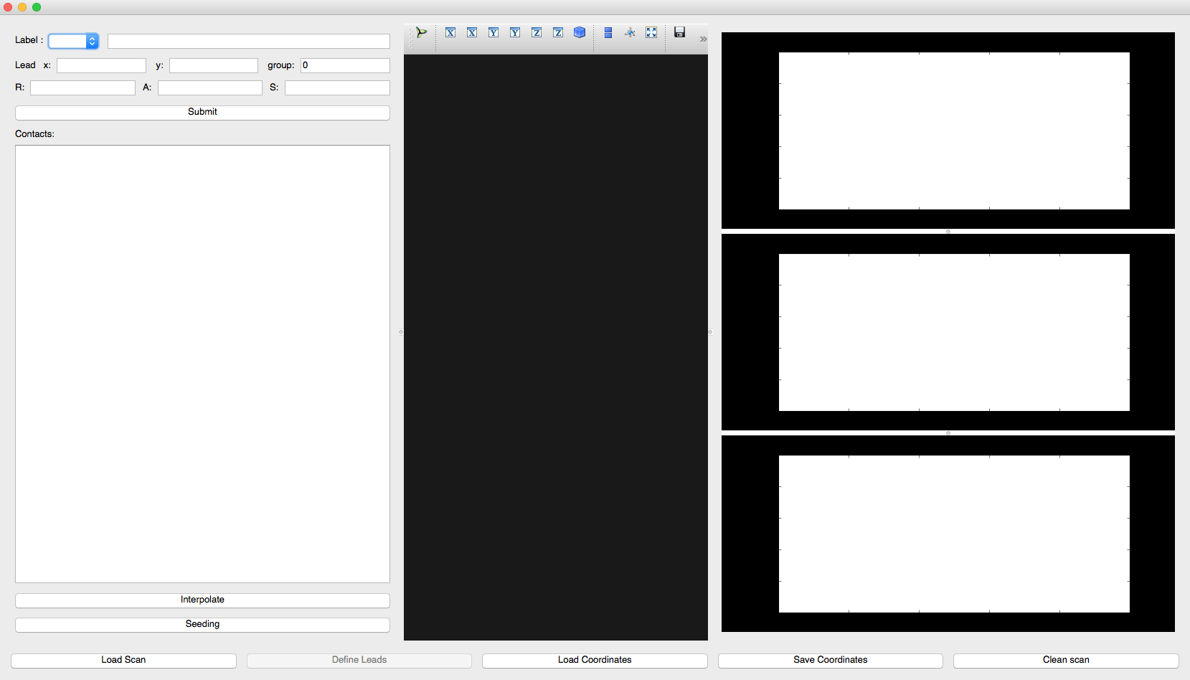
VoxTool Interface
Click Load Scan
Select the NIFTI image from the reconstruction output

Slide 6
Choosing your input image
I would like to give an example of where the output images will live on XNAT and how they will be named

Slide 7
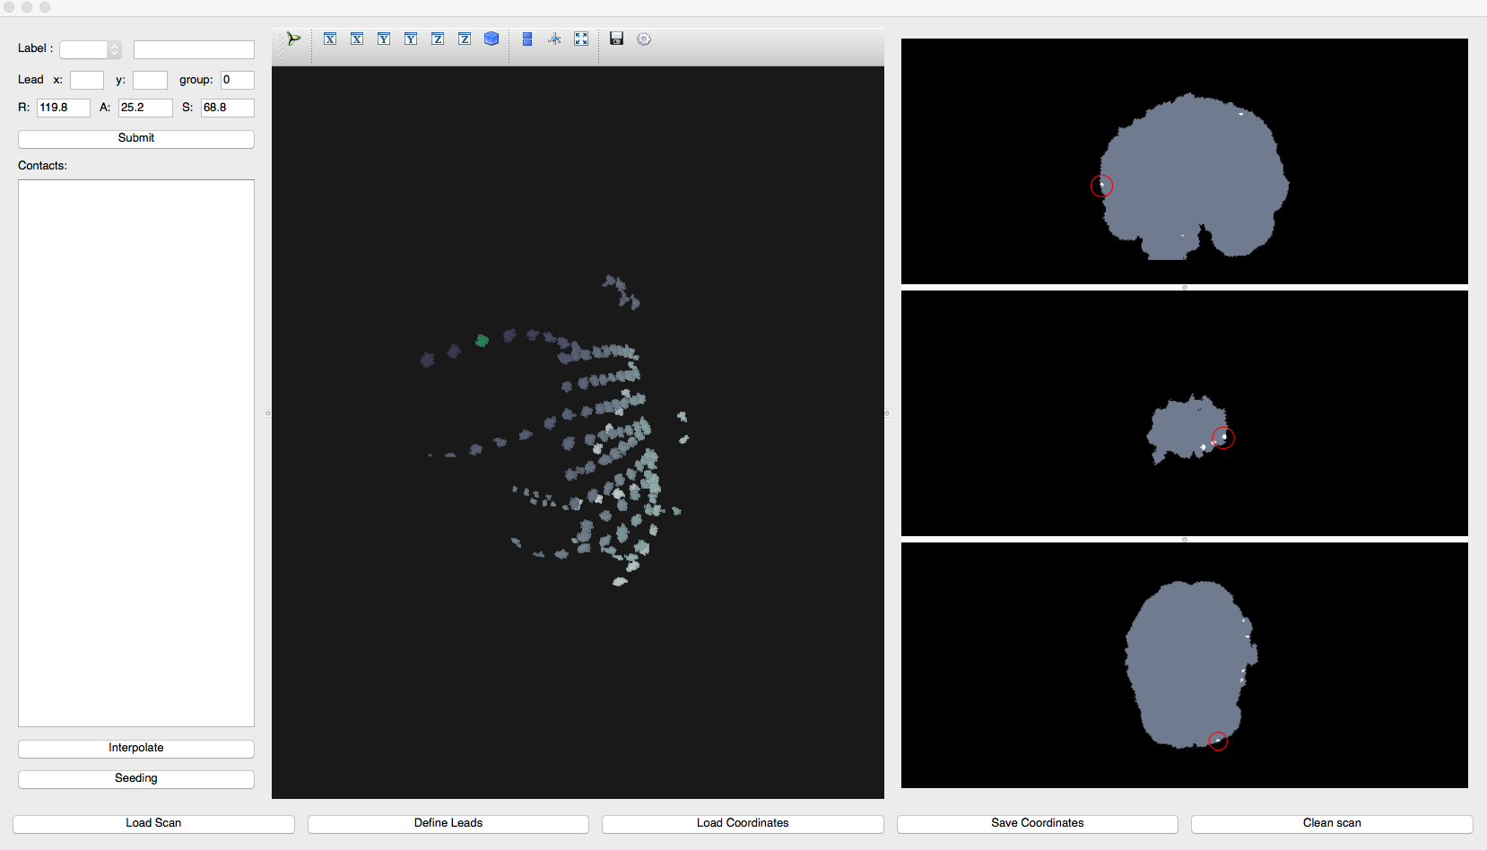
Scan loaded
Click Define Labels

Slide 8
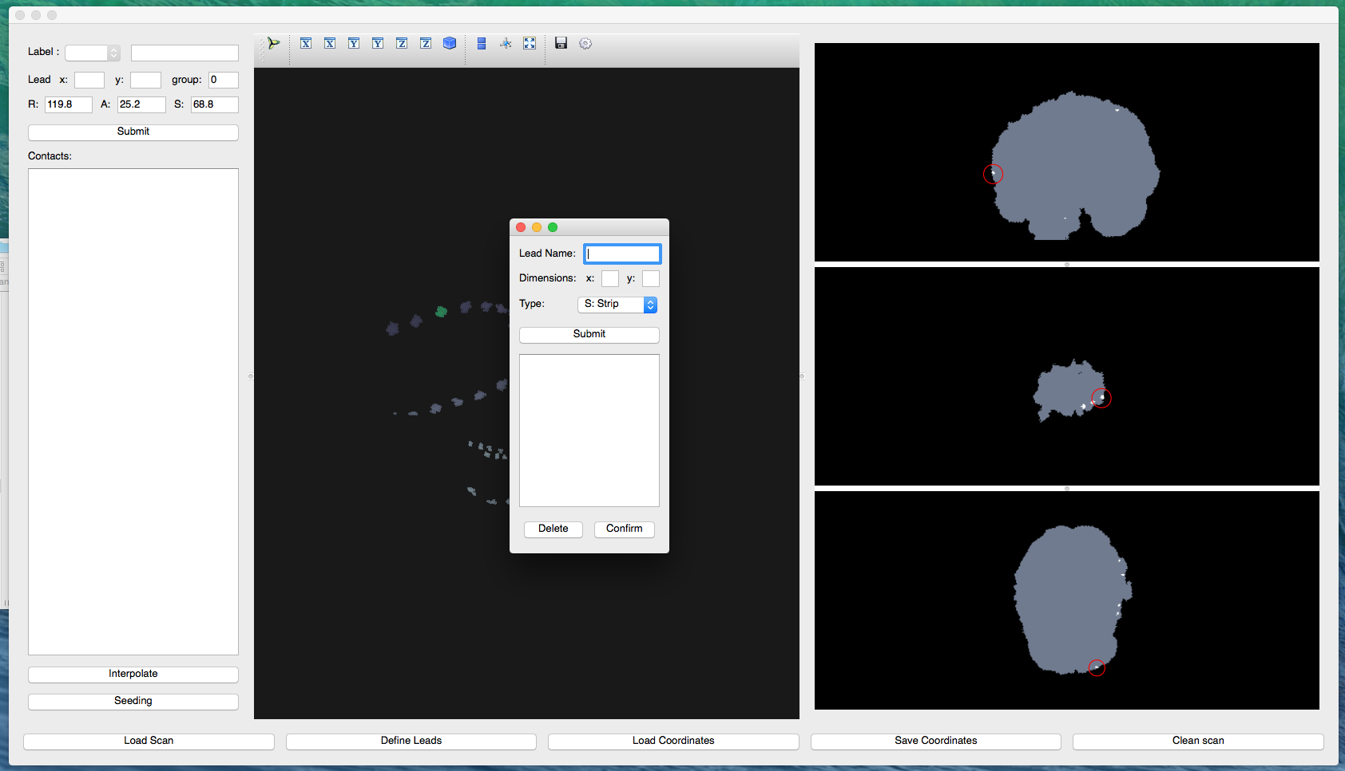
Define Labels Pop-up Window

Slide 9
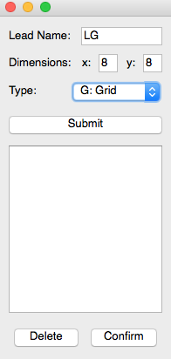
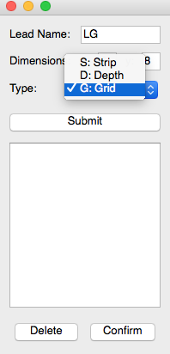
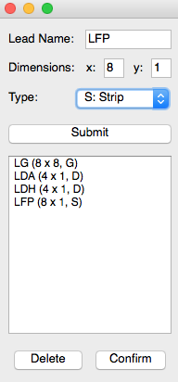
Specify Electrodes
Repeat steps 6, 7 & 8 until all electrodes have been added. Then click Confirm.
Name each electrode and specify dimensions; y = 1 for depths and strips, x = number of contacts
Choose the electrode type from the dropdown menu
Click submit. You will see the electrode and its dimensions appear in the white box below the controls.

Slide 10
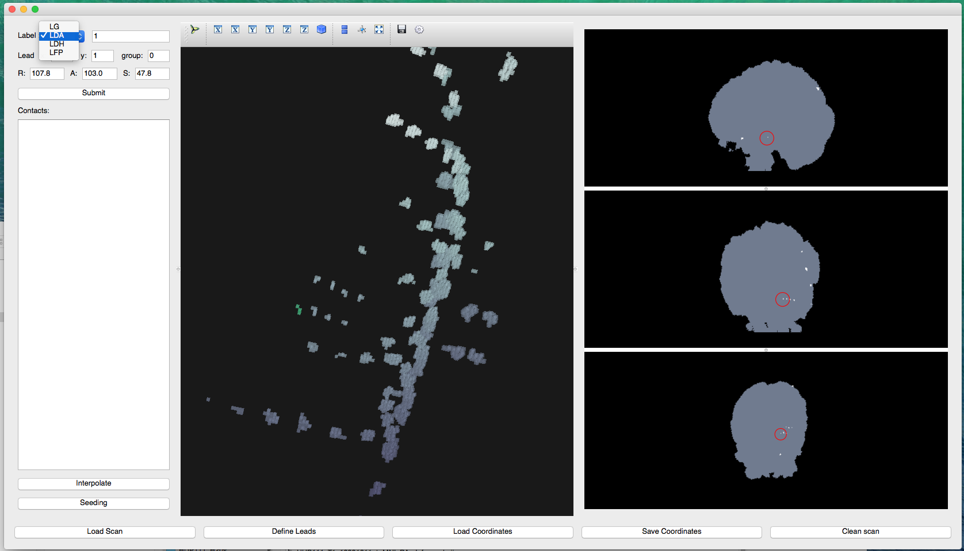
Begin Labeling Contacts
Select the electrode you’d like to label from the dropdown menu
Click on contact 1 of that electrode in the image
Click Submit.

Slide 11
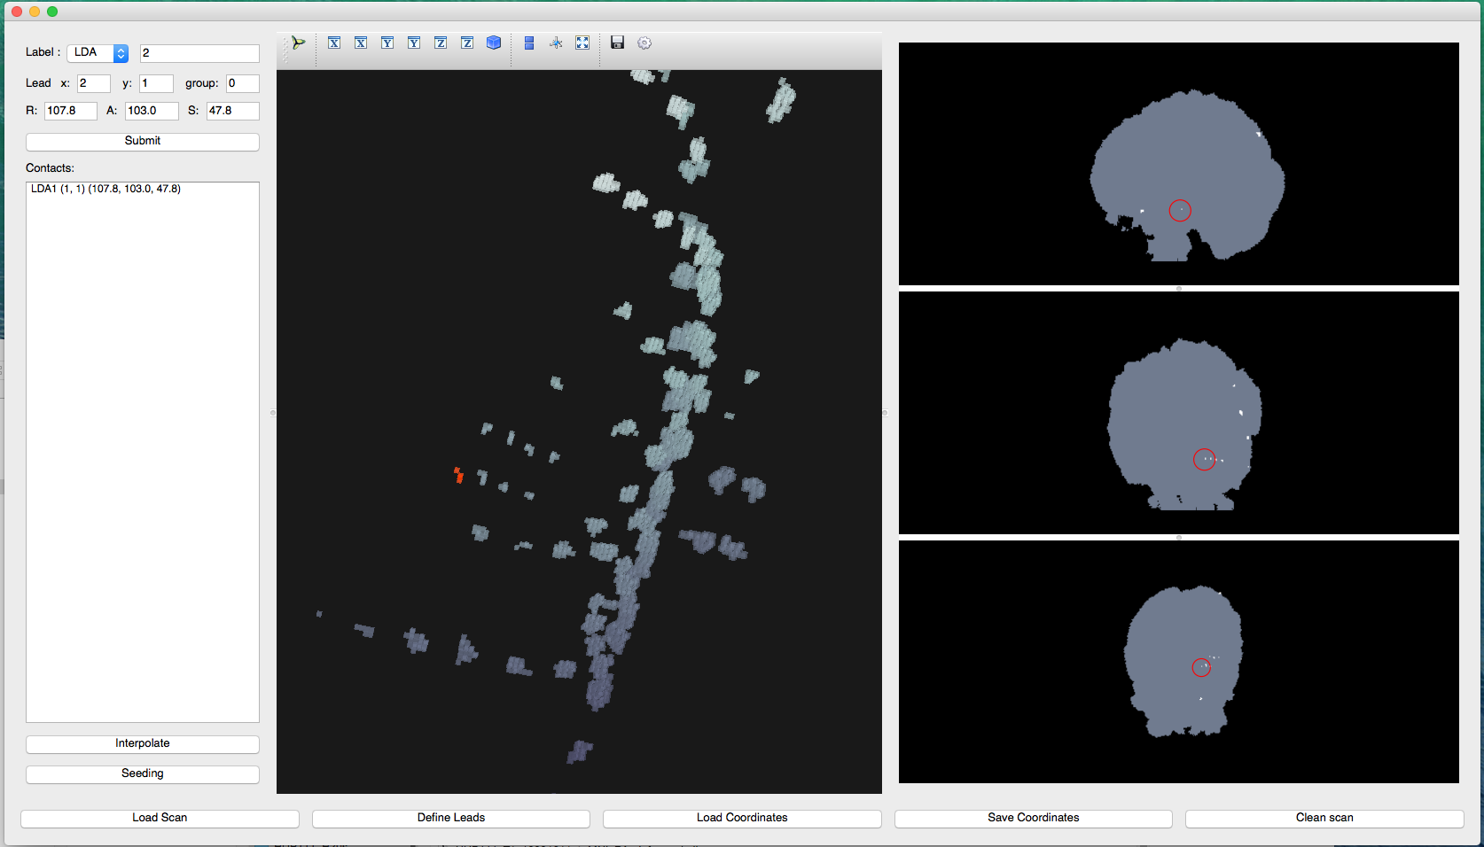
Submitted Labeled Contacts
After clicking submit, the contact name (LDA1), index number (1,1), and coordinates will appear in the contacts list. The contact number will automatically increment and the contact will change from green to red in the image.

Slide 12
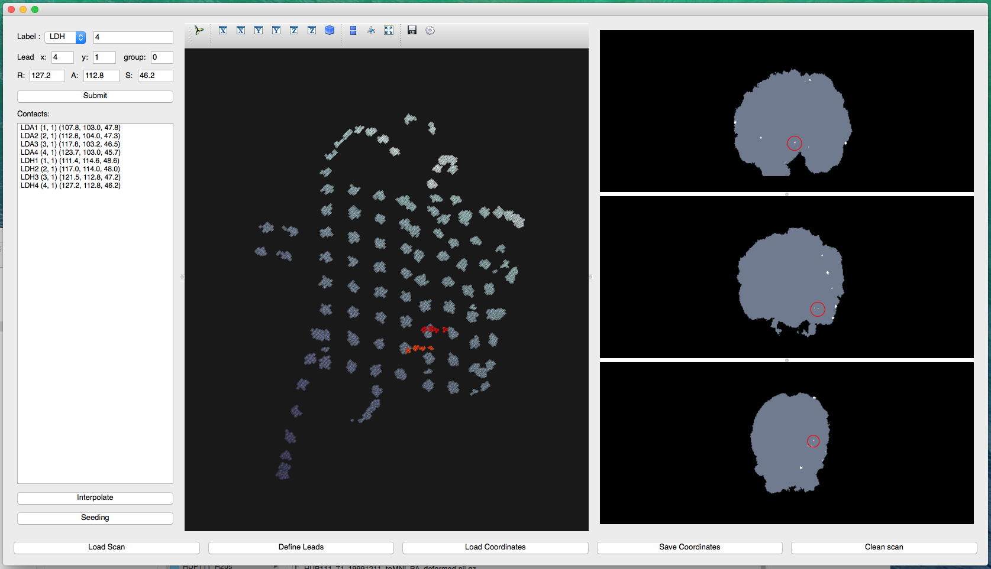
Repeat steps 10 – 12 until all electrode contacts are labeled. The amygdala and hippocampal depths are labeled
Click Save Coordinates to export a .csv file of electrode coordinates in the Output Folder on XNAT

Slide 13
Create 3D image
How would you like the fellows to visualize the output?
ITK-SNAP
Online system?

