Slide 1

PID Controller & Tuning for a Line Following Robot
Jose Salazar
03/10/2024
Based on materials by Sanjay and Arvind Seshan

Slide 2
Lesson Objectives
Learn about PID controllers, how they work, and how to tune them
Use a PID controller to make a robot follow a line
Prerequisites:
Basic programming in Python
VS Code installed on PC

Slide 3
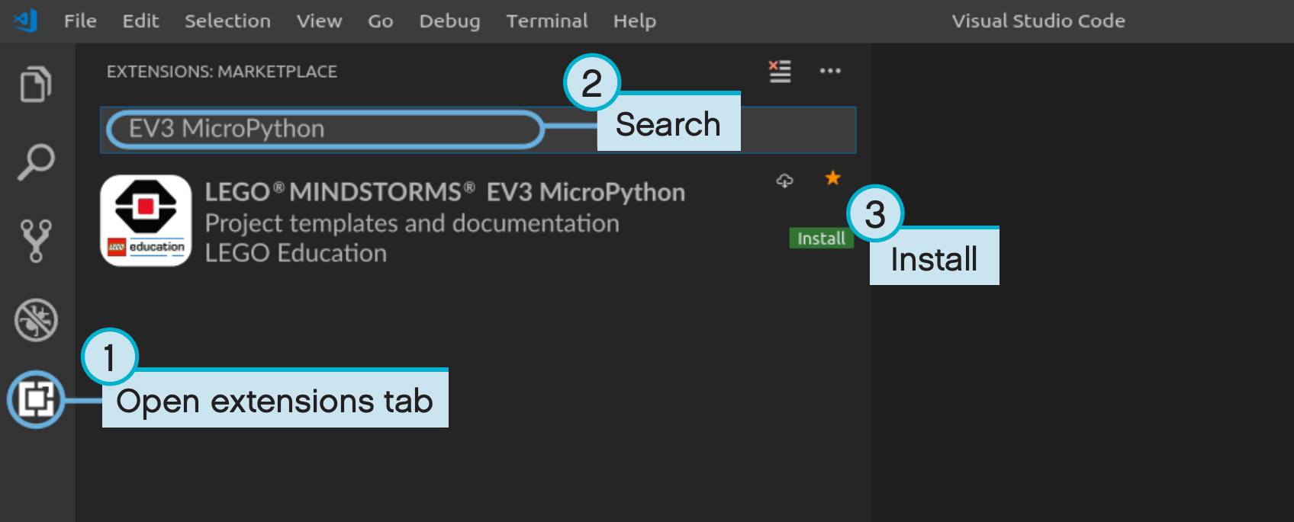
Environment Setup
Open VS Code
Open the extensions tab
Search for EV3 MycroPython
Install the EV3 MicroPython extension

Slide 4
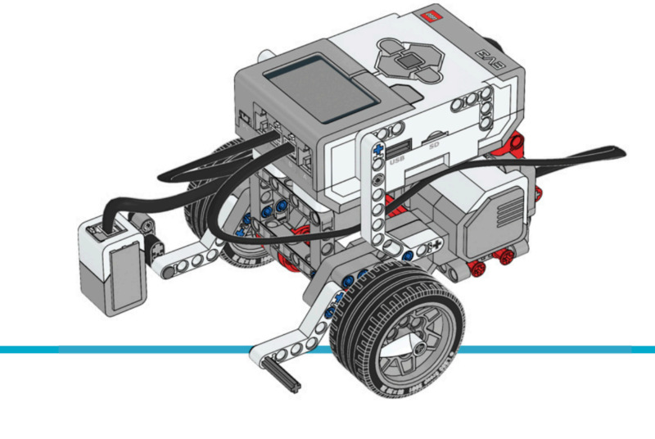
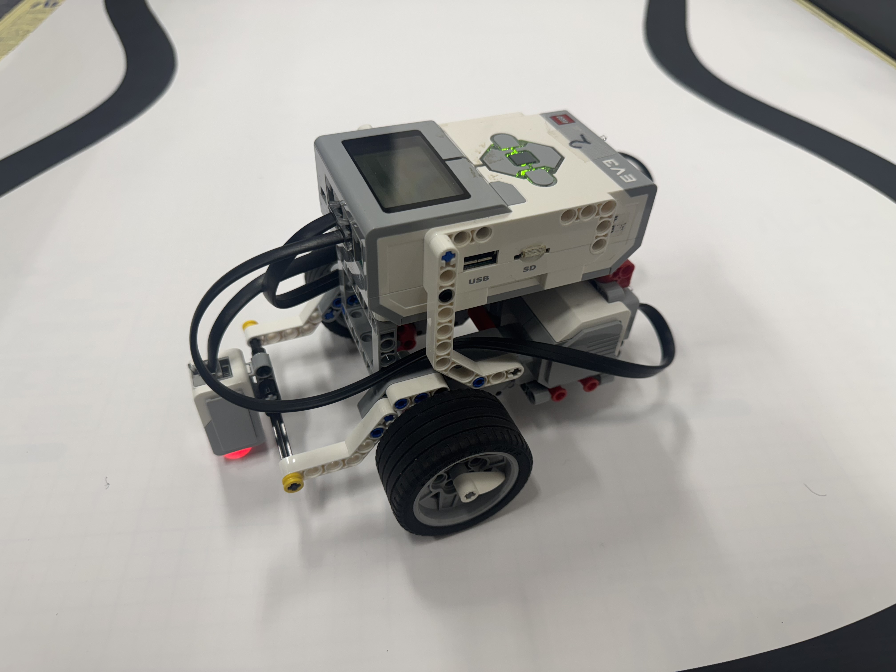
Line-following Platform
We will use a differential base created using LEGO Mindstorms EV3
Programmable using LEGO building blocks, Scratch or MicroPython
Light sensor used to detect reflection
We will use VS Code to write and upload the MicroPython program
Robot reference: https://pybricks.com/ev3-micropython/examples/robot_educator_line.html

Slide 5
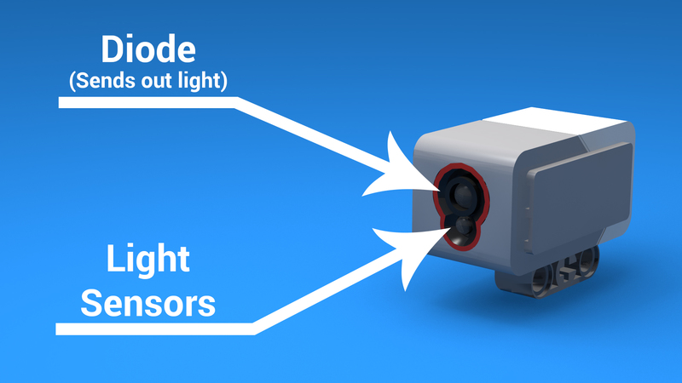
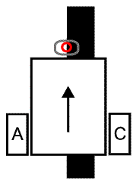
Challenge: Line-following
Edge Following Strategy: Instead of following the line, follow its edge
If the sensor detects white, it's unclear whether the robot is left or right of the line.
By following the line's edge, the robot can tell its position: if the sensor detects white, it’s right of the edge; if black, it’s left
This method is called Right Hand Line Follower
Sensor Calibration: we need to know the sensor's white and black readings
Light sensor
Light sensor measuring the value of reflection

Slide 6
How Far Is the Robot From The Line?
Reflected light sensor readings show how “dark” the measured area is on average
Calibrated readings should range from 100 (on just white) to 0 (on just black)
Light Sensor Measured Area:
Reading = 100
Reading = 50
Reading = 25
Reading = 75
Reading = 0
Line

Slide 7
Line-Following & Error Correction
Computing an error → how far is the robot from a target
Robots follow the edge of line → target should be a sensor reading of 50
We actually calibrate and take the average between black/white values
Error should indicate how far the sensor’s value is from a reading of 50
Making a correction → The robot should control the wheel speed to make up for this mistake

Slide 8
What are some simple strategies?
Simplest solution: 2-level & 3-level line follower
If-else based strategy
Let’s implement these control strategies as a baseline!

Slide 9
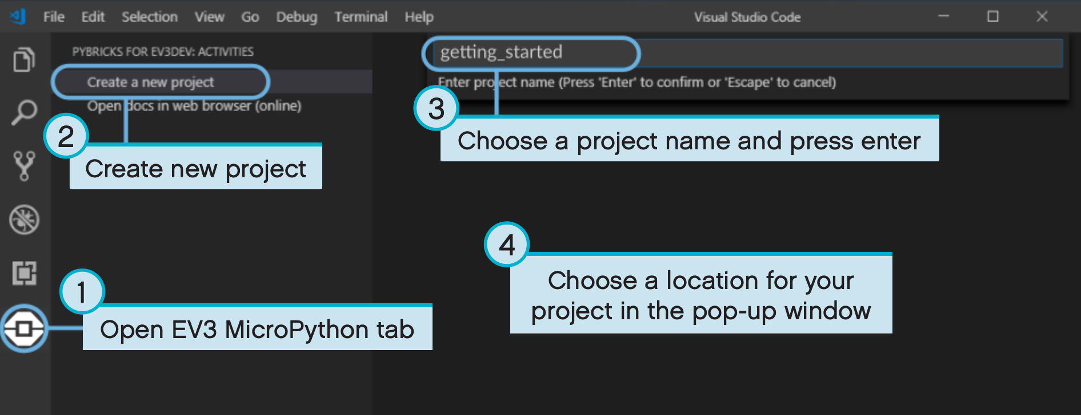
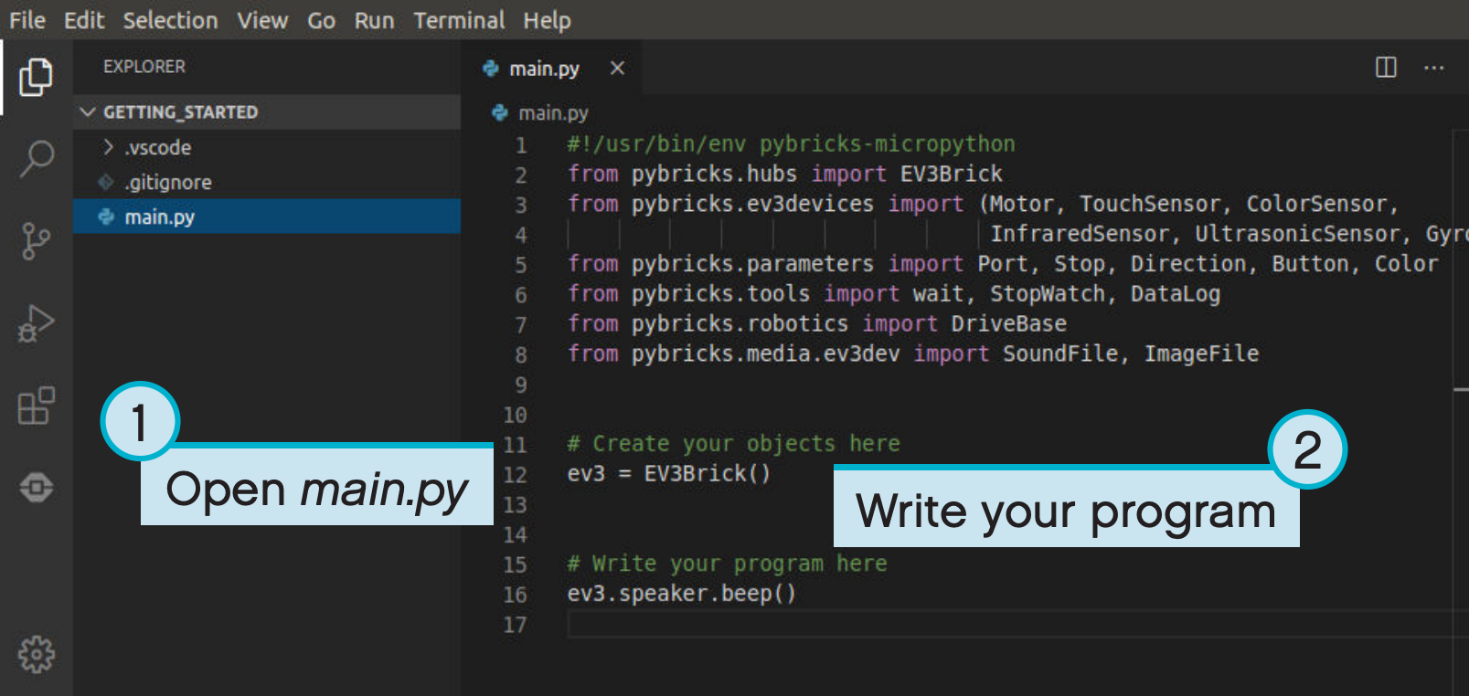
Creating our EV3 Project
Follow these steps to create a new project
After created, we’ll be writing our code in the main.py file, that can be found in the file explorer.

Slide 10
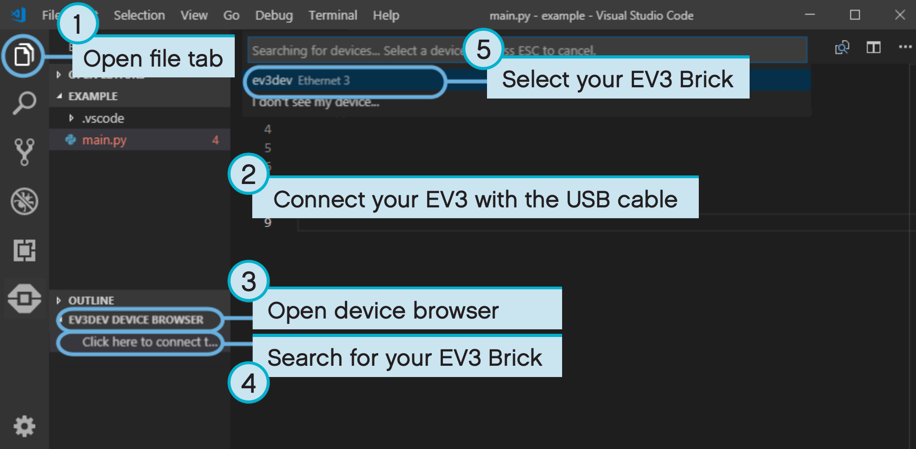
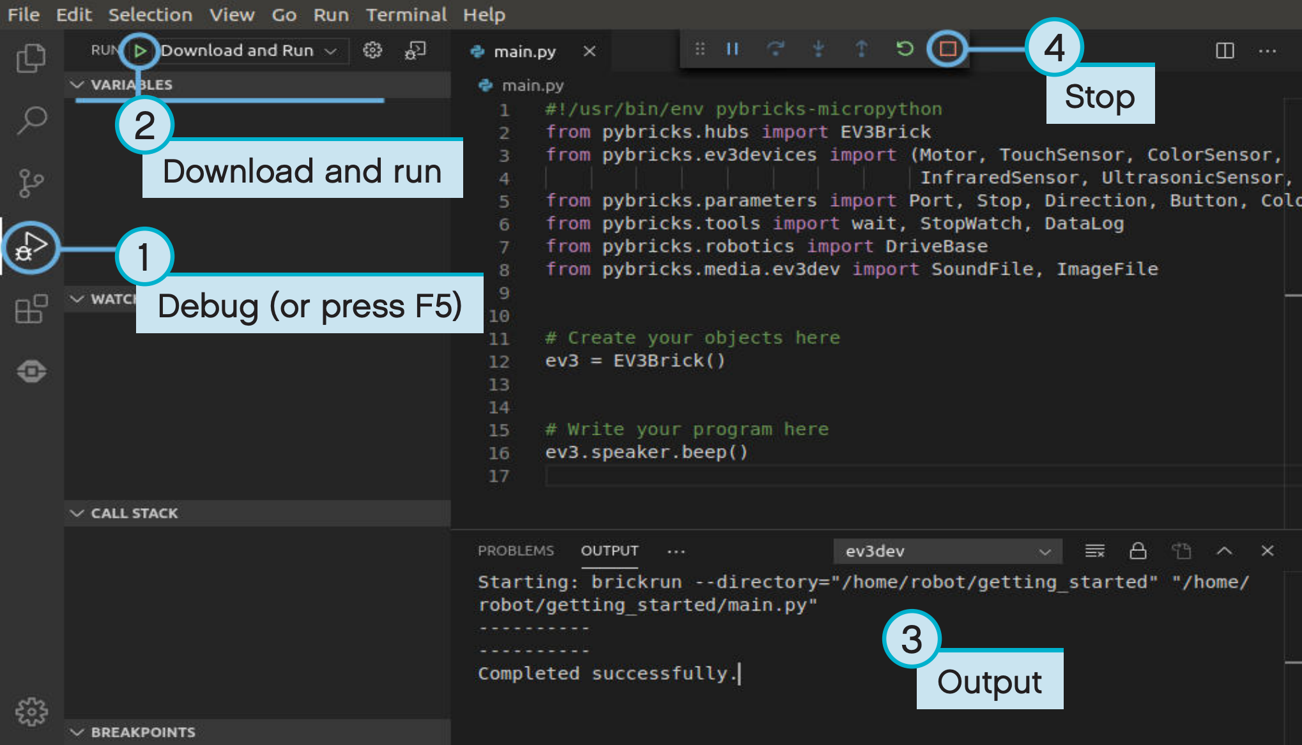
Connecting and executing our program
To connect the EV3, follow these steps →
To run your program, follow this steps after connecting with your robot →
Let’s try executing the sample program!

Slide 11
Create 2-level line-follower
We’ll create a 2-level line-follower
First step: go to Github repository https://github.com/smartrobotsdesignlab/ev3_linefollower and copy the contents of the main_base.py file into your main.py file
Verify that both motors move
Back button to stop the program
Implement the 2-level line follower:
Pseudo-code:
if measurement <= threshold turn right (drive left motor), else turn left (drive right motor)

Slide 12
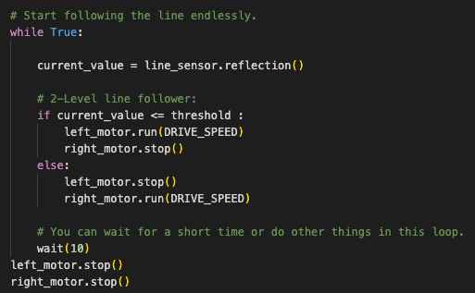
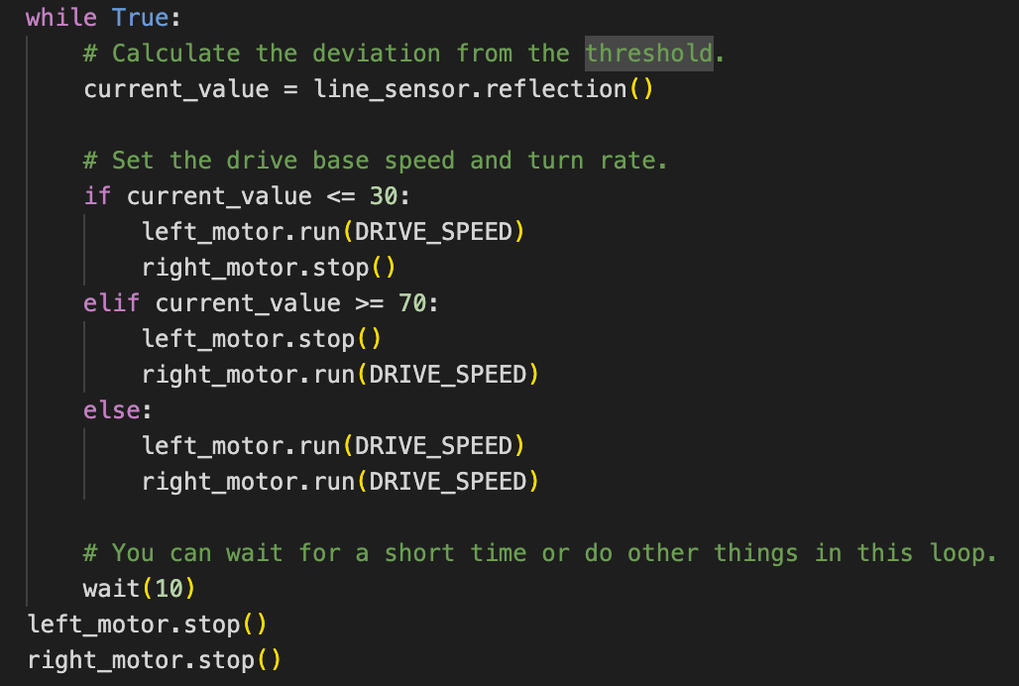
2-Level & 3-Level Solution
It can be implemented with a simple if-else statement:
It works OK, but as expected it oscillates
Can you turn it into a 3-level line follower?

Slide 13
What if we want a smoother motion?
To have a smoother motion, we could adjust the speed depending on how far the measurement is from the threshold
Further from threshold, stronger correction
Closer to threshold, smaller correction
We could just adjust the speed proportionally to this difference
Proportional control → make the robot take an action that is proportional to the error. You must multiply the error by a scaling factor to determine the correction.

Slide 14
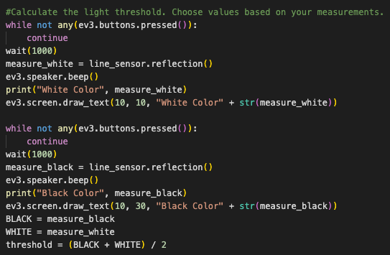
But first! Measuring sensor values
We need to actually measure the values for black and white
This code will:
Wait for a button press
Measure value
Repeat once
First measurement will be read as white, second one as black
Place the robot on a white space & press button, then on a black space & press button

Slide 15
How do you make a Proportional Line Follower?
Pseudocode:
Compute the error = Distance from line = (Light sensor reading - Target Reading)
Scale the error to determine a correction amount. Adjust your scaling factor to make you robot follow the line more smoothly.
Use the Correction value (computed in Step 2) to adjust the robot’s turn towards the line.

Slide 16
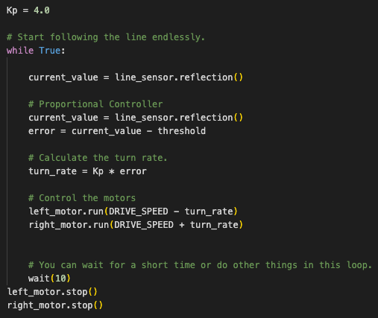
Let’s implement Proportional Control
Compute Error
Distance from line = (Light sensor reading - Target Reading)
Compute/Apply Correction
Scale the error to determine a correction amount. Use this to adjust the speed of each wheel

Slide 17
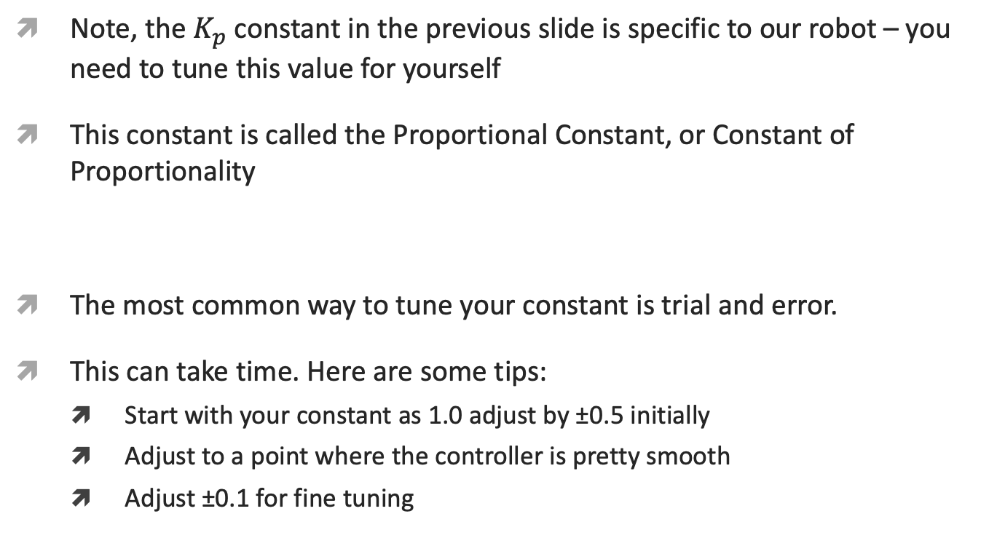
Key Step: Tuning the Constant
Note, the $K_{p}$ constant in the previous slide is specific to our robot – you need to tune this value for yourself
This constant is called the Proportional Constant, or Constant of Proportionality
The most common way to tune your constant is trial and error.
This can take time. Here are some tips:
Start with your constant as 1.0 adjust by ±0.5 initially
Adjust to a point where the controller is pretty smooth
Adjust ±0.1 for fine tuning

Slide 18
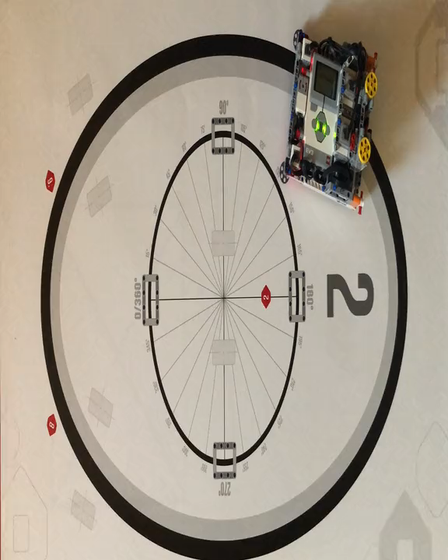
Proportional Control (0.6 Constant)
Play video. Turn on volume

Slide 19
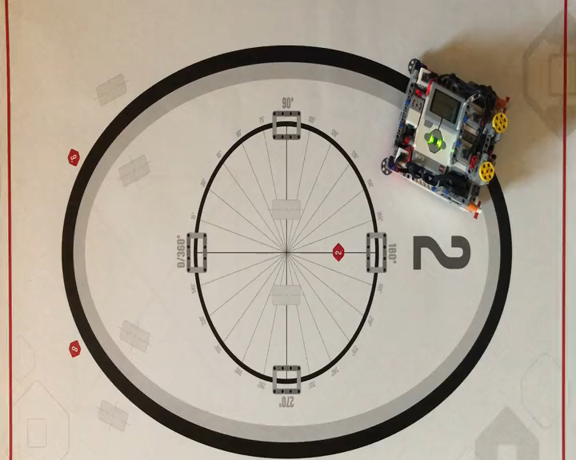
Proportional Control (0.8 Constant)
Play video. Turn on volume

Slide 20
When does Proportional Control Have Trouble?
What would a human do?
What would proportional control do?
On line → go straight
On white → turn left
Moving across line → turn right
On white → turn left
Getting further from line → turn even more!
On line → go straight
On white → turn left
Moving across line → go straight!
On white → turn left
Getting further from line → turn left the same amount!
50%
LIGHT READING =
100%

Slide 21
How can we fix Proportional Control?
What would a human do?
What would proportional control do?
Turning left/on line → turn right
Getting further from line → turn even more!
Turning left/on line → go straight!
Getting further from line → turn left the same amount!
1. Predict what the next sensor reading will be
2. Has past steering fixes helped reduce error?

Slide 22
Integrals and Derivatives
1. Predict what the next sensor reading will be?
2. Have past steering fixes helped reduce error?
If readings are: 75, 65, 55 → what do you think the next reading will be?
What if the readings were 57, 56, 55…
What information did you use to guess?
Derivative ➔ the rate at which a value is changing
When the correction is working well, what does error readings look like?
+5, -6, +4 -3…. i.e. bouncing around 0
When steering is not working, what does error look like?
+5, +5, +6, +5… i.e. always on one side of 0
How can we detect this easily?
Hint: look at the sum of all past errors
What is an ideal value for this sum? What does it mean if the sum is large?
Integral ➔ the “sum” of values

Slide 23
What is PID?
Proportional [Error] → How bad is the situation now?
Integral → Have my past fixes helped fix things?
Derivative → How is the situation changing?
PID control → combine the error, integral and derivative values to decide how to steer the robot

Slide 24
Error
Solid line represents what you have seen, dotted line is the future
At time 20, you see light reading = 40 and error = -10 (red X)
Subtract target (50)

Slide 25
Integral
Looks at past history of line follower
Sum of past error
Like area under the curve in graph (integral)
Green = positive area
Red = negative area
Notes:
f the error keeps the same sign for several loops the integral grows bigger and bigger. For example, if we check the light sensor and calculate that the error is 1, then a short time later we check the sensor again and the error is 2, then the next time the error is 2 again, then the integral will be 1+2+2=5. The integral is 5 but the error at this particular step is only 2. The integral can be a large factor in the correction but it usually takes a while for the integral to build up to the point where it starts to contribute.
Another thing that the integral does is it helps remove small errors. If in our line follower the light sensor is pretty close to the line's edge, but not exactly on it, then the error will be small and it will only take a small correction to fix. You might be able to fix that small error by changing Kp in the proportional term but that will often lead to a robot that oscillates (wobbles back and forth). The integral term is perfect for fixing small errors. Since the integral adds up the errors, several consecutive small errors eventually makes the integral big enough to make a difference.
One way to think about the integral term is that it is the controller's "memory". The integral is the cumulative history of the error and gives the controller a method to fix errors that persist for a long time.
One last detail should be mentioned about the integral. Usually the integral can only be moved towards zero, where it doesn't contribute anything to the controller, by having error values added that are the opposite sign of most of the ones that we have already collected in integral. For example, if over several cycles through the loop the errors are 1,2,2,3,2,1 that adds up to an integral of 11. But the error at the last data point is only 1, which is much smaller than the integral at that point. The only way for the integral to move towards zero is to get a string of negative errors to counter balance the earlier string of positive errors to "wind down" the integral. For example, if the next few errors are -2,-2,-3 then the integral will drop from 11 to 4 and we would still need more negative errors to get the integral down to zero. In addition, the integral wants the total error to be evenly distributed between positive and negative errors.
If something happens that pushes our line following robot to the left of the line's edge the integral term not only wants to get back to the line's edge it also wants to overshoot the edge to the right by as much as the original disturbance was the left. So the integral tends to "wind-up" if there are large errors that persist for a while. This can cause problems with controllers that include an integral term. Sometimes this tendency of the integral term to want to overshoot when it tries to correct the error is a big enough problem that the programmer must do something to the integral term so it won't cause problems.

Slide 26
Derivative
How quickly is position changing?
Predicts where the robot will be in the immediate future
Same as how fast is error changing
Can be measured using tangent line to measurements → derivative
Approximated using two nearby points on graph
Tangent line
Notes:
If the current error is worse than the previous error then the D term tries to correct the error. If he current error is better than the previous error then the D term tries to stop the controller from correcting the error. It is the second case that is particularly useful. If the error is getting close to zero then we are approaching the point where we want to stop correcting. Since the system probably takes a while to respond to changes in the motors' power we want to start reducing the motor power before the error has actually gone to zero, otherwise we will overshoot.

Slide 27
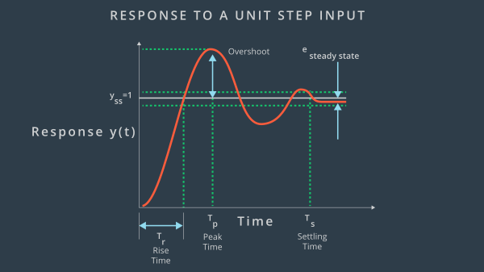
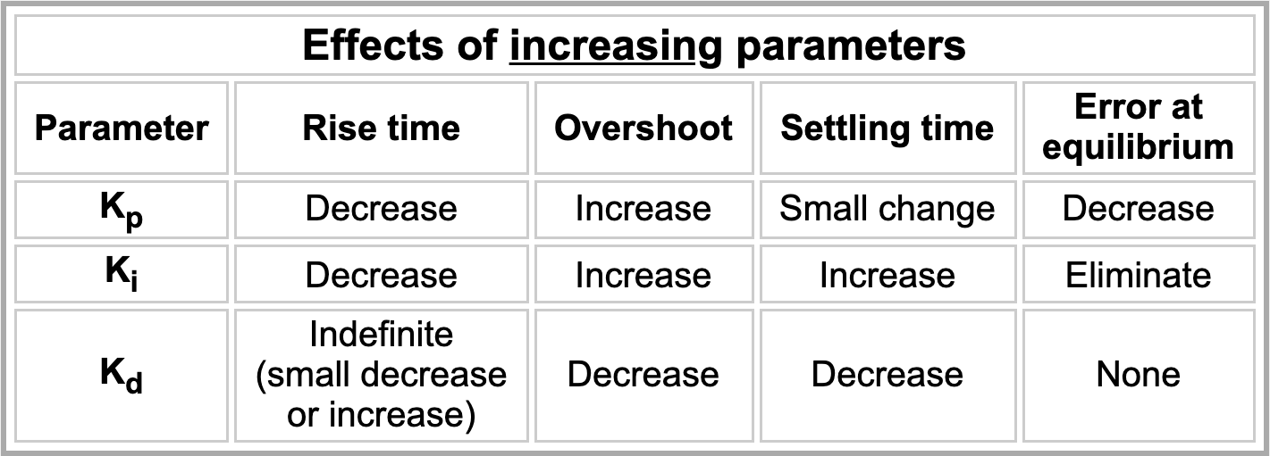
Effects of each constant

Slide 28
Pseudocode
Take a new light sensor reading
Compute the “error”
Scale error to determine contribution to steering update (proportional control)
Use error to update integral (sum of all past errors)
Scale integral to determine contribution to steering update (integral control)
Use error to update derivative (difference from last error)
Scale derivative to determine contribution to steering update (derivative control)
Combine P, I, and D feedback and steer robot

Slide 29
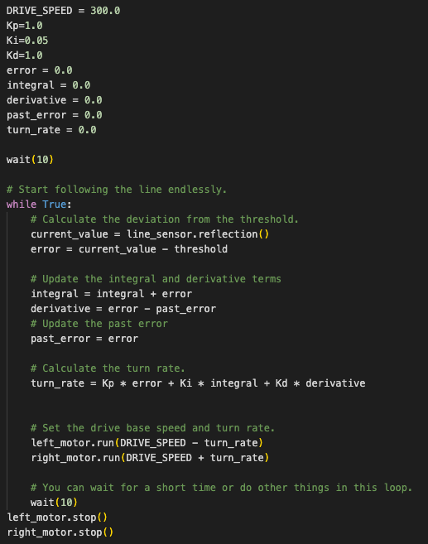
Implementation of PID Control
Take a new light sensor reading
Compute the “error”
Use error to update integral (sum of all past errors)
Use error to update derivative (difference from last error)
Scale error to determine contribution to steering update (proportional control)
Scale integral to determine contribution to steering update (integral control)
Scale derivative to determine contribution to steering update (derivative control)
Combine P, I, and D feedback and steer robot

Slide 30
Key Step: Tuning The PID constants
The most common way to tune your PID constants is trial and error.
This can take time. Here are some tips:
Disable everything but the proportional part (set the other constants to zero). Adjust just the proportional constant until robot follows the line well.
Then, enable the integral and adjust until it provides good performance on a range of lines.
Finally, enable the derivative and adjust until you are satisfied with the line following.
When enabling each segment, here are some good numbers to start with for the constants:
P: 1.0 adjust by ±0.5 initially and ±0.1 for fine tuning
I: 0.05 adjust by ±0.01 initial and ±0.005 for fine tuning
D: 1.0 adjust by ±0.5 initially and ±0.1 for fine tuning

Slide 31
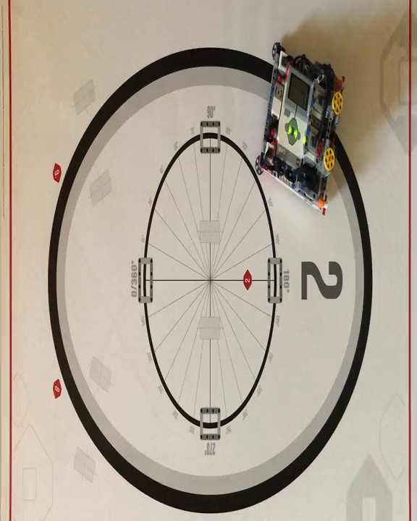
PID Control

Slide 32
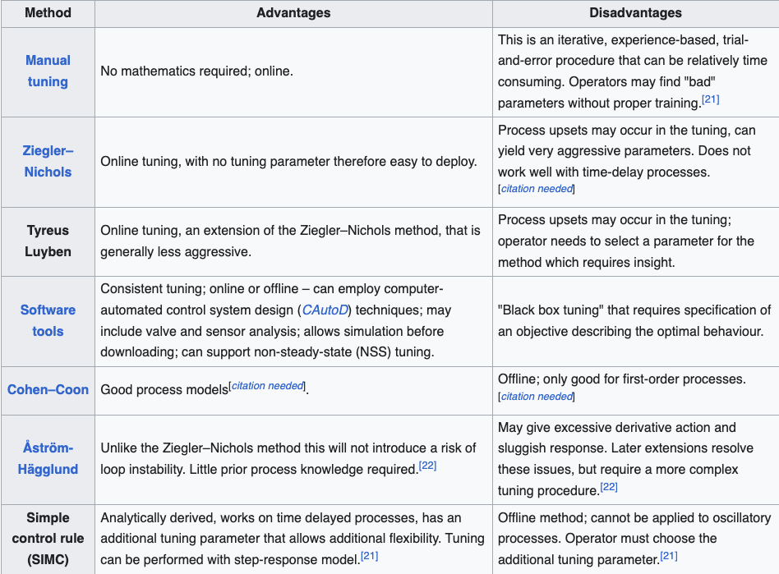
Tuning Methods
We can calculate "pretty good" values for Kp, Ki and Kd
It doesn't matter much what the exact system is that is being controlled, the tuning equations almost always work well

Slide 33
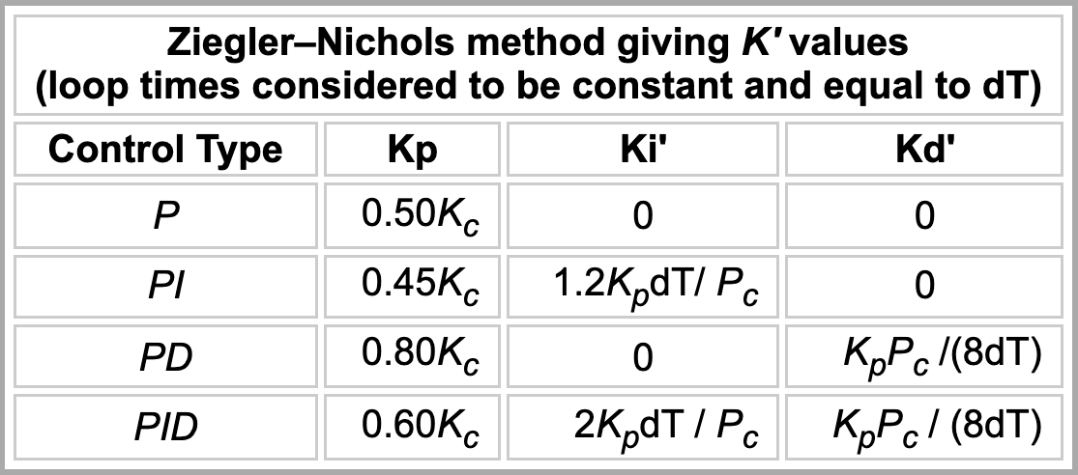
Ziegler-Nichols Procedure
Set the Ki and Kd values to zero (simple P controller)
Run the robot with a initial Kp value and watch what it does. If it can't follow the line and wanders off then increase Kp. If it oscillates wildly then decrease Kp. Keep changing the Kp value until you find one that follows the line and gives noticeable oscillation but not really wild ones. We will call this Kp value "Kc" ("critical gain" in the PID literature).
Measure the oscillation period (Pc), which is how long it takes the robot to swing back and forth once.
Measure the time per loop (dT) (usually 0.015 to 0.020 seconds per loop for an EV3)
Use the table below to calculate a set of Kp, Ki, and Kc values
Run the robot and see how it behaves.
Tweak the Kp, Ki and Kd values to get the best performance you can. You can start with fairly big tweaks (~30%) then try smaller tweaks to get the optimal (or at least acceptable) performance.
Keep repeating until the robot's behavior is acceptable.
Download Spreadsheet for easy calculation from the repository ☺ https://github.com/smartrobotsdesignlab/ev3_linefollower

Slide 34
Evaluating Line followers
Proportional
PID
Uses the “P” in PID
Makes proportional turns
Works well on both straight and curved lines
Can lead to oscillations depending on the value of the constant
It is better than proportional control on a very curved line, as the robot adapts to the curviness
It’s harder to tune and sometimes can lead to uncontrolled behavior

Slide 35
Visual Studio Code download webpage: https://code.visualstudio.com/download
Website for getting started with LEGO Mindstorms EV3 & MicroPython: https://assets.education.lego.com/v3/assets/blt293eea581807678a/bltb470b9ea6e38f8d4/5f8802fc4376310c19e33714/getting-started-with-micropython-v2_enus.pdf?locale=en-us
Line-follower assembly manual: https://assets.education.lego.com/v3/assets/blt293eea581807678a/bltc8481dd2666822ff/5f8801e3f4f4cf0fa39d2fef/ev3-rem-driving-base.pdf?locale=en-us
Line-follower MicroPython code: https://pybricks.com/ev3-micropython/examples/robot_educator_line.html
MicroPython Reference: https://pybricks.com/ev3-micropython/

