Slide 1
Apache Zookeeper: Issues‘ Pattern and Updates Analysis
Aynur Amirfallah
Georgios Kaklamanos
Emmanuel Owayin
Alireza Zarei

Slide 2
Motivation
To explore issues and events within the project
To discover the classification and occurrence of issues
To discover the priority attached to every class of issue
To discover issues’ resolution time
1/31/2017
Georg August University

Slide 3
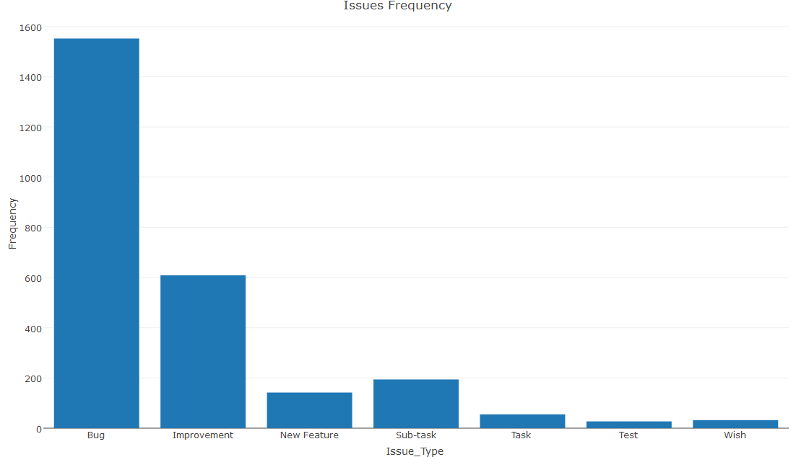
Classification and Occurrence of Issues
1/31/2017
Georg August University

Slide 4
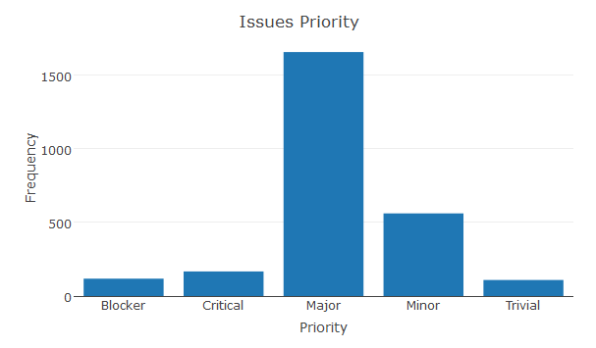
Issues priority
1/31/2017
Georg August University

Slide 5
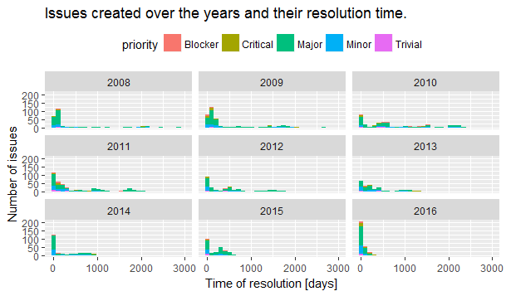
Issues resolution time over the years
1/31/2017
Georg August University

Slide 6
Key Findings
Issue resolution time over the years
Accuracy improvement for the mentioned models
Issues resolution time reduced over time as the project advanced
1/31/2017
1/31/2017
Georg August University
Georg August University

Slide 7
Model
Features engineering:
  Calculate the difference between created date and updated date (in days)
  Define 11 level of the issue based on the duration between created date and updated date
Model: Decision tree
  Divide dataset to trainset(85% of the data) and testset(15%)
1/31/2017
1/31/2017
Georg August University
Georg August University

Slide 8
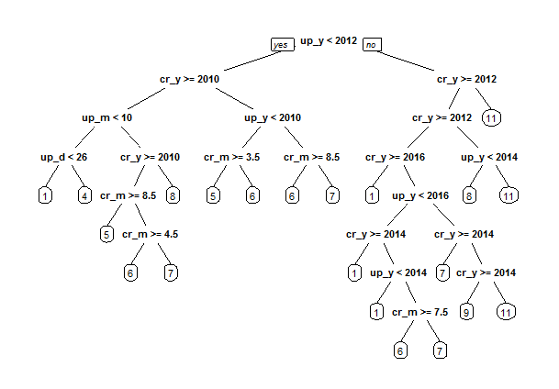
Growing the tree
1/31/2017
1/31/2017
Georg August University
Georg August University

Slide 9
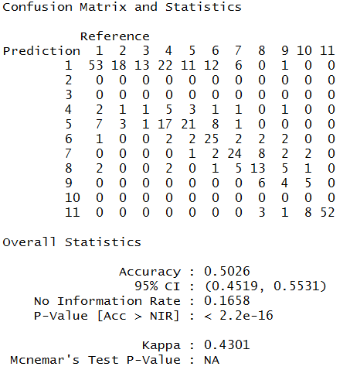
Evaluate model
1/31/2017
1/31/2017
Georg August University
Georg August University

Slide 10
Issues
Linking issue_id field of events collection with issues collection
More complex models required long computational times
R interaction with MongoDB
Time constraints during a heavy workload period
1/31/2017
1/31/2017
Georg August University
Georg August University

Slide 11
Future Work
Mapping the issue_id from the event collection, to the issue collection
Considering the length of issue_comment and issue_title
Create categories of people submitting issues (new, old, etc)
Create categories of devs based on the number of issues he's solved, the time,
1/31/2017
1/31/2017
Georg August University
Georg August University

