Slide 1

People's involvement analysis in committed issue types & Forecasting issue frequency using time series analysis
Data Science Challenge
Mainul Quraishi
Md Rubayet Hasan
Bikash Chandra Karmokar
Al Kafi Khan

Slide 2
Motivation
Finding peoples’ involvement in different committed issue types.
Forecasting the frequency of a particular issue in next year.

Slide 3
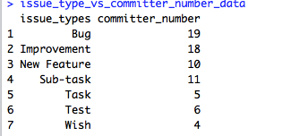
People's involvement analysis in committed issue types
extracting
matching
external_id
message
External id
commit
issue
issue_type
Committer_id

Slide 4
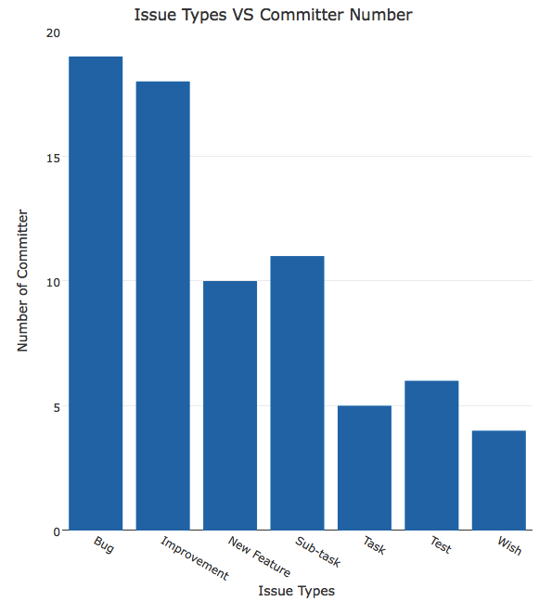
People's involvement analysis in committed issue types

Slide 5
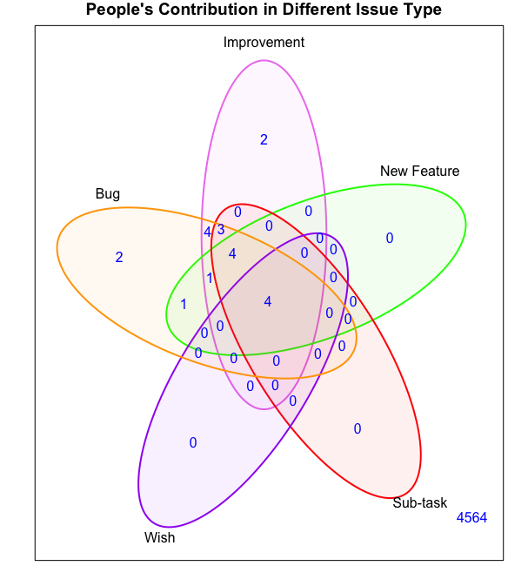
People's involvement analysis in committed issue types

Slide 6
Forecasting Number of New Feature

Slide 7
Issues Summary
Duration
2008-2016
Issue Type | Number
Bug | 1552
Improvement | 609
New Feature | 142
Sub-task | 194
Task | 55
Test | 27
Wish | 32

Slide 8
How many
??
New Features
In 2017

Slide 9
We Can Predict
No Problem
New Features

Slide 10
Algorithm and Library
ARIMA
Autoregressive integrated moving average
forecast

Slide 11
Procedure
Fetched data only for New Feature from server
Collect only created date and issue type into another data frame from the fetched data.
Arranged the data by month and year
Notes:
1. From issue table

Slide 12
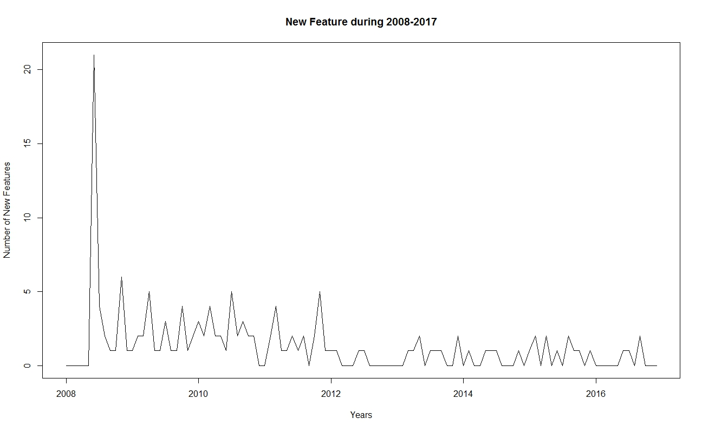
Observed Data: January 2008 - December 2016

Slide 13
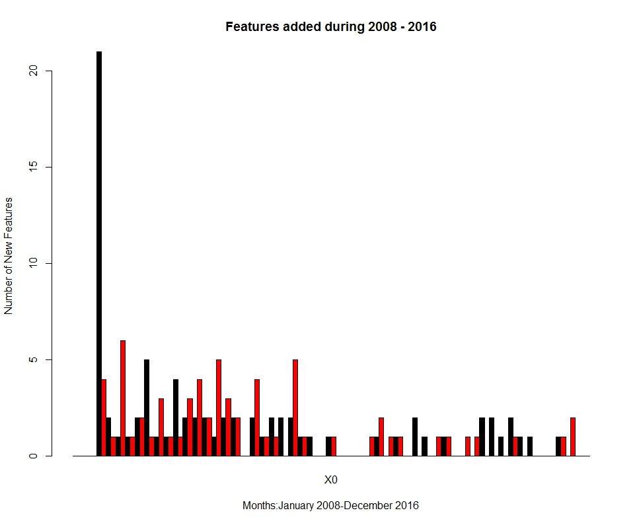
Observed Data: January 2008 - December 2016

Slide 14
Procedure (continue)
Data is decomposed into trend, seasonal and random influences
Notes:
1. From issue table

Slide 15
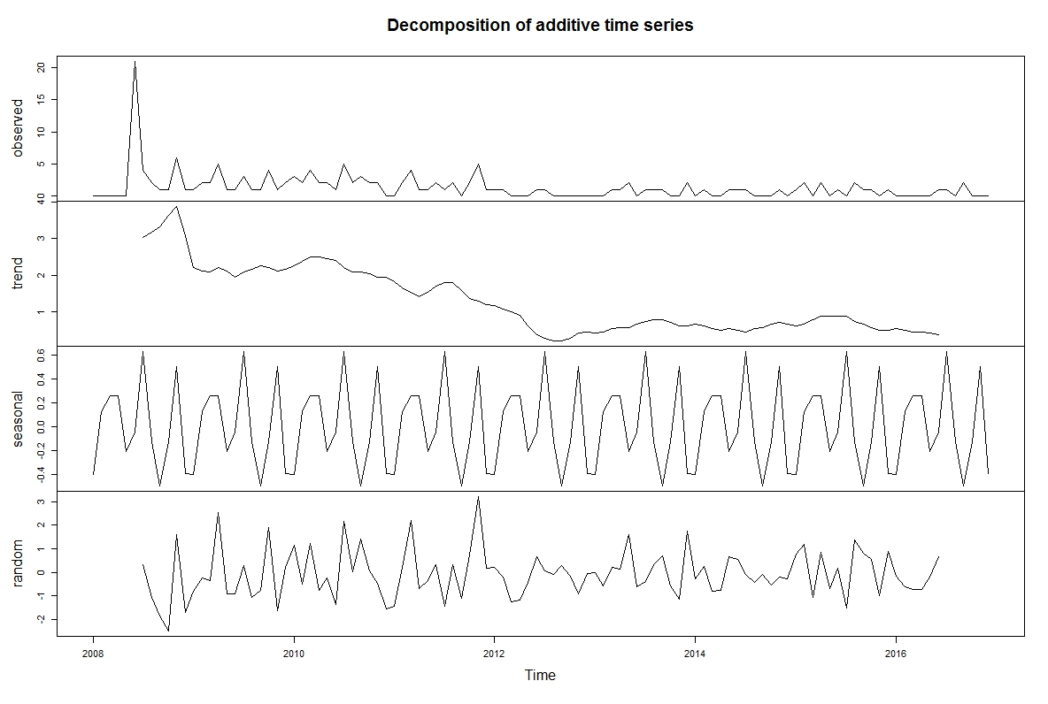
Decomposed Data

Slide 16
Procedure (continue)
Then Calculated adjusted time series without the seasonal effects.
Used that adjusted time series data to train an ARIMA model with automatically guessed parameters for p, q and d
Finally using trained module forecasting is done for year 2017

Slide 17
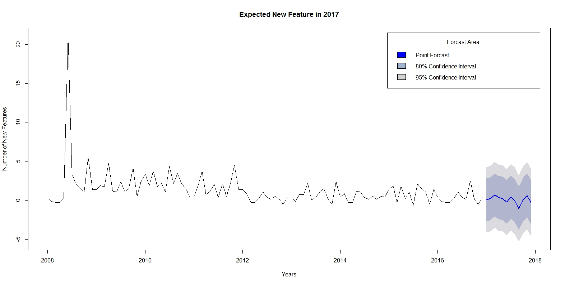
Result
Notes:
Have to add scale to plot

Slide 18
Thank You

Slide 19


