Slide 1
Solving Issues - How many developers do we need?
Applied Computer Sience
Data Science and Big Data Analytics
Christian Steinmeyer, Christoph Prinz, Nicole Sarna, Selina Klees

Slide 2


Goals
How much time was needed for issues?
How many people needed for issues?
→ Optimal number of people working on issues

Slide 3
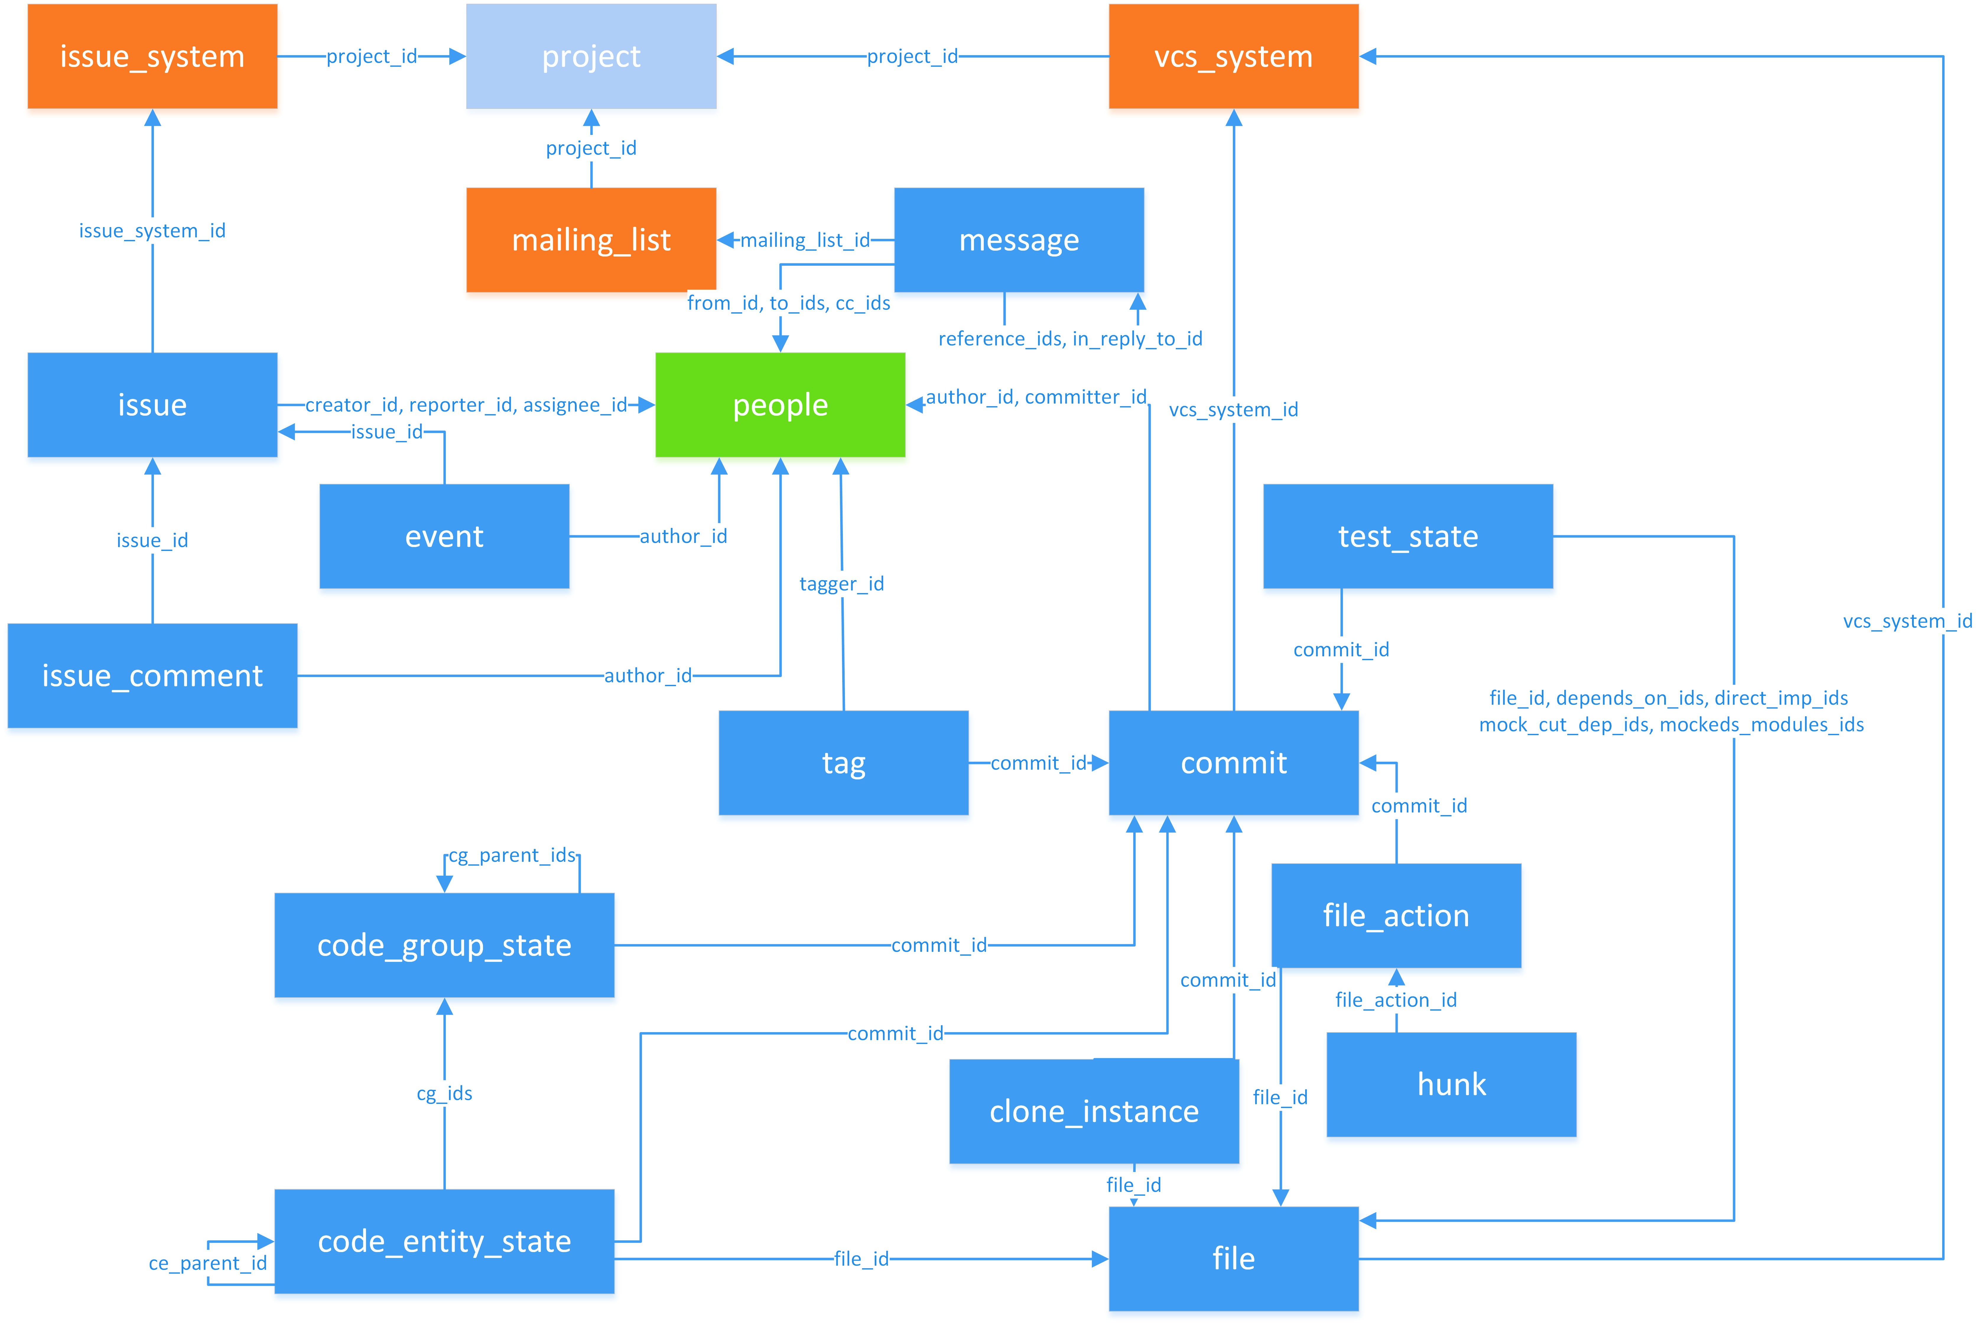
Notes:
How much time was needed for issue? ISSUE contains ID, Created_At, Creator_ID EVENT contains ID, Created_At, Author_ID, Isuue_ID, Status -> Get all event dates for issue ID (with respect to resolved ones)
How many people needed for issues? PEOPLE contains ID -> Collect all issues sorted by issue-ID and merged author-/creator-ID (why not assignee/reporterID?)

Slide 4
Methodic – Extract Issue Resolving Time
Find Issues that have been resolved
Select Events that contain status “resolved”
Save related Issue_IDs from those events
Remove all Events with Issue_IDs that haven’t been collected in the previous step
Calculate Issue Resolving Time
Convert all Timestamps to UTC+0
Calculate difference between first & last-event
Analyze Distribution
Set Class size to weeks
Calculate Histogram

Slide 5
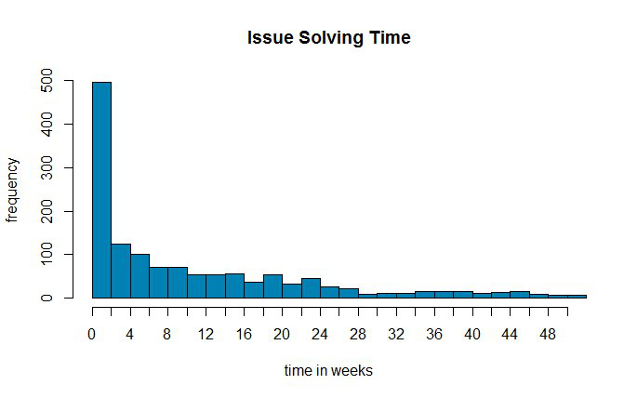
Notes:
Issues solved in 2 weeks intervals (from 0 to 50 weeks)
Everything more than 50 weeks was cut off

Slide 6
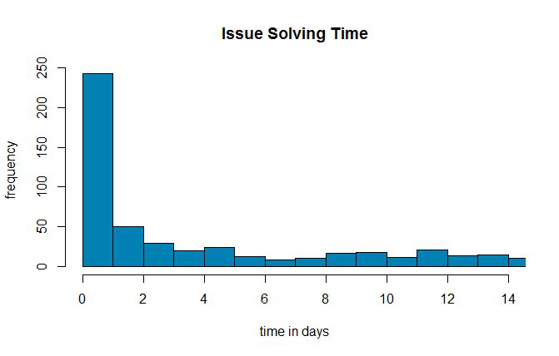
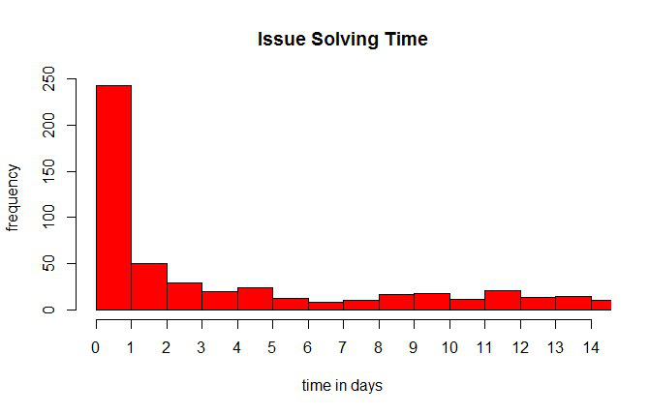
Notes:
Issues solved in 1 day intervals (from 0 to 14 weeks)
Shows first two weeks (from previous slide)

Slide 7
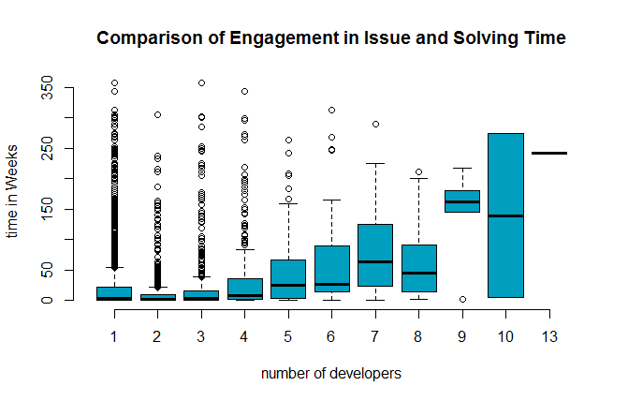
Notes:
Bring Information from duration and people involved together in boxplot:
-> Outlier for 1: Issues with low priority
-> 10: view issues (~2/3) with different resolving time
ANIMATION
-> 2 developers working on issue: best resolving time
SO goal is achieved

Slide 8
Questions?
Applied Computer Sience

