Slide 1
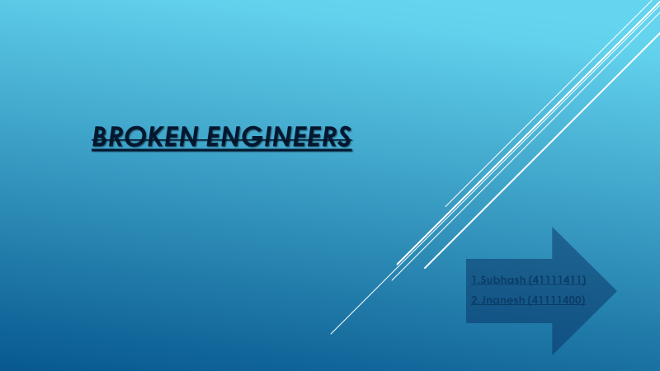

Slide 2
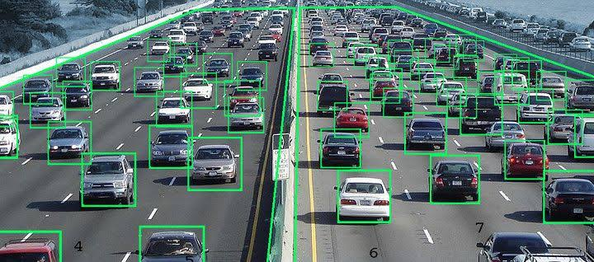
TRAFFIC SIGNAL VIOLATION DETECTEOR

Slide 4
The increasing number of cars in cities can cause high volume of traffic, and implies that traffic violations become more critical nowadays in Bangladesh and also around the world. This causes severe destruction of property and more accidents that may endanger the lives of the people. To solve the alarming problem and prevent such unfathomable consequences, traffic violation detection systems are needed. For which the system enforces proper traffic regulations at all times, and apprehend those who does not comply. A traffic violation detection system must be realized in real-time as the authorities track the roads all the time. Hence, traffic enforcers will not only be at ease in implementing safe roads accurately, but also efficiently; as the traffic detection system detects violations faster than humans. This system can detect traffic light violation in real-time. A user friendly graphical interface is associated with the system to make it simple for the user to operate the system. monitor traffic and take action against the violations of traffic rules
INTRODUCTION:

Slide 5
FOR PUBLIC SAFETY SERVICES TRAFFIC CONTROLS ARE USEFUL BUT IN A PLACE OF MILLIONS SOME WILL VIOLATE THE RULES BECAUSE THE CHANCE OF GETTING CAUGHT IS VERY LESS DUE TO MANUAL DETECTION SYSTEM

Slide 6
OUR SOLUTION :
WE HAVE COME UP WITH A SOLUTION TO SAVE INNOCENT HUMAN LIVES FROM OFFENSIVE DRIVERS ,WHERE BY IMPLEMENTING AN AUTOMATED ENFORCEMENT SYSTEM TO IDENTIFY AND CAPTURE IMAGES OF VEHICLES VIOLATING THE TRAFFIC RULES AND SEND THEM TO TRAFFIC CONTROL OFFICE TO GENERATE VIOLATION EVENTS AND CHALLANS

Slide 7
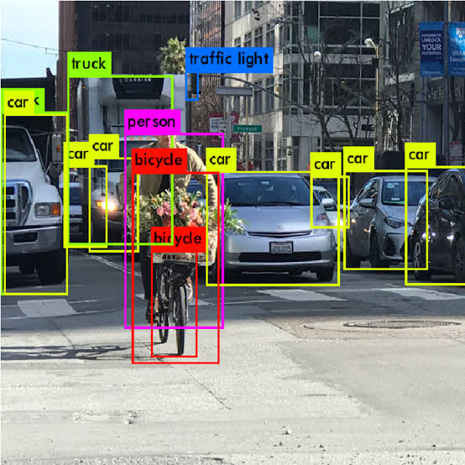
ADVANTAGES:
1.TRAFFIC VIOLATERS CAN BE CAUGHT EASILY AND PUNISHED.
2.ACCIDENTS WILL BE REDUCED.
3.EASY TO IMPLEMENT.
DISADVANTAGES:
1.TRAFFIC DELAY.
2.EMERGENCY VEHICLE HAVE TO WAIT IN THE TRAFFIC.

Slide 8
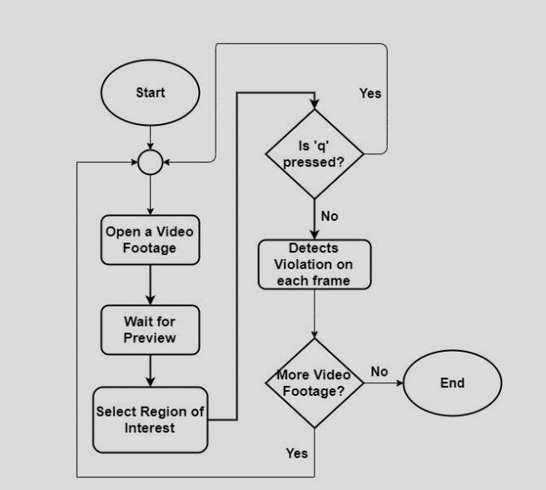
VEHICLE DETECTION MODEL:

Slide 9
THANK YOU

