Slide 1
UF
Herbert Wertheim
College of Engineering
UNIVERSITY of FLORIDA
MANTIS -- Updates
Zero Trust · the UI · the AML Office
October 30, 2026
Smart Systems Lab · Research testbed, synthetic data only
L E A D I N G T H E C H A R G E , C H A R G I N G A H E A D
Notes:
This is a quick update, not a full re-introduction -- you've seen MANTIS before. Three things changed since the last time we talked. We wired in a real Zero Trust Backplane. We built a minimal UI on top of the same CLI. And new this week, we added a fourth banking domain: an anti-money-laundering office, ported straight out of the legacy codebase our banking agents originally came from. All of it is off by default, and all of it has been verified against a live run, not just a passing test suite. Let's get into it.

Slide 2
MANTIS in brief
THE TESTBED
A real system under test
Five control points, one hook bus
Evidence, not exit codes
Unmodified banking multi-agent system. Front / mid / back office: 34 agents, 27 tools, a real backend.
Input, agent, interaction, tool, output. An attack, failure, or defense is a plugin declared in YAML.
Every run writes a manifest, a trace, and a scorecard -- verified against the real trace, every time.
WHAT'S NEW
Two new toggles, zero risk to the rest. Zero Trust and the AML office are both off by default -- every existing config's behavior is byte-identical whether or not they exist.
Everything below is a toggle on top of that unchanged core.
U N I V E R S I T Y O F F L O R I D A H E R B E R T W E R T H E I M C O L L E G E O F E N G I N E E R I N G
2
Notes:
Quick refresher before we get into what's new. MANTIS is a security testbed built on top of a real, unmodified banking multi-agent system -- front office, mid office, back office, all always running: thirty-four agents, twenty-seven tools. The trick is five fixed control points -- input, agent, interaction, tool, output -- so an attack, a failure, or a defense is never a code change. It's just a YAML file that plugs into one of those five points. Keep that in mind, because everything I'm about to show you -- Zero Trust, the AML office -- is just a toggle sitting on top of that same unchanged core.

Slide 3
Zero Trust Backplane: real PDP, toggled per run
POLICY DECISION
ALLOW — same domain
Agent request
PDP policy check
Unknown identity or
unrecognized call: deny
before a challenge issues.
DENY — everything else
WHAT IT IS
LIVE-VERIFIED
Real external project. The independent Citi_P3_Zero_Trust_Backplane's own signed PDP -- not reimplemented here.
Fails closed. Unreachable PDP, or anything but ALLOW, means deny -- not a silent pass-through.
Opt-in dependency. Guarded import -- a stock install never touches it.
1
Same-domain allow, cross-domain deny
2
Unrecognized agent denied pre-challenge
3
Shared tool name resolves correctly, both directions
4
2 full legitimate runs identical to the undefended baseline
zero_trust: {enabled: true} -- 11 regression tests guard it against drift.
U N I V E R S I T Y O F F L O R I D A H E R B E R T W E R T H E I M C O L L E G E O F E N G I N E E R I N G
3
Notes:
So, first, Zero Trust. This isn't something we built from scratch -- it's a real integration of an independent project, the Citi_P3 Zero Trust Backplane, and its actual signed policy decision point. We didn't reimplement it, we wired the real thing in. By default it isn't even imported -- it's an optional dependency behind a try/except, so a normal install never touches it. You turn it on with one block in the config, or one checkbox in the UI. The policy itself comes straight from MANTIS's own live inventory: an agent can act on a tool in its own domain, and the PDP denies everything else by default. And we didn't just trust that it works, we verified it live. Same-domain requests get allowed. Cross-domain requests get denied. An agent the system doesn't recognize gets denied before it's even challenged. And we ran two full legitimate campaigns through the real PDP and got results identical to the undefended baseline. Eleven regression tests sit on top of that to catch any future drift.

Slide 4
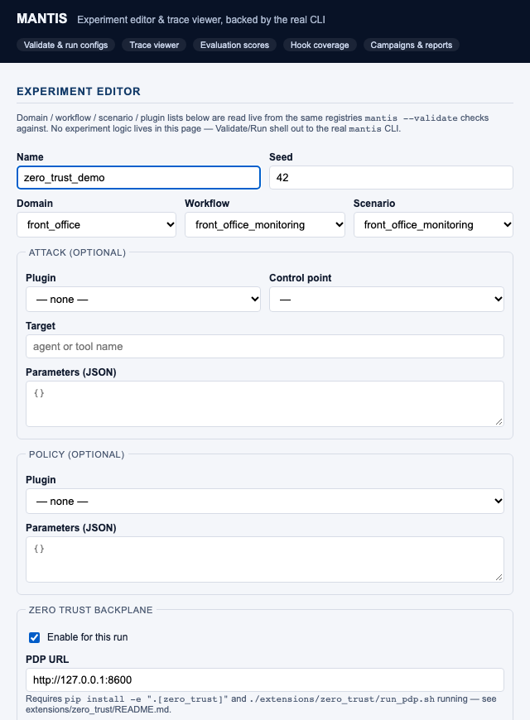
The minimal UI: a thin layer over the real CLI
NO SEPARATE BUSINESS LOGIC
Validate / Run → the real mantis CLI subprocess.
Schema, registries, inventory → the same live objects mantis --inventory reads.
Trace / evaluation / hook-coverage → the same JSON files every other consumer reads.
Campaign → two real CLI invocations chained, not UI-side aggregation.
TURN IT ON
mantis --ui
http://127.0.0.1:8765
Dedicated toggle fieldsets: Zero Trust + AML Office
A real screenshot of the real UI -- not a mockup.
U N I V E R S I T Y O F F L O R I D A H E R B E R T W E R T H E I M C O L L E G E O F E N G I N E E R I N G
4
Notes:
Next, the UI. This is deliberately thin -- there's no separate business logic hiding behind it. Validate and Run literally shell out to the same mantis CLI command you'd type in a terminal yourself. The dropdowns -- domain, workflow, scenario, plugin -- are populated live from the real running registries, so they can never drift out of sync with the actual system. We proved that by deliberately submitting a broken config through the UI, and it came back with the exact same error text the CLI itself gives you. What you're looking at on the left is a real screenshot, not a mockup. It's the UI running an actual AML office campaign, with dedicated toggles for Zero Trust and the AML office sitting right next to the existing attack and policy options.

Slide 5
AML office: four real detectors, ported from Citi_P3
PORTED, NOT REINVENTED
1
Structuring detection
2
Threshold anomaly
Sliding-window cumulative deposits; default $10,000 / 7 days
Flags a transaction over 5x a customer's baseline peak
3
Mule-ring detection
4
Identity verification
Closed-loop graph traversal over a customer's own transaction history
Levenshtein name + DOB + ID number, weighted 0.30 / 0.30 / 0.40
TURN IT ON
aml_office:
enabled: true
Off by default — every existing config's root agent is byte-identical to before this domain existed.
Four real detectors, one toggle -- the identical discipline as Zero Trust.
U N I V E R S I T Y O F F L O R I D A H E R B E R T W E R T H E I M C O L L E G E O F E N G I N E E R I N G
5
Notes:
Now, the new piece: the AML office. Quick backstory -- MANTIS's banking agents were originally pulled out of a bigger legacy codebase called Citi_P3. That codebase had a working anti-money-laundering investigation office that never made the move over. This week, we ported it. Four detectors, and we kept the logic exactly as it was in the source -- we didn't reinvent any of it. Structuring detection is a real sliding-window analysis of cumulative deposits. Threshold anomaly flags anything over five times a customer's normal baseline. Mule-ring detection walks the actual transaction graph looking for closed loops. Identity verification scores name similarity against date of birth and ID number, weighted thirty, thirty, forty. On top of all that, there's a real alert lifecycle -- open, under investigation, cleared, or escalated to a SAR filing. It's a fourth banking domain, off by default, and you turn it on exactly the same way you turn on Zero Trust.

Slide 6
Live verification found 2 real bugs
...BEFORE WE CALLED THE AML OFFICE “DONE”
BUG 1 — Routing gap
BUG 2 — Unreachable capability
WHAT HAPPENED
WHAT HAPPENED
Identity verification was misrouted to the front office -- the root agent's instruction never named it as an AML task.
Alert-triage was implemented and unit-tested, but no agent in the built tree had it on its toolset.
FIX
FIX
Wording, not logic: both the root agent's and the AML router's instructions now name identity verification and alert triage explicitly.
Wired the three alert-lifecycle tools onto the investigator agent. Re-verified: a real database status transition, confirmed by reading it back.
Neither bug was caught by the unit suite -- both are properties of the live agent tree.
U N I V E R S I T Y O F F L O R I D A H E R B E R T W E R T H E I M C O L L E G E O F E N G I N E E R I N G
6
Notes:
Here's the part I actually want to spend time on, because it's the whole point of verifying against a live trace instead of a clean exit code. When we ran five new AML scenarios live, we found two real bugs -- not in the ported logic itself, but in how it was wired into the agent tree. First, a routing gap. Identity-verification requests were going to the front office instead of the AML office, because the root agent's own instructions never mentioned identity verification by name. Second, an unreachable capability. The alert-triage tool was implemented correctly, and it even passed its own unit test as a standalone function. But no agent in the actual built tree had it on its toolset, so in a real run it could never be called. Neither one would have shown up in the unit suite, because both are bugs in the live agent tree, not in any one function. We fixed both, and re-verified live, including reading the actual database state back afterward to confirm the fix -- not just trusting what the model reported. All five scenarios now score perfectly, every time.

Slide 7
Where things stand
BY THE NUMBERS
853
880
0
2
tests passing offline
with both toggles' deps installed
failures, either way
new toggles, zero impact when off
THE SAME DISCIPLINE, BOTH TIMES
Opt-in, off by default
Byte-identical existing behavior when disabled
1
2
Real external logic, not reimplemented or invented
Verified against the live trace / database, not a clean exit code
3
4
Reproducible from a committed config, against the real backend and a real model.
U N I V E R S I T Y O F F L O R I D A H E R B E R T W E R T H E I M C O L L E G E O F E N G I N E E R I N G
7
Notes:
So, where does that leave us. Both toggles follow the exact same discipline: opt-in, off by default, byte-identical behavior when they're not turned on, and verified live rather than just unit-tested. Right now the full suite stands at 853 tests passing with neither optional dependency installed, and 880 passing with both Zero Trust and the AML office installed -- zero failures, either way. And every single thing I've shown you today is reproducible. Pick up the committed config file, run it against the real backend and a real model, and you get the same result.

