Slide 1















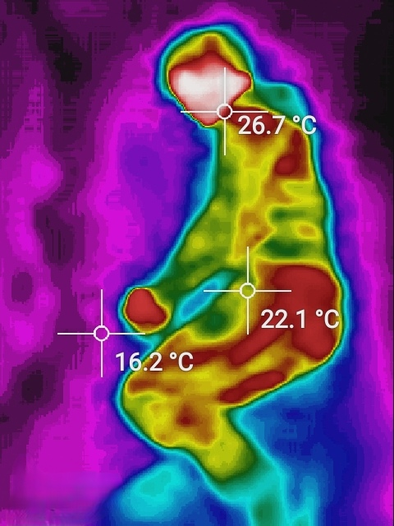




AIoT Coding, Engineering and Entrepreneurial Skills Education for Gifted Students
AIoT Bedroom
Student: Au Ka Long
Aim
Application
AI and IoT technology to improve Elderly’s life by enhancing bedroom environment
Actions | Case1(When) | Case2(When)
Call ambulance | High fever/ Hypothermia | Fall out of bed and fainted
Control air-con | Optimal body temperature | Optimal bed temperature
Care service | Not able to sleep | Possible diseases
Objective
Cozy bedroom
Wipe out the threads for Elderly
Reduce labour cost for elderly care
Background & Motivation
More To Go
Safe and Cozy environment
No action required
Healthy sleep
Can customize for different cases
Sudden Death in sleep
Imperfect of sleeping environment
Lack of labour for elderly care
~33% Elderly people living alone
Methodology
GitHub Link
YouTube Link
Detect the status of Person
Control Devices by the status
Fit within elderly’s preferences
Conclusion
Ensure bedroom safety
40% of household injuries
Suit elderly’s situations
All automatic(Few labour needed)
Cater elderly’s needs
Object detection
Yolo v5
Gesture analysis
Extend the system
Include other living spaces
E.g. Living room, kitchen, etc.
IR camera
Visual image
Thermal image
Other home IoT devices
Lights
Air-conditioner
Music box
Continuous revenues
Care-on-Call service, etc.
To Support continuous update

