Slide 1

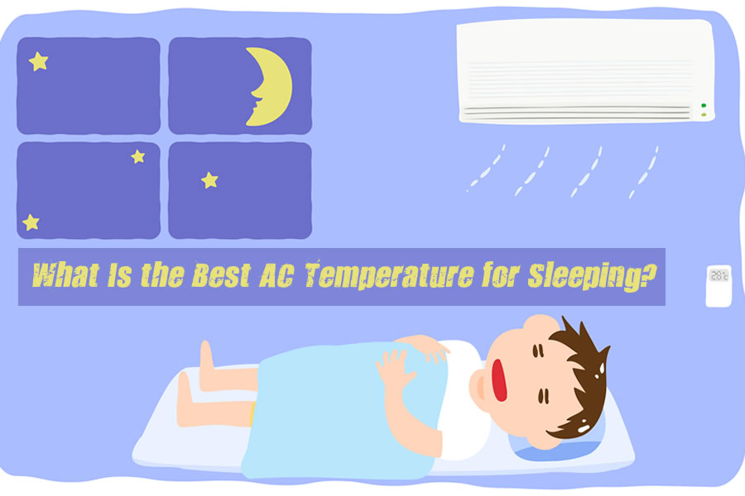

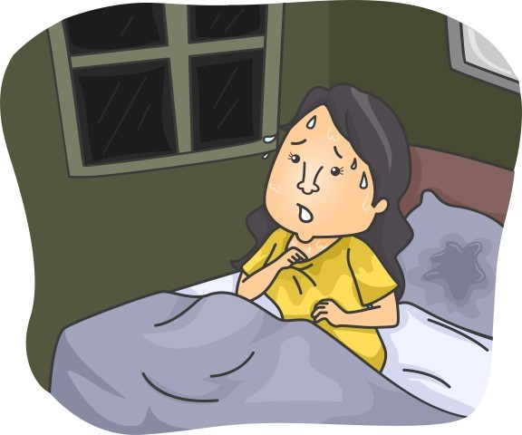
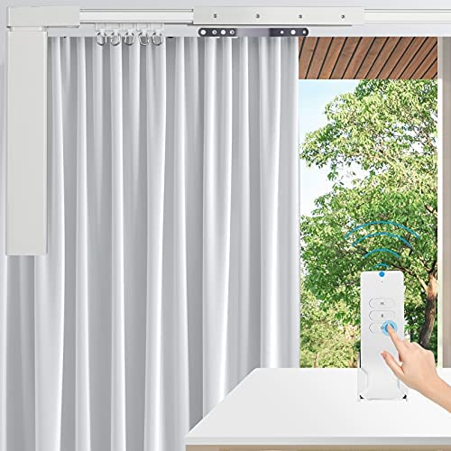
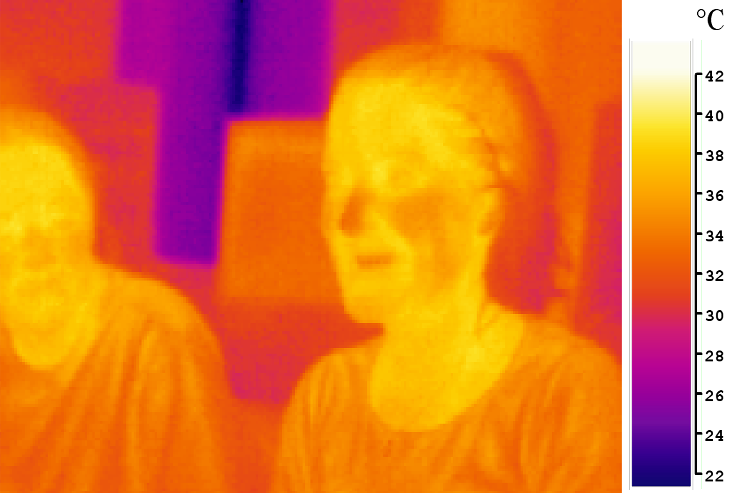

Gifted Education Fund AIoT Coding, Engineering and Entrepreneurial Skills Education for Gifted Students AIOT Bedroom
Student: 04 Au Ka Long
Objective/Background/Motivation
Massive workload(either work or studying)
Late at home
Don’t want to do much when get back to home
Forgot to turn off light when ready to bed
Temperature of air con is never at best situation
Wants a more relaxing bedroom
Existing Solution
Air con
Heat sensor integrate on the air con
Not accurate
Time control, remote control(phone)
Doesn’t work automatically
Lights
Sound control, time control, remote control
Doesn’t work automatically
Music
Sound control, time control, remote control
Your Solution
AI detection using IR sensor
High privacy than uising camera
Detect movement ,posture and temperature of human.
With analysis of the above
Best temperature
Correct time to turn on and off light
Protect eyes (auto turn on lights when using phone)
Turn off lights when ready to sleep
Play music automatically
Everything work total automatically in your needs
No efforts
Future
Integrate more modules
Infinity possibility for the best condition for bedroom
API to communicate with other IoT products
Easy to extends
Compatibility with others
More competitive
Resources Needed
IR sensor
Simple IoT connector
E.g.
Air con signal copier
Lights controller

