Slide 1








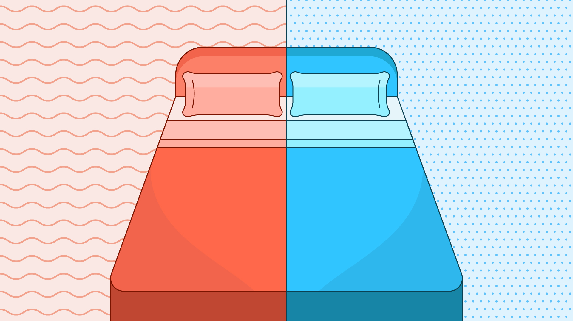
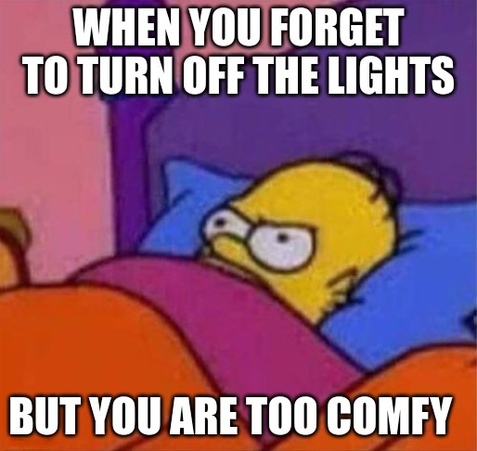



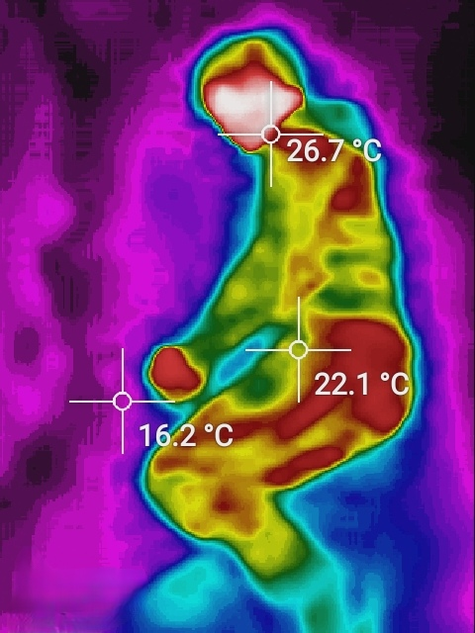





AIoT Coding, Engineering and Entrepreneurial Skills Education for Gifted Students
AIoT Bedroom
Student: 04 Au Ka Long Project ID: P21
Abstract
Application
AI and IoT technology to improve bedroom environment
Actions | Case1 | Case2
Call ambulance | High fever/ Hypothermia | Fall out of bed and fainted
Control lights | Sleeping mood | Using phone
Control air-con | Optimal body temperature | Optimal bed temperature
Objective
Cozy bedroom
100% Relaxing
100% Automation
Motivation
More To Go
Safe and Cozy environment
No action required
Wide range of users
Can further customize
Annoyed of Turn off lights on bed
Feeling hot/cold when sleeping
Harmful for Eyes, phone in dark
ETC
Methodology
GitHub Link
YouTube Link
Object detection
Yolo v5
Gesture analysis
Conclusion
Extensible with IoT devices
Ensure bedroom safety
40% of household injuries
All automatic
Cater your needs
IR camera
Visual image
Thermal image
Other home IoT devices
Lights
Air-conditioner
Music box
Custom dataset
Use Thermal image
Higher privacy
Detect the status of Person
Control Devices by the status
Fit within your preferences
Co-operate with IoT company
Service bundle with products
Selling IR camera with system

