Slide 1







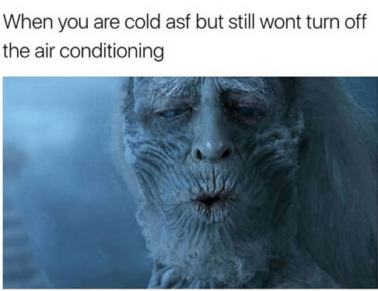
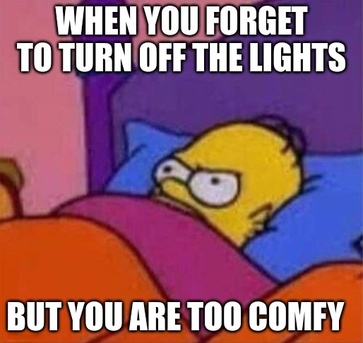


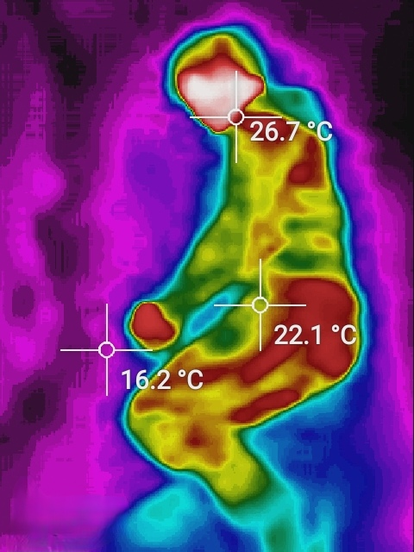





AIoT Coding, Engineering and Entrepreneurial Skills Education for Gifted Students
AIoT Bedroom
Student: 04 Au Ka Long Project ID: P21
Abstract
Application
AI and IoT technology to improve bedroom environment
Actions | Case1 | Case2
Call ambulance | High fever/ Hypothermia | Fall out of bed and fainted
Control lights | Sleeping mood | Using phone
Control air-con | Optimal body temperature | Optimal bed temperature
Objective
Cozy bedroom
100% Relaxing
0% Movement
Motivation
More To Go
Safe and Cozy environment
No action required
Useful for wide range of people
Can further customize
Annoying of Turning off light
Inconsistent air-con temperature
Eyes damage, using phone in dark
ETC
QR Code for Video Demo
Methodology
GitHub Link
YouTube Link
Object detection
Gesture analysis
Yolo v5
Conclusion
Extensible with IoT devices
Ensure bedroom safety
40% of household injuries
All automatic
Do what you want
IR camera
Visual image
Thermal data
Other home IoT devices
Lights
Air-conditioner
Music box
Custom dataset
Bypass visual image
Higher privacy
Detect the status of Person
Call Devices by the status
Customize with users’ habits
Co-operate with IoT company
Service bundle with products
Selling IR camera

