Slide 1

SWN Monitor
Monitor water usage and health of assets in the smart water network installation site across aggregations.
Get notified about events and anomolies in the water network like leaks and when acceptable water quality is breached.
Get useful predictions like the amount of water needed for the next day and when to water the garden.
Track the resolution of problems in the water network by field personnal.
Installation specific.

Slide 2
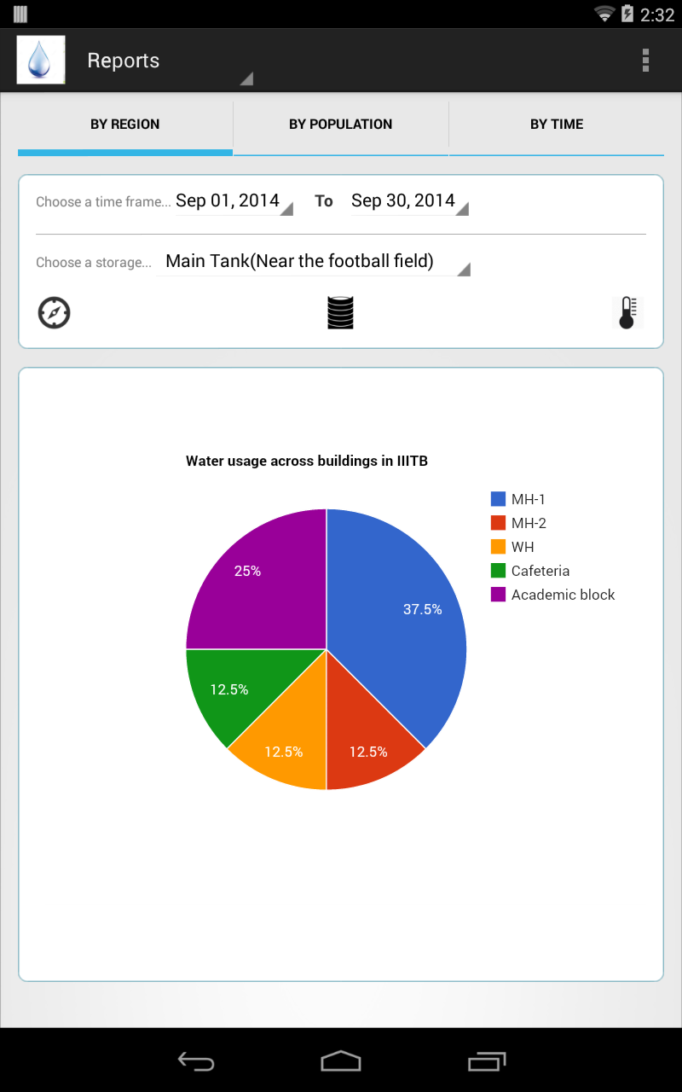
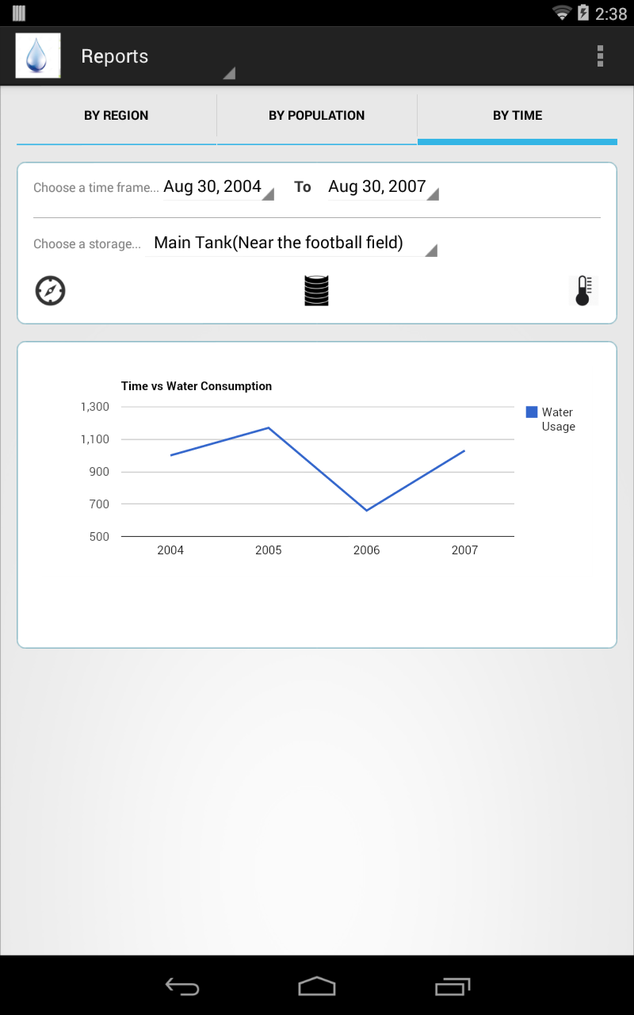
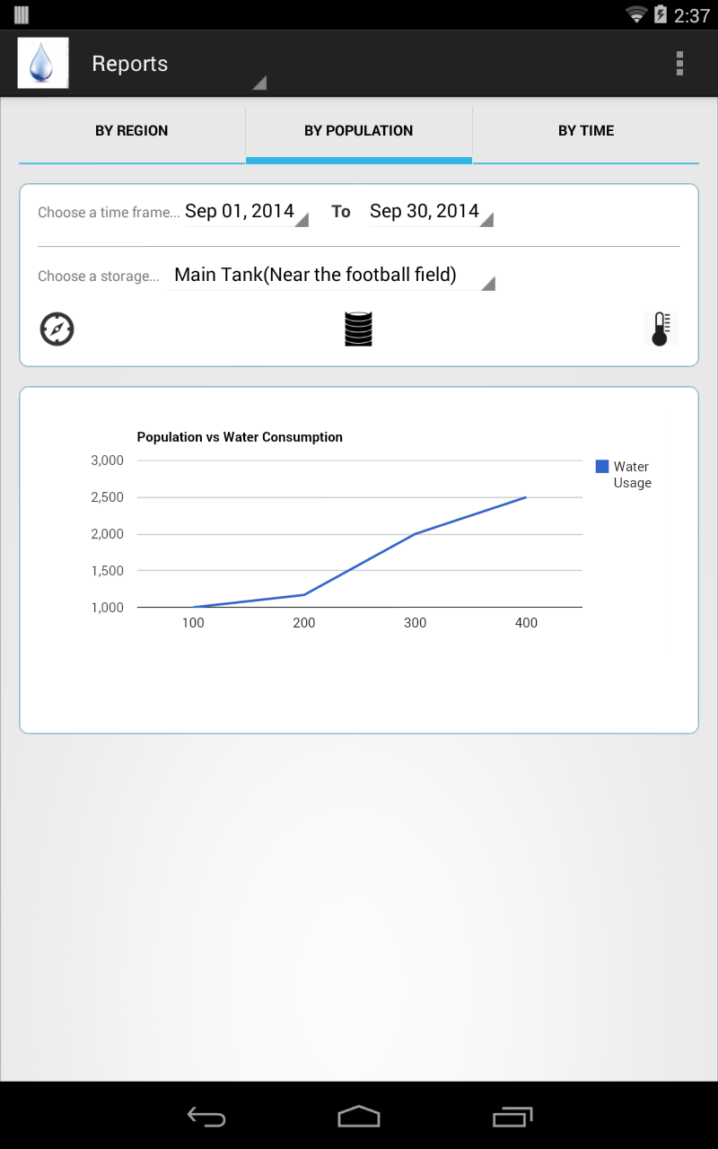
Reports

Slide 3
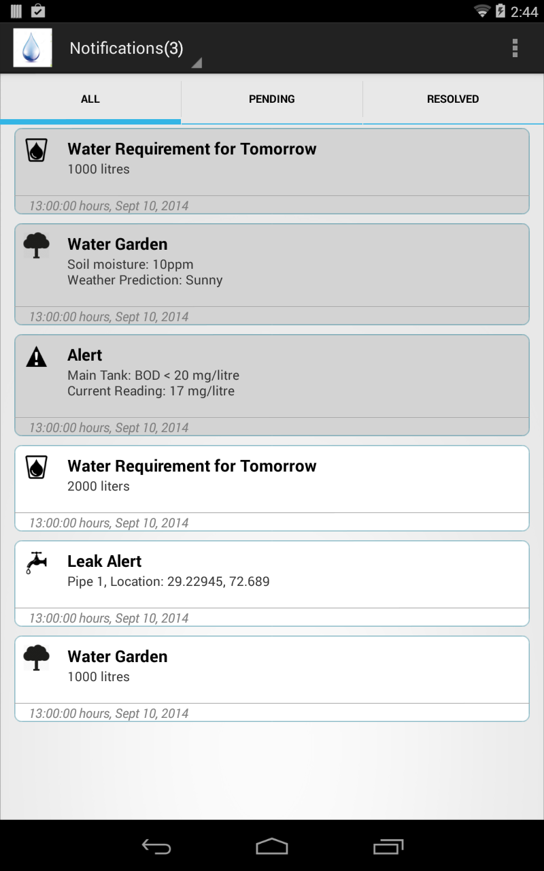
Notifications

Slide 4

SWN Notifier
Provides notifications about concerned events in the smart water networks for resolution
Provides mechanisms to update status about the same.
Provides map based location information about the problem in the smart water network.

