Slide 1
Giphy-Weather
Designers:
Sharon Roy
Roxette Banos
Nathan Larsen
Ben Flynn
Nadirah Jama

Slide 2
Elevator Pitch
Have you ever thought your weather was boring? Does your current weather app make you feel inadequate? Boy, do we have a solution for you!
The thought was to take a boring old weather app and make it fun by utilizing the data provided by an API call to generate a corresponding GIPHY API call that would give a representation of the current weather for that zip code.

Slide 3
Concept
User Story: I am weather fanatic, but my children think weather websites are boring, what can I do?
Description: This site was created using a Bulma CSS framework to create a user friendly interface that is responsive. The site is intended to take a zip code input from the user and then generate both the weather and a GIF style image that correlates to the weather and your emotions. It also has a functional contact us page which is linked in the header.
Motivation: Make weather fun! The motivation for making this page was to take some concepts learned in class and to expand them to generate a working, bug free, polished interface; that is both fun and useful. As well as incorporating different elements from what had been done in class to expand our knowledge.

Slide 4
Process
Technologies used: Open weather API, GIPHY API, Mail Chimp, Bulma CSS, Jquery, Javascript, HTML, CSS
Breakdown of tasks and roles:
  Nadirah – HTML structure, local storage
  Roxette – Styling and images
  Nathan – Open weather API logic
  Ben – validation and modals
  Sharon – Giphy API Logic and contact us page
Challenges:
  Merging code and then combing to make functional
  Using a bootstrap modal when we used Bulma
  Determining which weather API option/parameters to search with
Successes:
  Randomized GIPHY generation
  Zip code validations via modal for both incorrect entries and zip’s that do not exist
  Refresh button provides different GIPHY

Slide 5
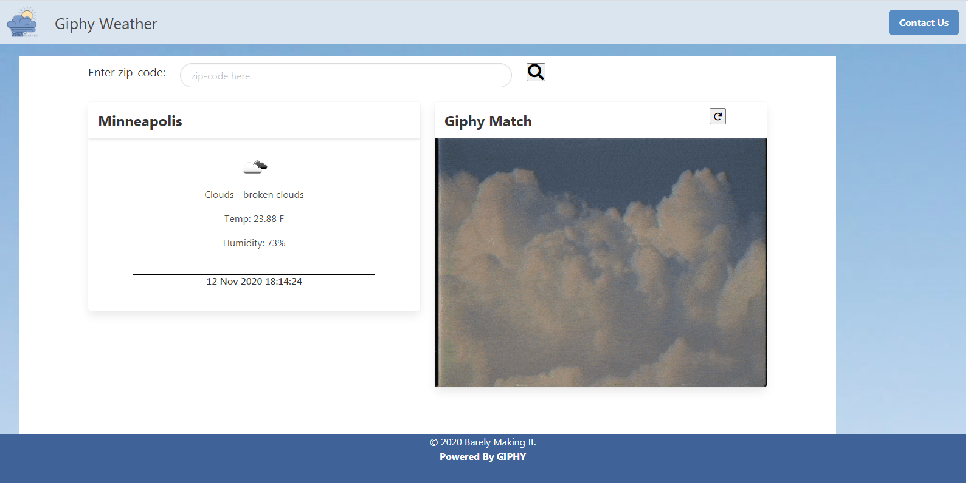
Demo

Slide 6
Directions For Future Development
Sound button to that ties to weather/giphy
5 day forecast
International locations
Accept mixed parameters (i.e. zip & city name)
Rating limitations on the GIPHY dependent on audience via click settings

Slide 7
Links
Repository: https://github.com/ironicminer/Giphy-Weather
URL: https://ironicminer.github.io/Giphy-Weather/

