Slide 1

Cracking
(Based on Many True Stories)

Slide 2
Blockchain
It is an open, distributed ledger that can record transactions between two parties efficiently and in a verifiable and permanent way.
Major Attributes:
Immutability
Traceability
Cryptography
Transparency
Security

Slide 3
Pool of Ideas
Product Marketing
Hiring Procedure
Secure PDFs
Task Analytics
Fake News

Slide 4
“As you scroll through posts on facebook and spot the latest meme or attack on a politician, do you find yourself wondering- If it is true?”

Slide 5
Problem Statement
With the rise of clickbaits and fake news around the world, the credibility of social media is inadvertently affected. These misleading news need to be curbed as it often leads to civil disorder and cause of chaos in people.
Often, genuine news are manipulated in order to cater personal bias and beliefs.

Slide 6
Proposed solution
Assumptions:
Only a verified user can upload a post.
While uploading, any news cannot be classified either as genuine or fake. For example, In a Bomb blast, 150 people got killed.
Any verified user can either share an existing post or repost it with his own changes.
We will not discuss sharing of the post as in that case, any fake news can be easily traced down to its creator by saying the creator’s name written with it.

Slide 7
Propsoed Solution Cont…
Solution:
We will consider each post as a block in Blockchain and each transaction as a repost that someone posts with his own changes and ends up creating another Block in that chain.
We will use the previous Block Hash as a link between two Blocks that differ in terms of the changes that has been made by the user.
The process of traceability will start when a user identifies the image as fake. And the owner or custodian can track down the user who edited the image(post).

Slide 8
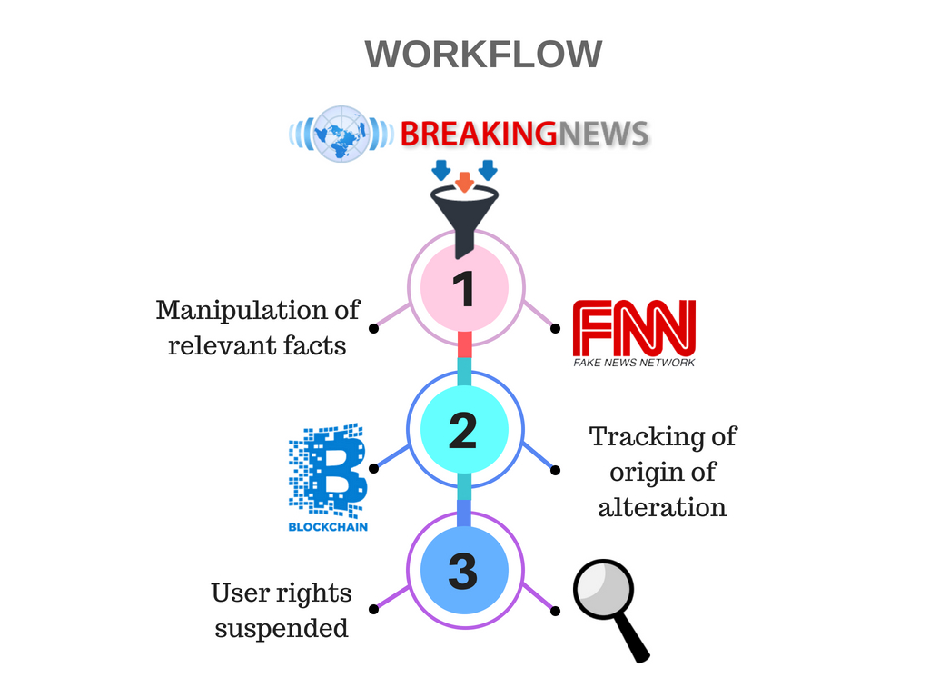

Slide 9
Technology comparisons
Q. What are the other technologies used to solve this problem?
Ans. We didn’t come across any technology or solution to this problem
Q. What advantages does blockchain provide as compared to other technologies?
Ans. 1. Immutability – No manipulation allowed
2. Traceability – Alteration in image is traced by Previous Block Hashes
3. Cryptography – All the data is shown through hashes in view page.
4. Transparency – All the transactions are visible to the user

Slide 10
Current Limitations
For simplification of our implementation, we have taken an image only as an individual post
As of now, we have generated the hashes manually
We have not done much around distributed system with the assumption that it will be implemented at a higher level

Slide 11
Future enhancements
We have seen that there exists a Hyperledger framework, Sawtooth which provides a template for our solution and we would like to implement our idea using it
We would like to replace the Image used in our prototype by an actual post from any Social Media platform, for example Facebook.
We would like to use an algorithm like bcrypt to generate Hashes on the fly
Various platforms can adapt this solution according to their structures.

Slide 12
Any Questions?
Thank You!

