Slide 1
Enhancing Graph Neural Network-based Fraud Detectors against Camouflaged Fraudsters (link)

Slide 2
Problem Statement: GNNs are effective for fraud detection but struggle with fraudsters' camouflage behaviors.
Objective: Propose CARE-GNN to address feature and relation camouflages in fraud detection.

Slide 3
Types of Camouflage
Feature Camouflage: Fraudsters alter their behavior or use techniques to resemble benign users.
Relation Camouflage: Fraudsters connect to many benign entities, reducing their apparent suspiciousness

Slide 4
CARE-GNN Overview
Model Components:
Label-aware Similarity Measure
Similarity-aware Neighbor Selector
Relation-aware Neighbor Aggregator

Slide 5
Label-aware Similarity Measure
Description: Uses a neural classifier (MLP) to measure similarity based on node features and domain knowledge.
Optimization: Directly optimized with cross-entropy loss to ensure effective neighbor selection.

Slide 6
Similarity-aware Neighbor Selector
Description: Utilizes reinforcement learning (BMAB) to adaptively find optimal neighbor selection thresholds.
Process: Selects neighbors based on similarity scores, adapting dynamically during training.

Slide 7
Relation-aware Neighbor Aggregator
Description: Aggregates selected neighbors from different relations to enhance node representation.
Process: Divides aggregation into intra-relation and inter-relation steps.

Slide 8
Experimental Setup (dataset)
Datasets: Yelp and Amazon review datasets.
Metrics: AUC (Area Under the Curve) and Recall to evaluate performance.

Slide 9
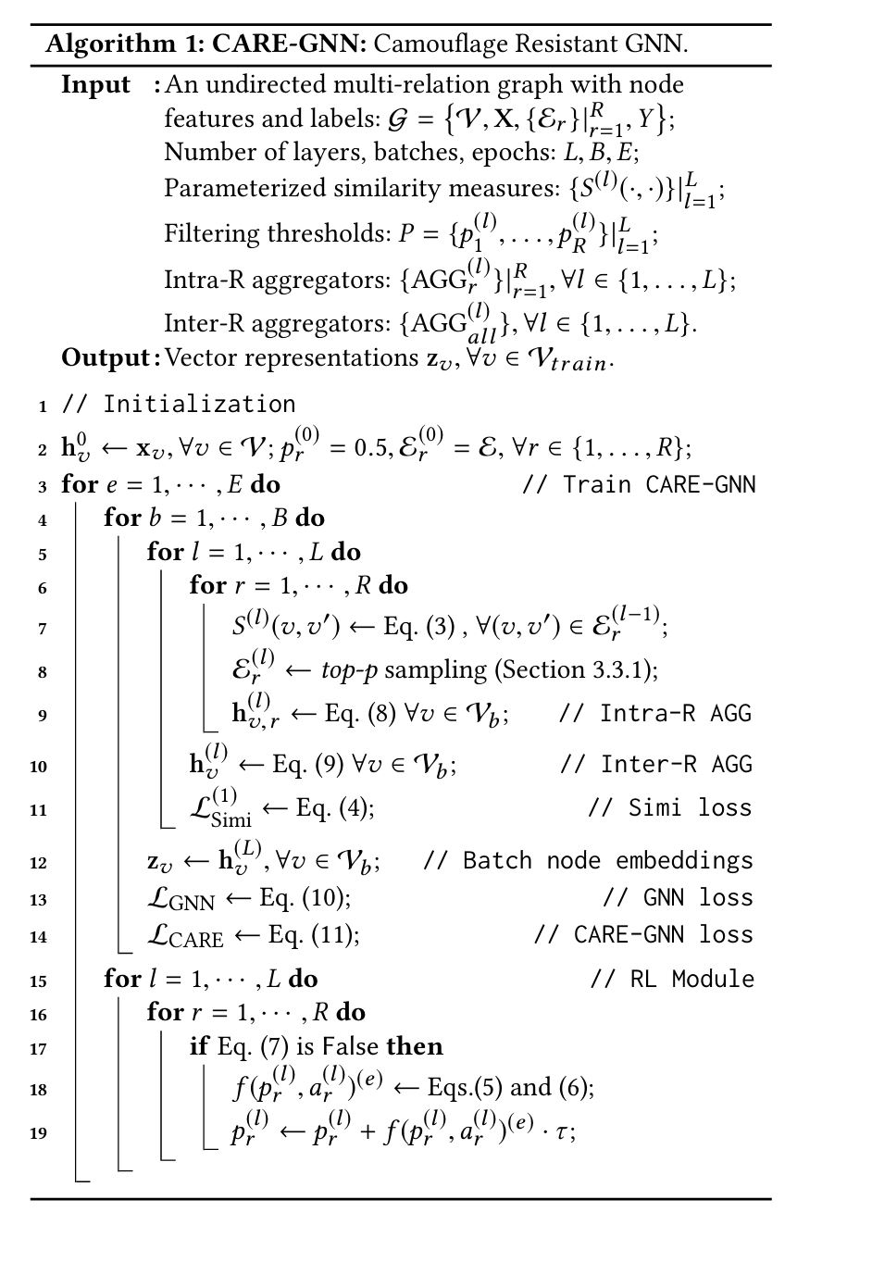
Algorithm

Slide 10
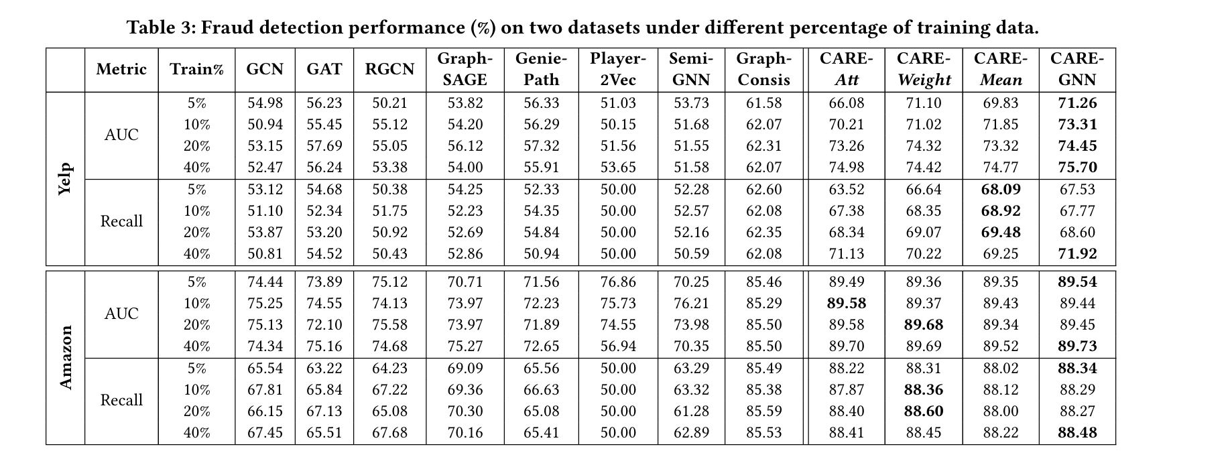
Results - Performance Comparison

Slide 11
Conclusion
Model | Yelp_AUC | Amazon_AUC
CARE-GNN | 75.70 | 89.73
GraphConsis | 62.31 | 85.50
SemiGNN | 51.55 | 73.98
Player2Vec | 51.03 | 76.86
GeniePath | 56.33 | 71.56
GraphSAGE | 54.20 | 73.97
RGCN | 55.12 | 75.58
GAT | 56.23 | 74.55
GCN | 54.98 | 74.44

Slide 12
The End

