Slide 1
Amazon EC2 Systems Manager
Hybrid Cloud Management at Scale
Adnan Ijaz, Taylor Anderson, Amjad Hussain
EC2 Systems Manager

Slide 2
What to Expect from the Session
Overview of Systems Manager and its capabilities
Learn how to configure and manage your cloud and hybrid IT environments at scale
Demo

Slide 3
What customers have told us:
Managing cloud and hybrid environments using a traditional toolset is complex and costly
Traditional IT toolset is not designed and built for cloud scale
Maintaining broader enterprise-wide visibility is challenging
Deploying and maintaining multiple products is a significant operational overhead
Licensing costs and complexity

Slide 4

Amazon EC2 Systems Manager
A set of capabilities that enable automated configuration and ongoing management of systems at scale, across all your Windows and Linux workloads, running in Amazon EC2 or on-premises

Slide 5
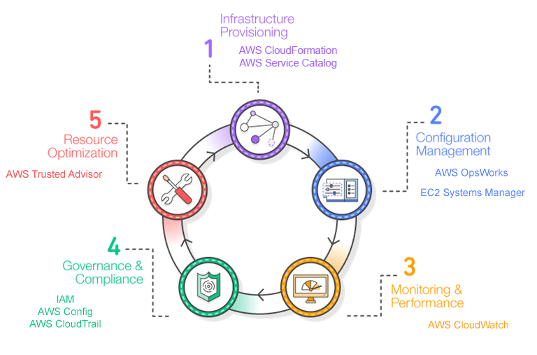

Slide 6
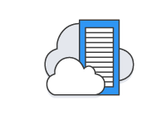

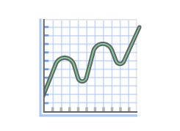



Why should I care?
Hybrid
Cross-platform
Scalable
Secure
Easy-to-write automation
Reduced TCO

Slide 7



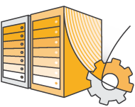



Systems Manager capabilities
Deploy, Configure,
and Administer
Shared
Capabilities
Track and
Update
Inventory
Run Command
Maintenance Window
Patch Manager
State Manager
Parameter Store
Automation

Slide 8
Run Command
Perform common administrative tasks remotely at scale
Example: Running shell and PowerShell scripts
Easily define new tasks using simple JSON-based Documents – no specialized skillset required
Leverage Documents built by AWS and the broader community
Delegate access, perform audit, receive notifications
Helps improve security posture by eliminating the need to SSH or RDP

Slide 9
State Manager
Define and maintain a consistent configuration of OS and applications
Example: Configuring firewall and updating anti-malware definitions
Define new policies using simple JSON-based Documents
Control how and when a configuration is applied and maintained
Helps enforce enterprise-wide compliance of configuration policies

Slide 10
Automation Service
Automate common tasks using simplified workflows
Optimized for building and maintaining Amazon Machine Images (AMIs)
Start with an AMI → perform automation steps like OS patching and drive updates → produce a new AMI
Express your workflow as automation steps in a JSON-based Document
Support for Run Command, Lambda functions
Eliminates the overhead in managing ‘golden’ enterprise images

Slide 11
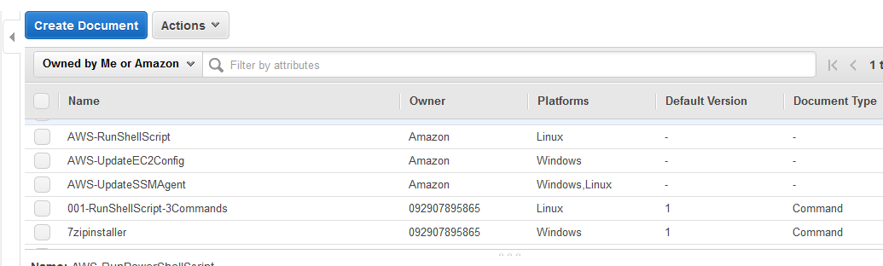
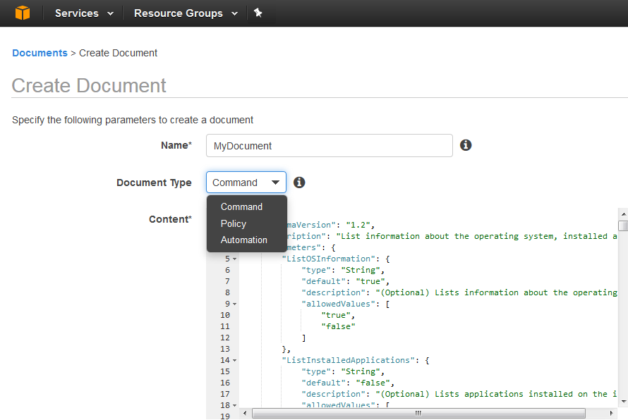
Documents

Slide 12
Parameter Store
Centralized management of IT assets such as passwords and connection strings
Parameters reference-able via a Run Command, State Manager, and Automation Service
Granular access control limits unwanted data access
Encrypt sensitive information using your own KMS keys
Eliminates on-going maintenance challenge of critical enterprise assets

Slide 13
Maintenance Window
Schedule disruptive tasks in well defined window to minimize downtime
Define one or more recurring windows of time during which it is acceptable for disruptive actions to occur
Built-in integration with Run Command and Patch Manager
Helps improve availability and reliability of your workloads by automatically performing tasks in a well-defined window of time

Slide 14
Inventory
Scalable way of collecting, querying, and auditing detailed software inventory information
Example: Instance and OS details, network configuration, list of files, installed software and patches
Collect data from predefined inventory types or write a custom one using JSON Document
AWS Config integration enables tracking the history of changes
Simplifies management scenarios, such as licensing usage tracking and identifying zero-day vulnerabilities

Slide 15
Patch Manager
Roll out Windows OS patches using custom-defined rules and pre-scheduled maintenance windows
Express custom patch policies as patch baselines e.g. apply critical patches on day 1 but wait 7 days for non-critical patches
Perform patching during scheduled maintenance windows
Built-in patch compliance reporting
Eliminates manual intervention and reduces time-to-deploy for critical updates and zero-day vulnerabilities

Slide 16
Systems Manager availability
No charge – only pay for AWS resources you manage
Available in multiple regions
Patch Manager coming very soon!

Slide 17
Demo

Slide 18
In summary …
Hybrid
Cross-platform
Scalable
Secure
Easy-to-write automation
Reduced TCO

Slide 19
Next steps
Learn more at https://aws.amazon.com/ec2/systems-manager/
Get started using EC2 Management Console, AWS CLI and PowerShell

